Slide 1
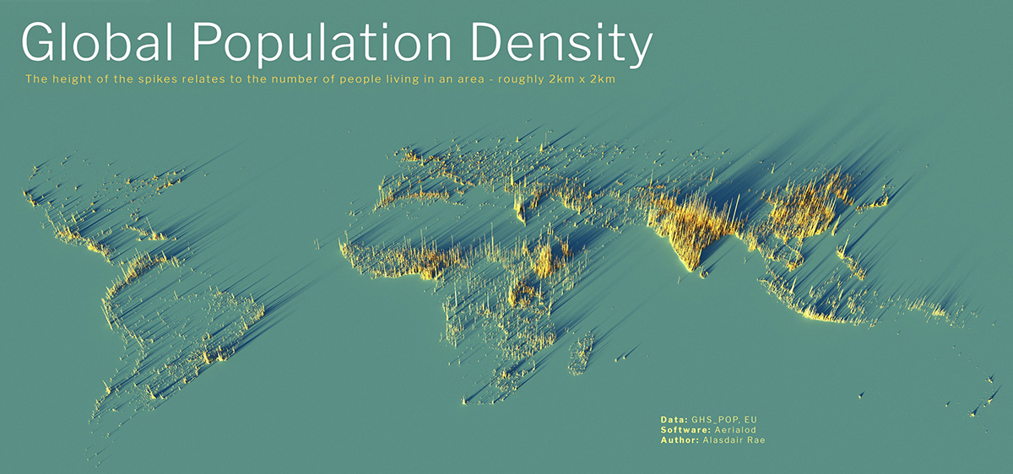
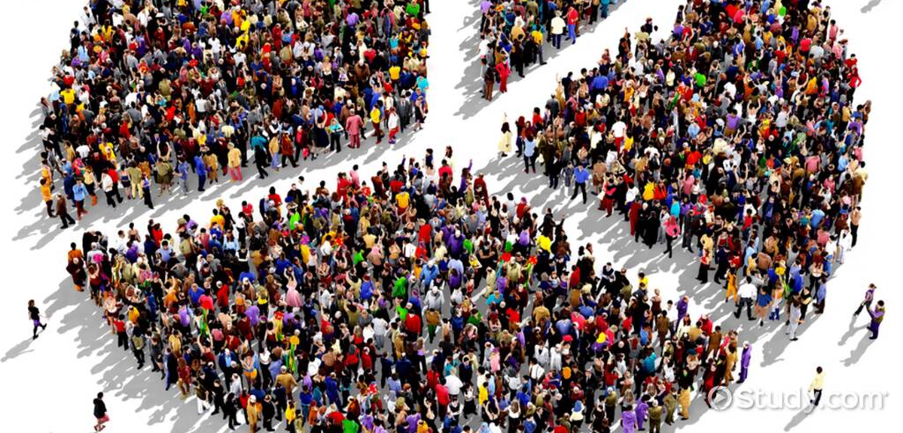
Population Density
IN Pairs: Discuss what you understand by the term Population Density.
Big question: Where is the riskiest place to live in the USA?

Slide 2
Pairs: How many different types of power can you think of?
Learning Intentions
What: is the pattern of population density in the USA and how does this pose a threat? ​Why: to understand that there is greater risk of a disaster when a hazard threatens an area with a high population density. This exposes more people to the risk of a hazard and can make disasters worse. How: Using our geographical skills to calculate and present the population density of the USA.

Slide 3
Individually: Write 5 - 10 sentences with the word power in them.
How good is you knowledge of the USA?
Follow the link on the Weebly to the following quiz.
Can you name all of the states of the USA?
Record your score to share with the class.

Slide 4
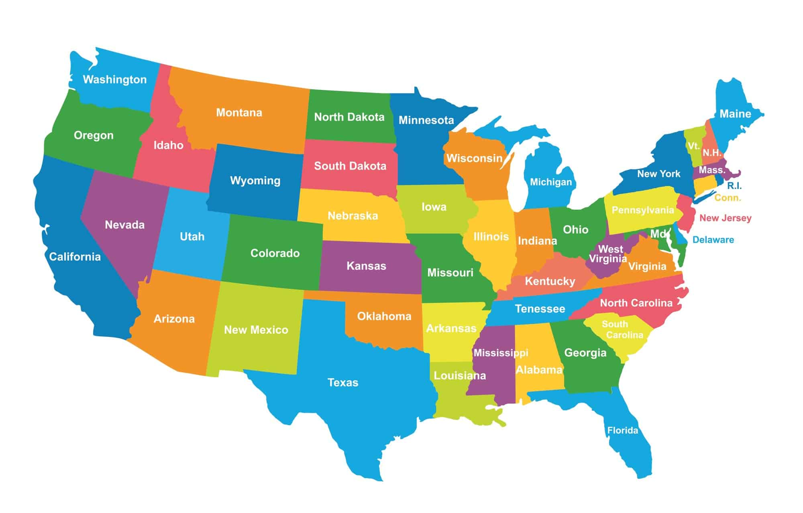
Answers

Slide 5
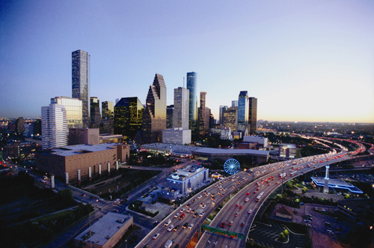
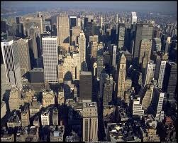
Knowledge Challenge
What are the 10 most populous cities of the USA?

Slide 6
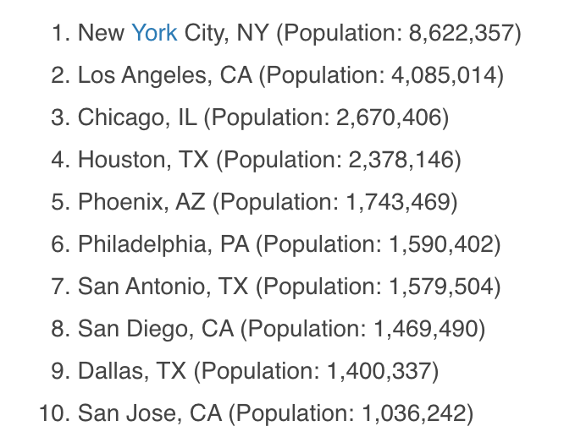
Answers
2021 Figures
https://worldpopulationreview.com/us-cities
Can you suggest geographical reasons for the distribution of the 10 most populous cities?

Slide 7
Human Environment of the USA
Think Pair Share
What is this map showing?

Slide 8
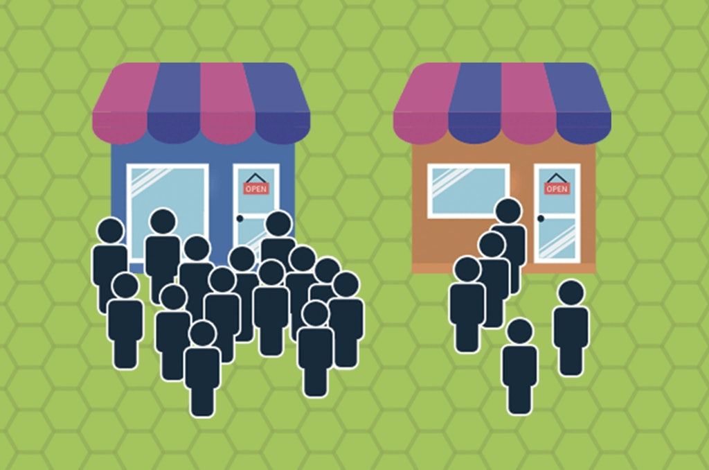
What is Population Density?
Population density is a measurement of the number of people in an area. It is an average number. Population density is calculated by dividing the number of people by the area. Population density is usually shown as the number of people per square kilometre.
Population Density Calculation
Number of people ÷ the area they occupy = population density
https://www.census.gov/popclock/

Slide 9
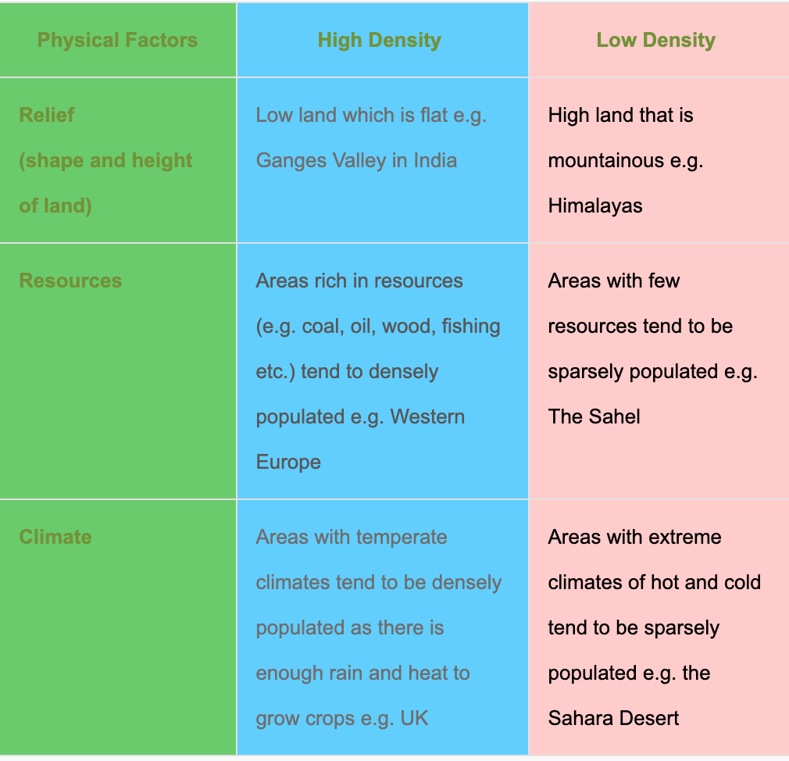
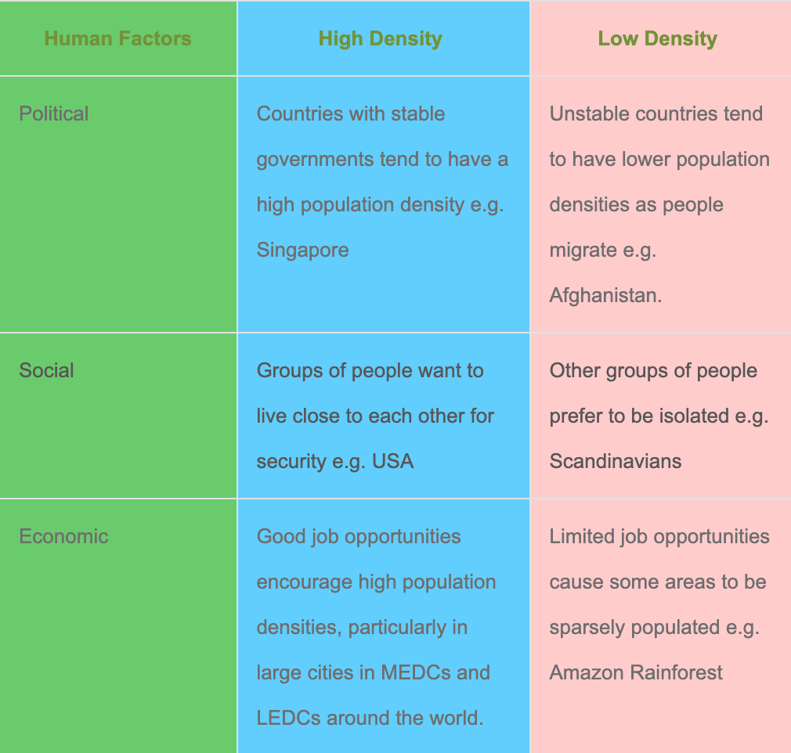
Why are some areas more populated than others?
Using the factors below try to explain why Houston is a densely populated area.

Slide 10
How do we calculate Population Density?
Number of people ÷ the area they occupy = population density
Work in pairs to calculate the population Density of the 50 States of the USA.

Slide 11
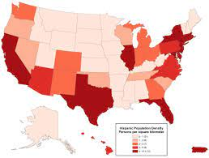
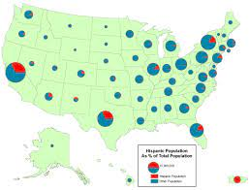
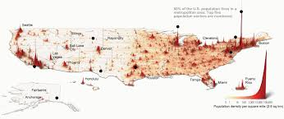
How do we represent Population Density?

Slide 12
Choropleth map
A Choropleth Map uses shades of colour to show differences in population density.

Slide 13
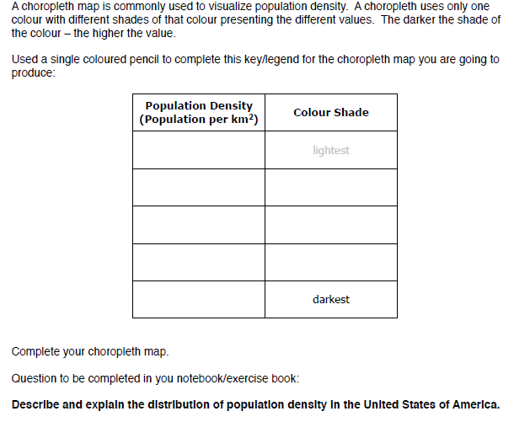

Slide 14
Choropleth map and population patterns analysis
1. Produce your choropleth map
Using the population density data, produce a choropleth map.
The map should have a key and a clear and descriptive title should be provided.
2. Data analysis/ conclusion
Describe data- what is the general trend? i.e. How is population spread out across the USA (distribution)? Which regions of the USA are more densely/sparsely populated?
Use specific examples from the map to back up your description. Also use figures (numerical data).
Are there any anomalies in your data (things that do not fit the overall pattern)?
Explain why you may have got the patterns you have found (may require additional research)
What conclusions can we draw from this?
3. Evaluation
How successful is a choropleth map in showing the pattern of population distribution in the USA?
Does your data tell the whole story?

Slide 15
Why does population density present a risk?
A large, violent tornado, passing through an open field presents little danger. On the other hand, a relatively weak tornado can pose significant risks to human life and can result in great economic losses in densely populated areas.
While the intensity is important, of equal or greater importance is the presence of a population whose socioeconomic characteristics may place its members at greater risk of harm before, during, and after a disaster.
Which groups of people are more at risk of a disaster?

Slide 16
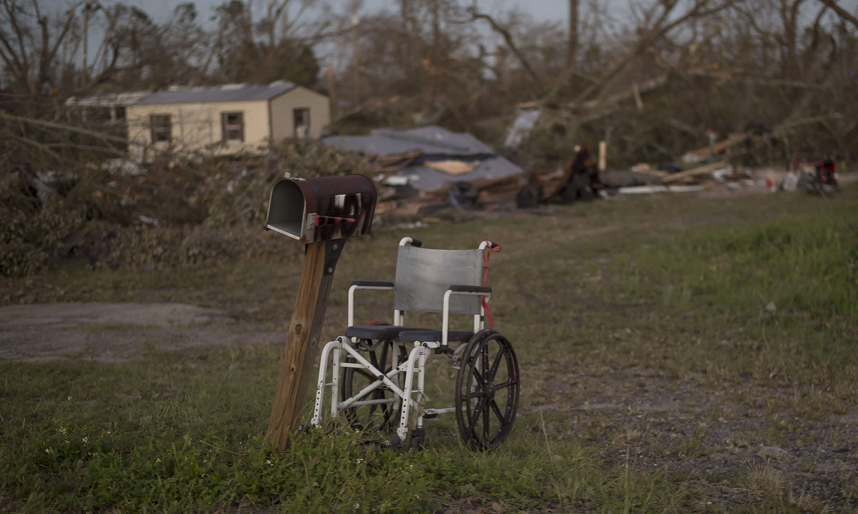
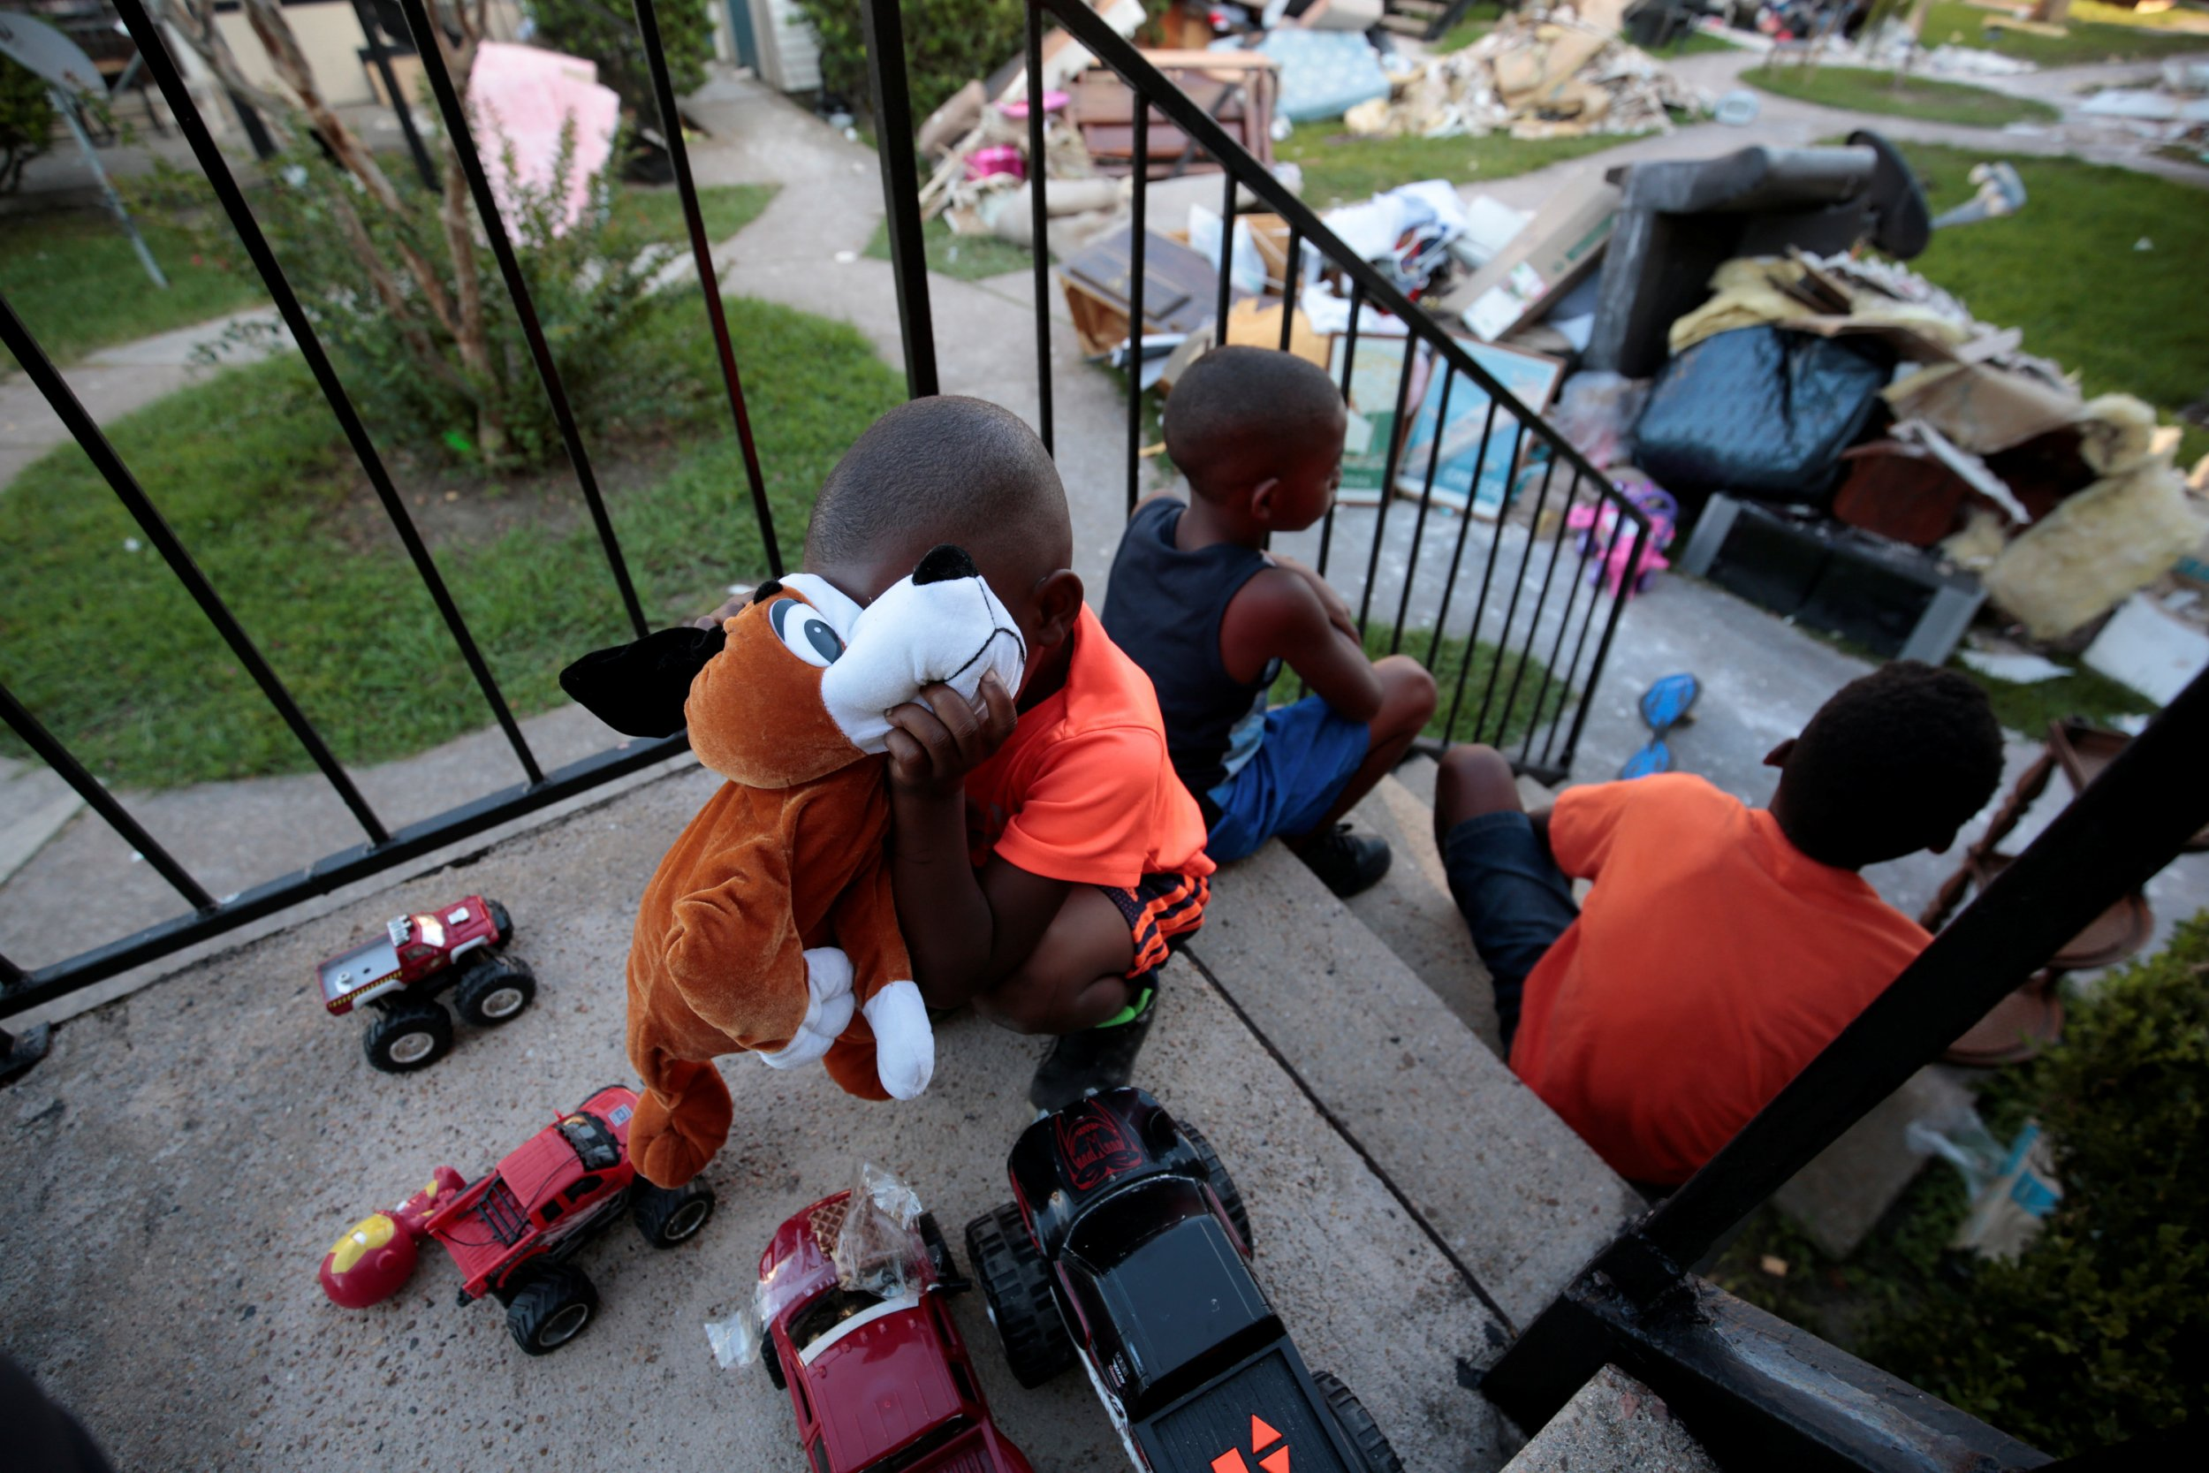
The “vulnerability” perspective in disasters, assumes that a real disaster occurs when it strikes an underprivileged population.
Vulnerability is defined as “the characteristics of a person or group and their situation that influences their capacity to anticipate, cope with, resist, and recover from the impact of a natural hazard.”¹
When addressing risk and vulnerability we must take into account these impacts and outcomes of disasters. Although the sources of vulnerability are multiple and quite diverse, some of the most important factors that affect vulnerability include population growth and distribution and social diversity of the people.

Slide 17
So…why are we looking at this?
Threat- this is the frequency with which a hazard can hit the area.
Vulnerability: the conditions that increases the susceptibility of a community to a hazard.
RISK
Risk, is the likelihood/possibility that an area (or section of population) will be negatively affected by a hazard. It is the risk that ultimately controls the possibility of converting a hazard into a disaster. The word is often used to quantify the probability of a hazard turning into a disaster.
Cost- this is the human factor of the hazard. More the number of humans and property, greater is the cost involved and therefore, greater is the risk.

