Slide 1
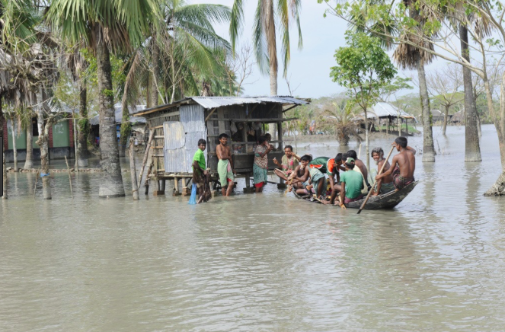
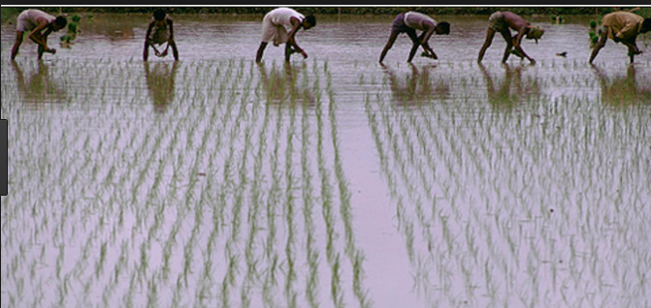
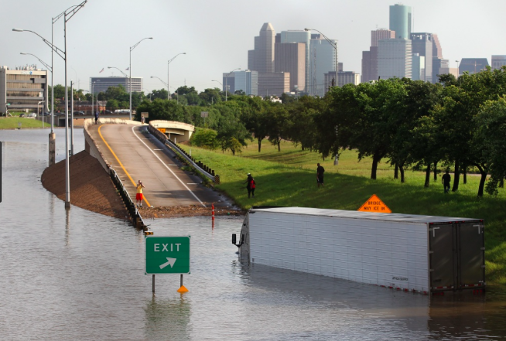
The benefits and risks of living near rivers
What: To be able to evaluate the benefits and issues of living near rivers
Why: To be able to understand the interaction between human development and the natural environment
How: To assess the opportunities rivers bring
To construct a flood hydrographs
To build on our case studies of Houston and Bangladesh to understand the opportunities that living in proximity to fluvial areas brings

Slide 2
Objectives from exam board
Demonstrate an understanding that rivers present hazards and offer opportunities for people | I can draw a flood hydrograph and identify what it shows
 | I can identify the human and physical causes of flooding
 | I can explain the effects of a specific flood- a hazard of living near a river
 | I can explain the benefits of living near a river
Explain what can be done to manage the impacts of river flooding | I can describe the difference between hard and soft engineering.
 | I can explain the benefits and costs of using hard and soft engineering on a river area.
 | I can use specific detail to explain how the flood risk is managed in a specific area.

Slide 3
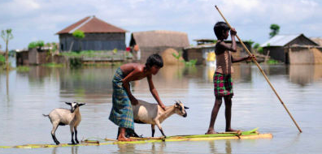
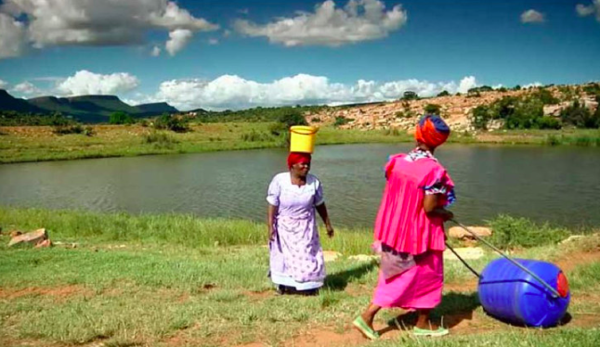
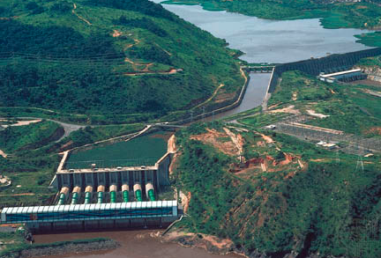
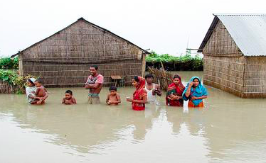
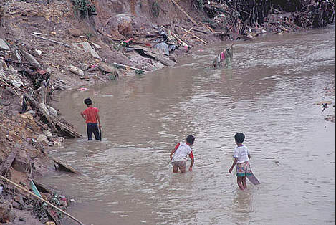

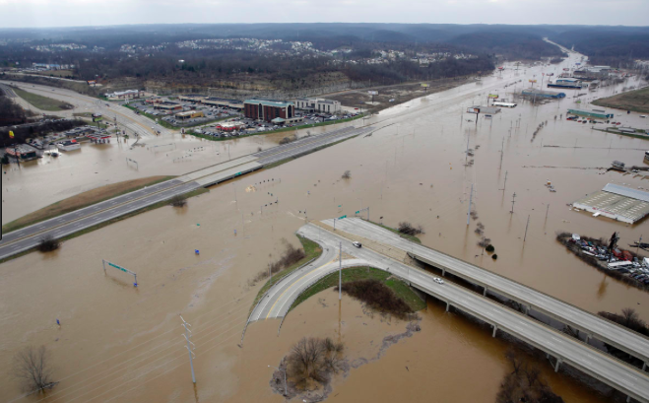

Think, see, wonder

Slide 4
The benefits and threats of living near a river
https://www.youtube.com/watch?v=-PBT4OEJfGs
Watch the above video
In pairs make notes- one to highlight the benefits (opportunities) of living near a river, one to highlight the risks
Share your answers and put on a post it note

Slide 5
Benefits
Floodplains are dynamic natural systems. The natural processes of periodic flooding, accompanied by erosion and deposition, bring changes to the topography, soils, vegetation, and physical features (such as meanders, braided channels and oxbow lakes) within these areas over time.

Slide 6
Floodplains provide a wide range of benefits to the ecosystem and community that include:
Flood storage and erosion control–offer a broad area for streams and rivers to spread out and accommodate temporary storage of flood water, reducing flood peaks and erosion potential
Water quality maintenance – reducing sediment loads, filtering nutrients and impurities, and moderating water temperature
Groundwater recharge
Biological productivity – providing fertile soils with high rate of plant growth and diversity, richer agricultural harvests, and healthier forests
Habitat for a variety of fish and wildlife, including rare and endangered species
Recreational opportunities – providing areas for active and passive activities, supporting the economic base
Open space

Slide 7
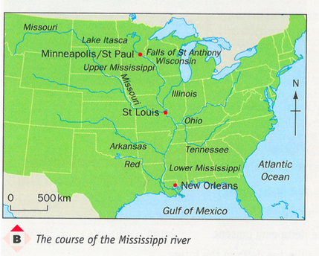
The Mississippi River- threats and benefits
Task: Read the information sheet about the Mississippi River
Create a table of the benefits and issues caused by the river.
Ensure you have specific case study detail such as figures and place names.

Slide 8
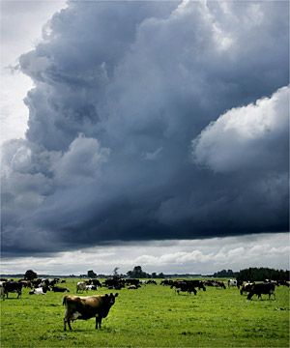
THE CAUSES OF
FLOODING
LO:
I can explain he physical and human causes of river flooding.
Moo!

Slide 9
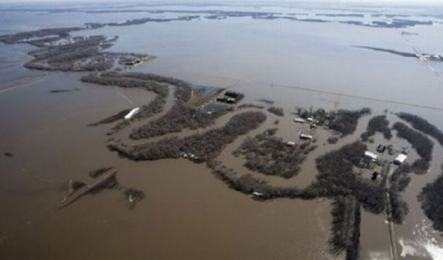
What are floods?
Floods happen when a river gets more water than the river channel can hold. The water flows over the banks and onto the river flood plain.
http://apps.sepa.org.uk/floodlinekids/rivers/flooding.html

Slide 10
Causes of flooding-
Split these terms into physical and human factors
Impermeable rock
Steep slopes
Urbanization
Ploughing
Destruction of marsh land
Heavy rain rainfall
Snow melt
Antecedent rainfall (it has rained before so the soil is saturated)
Hot dry weather
Deforestation
Extension: For at least 2 of the cause explain how that would cause flooding
Which of these factors happened in Bangladesh or Houston?

Slide 11
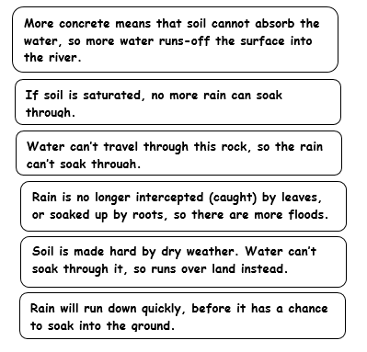
Some explanations that may help…

Slide 12
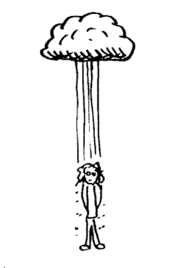
CLIMATIC CAUSES
These cause flooding because of changes in weather that are often unusual or unexpected
Heavy persistent rainfall
Warm conditions leading to ice or snow melt

Slide 13
Terrestrial Processes
This refers to the physical geography of the area and how this can lead to flooding
Geology of the area
A drainage basin consisting of mainly impermeable rock. This will mean that water cannot percolate through the rock layer, and so will run faster over the surface.
Gradient of land- steep-sided channel. A river channel surrounded by steep slopes causes fast surface run-off.

Slide 14
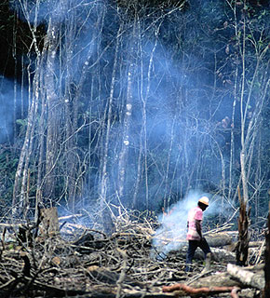
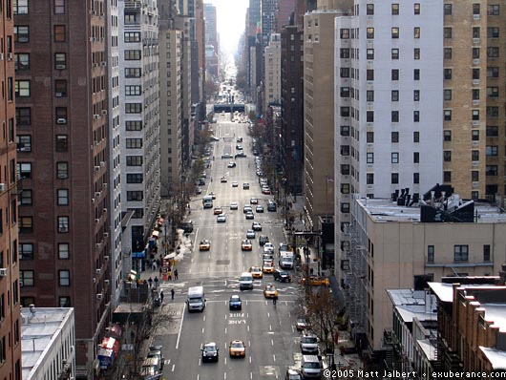
Human causes
How can we increase risks of flooding?

Slide 15
Overcultivation
Removing natural vegetation from land – this increases run off . Also less roots to bind soil

Slide 16
Deforestation
A lack of vegetation or woodland. Trees and plants intercept precipitation (ie they drink water). If there is little vegetation in the drainage basin then surface run-off will be high.

Slide 17
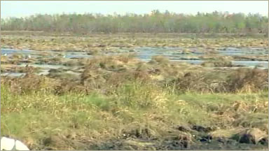
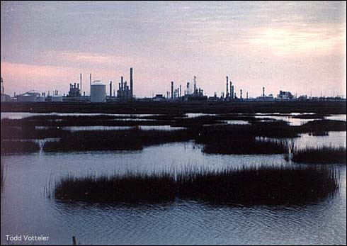
Destruction of Wetlands and Marshlands
Wetlands absorb water – like sponges! If these are removed water remains in the system and leads to flooding
Eg Saeftinghe in the Netherlands
Lower courses of river in floodplains

Slide 18
Urbanisation
Urban areas consist largely of impermeable concrete, which encourages overland flow. Drains and sewers take water quickly and directly to the river channel. Houses with sloping roofs further increase the amount of run-off

Slide 19
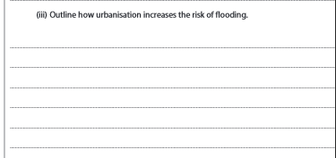
3 mark question

Slide 20
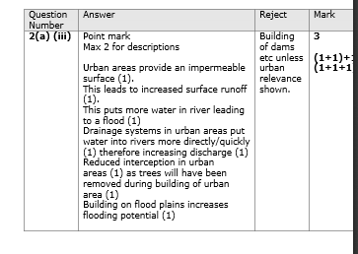

Slide 21
4 mark question
Explain the causes of flooding in a specific area.
Write a paragraph describing the causes of flooding in Bangladesh. In your paragraph you should mention:
The location of Bangladesh (where it is)
The rivers that run through Bangladesh
The causes of flooding in Bangladesh and explain why these lead to flooding. You should split these into human and natural causes.
e.g. Snow from the Himalayan Mountains melts and runs-off down the steep slopes of the mountains into Bangladesh. This happens quickly and so water cannot soak into the ground (infiltrate).

Slide 22
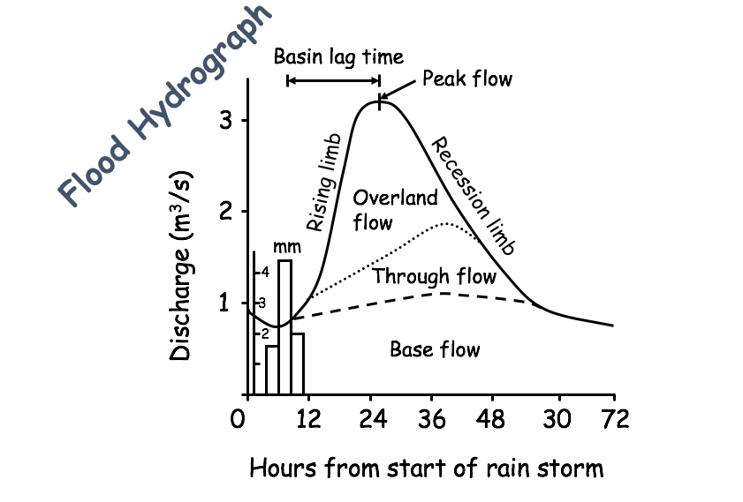
Storm Hydrographs
Storm hydrographs are used to measure a river’s flow and show the change in river discharge over a short period of time after a storm. Have a go at answering the following question:
Why is measuring river discharge in this way useful?

Slide 23

Learning Objectives
To be able to analyse a storm hydrograph
To understand the factors that may affect the shape of a storm hydrograph

Slide 24
Hydrograph
Record of River Discharge over a period of time
River Discharge
rivers mean (average) velocity
= cross sectional area
X
(at a particular point in its course)
Storm Hydrographs
Show the change in discharge caused by a period of rainfall

Slide 25
Construction
©Microsoft Word clipart
Of
Storm (flood) Hydrographs

Slide 26
Basin lag time
Peak flow
Flood Hydrograph
3
Rising limb
Overland flow
Recession limb
2
Discharge (m³/s)
mm
4
Through flow
1
3
2
Base flow
0 12 24 36 48 30 72
Hours from start of rain storm

Slide 27
3
2
Discharge (m³/s)
1
0 12 24 36 48 30 72
Hours from start of rain storm

Slide 28
Rainfall shown in mm, as a bar graph
3
2
Discharge (m³/s)
mm
4
1
3
2
0 12 24 36 48 30 72
Hours from start of rain storm
Notes:
28

Slide 29
Discharge in m³/s, as a line graph
3
2
Discharge (m³/s)
mm
4
1
3
2
0 12 24 36 48 30 72
Hours from start of rain storm
Notes:
29

Slide 30
Rising limb
The rising flood water in the river
3
Rising limb
2
Discharge (m³/s)
mm
4
1
3
2
0 12 24 36 48 30 72
Hours from start of rain storm
Notes:
30

Slide 31
Peak flow
Peak flow
Maximum discharge in the river
3
Rising limb
2
Discharge (m³/s)
mm
4
1
3
2
0 12 24 36 48 30 72
Hours from start of rain storm
Notes:
31

Slide 32
Recession limb
Peak flow
Falling flood water in the river
3
Rising limb
2
Recession limb
Discharge (m³/s)
mm
4
1
3
2
0 12 24 36 48 30 72
Hours from start of rain storm
Notes:
32

Slide 33
Basin lag time
Basin lag time
Peak flow
Time difference between the peak of the rain storm and the peak flow of the river
3
Rising limb
2
Recession limb
Discharge (m³/s)
mm
4
1
3
2
0 12 24 36 48 30 72
Hours from start of rain storm
Notes:
33

Slide 34
Base flow
Basin lag time
Peak flow
Normal discharge of the river
3
Rising limb
2
Recession limb
Discharge (m³/s)
mm
4
1
3
2
Base flow
0 12 24 36 48 30 72
Hours from start of rain storm
Notes:
34

Slide 35
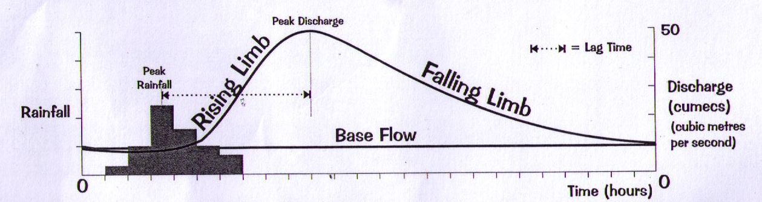
Storm Hydrographs
Storm hydrographs show how a river’s discharge changes after a storm. Depending on a number of factors, the hydrograph can change considerably in shape.
Video

Slide 36
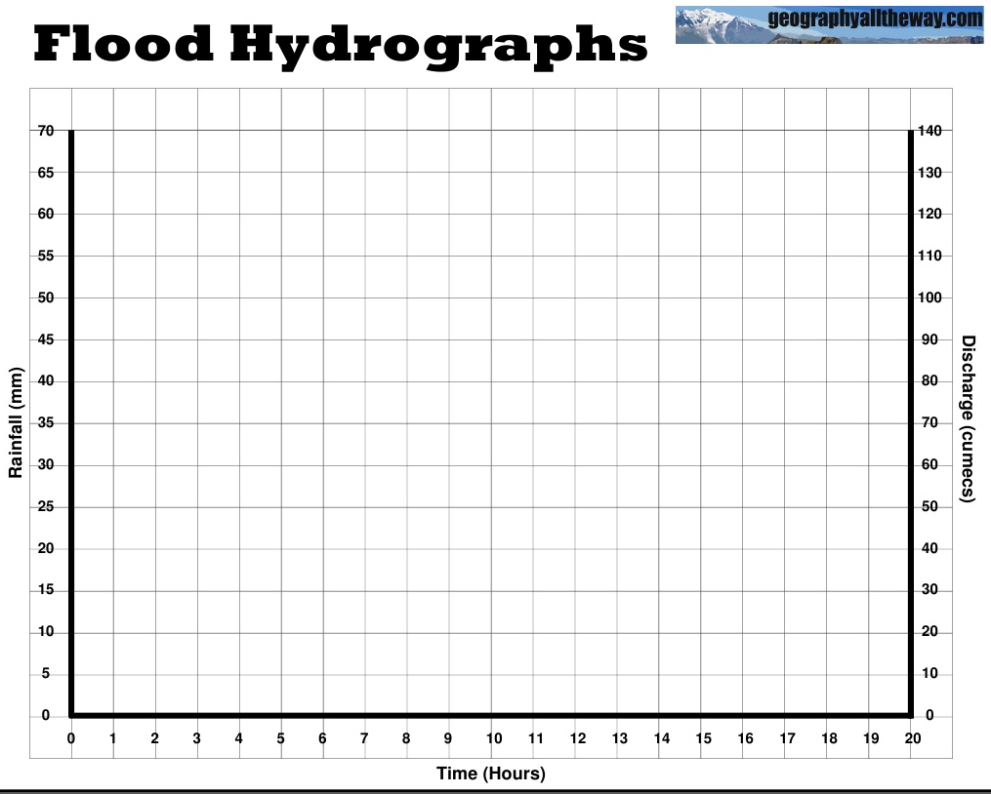
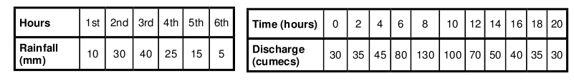

Slide 37
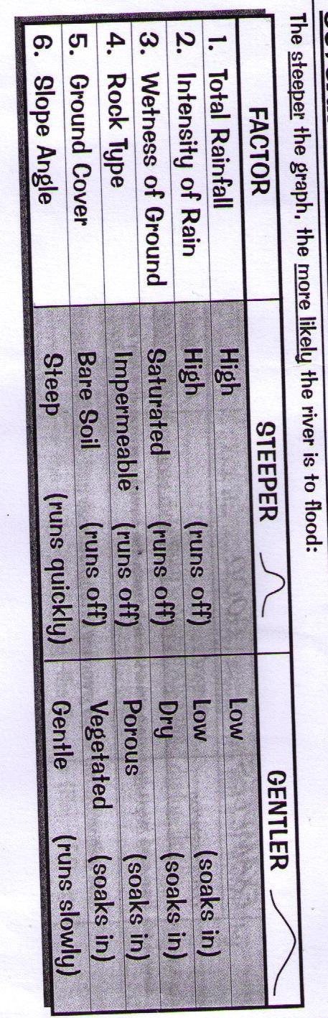
Tables.
Extra information can be found: http://www.s-cool.co.uk/a-level/geography/river-profiles/revise-it/storm-hydrographs-and-river-discharge
There are several different factors which may affect the shape of a hydrograph. These are listed in the table below.
Copy the table below and fill in the blanks.

Slide 38
Factor | Human OR Physical | Describe it (what happens) | Explain it (why does it happen?)
Deforestation | Human | Trees are removed. This means that much more water is suddenly available and transferred rapidly to the river channels, increasing flood risk. | This is because much of the water that falls on trees is evaporated or stored temporarily on leaves and branches. Trees also use up water as they grow. The removal of trees means this water will now flow to the river channels.
Relief
 |  | In arable farming, soil is left unused and exposed to the elements for periods of time. This can lead to more surface runoff. | This means that
Geology
 |  | Building on floodplains creates impermeable surfaces such as tarmac roads, concrete driveways and slate.

Slide 39
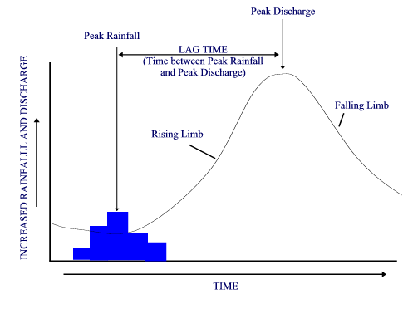
Re-cap

