Slide 1

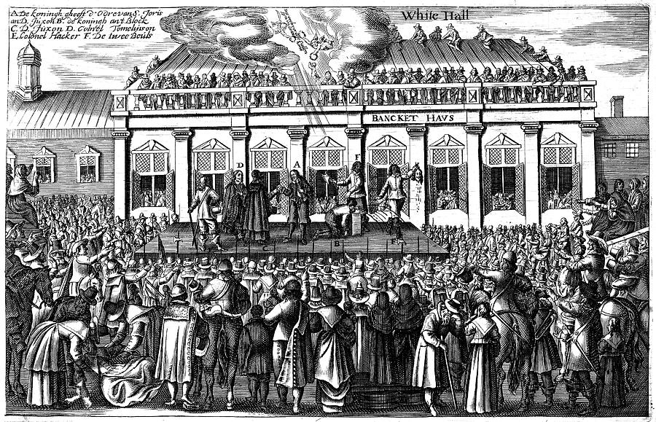
Did Charles I deserve to die?
Part 1
Learning Objectives
To put the King on trial and use evidence to support your argument.
To find out why some people wanted Charles I executed

Slide 2
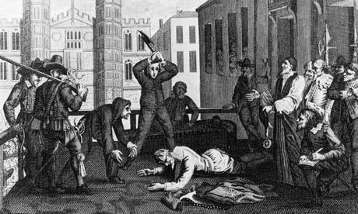
To Kill a King (2002)
www.youtube.com/watch?v=IPmSR--BktE

Slide 3
Task
Write a paragraph in your books explaining the trial as you have witnessed it and why Charles was executed.
Think!:
Was it right?
Did everyone support it?
What is your view?
Can you guess what happens next?

Slide 4
The story so far....
Charles and Parliament have been at war for 4 years, from 1642-1646.
Charles surrendered in 1646, after a crushing defeat at Naseby and was kept under arrest by Parliament.
Charles escaped to try and continue the fight in 1647, but was captured again in 1649.

Slide 5
Detective Work
Use the evidence in front of you to build up your argument. To do this you need to work together and…
Write in any factors that prove Charles’ innocence.
Write in any factors that prove Charles’ guilt.
KEY WORDS:
Authority = Power over people
Republic = Country without a King

Slide 6
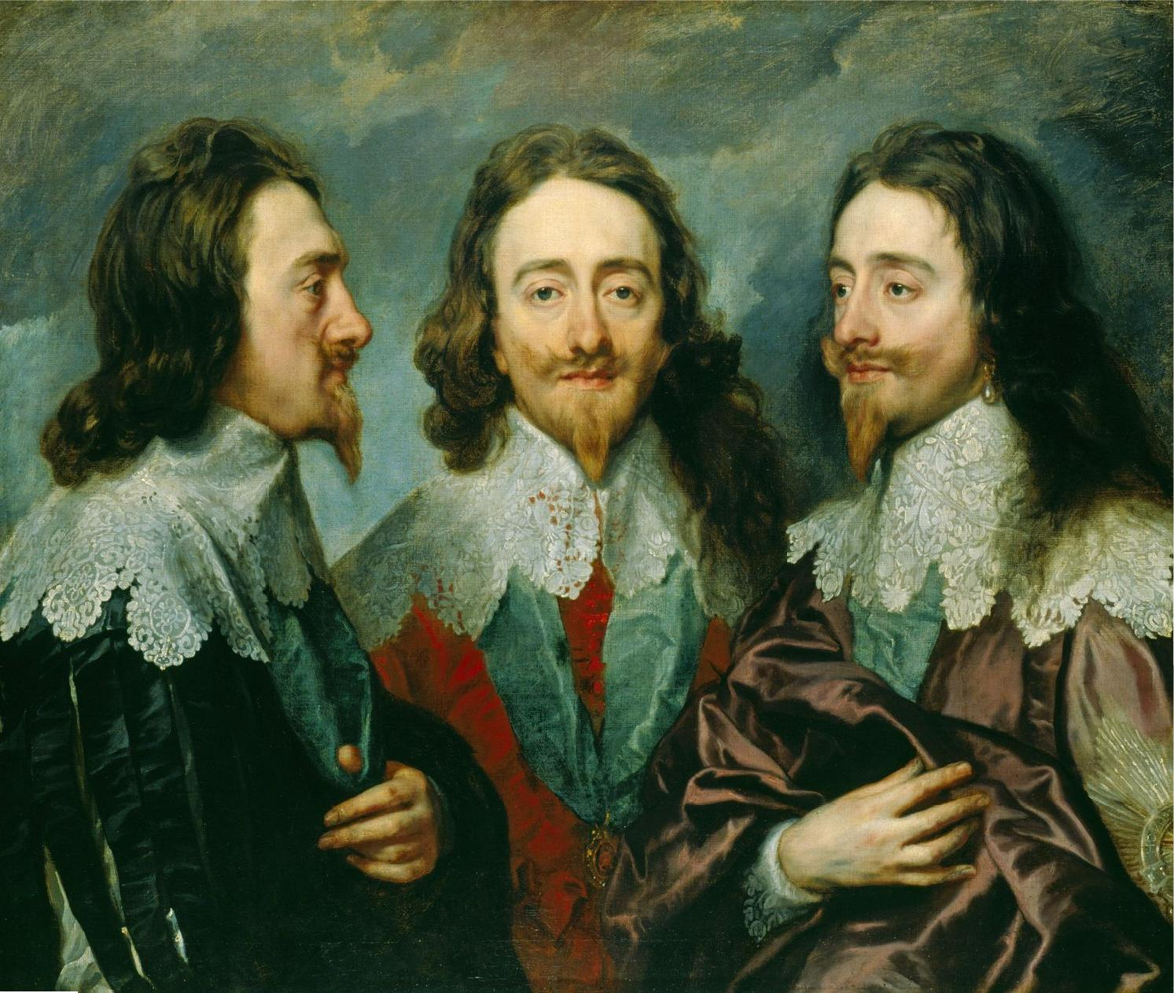

Slide 7
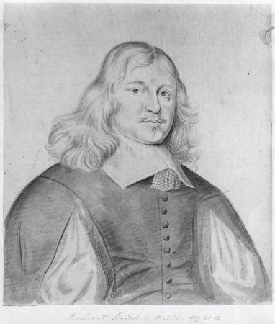
Diary entry of Philip Henry describing the execution of Charles I
I stood amongst the crowd where the scaffold was erected, and saw what was done. I saw the blow given, I can truly say with a sad heart. At that instant, I remember well, there was such a groan by thousands then present, as I never heard before and desire I may never hear again.
What does this source tell you about the execution of Charles I?

Slide 8
Challenge
Write a short speech in your book, as a member of the jury, explaining whether you found Charles innocent or guilty.
Think!:
What evidence was there for him?
What evidence was there against him?
How did people feel about him?

Slide 9
Plenary -How does the Jury find the defendant?
Guilty
Not Guilty

