Slide 1
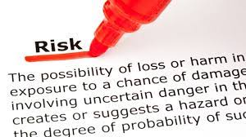
Hazard, Risk or Disaster?

Slide 2
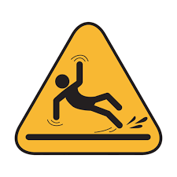
Risk, Hazard or Disaster?

Slide 3
Collaborative Discussion
What is the difference between RISK HAZARD and DISASTER?

Slide 4
Hazard and Disaster
A hazard is any phenomena that has the potential to cause destruction to life and property.
A hazard become a disaster when the potential to cause destruction is fulfilled. When there is harm to life and property of humans, the hazard is termed a disaster.
All disasters are hazards, but all hazards are not disasters
A natural hazard is a threat of a naturally occurring event will have a negative effect on humans.
This negative effect is what we call a natural disaster. In other words when the hazardous threat actually happens and harms humans, we call the event a natural disaster.

Slide 5
Threat- this is the frequency with which a hazard can hit the area.
Vulnerability: the conditions that increases the susceptibility of a community to a hazard.
RISK
Risk, is the likelihood/possibility that an area (or section of population) will be negatively affected by a hazard. It is the risk that ultimately controls the possibility of converting a hazard into a disaster. The word is often used to quantify the probability of a hazard turning into a disaster.
Cost- this is the human factor of the hazard. More the number of humans and property, greater is the cost involved and therefore, greater is the risk.

Slide 6
PAIRED DISCUSSION
What makes a community VULNERABLE?

Slide 7
MEASURING VULNERABILITY
Physical Vulnerability - determined by aspects such as population density, remoteness of a settlement, the site, design and materials used for critical infrastructure and for housing vulnerable to fire.
Social Vulnerability refers to the inability of people, organizations and societies to withstand adverse impacts to hazards due to characteristics inherent in social interactions, institutions and systems of cultural values.
Economic Vulnerability. vulnerability is dependent on the economic status of individuals, communities and nations The poor are usually more vulnerable to disasters because they lack the resources to build sturdy structures and put other measures in place to protect themselves.
Environmental Vulnerability. Natural resource depletion and resource degradation are key aspects of environmental vulnerability.

Slide 8
PAIRED DISCUSSION
How can you deal with Risk?

Slide 9
DEALING WITH RISK
Risk can be calculated using the following equation: Risk = Probability of Hazard x Degree of Vulnerability X likely cost
There are different ways of dealing with risk, such as:
Risk Avoidance: an informed decision to avoid involvement in activities leading to risk realization.
Risk Reduction refers to the application of appropriate techniques to reduce the likelihood of risk occurrence and its consequences.
Risk Acceptance: an informed decision to accept the possible consequences and likelihood of a particular risk.
Risk Transfer involves shifting of the burden of risk to another party. One of the most common forms of risk transfer is Insurance.

Slide 10
Assess the Risk of a Natural Disaster in Houston
Threat
Vulnerability
Cost

