Slide 1


Work, work work!
Learning Objective: To understand the different sectors of industry and analyse how the job you do may be influenced by the country you live in.
Key words: Primary
Secondary,
Tertiary
Quaternary
What are the different types of industry?
Explain how and why the types of industries
found in HIC may be different to those in a LIC. (4 Marks)

Slide 2
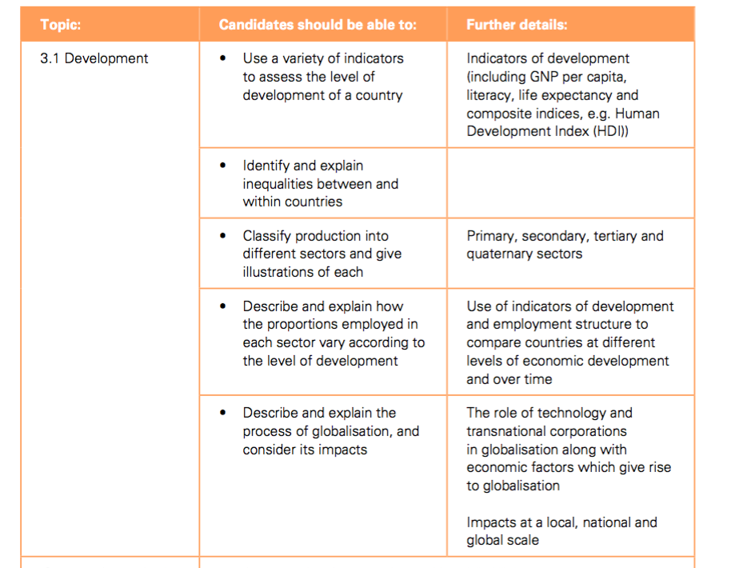

Slide 3



How can industrial activity be classified?
There are many different types of industry. We can classify industry into three main categories:
Primary
Secondary
Tertiary
These industries extract raw materials directly from the earth or sea.
These industries process and
manufacture products from raw materials.
These industries provide a service.

Slide 4

What is a quaternary industry?
There are also quaternary industries.
These industries incorporate a high degree of research and technology in their processes and employ highly qualified people.
Biotechnology and computer programming are examples of quaternary industries.

Slide 5
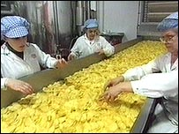
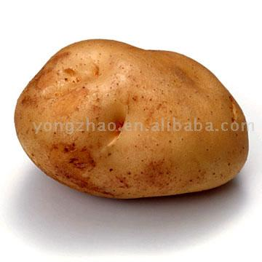

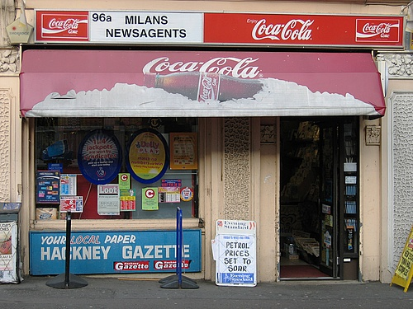

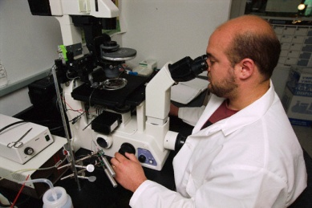
Where do your crisps
come from?
Re-cap
A Crisp’s Journey

Slide 6

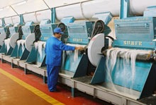
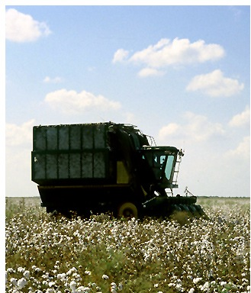
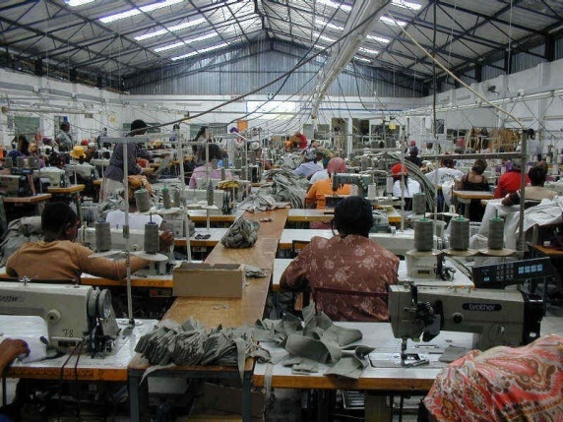

COTTON IN THE FASHION INDUSTRY...
PRIMARY
Cotton is grown and picked on a cotton farm
SECONDARY
TERTIARY
Cotton is processed to cloth, which is, in turn, sewn in to clothing.
Cotton clothes (e.g. jeans, shirts etc) are sold in high street shops.
QUATERNARY: Research is carried out in to new ways of processing or growing cotton. e.g. organic cotton.

Slide 7

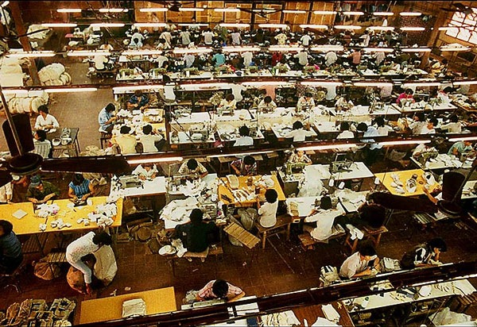
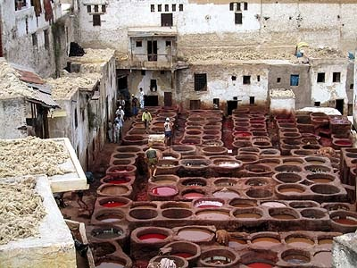
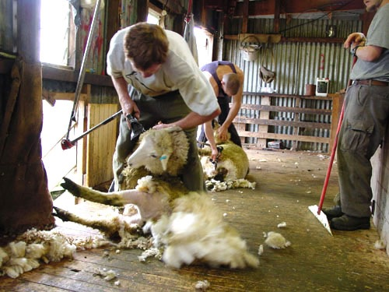

Leather manufacture
in a tannery
Models and fashion shows
A shoe factory in Hanoi
The entire fashion industry involves a great number of different products and services, all of which can be classified according to industrial sector...
Sheep farming and sheering for wool production
Cosmetics research

Slide 8
What is the primary industry involved in making these trainers?
What is the secondary industry involved in making these trainers?
What is the tertiary industry involved in making these trainers?
What is the quaternary industry involved in making these trainers?

Slide 9
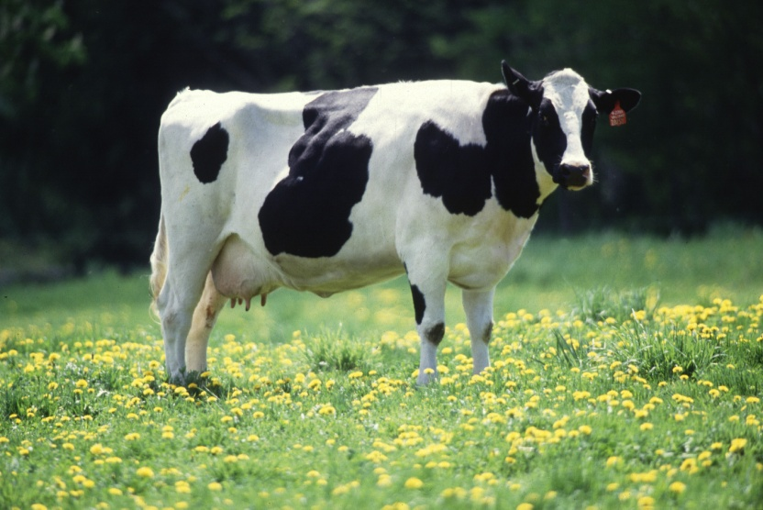
Make the link...
What industry do you think this is?
PRIMARY INDUSTRY – “TAKE IT” - Take raw materials
from the land or sea.
EXAMPLES:

Slide 10
So how are they made?
SECONDARY INDUSTRY – “MAKE IT” – Raw materials
are changed by one or more manufacturing processes
into products.
EXAMPLES:
What industry do you think this is?

Slide 11
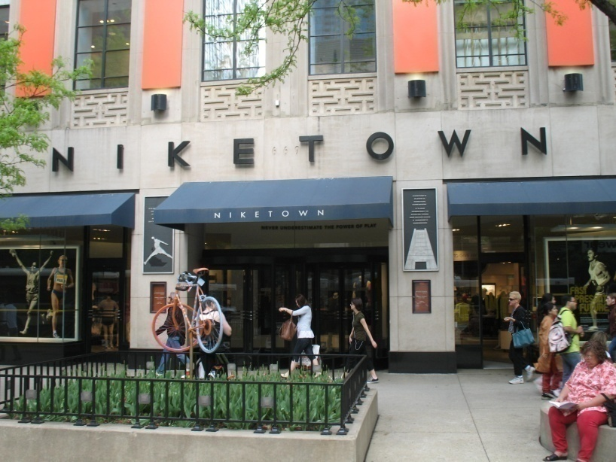
Make the link...
TERTIARY INDUSTRY – “SERVE IT” – Provides a service
to people and other industries.
EXAMPLES:
What industry do you think this is?

Slide 12
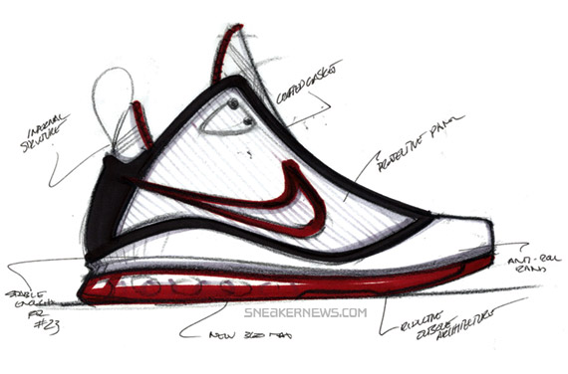
QUARTERNARY INDUSTRY – “”REASEARCH AND DEVELOP IT” –Goods are research so see which product you would prefer.
EXAMPLES:
What industry do you think this is?

Slide 13
Waiter, Doctor, Forensic Scientist, Gold digger, machinist, farmer, teacher, Coal miner, furniture maker, dentist, Web page designer, Genetic Scientist, nurse, cheese maker, gardener, fisher, statistical officer, shop assistant
Decide which sectors the jobs below belongs to:
Primary | Secondary | Tertiary | quaternary
PRIMARY INDUSTRY – “TAKE IT | SECONDARY INDUSTRY – “MAKE IT” – | TERTIARY INDUSTRY – “SERVE IT” – | QUATERNARY INDUSTRY – “DEVELOP IT
Extension: Add your own examples

Slide 14
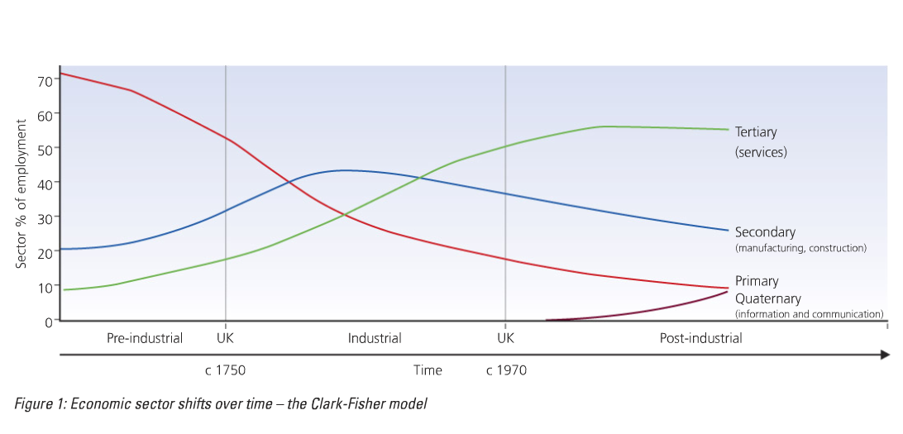
Line graph to show the UK employment structure from 1800 – 2000
The Clark Fisher model
Think- pair- share
What is this graph showing?

Slide 15
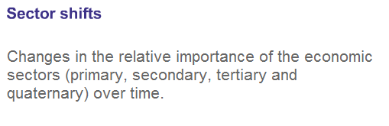
Key term

Slide 16
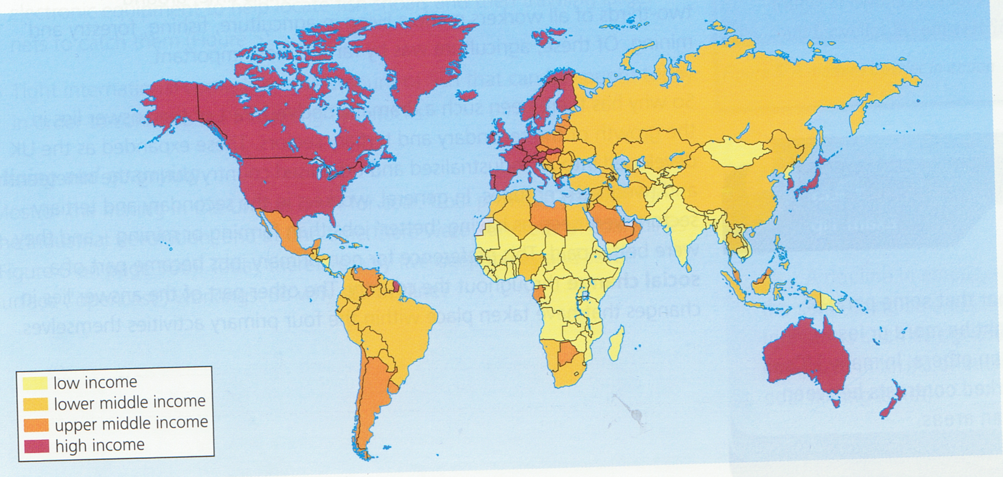
Look at the following map which colour do you think represent the follow? HIC, MIC, LIC. Complete the key on your map.
Describe the location of HIC in the world
2 Marks
Success criteria
KEY

Slide 17
What type of industry do you think your will find more of in the UK? Why?
Be ready to feedback.
Industries currently found in the UK
Do you think this is typical of all HIC? Why?
Notes:
Primary-2%
Secondary – 20%
Tertairy-78%

Slide 18
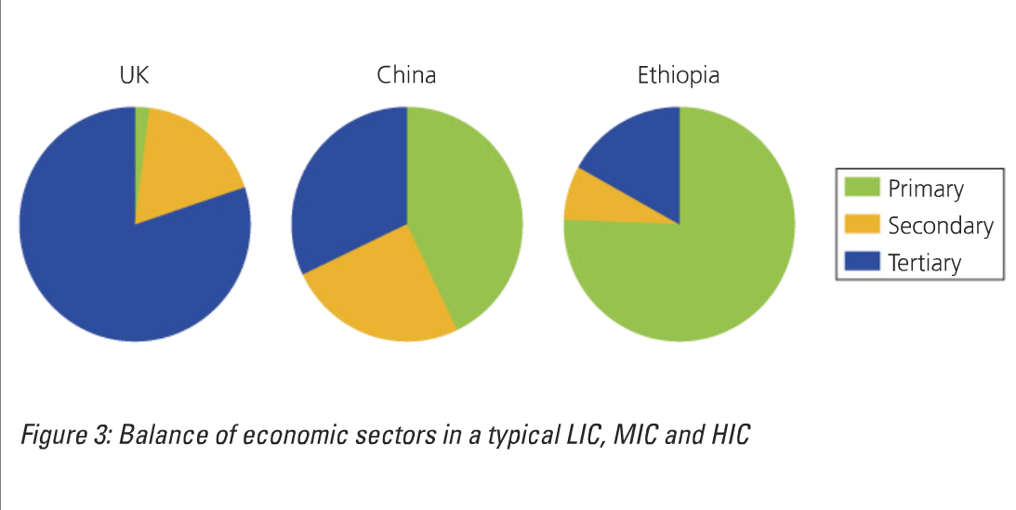
How do employment patterns differ between countries?
Discuss- why do we have this pattern?

Slide 19
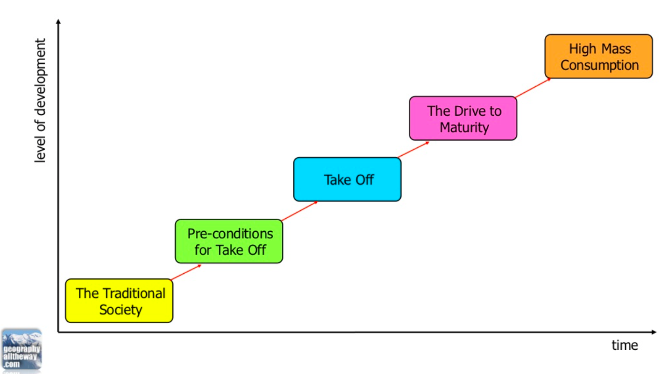

Slide 20
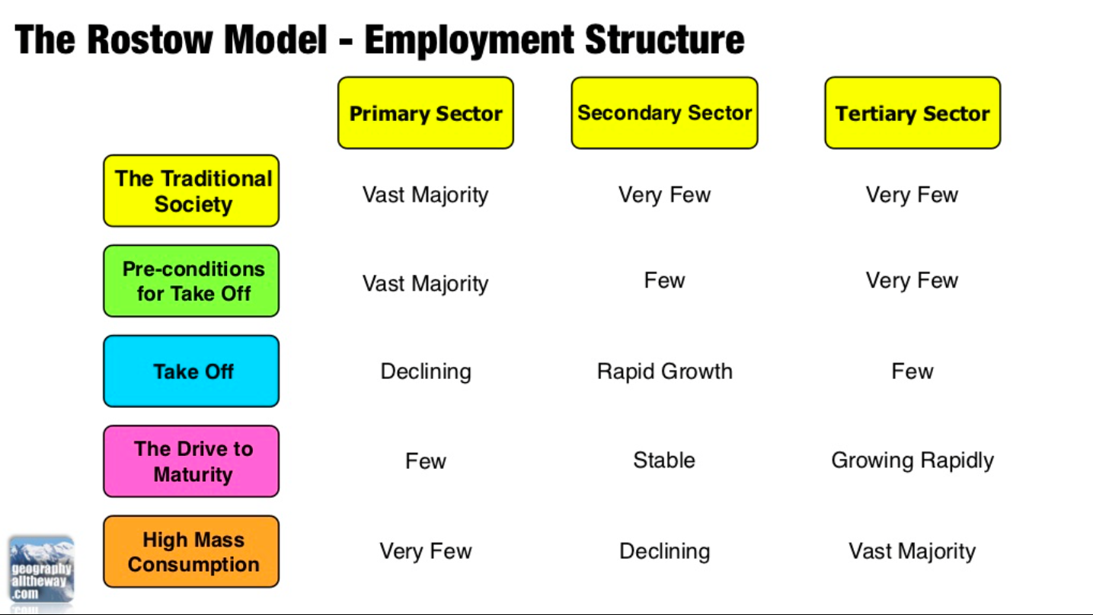

Slide 21

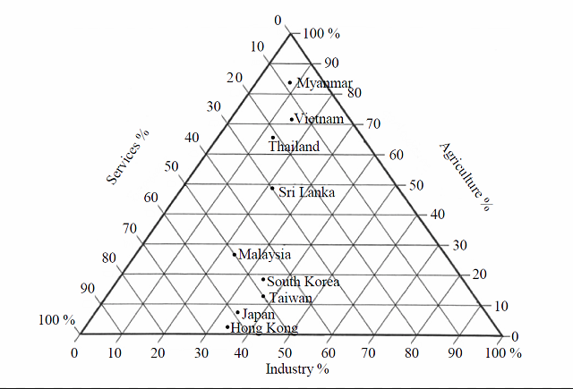
Preparation for paper 2 skills exam

Slide 22
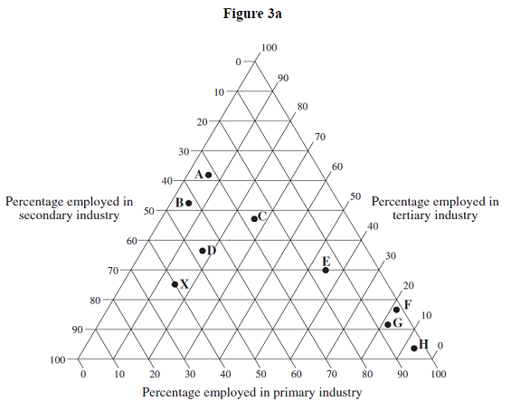
Besides pie charts …
Employment is can demonstrated on triangular graphs
Primary: E is between 50% & 60%. What?
Secondary: C is between 20% & 30%. What?
Tertiary: D is between 30% & 40%. What?

Slide 23
Besides pie charts …
X
15% primary
60% secondary
So what % tertiary?
Hint: adds to 100%

Slide 24
Besides pie charts …
G
?% primary
?% secondary
And ? % tertiary

Slide 25
Besides pie charts …
B
5% primary
?% secondary?
And ? % tertiary

Slide 26
Besides pie charts …
C?
? % primary
? % secondary
? % tertiary?
E?
? % primary
? % secondary
? % tertiary?

Slide 27
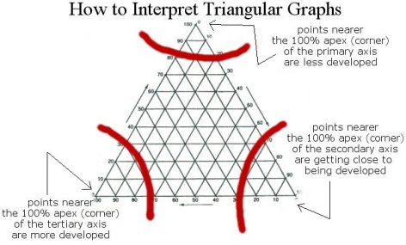

Slide 28
Explain how and why the types of industries found in HIC may be different to those in a LIC. (7 Marks)
A HIC like the UK has only 2% of the population working within the Primary industry, whereas a LIC like Ethiopia has 75% of people in this industry.
P
E
This is because primary jobs pay less so not many people in the UK are willing to do them.
Level 1 is a list (you can put a million level 1 answer but maximum marks you will get is 2 out of 6) –There is more primary industries in LIC.
Level 2 is point made with some explanation (you can put a million of level 2 answers but maximum marks you will get is 4-5 out of 6 - There is more primary industries in LIC than HIC, as these jobs pay less.
Level 3 is point made with detailed explanation (need 3 points explained in detail to get 7 marks) – A HIC like the UK has only 2% of the population working within the Primary industry, whereas a LIC like Ethiopia has 75% of people in this industry. This is because primary jobs pay less so not many people in the UK are willing to do them.
P
E

Slide 29
Explain how and why the types of industries found in HIC may be different to those in a LIC. (6 Marks)
A HIC like the UK has only 2% of the population working within the Primary industry, whereas a LIC like Ethiopia has 75% of people in this industry.
P
E
This is because primary jobs pay less so not many people in the UK are willing to do them.
P
Now try and get the other two marks.
E

