Slide 1
Managing Floods: Soft Engineering
Who is wrong and who is right?
Be READY TO LEARN
Start thinking like a Geographer
Make sure you have your book, write today’s date and title.
CONNECT
Soft engineering involves working with natural river processes to manage the flood risk. Unlike hard engineering it does not involve building artificial structures or trying to stop natural processes. It aims to reduce and slow the movement of water in to a river channel to help prevent flooding.
Soft engineering involves working with river processes to manage the flood risk. It involves building artificial structures or trying to stop natural processes. It aims to reduce and slow the movement of water in to a river channel to help prevent flooding.
LO: To explore the costs and benefits of soft engineering strategies.

Slide 2
LO: To explore the costs and benefits of soft engineering strategies.
ACTIVATE
Be READY TO LEARN
Think like a Geographer
Write the Learning Objective.
SUCCESS CRITERIA:
I can describe the costs and benefits of flood warnings and preparation, flood plain zoning, planting trees and river restoration.
I can explain how flood warnings and preparation, flood plain zoning, planting trees and river restoration decrease the risk of flooding.
I can argue how soft engineering methods have a limited effect on the environment.
MANAGING FLOODS: SOFT ENGINEERING

Slide 3
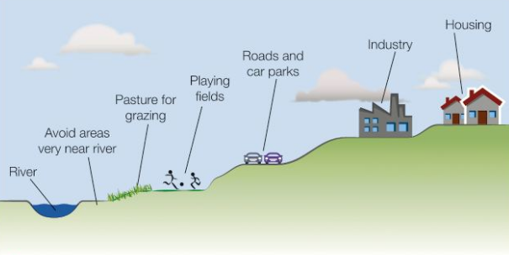
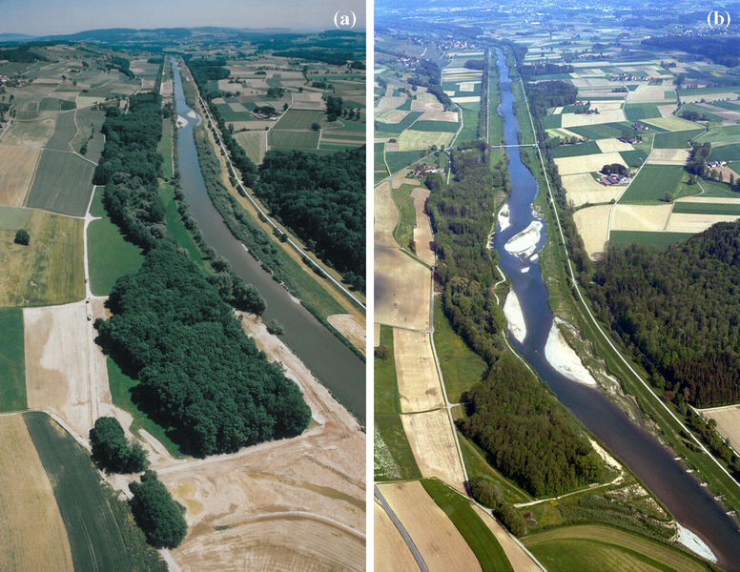
Identify the methods of soft engineering from these photos.
ACTIVATE
Be READY TO LEARN
Think like a Geographer
LO: To explore the costs and benefits of soft engineering strategies.

Slide 4
Use the costs and benefits sheets to complete your worksheet. DO NOT WRITE EVERTHING DOWN.
Activate
Be READY TO LEARN
Think like a Geographer
LO: To explore the costs and benefits of soft engineering strategies.

Slide 5
Flood warnings and Preparation
ACTIVATE
Be READY TO LEARN
Think like a Geographer
Flood plain Zoning
Land in a river valley is categorised into 4 flood risk zones by the EA. Local authorities are required to use these to produce flood risk assessments and to guide decisions regarding new building applications.
The EA and other agencies, such as district councils and water and highway authorities co-ordinate efforts to devise and carry out action plans for areas at risk. Distinct roles are identified for the emergency services, the armed forces and voluntary groups such as the RNLI.
The meteorological office analyses data from its 200 automated weather stations and passes this to the EA, who use it along with river level data to provide updated flood alert information. The EA provides a flood risk map website, a three day flood forecast and personalised updates and the media publish these.
River Restoration
This is when a river that has previously been hard engineered is restored to a natural channel, including the recreation of meanders and lowering of floodplains.
Use your own knowledge to describe how planting trees can reduce flooding.
LO: To explore the costs and benefits of soft engineering strategies.

Slide 6
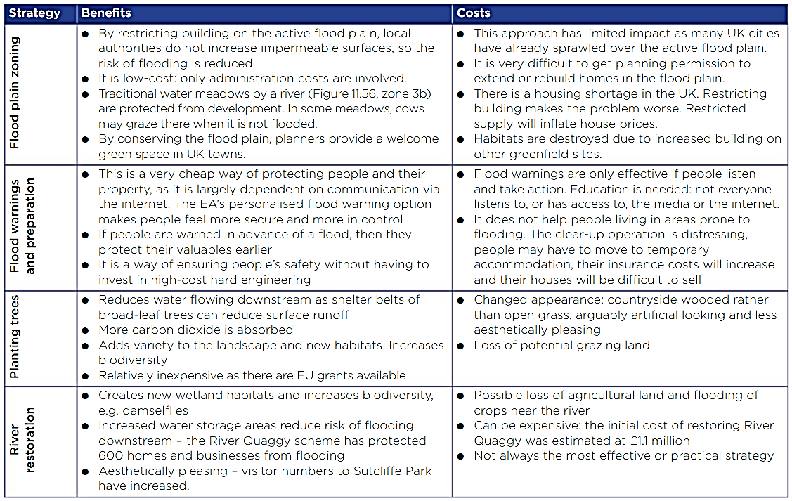
Costs and Benefits of Soft Engineering
Activate
Be READY TO LEARN
Think like a Geographer
LO: To explore the costs and benefits of soft engineering strategies.

Slide 7
Question Time
AFL
Be READY TO LEARN
Think like a Geographer
It absorbs carbon dioxide is an advantage of
River Restoration
Flood Warnings and Preparation
Planting Trees
Restricting building and increasing the housing shortage will inflate house prices is a disadvantage of
River Restoration
Planting Trees
Flood Plain Zoning
LO: To explore the costs and benefits of soft engineering strategies.

Slide 8
Use examples of two soft engineering river flood management strategies to show how it has a limited effect on the environment (6).
DEMONSTRATE
Be READY TO LEARN
Think like a Geographer
P
State a soft engineering method.
P
State a soft engineering method.
E
Give an example of what it does.
E
Give an example of what it does.
E
Explain how this has a limited effect on the environment.
E
Explain how this has a limited effect on the environment.
L
L
LO: To explore the costs and benefits of soft engineering strategies.

Slide 9
Use examples of two soft engineering river flood management strategies to show how it has a limited effect on the environment (6).
DEMONSTRATE
Be READY TO LEARN
Think like a Geographer
One soft engineering method is flood plain zoning (1). The EA categories flood plains into four flood risk zones which restrict land use on different parts of the flood plain, the local authorities must use as a guide when assessing building applications and it reserves greenspace in the UK (1). This has a limited effect on the environment as it restricts building on the lower floodplains and so removes the possibility of surface run-off from impermeable surfaces and therefore reduces the risk of flooding (1).
Another soft engineering method is planting trees (1). Creating shelter belts across slopes and woodlands on floodplains by planting trees means that less water is able to reach the channel as the leaves intercept and store the water and some water is taken up by roots (1). This has a limited effect on the environment as adds a natural variety of landscapes that increase habitats and biodiversity and it also takes up carbon dioxide and therefore reduces air pollution (1).
LO: To explore the costs and benefits of soft engineering strategies.

Slide 10
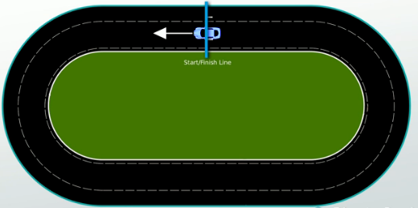
Information Race
CONSOLIDATE
Be READY TO LEARN
Think like a Geographer
In teams (tables) answer the following questions on your whiteboards (only one board) and race over to me at the front to check your answer before you move on to the next question.
START
FINISH
Explain how flood warnings and preparation works.
Give 2 disadvantages of flood plane zoning.
Give an advantage of flood plain zoning.
Outline how planting trees will reduce the risk of flooding.
Give a disadvantage of flood warnings and preparation.
Describe the possible implications (2) of river restoration.
LO: To explore the costs and benefits of soft engineering strategies.

