Slide 1
Managing Floods: Hard Engineering
CONNECT
Be READY TO LEARN
Start thinking like a Geographer
Make sure you have your book, write today’s date and title.
Look back at your coasts work.
What is hard engineering?
WRITE THIS DOWN IN YOUR BOOKS
Hard engineering involves using man-made structures to _________ or control _______ processes from taking place. This form of flooding management tends to be very _________. However, it is the _________ option for protecting expensive property or land.
prevent inexpensive expensive
preferred avoided natural
LO: To explore the costs and benefits of hard engineering strategies.

Slide 2
LO: To explore the costs and benefits of hard engineering strategies.
ACTIVATE
Be READY TO LEARN
Think like a Geographer
Write the Learning Objective.
SUCCESS CRITERIA:
I can describe the costs and benefits of dams and reservoirs, channel straightening, embankments and flood relief channels.
I can explain how dams and reservoirs, channel straightening, embankments and flood relief channels can decrease the impact of flooding.
I can evaluate to what extent hard engineering schemes are sustainable.
MANAGING FLOODS: HARD ENGINEERING

Slide 3
Managing Floods: Hard Engineering
CONNECT
Be READY TO LEARN
Start thinking like a Geographer
Make sure you have your book, write today’s date and title.
Look back at your coasts work.
What is hard engineering?
Hard engineering involves using man-made structures to prevent or control natural processes from taking place. This form of flooding management tends to be very expensive. However, it is the preferred option for protecting expensive property or land.
prevent inexpensive expensive
preferred avoided natural
LO: To explore the costs and benefits of hard engineering strategies.

Slide 4
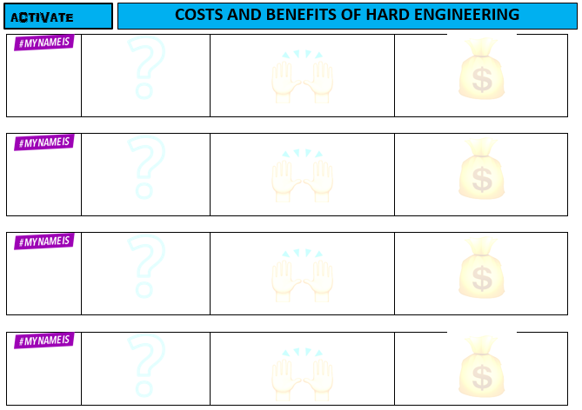
Use the activate information to complete the worksheet.
ACTIVATE
Be READY TO LEARN
Think like a Geographer
LO: To explore the costs and benefits of hard engineering strategies.

Slide 5
Dams and Reservoirs
ACTIVATE
Be READY TO LEARN
Think like a Geographer
LO: To explore the costs and benefits of hard engineering strategies.

Slide 6
Dams and Reservoirs
ACTIVATE
Be READY TO LEARN
Think like a Geographer
LO: To explore the costs and benefits of hard engineering strategies.

Slide 7
Dams and Reservoirs
ACTIVATE
Be READY TO LEARN
Think like a Geographer
LO: To explore the costs and benefits of hard engineering strategies.

Slide 8
Channel Straightening
ACTIVATE
Be READY TO LEARN
Think like a Geographer
LO: To explore the costs and benefits of hard engineering strategies.

Slide 9
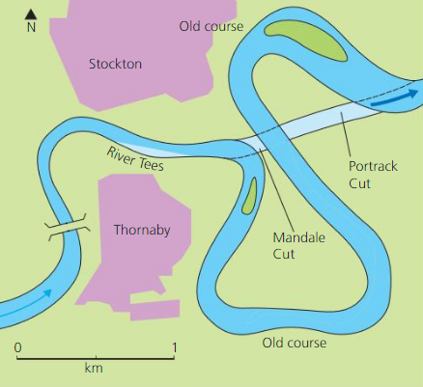
Channel Straightening
ACTIVATE
Be READY TO LEARN
Think like a Geographer
LO: To explore the costs and benefits of hard engineering strategies.

Slide 10
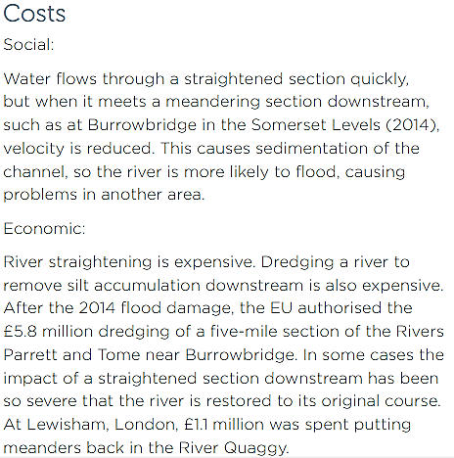
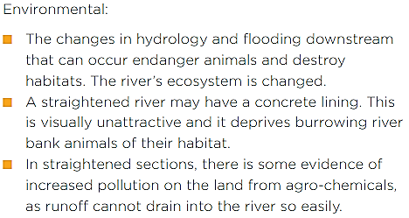
Channel Straightening
ACTIVATE
Be READY TO LEARN
Think like a Geographer
LO: To explore the costs and benefits of hard engineering strategies.

Slide 11
Embankments
ACTIVATE
Be READY TO LEARN
Think like a Geographer
LO: To explore the costs and benefits of hard engineering strategies.

Slide 12
Embankments
ACTIVATE
Be READY TO LEARN
Think like a Geographer
LO: To explore the costs and benefits of hard engineering strategies.

Slide 13
Embankments
ACTIVATE
Be READY TO LEARN
Think like a Geographer
LO: To explore the costs and benefits of hard engineering strategies.

Slide 14
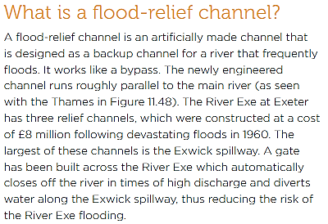
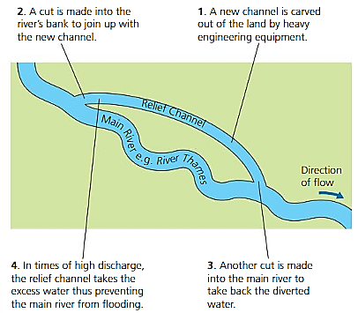
Flood Relief Channel
ACTIVATE
Be READY TO LEARN
Think like a Geographer
LO: To explore the costs and benefits of hard engineering strategies.

Slide 15
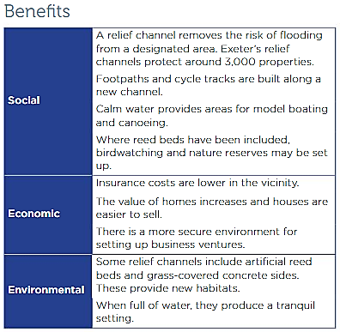
Flood Relief Channel
ACTIVATE
Be READY TO LEARN
Think like a Geographer
LO: To explore the costs and benefits of hard engineering strategies.

Slide 16
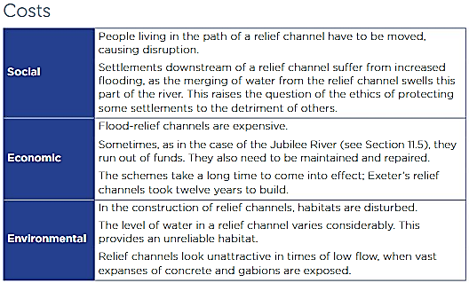
Flood Relief Channel
ACTIVATE
Be READY TO LEARN
Think like a Geographer
LO: To explore the costs and benefits of hard engineering strategies.

Slide 17
Question Time
AFL
Be READY TO LEARN
Think like a Geographer
What is a flood relief channel?
An artificial channel that is designed as a back up channel for a river that frequently floods.
The deepening of the river channel.
Which is a benefit of channel straightening?
The changes in hydrology and flooding downstream that can endanger animals and destroy habitats. The rivers ecosystem is changed.
Home owners gain confidence to invest in their property as they no longer expect to be flooded. Insurance costs are also reduced due to the lower flood risk.
LO: To explore the costs and benefits of hard engineering strategies.

Slide 18
To what extent are hard engineering schemes sustainable? (6)
DEMONSTRATE
Be READY TO LEARN
Think like a Geographer
Command words ‘to what extent’ indicates the you should interrogate (good and bad) the evidence and reach a conclusion. The focus is sustainability – there should be a clear recognition of the needs of the present and future population and the impact on the environment.
LEVEL | SUCCESS CRITERIA
2 (Detailed) 4-6 | Shows sound knowledge of hard engineering flood prevention strategies. Demonstrates reasonable application of knowledge and understanding in analysing and evaluating the extent to which hard engineering flood prevention strategies are sustainable.
1 (Basic) 1-3 | Shows limited knowledge of hard engineering flood prevention strategies. Demonstrates limited or no application of knowledge and understanding in analysing and evaluating the extent to which hard engineering flood prevention schemes are sustainable.
0 | No relevant information.
LO: To explore the costs and benefits of hard engineering strategies.

Slide 19
To what extent are hard engineering schemes sustainable? (6)
Step 1: Start with an intro…
Step 2: On one hand...
Step 3: On the other hand...
Step 4: Overall...
Dams and reservoirs such as …. are sustainable as…
Overall, Dams are Reservoirs are ….. because…
Dams and reservoirs are… and are used to reduce flood risk.
However, Dams and Reservoirs can cause problems as…
________________________________________________________________________
______________________________________________________
________________________________________________________________________________________________________________
________________________________________________________________________
______________________________________________________
The question says ‘schemes’ and so you need to do this for two hard engineering schemes. Use this structure to write another paragraph.

Slide 20
To what extent are hard engineering schemes sustainable? (6)
DEMONSTRATE
Be READY TO LEARN
Think like a Geographer
MODEL ANSWER:
Hard engineering such as the construction of dams and reservoirs are widely used to regulate the river flow and reduce the risk of flooding (1). However, dams are expensive, for example Kielder Dam and Reservoir in Northumberland cost £167 million and may cause economic instability for farmers of land further downstream as soils can become less fertile which can reduce crop yields (1). On the other hand, as well as reducing the risk of flooding, dams can also be used as a source of drinking water and hydroelectric power, for example Kielder Dam generates 6MW of electricity, enough to serve a town of 10,000 people (1). This means that dams are very sustainable as they reduce the risk of flooding and provide many other services to the population and environment.
Flood relief channels are artificial channels that are designed to run parallel as a back up channel for a river that frequently floods (1). The River Exe, Exeter has three relief channels that remove the risk of flooding from designated areas and protects around 3,000 properties (1). However, the use of flood relief channels are not sustainable as Exeter's relief channels took twelve years to build, meaning they take a long time to come into effect and properties are still flooded in the meantime (1).
To conclude the use of dams and reservoirs are very sustainable as these have multiple purposes which can reap benefits in the long term whereas the use of flood relief channels cost a lot and take a while to work, meaning properties continue to be flooded and so this is not sustainable.
LO: To explore the costs and benefits of hard engineering strategies.

Slide 21
Fill your hard hat.
CONSOLIDATE
Be READY TO LEARN
Think like a Geographer
Identify the names of hard engineering strategies.
Describe the costs of the strategies.
Describe the benefits of the strategies.
LO: To explore the costs and benefits of hard engineering strategies.

