Slide 1
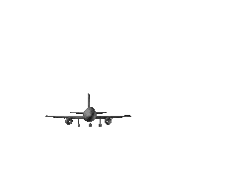
Depositional Landforms: Levées, Flood plains and Deltas
CONNECT
Be READY TO LEARN
Start thinking like a Geographer
Make sure you have your book, write today’s date and title.
What landform is being portrayed by the catchphrase?
LO: To explore the characteristics and formation of levées, flood plains and deltas.

Slide 2
LO: To explore the characteristics and formation of levées, flood plains and deltas.
ACTIVATE
Be READY TO LEARN
Think like a Geographer
Write the Learning Objective.
SUCCESS CRITERIA:
I can describe the characteristics of levées, flood plains and deltas.
I can explain the formation of levées, flood plains and deltas.
Depositional Landforms: Levées, Flood plains and Estuaries.

Slide 3
The lower course of the river
What are the characteristics?
What landforms may be found here?
What is the land use?
http://www.youtube.com/watch?v=bsc2_NwyD-A

Slide 5
What is a levées?
ACTIVATE
Be READY TO LEARN
Think like a Geographer
Levées are naturally raised river banks (ridges of sediment) found on either or both sides of a river channel, that is prone to flooding. They are found in a river’s lower course. It is formed by flooding over many years and composed of gravel, stones and alluvium (silt).
What is a flood plan?
A flood plain is wide, flat area on marshy land on either side of a river, and found in the middle and lower courses. Flood plains are made from alluvium which is deposited when a river floods. Flood plains are used for farming as the soil is very fertile.
LO: To explore the characteristics and formation of levées, flood plains and deltas.

Slide 6
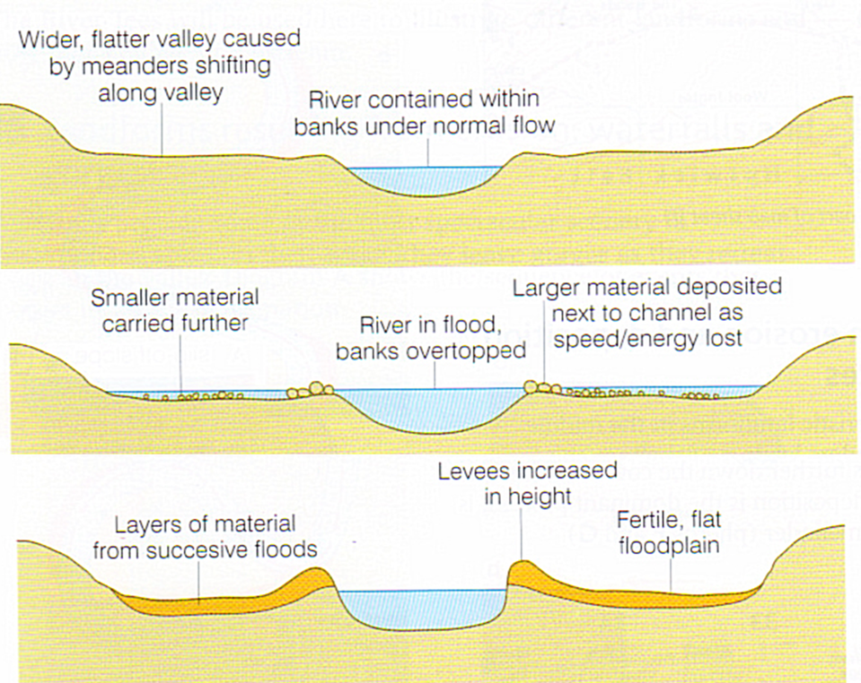
Formation of Levées
ACTIVATE
Be READY TO LEARN
Think like a Geographer
When a river bursts its banks, friction with the land reduces velocity (speed of river) and causes deposition. Heavy sediment is deposited closest to the river.
The size of sediment then becomes progressively smaller with distance from the river.
With each successive flood, the banks are built up higher.
Although it may seem that make it more difficult for the river to flood next time, this is not the case as overtime the bed of the river deposits a thicker layer of sediment, which raises the river in its channel.
LO: To explore the characteristics and formation of levées, flood plains and deltas.

Slide 7
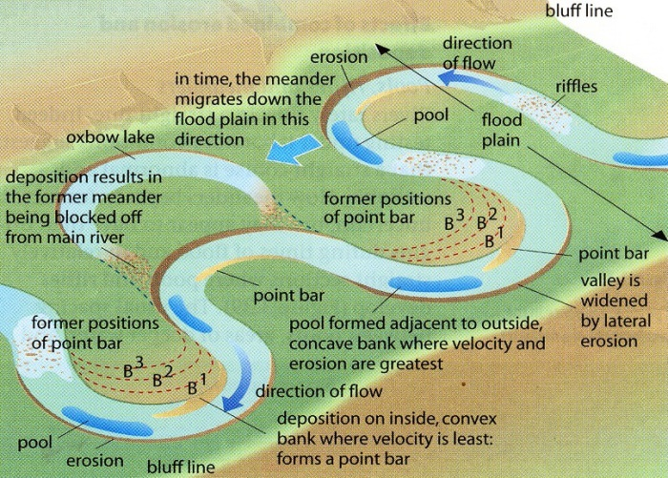
Formation of Flood plains
ACTIVATE
Be READY TO LEARN
Think like a Geographer
Flood plains are formed by two processes:
Meanders migrate across the flood plain due to lateral erosion. When they reach the edge of the floodplain they erode the valley side (bluff line). Eventually this cuts a wider valley. This explains why flood plains are very wide.
When the river floods its deposits silt, creating a very flat flood plain. Layer upon layer builds up over many years to form a thick deposit of fertile alluvium.
LO: To explore the characteristics and formation of levées, flood plains and estuaries.

Slide 8
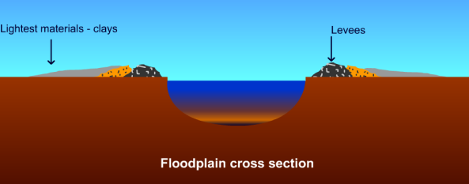
Floodplain formation
Floodplains and leveés are formed by deposition in times of river flood. The river’s load is composed of different sized particles. When a river floods it deposits the heaviest of these particles first. The larger particles, often pebble-sized, form the leveés. The sands, silts and clays are similarly sorted with the sands being deposited next, then the silts and finally the lightest clays. Every time the river floods deposition builds up the floodplain.

Slide 9
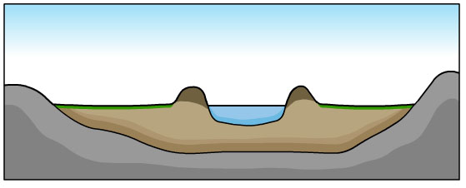
Floodplain formation
This is a cross section of a floodplain.
Draw a simple sketch of the diagram and annotate with the following labels:
leveés
sands
clays and silts

Slide 10
Where in the World? What geographical feature is the green triangle? Why is it there?

Slide 11
Deltas are river sediments deposited when a river enters a standing body of water such as a lake, a lagoon, a sea or an ocean. They are fundamentally features of river deposition, not marine deposition.

Slide 12
Types of delta

Slide 14
Conditions favouring deltaic accumulation are:
A river with a high sediment load, such as the Nile or the Mississippi.
Usually a large river. This condition is necessary for marine deltas otherwise the action of the sea might disperse the sediment.
Reasonably shallow water offshore. Very deep water inhibits delta building. For example, the Congo, which virtually debouches into a submarine canyon, has no delta.
A coast on which the wave energy is low, such as the Mediterranean or the Gulf of Mexico, though here again how low will depend on other factors such as sediment supply and tidal range.

Slide 15
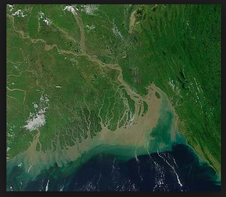
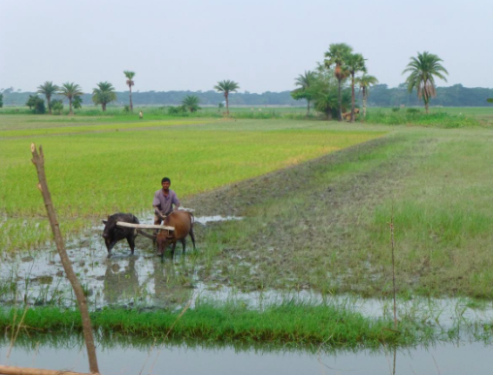
Case study: The Ganges Delta
https://www.youtube.com/watch?v=xf95cCwSGBI
Task: Read the sheet ‘The Ganges Delta’
Explain the conditions in this area which have created the formation of the delta
What are the advantages for people living in delta area?
What are the problems caused?
Use specific case study detail.

Slide 17
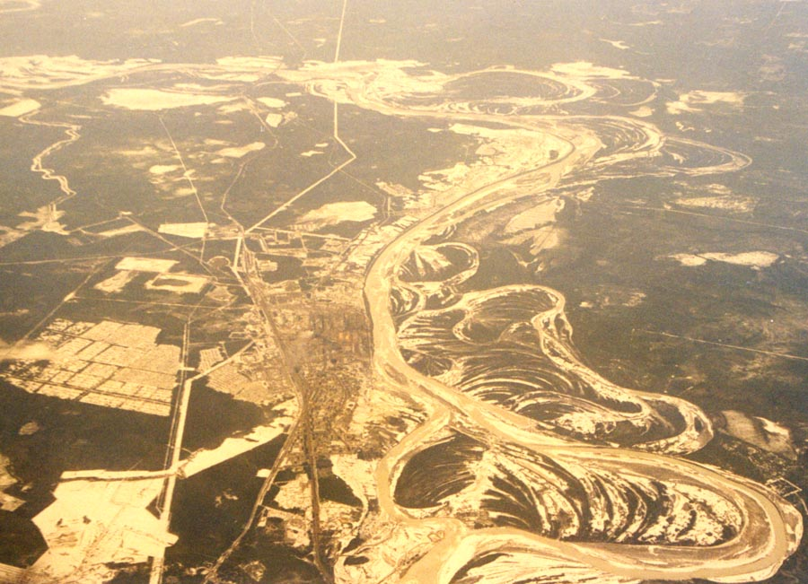
Techniques – interpreting aerial photographs
Name the river landform shown in this aerial photograph.
What else can you identify?
How can you tell that this is not the upper course of a river?

