Slide 1
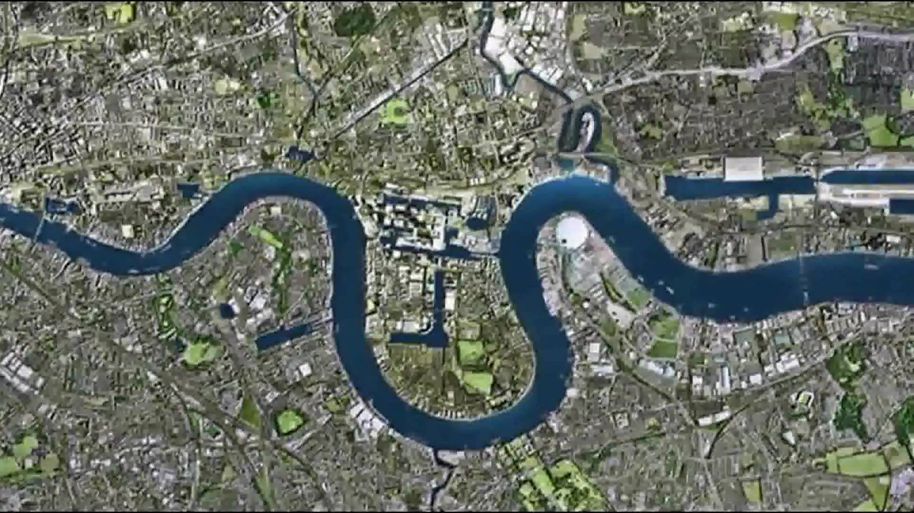
Erosional and Depositional Landforms: Meanders and Ox-bow Lakes
CONNECT
Be READY TO LEARN
Start thinking like a Geographer
Make sure you have your book, write today’s date and title.
What’s the name of this river?
Where is it located?
Why is it this shape?
Which course of the river is this image?
LO: To explore the characteristics and formation of meanders and ox-bow lakes.

Slide 2
LO: To explore the characteristics and formation of meanders and ox-box lakes.
ACTIVATE
Be READY TO LEARN
Think like a Geographer
Write the Learning Objective.
SUCCESS CRITERIA:
I can identify meanders and ox-bow lakes.
I can describe the characteristics of meanders and ox- bow lakes.
I can explain the formation of meanders and ox-bow lakes.
Erosional and Depositional Landforms: Meanders and Ox-bow Lakes

Slide 3
What is the middle course like?
http://www.youtube.com/watch?v=_jOFjaLO98I
What are the characteristics?
What landforms are created?

Slide 5
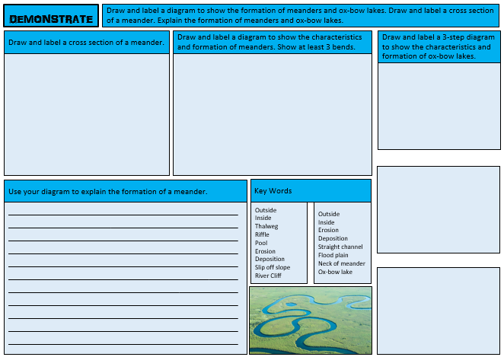

Slide 6
What is a meander?
ACTIVATE
Be READY TO LEARN
Think like a Geographer
A meander is a bend in a river. They are found mainly in lowland areas and are extremely common in the middle course of a river.
What are the conditions needed for a meander to form?
In the early stages of meander formation, water flows slowly over shallow areas (riffles) in the riverbed and faster through deeper sections (pools). This makes way for a motion called helicoidal flow that corkscrews across from one bank to another. This starts the erosion and deposition process which continuously shape a meander.
LO: To explore the characteristics and formation of meanders and ox-bow lakes.

Slide 7
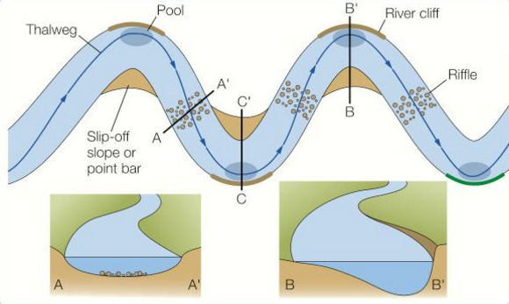
The formation of a meander
ACTIVATE
Be READY TO LEARN
Think like a Geographer
Fast flowing water on the outside of the bank causes lateral erosion through abrasion and hydraulic action, which undercuts the banks and forms a river cliff.
Helicoidal flow is a corkscrew movement. The top part of the flow hits the outside of the bank and erodes it. The flow then ‘corkscrews’ down to the next inside bend where it deposits its load due to friction slowing down the flow.
Fast flow causes vertical erosion on the outside bend, this deepens the river bed, resulting in an asymmetrical cross-profile.
Sand and pebbles are deposited on the inside bank where the current is slower, forming a gentle slip off slope.
LO: To explore the characteristics and formation of meanders and ox-bow lakes.

Slide 8
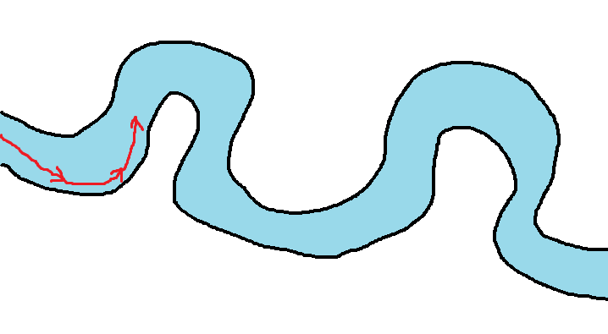
TASK 1: Draw a river. Make sure it has bends it in like this one:
TASK 2: Using a different colour mark on your river the route of the fastest water.

Slide 9
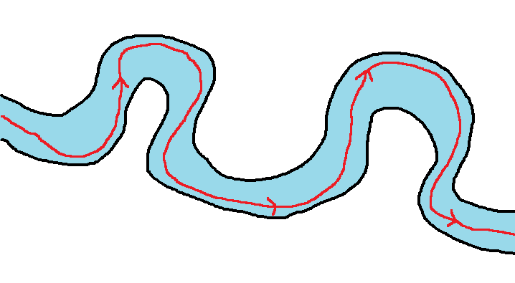
Where the red line hits the banks – it erodes material. In the areas of the river the water is travelling slower, the water has less energy and so deposits the eroded material.

Slide 10
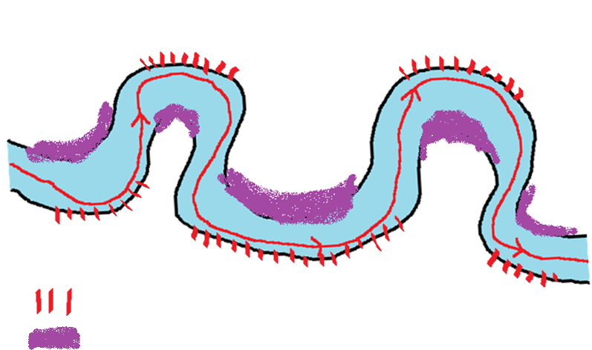
TASK 2: Add to your diagram where deposition and erosion are taking place
Deposition
Erosion
= Erosion
= Deposition

Slide 11
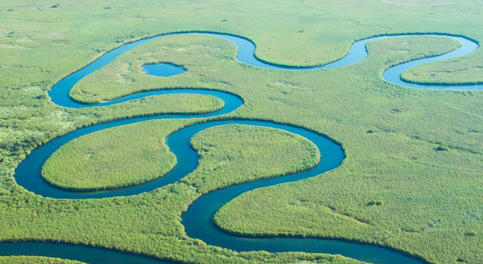
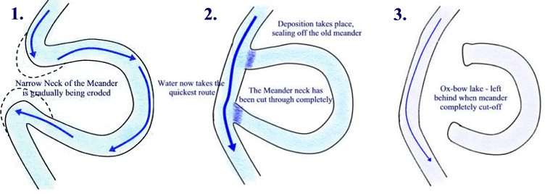
An ox-bow lake
ACTIVATE
Be READY TO LEARN
Think like a Geographer
A river with many meanders is called a sinuous river. The loops increase is size as erosion continues on the outside bank and deposition continues on the inside bank. As meanders grow, they migrate over the floodplain.
As they migrate they may start to erode towards each other.
Gradually the neck of the meander narrows until it is completely broken through (usually during a flood) to form a new straighter channel.
The old meander loop is cut off by deposition from subsequent flooding to form an ox-bow lake.
LO: To explore the characteristics and formation of meanders and ox-bow lakes.

Slide 12
Explain the formation of an oxbow lake

Slide 13
Question Time
AFL
Be READY TO LEARN
Think like a Geographer
A meander is…
A bend in the river.
When the bend is cut off to form a straight channel.
Meanders and ox-bow lakes are found in the upper course of the river.
True OR False
What is the name of the flow that has a corkscrew effect?
Thalweg
Helicoidal flow
LO: To explore the characteristics and formation of meanders and ox bow lakes.

Slide 14
Use the activate cards to complete the worksheet.
DEMONSTRATE
Be READY TO LEARN
Think like a Geographer
LO: To explore the characteristics and formation of meanders and ox bow lakes.

Slide 15
Explain how an ox-bow lake could form on the river shown in Figure 1. (6)
DEMONSTRATE
Be READY TO LEARN
Think like a Geographer
SUCCESS CRITERIA:
L1 (1-2) There is a basic explanation of the formation of an ox-bow lake.
L2 (3-4) There is a clear explanation of the formation of an ox-bow lake.
L3 (5-6) There is a detailed explanation of the formation of an ox-bow lake.
Figure 1
LO: To explore the characteristics and formation of meanders and ox bow lakes.

Slide 16
Explain how an ox-bow lake could form on the river shown in Figure 1. (6)
DEMONSTRATE
Be READY TO LEARN
Think like a Geographer
There are many meanders shown in figure 1. The current is fastest at the outside bend of a meander because the channel is deeper (1). This means that hydraulic action and abrasion erode the outside bank of the river (1). Overtime erosion causes meanders to migrate across flood plains and get closer together (1). The outside bends continue to get closer until there is only a small bit of land left between two outside bends of a meander (1). This is called the neck. The river breaks through the neck usually during a flood to create a straight channel (1). Material is deposited across the shallow parts of the channel which eventually cuts the meander off and creates and ox-bow lake (1).
Figure 1
LO: To explore the characteristics and formation of meanders and ox bow lakes.

