Slide 1
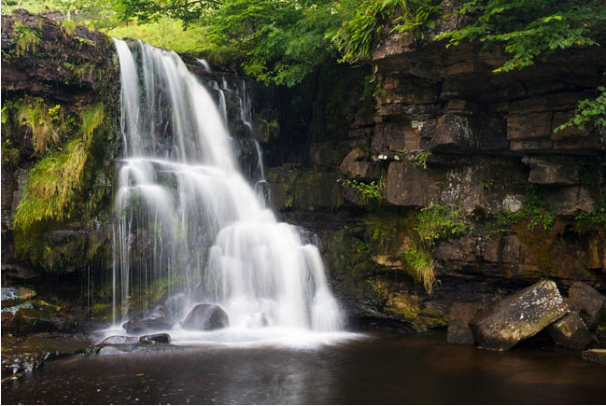
Erosional Landforms: Interlocking Spurs, Waterfalls and Gorges
CONNECT
Be READY TO LEARN
Start thinking like a Geographer
Make sure you have your book, write today’s date and title.
LO: To explore the formation of Interlocking Spurs, Waterfalls and Gorges.

Slide 2
LO: To explore the formation of Interlocking Spurs, Waterfalls and Gorges.
ACTIVATE
Be READY TO LEARN
Think like a Geographer
Write the Learning Objective.
SUCCESS CRITERIA:
I can draw and label a sketch of interlocking spurs.
I can list three erosional river landforms.
I can describe the formation of an interlocking spur.
I can explain the formation of waterfalls and gorges.
I can explain why a waterfall is only a temporary feature on a river’s course
Erosional Landforms: Interlocking Spurs, Waterfalls and Gorges

Slide 3
Watch the video of the upper course of a river….
When complete you will be undertaking the following activities:
Describe characteristics of the upper course of the river?
What processes are happening?
What landforms are found?
http://www.youtube.com/watch?v=DI2DocEw_So

Slide 5
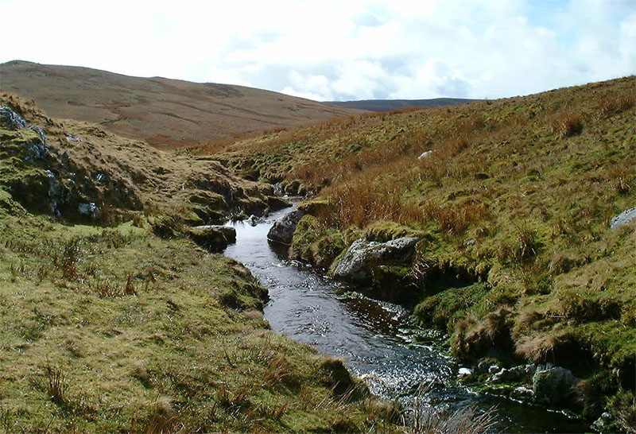
Landforms in the upper course
V-shaped valleys and interlocking spurs
Rapids
Waterfalls
river disappears from view hidden by this spur of land
River Conwy
(near Mignant Moor)

Slide 6
Why do V-shaped valleys occur?

Slide 7
4 mark question…explain the formation of a V shape valley (or river valley)
https://www.youtube.com/watch?v=FkvywlhBXZk

Slide 8
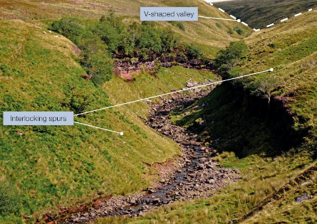
Interlocking Spurs
ACTIVATE
Be READY TO LEARN
Think like a Geographer
Interlocking spurs are projections of high land that alternate from either side of a V-shaped valley. They are formed by fluvial erosion and are found in the upper course of a river where rocks are hard. The river is not powerful enough to cut through the spurs of land and so has to flow around them.
LO: To explore the formation of Interlocking Spurs, Waterfalls and Gorges.

Slide 11
Geographical skills-Techniques! – Field-sketching….
Produce an annotated fieldsketch to show that this is part of an upland river valley.

Slide 12
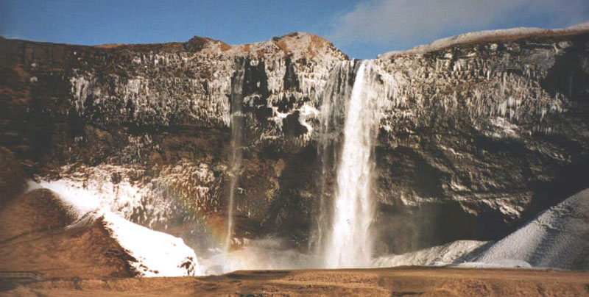
Waterfalls!
Seljalandsfoss, SW Iceland

Slide 13
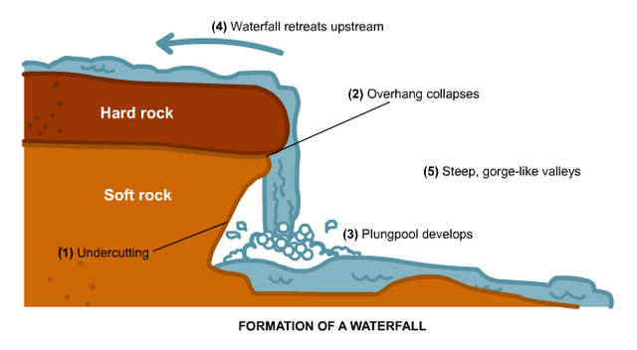
Waterfalls
ACTIVATE
Be READY TO LEARN
Think like a Geographer
As it makes its way from source to mouth, a river flows over different types of rock. Tougher, more resistant rocks are less easily eroded than weaker rocks and they will perform ‘steps’ in the long profile of a river. These steps form waterfalls.
Waterfalls are most commonly formed when a river flows over a relatively resistant band of rock. When the river plunges over a waterfall it forms a deep and turbulent plunge below. Here the processes of erosion (hydraulic action and abrasion) are active and they undercut the waterfall. Eventually, the overhanging rock collapses and the waterfall retreats upstream. Over many years the waterfall will leave behind a steep sided gorge.
LO: To explore the formation of Interlocking Spurs, Waterfalls and Gorges.

Slide 14
Waterfall formation
https://www.youtube.com/watch?v=XFGFEb9MZcY
https://www.youtube.com/watch?v=fOI7aKvrFn4

Slide 15
Waterfalls

Slide 16
How does a waterfall form?
Rearrange the stages of formation into the correct order:

Slide 17
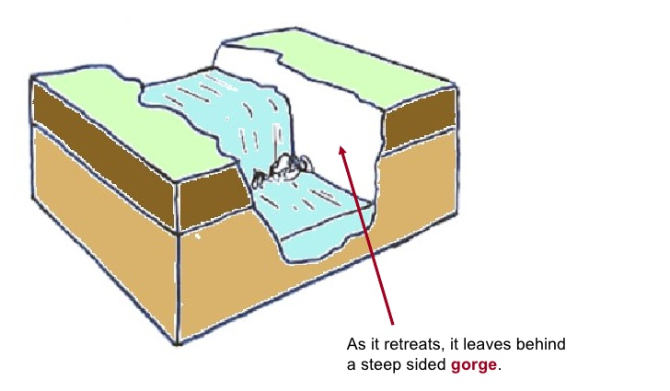
Gorge
ACTIVATE
Be READY TO LEARN
Think like a Geographer
A gorge is a vertical narrow steep sided valley that is usually found immediately downstream of a waterfall.
It is formed by the gradual retreat of waterfalls over hundreds, sometimes thousands of years.
LO: To explore the formation of Interlocking Spurs, Waterfalls and Gorges.

Slide 19
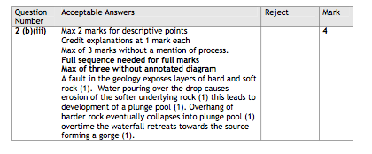

Slide 20
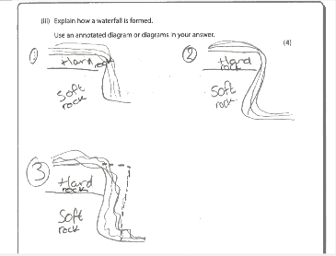
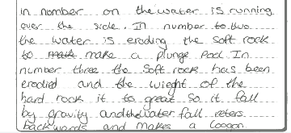

Slide 23
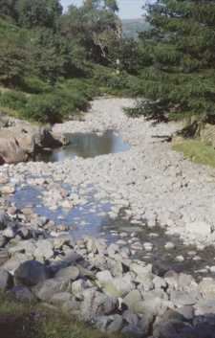
River load in upper course
Why are they rounded?

Slide 24
River load in upper course
Why are they rounded?
Boulders are large and semi-rounded, due to attrition within the load and abrasion with the stream bed and banks

Slide 25
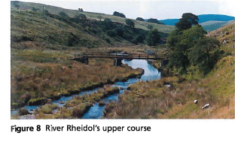
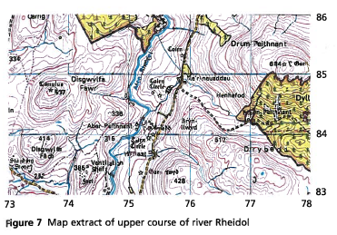
Skills (paper 2) linked to rivers

Slide 26
Question Time
AFL
Be READY TO LEARN
Think like a Geographer
Which erosional landform retreats upstream?
Gorge B) Waterfall C) Interlocking Spurs
Where would you find interlocking spurs?
Upper Profile B) Middle Profile C) Lower Profile
D) Source E) A and D
What processes of erosion undercut a waterfall?
Hydraulic Action and Abrasion
Hydraulic Action and Attrition
LO: To explore the formation of Interlocking Spurs, Waterfalls and Gorges.

Slide 27
Study the characteristics and formation of interlocking spurs, waterfalls and gorges.
DEMONSTRATE
Be READY TO LEARN
Think like a Geographer
LO: To explore the formation of Interlocking Spurs, Waterfalls and Gorges.

Slide 28
Explain why a waterfall is only a temporary feature on a river’s course (4 marks)
DEMONSTRATE
Be READY TO LEARN
Think like a Geographer
SUCCESS CRITERIA:
Level 1 (1-2) Demonstrates some knowledge of river processes and environments. Shows limited geographical understanding of the interrelationships between river environments and processes.
Level 2 (3-4) Demonstrates specific and accurate knowledge of river processes and environments. Shows thorough geographical understanding of the interrelationships between river environments and processes.
LO: To explore the formation of Interlocking Spurs, Waterfalls and Gorges.

Slide 29
Explain why a waterfall is only a temporary feature on a river’s course (4 marks)
DEMONSTRATE
Be READY TO LEARN
Think like a Geographer
The river will try to develop a smooth long profile. A waterfall is formed where the river flows over a band of more resistant rock (1). This represents an irregularity in the river’s long profile that it will try to remove. Where the more resistant rock overlays less resistant rock, different rates of erosion take place as the less resistant rock is eroded faster than the overlying harder rock by abrasion and hydraulic action (1). Over time the less resistant rock is removed leaving a shelf of more resistant rock overhanging. Eventually this overhang will collapse and the waterfall will retreat further upstream (1). This process continues until all the more resistant rock has been removed, the waterfall disappears and the river’s long profile is smoothed out, therefore a waterfall is only a temporary feature (1).
LO: To explore the formation of Interlocking Spurs, Waterfalls and Gorges.

Slide 30
Write down 2 things you are proud to have achieved this lesson. Tell me what they are.
CONSOLIDATE
Be READY TO LEARN
Think like a Geographer
LO: To explore the formation of Interlocking Spurs, Waterfalls and Gorges.

