Slide 1
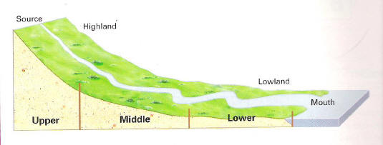
Fluvial Processes – Erosion, Transportation and Deposition
CONNECT
Be READY TO LEARN
Start thinking like a Geographer
Make sure you have your book, write today’s date and title.
Write the course(s) of the river where there will be lateral erosion.
Write the course of the river where there will be the most deposition.
Write the course of the river where there will be vertical erosion.

Slide 2
LO: To explore how rivers erode, transport and deposit material.
ACTIVATE
Be READY TO LEARN
Think like a Geographer
Write the Learning Objective.
SUCCESS CRITERIA:
I can describe the fluvial processes.
I can explain how a river erodes, transports and deposits material.
I can suggest how velocity affects the processes of erosion, transportation and deposition.
Fluvial Processes – Erosion, Transportation and Deposition

Slide 3
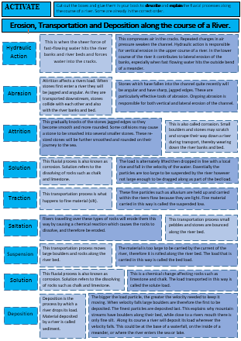
Erosion of the river bed and banks.
ACTIVATE
Be READY TO LEARN
Think like a Geographer
Use the diagrams and text boxes to identify, describe and explain the fluvial processes that occur along the course of a river.
Cut them out and glue them in your books
(Get them checked first!)
Here’s an example of what your connections should look like.
This is when the sheer force of fast-flowing water hits the river banks and river beds and forces water into the cracks.
This compresses air in the cracks. Repeated changes in air pressure weaken the channel. Hydraulic action is responsible for vertical erosion in the upper course of a river. In the lower course of the river it contributes to lateral erosion of the banks, especially when fast flowing water hits the outside bend of a meander.
Hydraulic Action
LO: To explore how rivers erode, transport and deposit material.

Slide 4
Question Time
AFL
Be READY TO LEARN
Think like a Geographer
What is name of the transportation process where larger boulders are rolled along the river bed?
What is the name of the process that compresses air into cracks?
What process is responsible for the vertical deepening of the channel in the rivers upper course?
Hydraulic Action
Abrasion
Solution
Attrition
What process occurs when the velocity in the river decreases?
What is the name of the process when stones collide with one another and the banks and the bed of the river?
Abrasion
Attrition
What is the name of the process that occurs at the base of waterfalls and on the inside bends of meanders?
LO: To explore how rivers erode, transport and deposit material.

Slide 5
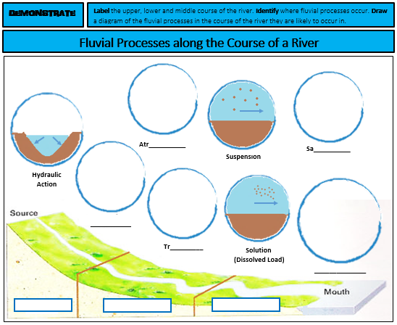
Fluvial Processes along the Course of a River
DEMONSTRATE
Be READY TO LEARN
Think like a Geographer
Label the upper, lower and middle course of the river.
Identify the fluvial processes.
Draw a diagram of the fluvial processes in the course of the river they are likely to occur in.
LO: To explore how rivers erode, transport and deposit material.

Slide 6
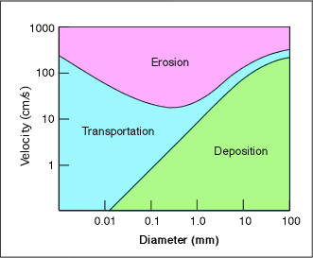
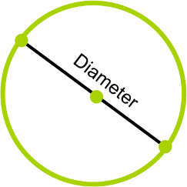
Apply your understanding to the Hjulstrom Curve – a graph used by hydrologists.
DEMONSTRATE
Be READY TO LEARN
Think like a Geographer
Using the Hjulstrom Curve, suggest how velocity (speed of the river) affects the processes of erosion, transportation and deposition (4).
MARK SCHEME:
Suggest the general relationship between particle size and the velocity at which erosion occurs (use data to back it up).
Suggest the general relationship between particle size and the velocity at which deposition occurs (use data to back it up).
LO: To explore how rivers erode, transport and deposit material.

Slide 7
Apply your understanding to the Hjulstrom Curve – a graph used by hydrologists.
DEMONSTRATE
Be READY TO LEARN
Think like a Geographer
Using the Hjulstrom Curve, suggest how velocity (speed of the river) affects the processes of erosion, transportation and deposition (4).
MODEL ANSWERS:
The higher the velocity the more erosion that occurs (1), for example when the river flows between 400cm/s material is likely to be eroded regardless of diameter (1).
The larger the boulder the more deposition that occurs (1), for example when the particle size has a diameter between 1.0 and 100mm, the particle will be deposited at speeds between 0 and 300cm/s (1).
LO: To explore how rivers erode, transport and deposit material.

Slide 8
Write down 4 items of new knowledge that you have gained today.
CONSOLODTATE
Be READY TO LEARN
Think like a Geographer
2
3
1
4
LO: To explore how rivers erode, transport and deposit material.

Slide 9
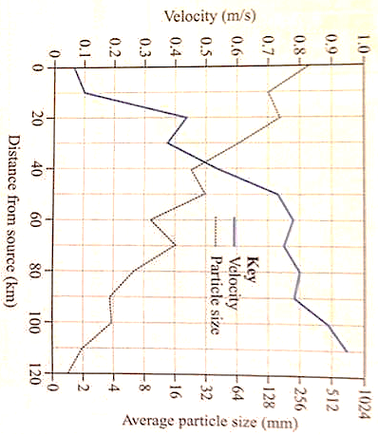
Study Figure 1, which shows how the velocity of the River Dance varies along its course.
HOMEWORK
Be READY TO LEARN
Think like a Geographer
1. Using Figure 1, suggest why deposition is the dominant process between 20 and 30km (2).
2. Using Figure 1, describe how particle size changes with distance from the source of the river and explain the processes that cause this change (3).
LO: To explore how rivers erode, transport and deposit material.

