Slide 1
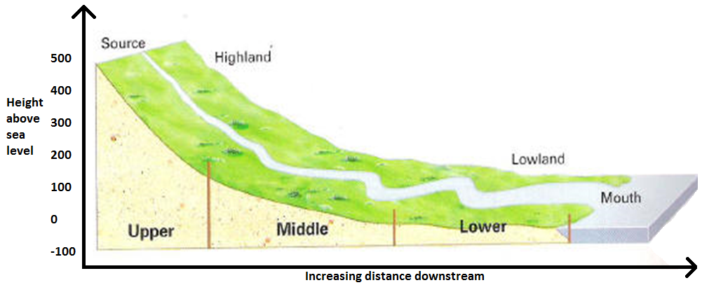
Changes in Rivers and their Valleys.
CONNECT
Be READY TO LEARN
Start thinking like a Geographer
Make sure you have your book, write today’s date and title.
What does this image show?
LO: To explore the changing profile of rivers and their valleys with distance downstream.

Slide 2
LO: To explore the changing profile of rivers and their valleys with distance downstream.
SUCCESS CRITERIA:
I can describe how a river and its valley change downstream.
I can draw a graph to show the long profile of a river.
I can explain how the profile of a river changes downstream.
Changes in Rivers and their Valleys

Slide 3
How does a river change from source to mouth?
Think, pair, share

Slide 4
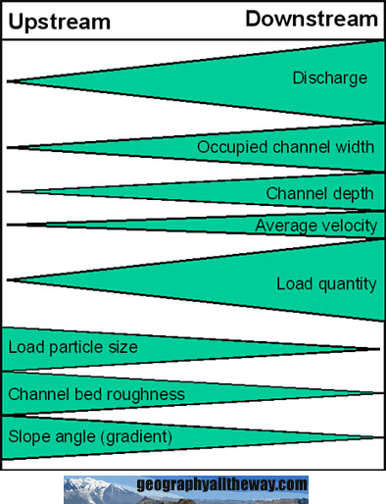

Slide 5
Long Profile of a river and its valley.
ACTIVATE
Be READY TO LEARN
Think like a Geographer
LO: To explore the changing profile of rivers and their valleys with distance downstream.

Slide 6
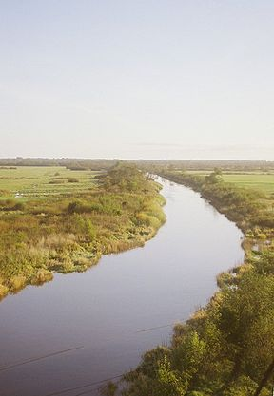
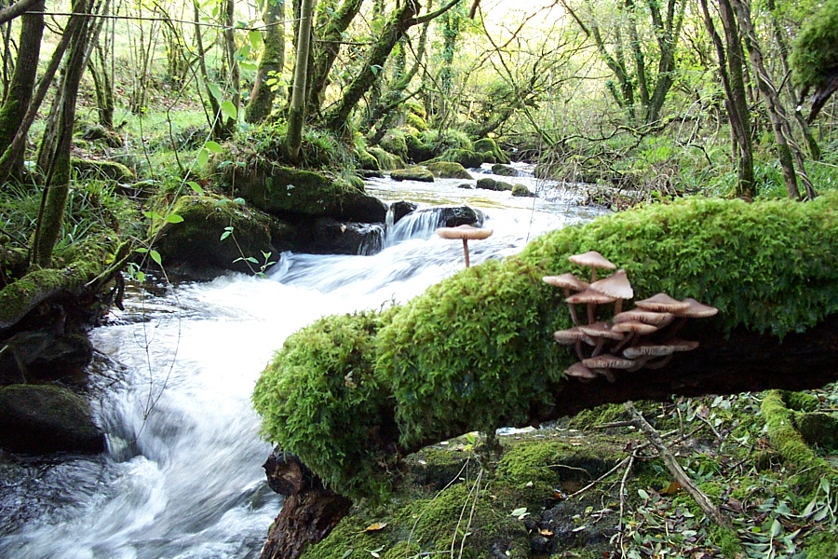
Many people think that rivers flow faster in upper course – why?
Lower course
Upper course

Slide 7
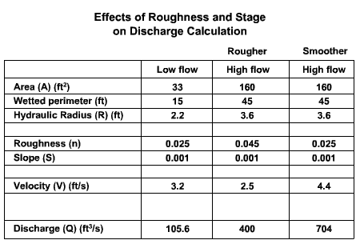
Is it true though?

Slide 8
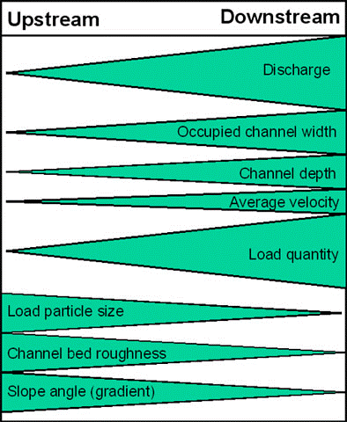
The Bradshaw Model
Positive changes
Negative changes
Notes:
Explain to students – get them to note down on their long profile diagram the changes. Get verbal feedback after activity.

Slide 9
The Bradshaw Model
Activity:
Choose 3 characteristics to explain (including at least one positive and one negative)
Notes:
Explain to students – get them to note down on their long profile diagram the changes. Get verbal feedback after activity.

Slide 10
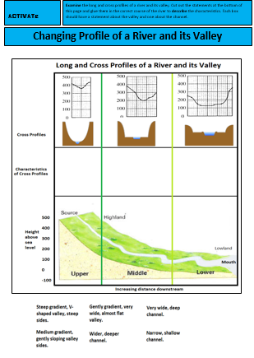
Cross Profiles of a river and its valley.
ACTIVATE
Be READY TO LEARN
Think like a Geographer
Examine the long and cross profiles of a river and its valley. Cut out the statements at the bottom of this page and glue them in the correct course of the river to describe the characteristics.
Each box should have a statement about the valley and a statement about the channel.
LO: To explore the changing profile of rivers and their valleys with distance downstream.

Slide 11
Use the data to draw a graph to show the long profile of a river.
DEMONSTRATE
Skills practice
Name of place/ feature | Distance from source (km) | Altitude (m)
Plynlimon Hills | 0 | 610
Llanidloes | 35 | 170
Welshpool | 95 | 76
Shrewsbury | 135 | 75
Stourport | 215 | 31
Worcester | 240 | 29
Tewkesbury | 265 | 20
Gloucester | 290 | 19
Estuary mouth in Bristol Channel | 355 | 0
What should the title be?
What should the Y axis be called?
What should the x axis be called?
LO: To explore the changing profile of rivers and their valleys with distance downstream.

Slide 12
A graph to show the long profile of the River Severn, Wales
700
600
Upper
Middle
Lower
Altitude above sea level
500
400
300
200
100
0
0 50 100 150 200 250 300 350 400
Distance from the source
LO: To explore the changing profile of rivers and their valleys with distance downstream.

Slide 13
Question Time
AFL
Be READY TO LEARN
Think like a Geographer
How many courses of a river are there?
Where will I find the source of the river?
Is the mouth located in the upper of lower course of the river?
Where is the channel wide and deep but on a medium gradient?
Upper course
Middle course
Lower course
LO: To explore the changing profile of rivers and their valleys with distance downstream.

Slide 14
DEMONSTRATE
Be READY TO LEARN
Think like a Geographer
Explain how the profile of a river changes downstream.
Read the text below and delete (cross out with black marker) the incorrect word.
I have done one for you.
LO: To explore the changing profile of rivers and their valleys with distance downstream.

Slide 15
Self Assess to tick/cross. to correct.
DEMONSTRATE
Be READY TO LEARN
Think like a Geographer
The average velocity (speed of water) and discharge (amount of water) of a river increases/decreases along its course. Although the upper course has a steep/gentle gradient and is v/u shaped, the velocity depends on how much water comes into contact with the channel banks and bed. In the upper course the channel is shallow/deep due to vertical/lateral erosion and narrow/wide, so there is much/less friction. This is because in the upper course the rock is harder/softer and so the valley sides are/are not widened out much by weathering and erosion. Therefore, velocity is low/high.
In the middle course the river is flowing through lower country. The gradient is less/more steep, so the river begins to meander and erode vertically/laterally into the valley sides. The rate of erosion increases/decreases as the rocks that make up the valley sides are harder/softer. As the river uses more energy in lateral erosion it is not able to remove all the eroded material so this builds up the valley floor to give it a more steep/gentle profile.
The lower course of river flows through low lying land and has a narrow/wide and deep/shallow channel. Therefore, there is much/less friction resulting in a low/high velocity. The speed is boosted by the additional discharge from all the tributaries. Deposition from floods builds up the flood plain and meanders migrate. This builds up and narrows/widens the valley.
LO: To explore the changing profile of rivers and their valleys with distance downstream.

Slide 16
Explain why the upper course of a river valley has a different cross profile from the lower course (4).
Exam Question
Be READY TO LEARN
Think like a Geographer
……………………………………………………………………………………………………………………………………………………………………………………………………………………………………………………………………………………………………………………………………………………………………………………………………………………………………………………………………………………………………………………………………………………………………………………………………………………………………………………………………...
LO: To explore the changing profile of rivers and their valleys with distance downstream.

Slide 17
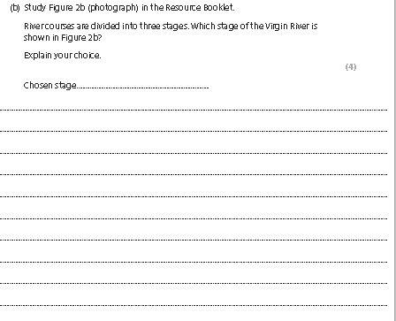
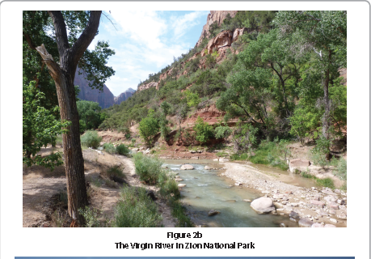
Exam practice

Slide 18
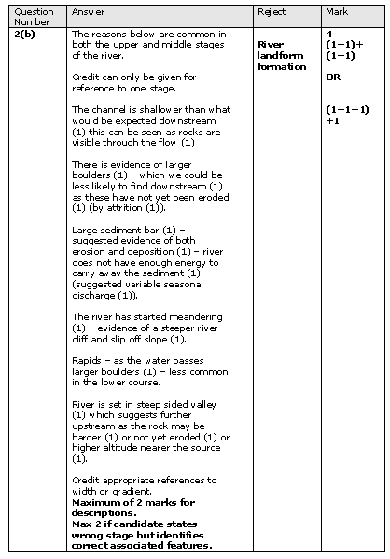
Mark scheme

Slide 19
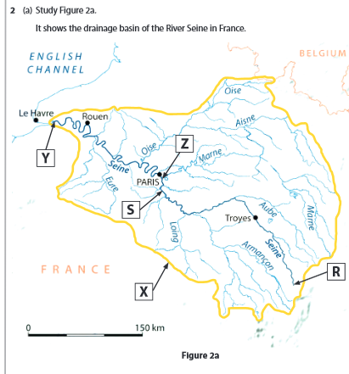
Exam practice

Slide 20
