Slide 1
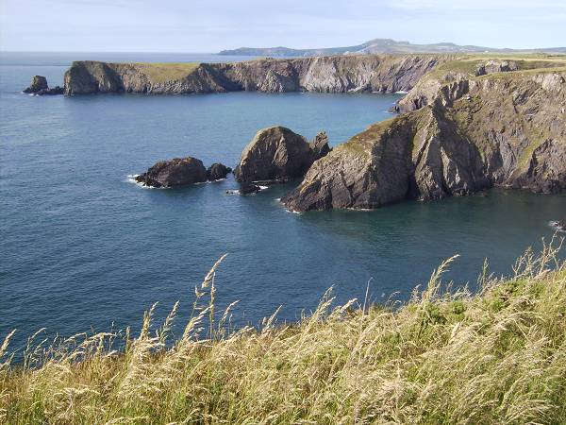
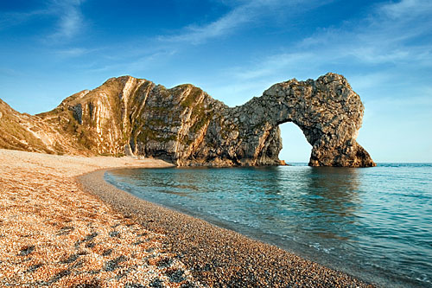
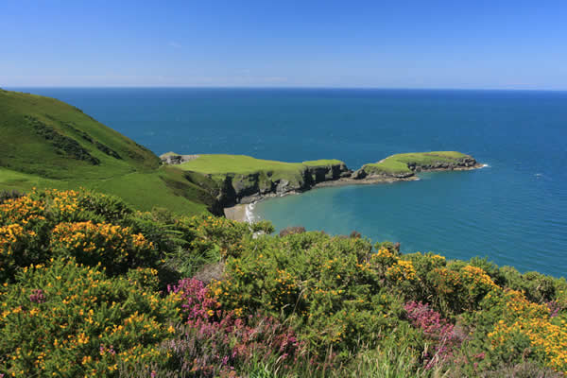
Erosional coastal Processes
Lesson objectives:
Identify the 4 main process that cause coast line erosion.
Describe and explain the formation of cliffs and wave cut platforms, headlands and bays, caves, arches, stacks and stumps.

Slide 2
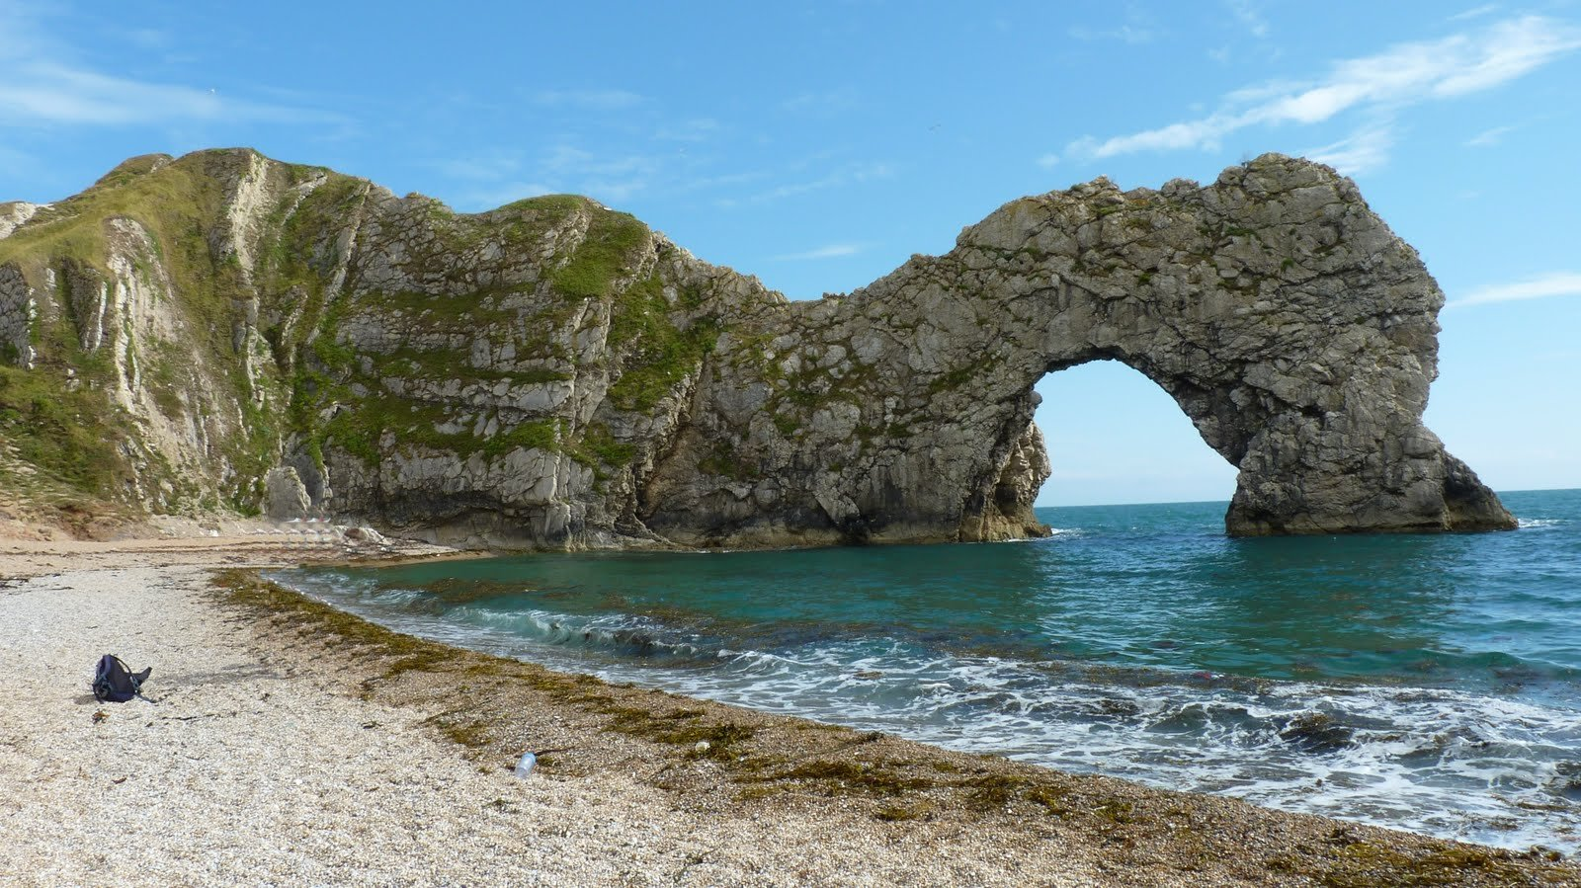
In your books, write down how you think this arch way was created??
Clue: Think back to last weeks lesson on waves…..

Slide 3
Coastal Processes
There are 3 main things that coasts can do:
They erode material
Then they transport material
And finally they deposit material
Key concept: PROCESSES

Slide 4
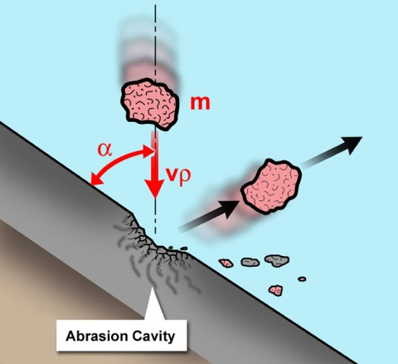
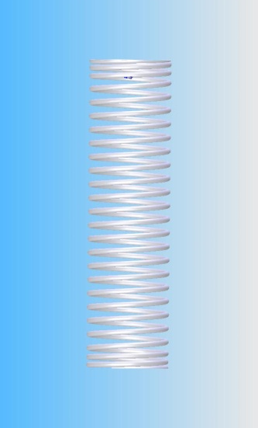
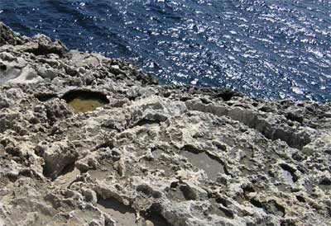
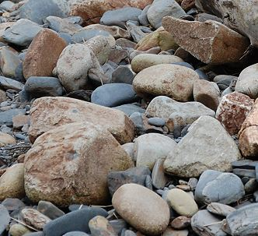
Hydraulic action
Abrasion
There are 4 different types of Erosion that operate along the coast. Does any one know what they are?
Animations
Solution
Attrition
Task: complete sheet to create an illustration to show the work of each type of coastal erosion

Slide 5
What are the processes of erosion along a coastline?
The same 4 processes of erosion that are at work on rivers also apply to coasts.
Hydraulic action: The force of the water causes cracks in the cliffs and material gradually breaks off.
Abrasion/corrasion: Bits of rock and sand in waves grind down cliff surfaces like sandpaper.
Attrition: Waves smash rocks and pebbles on the shore into each other, and they break and become smoother.
Corrosion/Solution: Acids contained in sea water will dissolve some types of rock such as chalk or limestone.
The 4 types of erosion video
WHY do we need to know this?

Slide 6
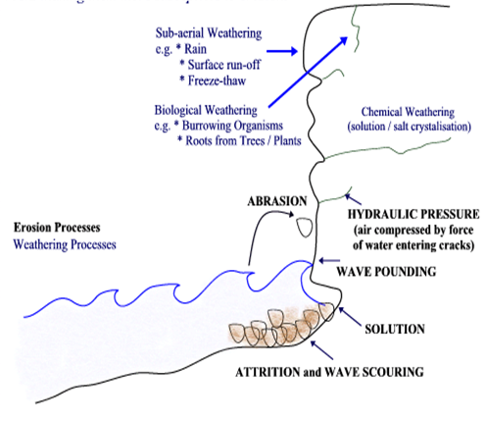
If the sea wins!

Slide 7
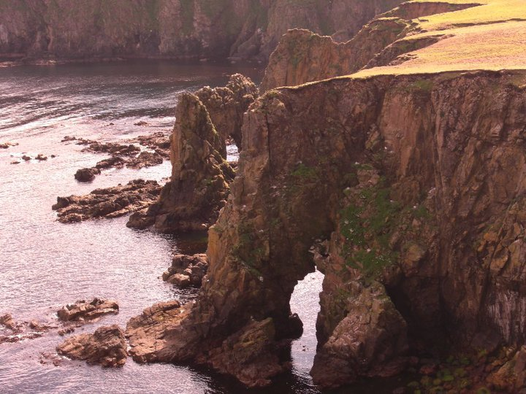
Features of
Coastal Erosion

Slide 9
Headlands and Bays
http://www.youtube.com/watch?v=c5gpkGIuB2M

Slide 10
Headlands and bays

Slide 11
Concordant and discordant coastlines
Coastlines where the geology alternates between strata (or bands) of hard rock and soft rock are called discordant coastlines. A concordant coastline has the same type of rock along its length. Concordant coastlines tend to have fewer bays and headlands.

Slide 12
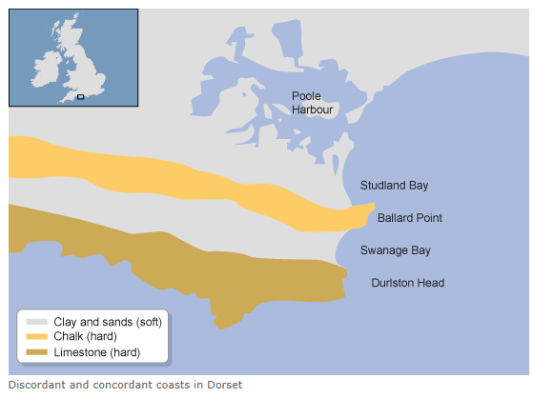
Discordant
Concordant

Slide 13
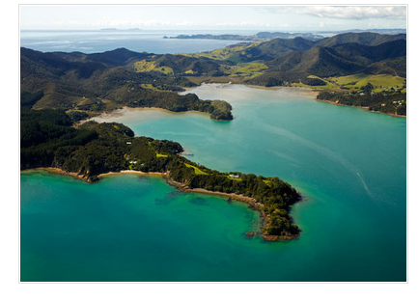

Slide 14
Headlands and Bays
These form where there are alternating layers of hard and soft rock along a coastline.
Where there is more resistant rock it will be worn away more slowly leaving a headland sticking out to sea.
Softer rock will be eroded more quickly forming a bay.

Slide 16
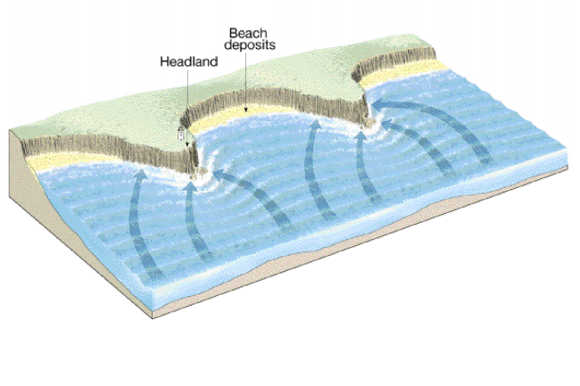

Slide 17
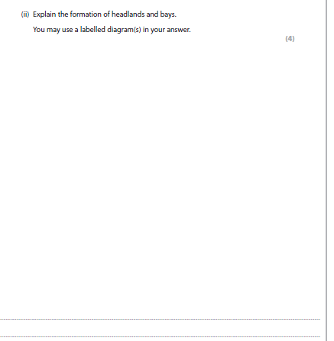

Slide 18
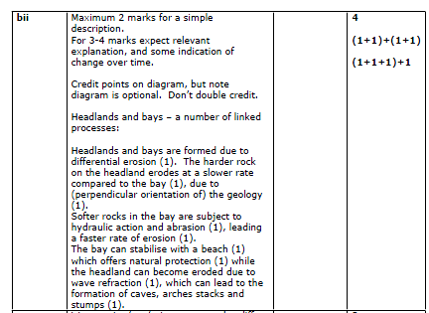
Markscheme

Slide 19
Peer assessment

Slide 20
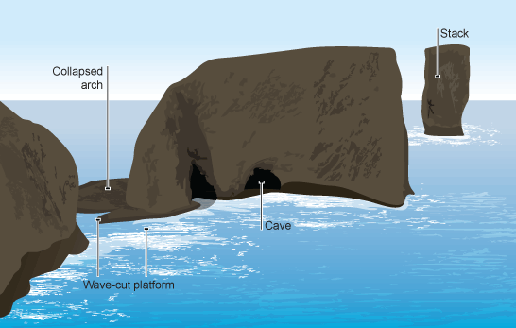
Caves, arches, stacks and stumps

Slide 21
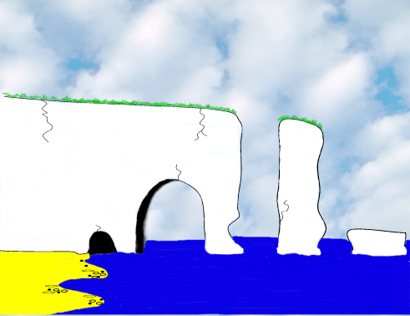

Slide 22
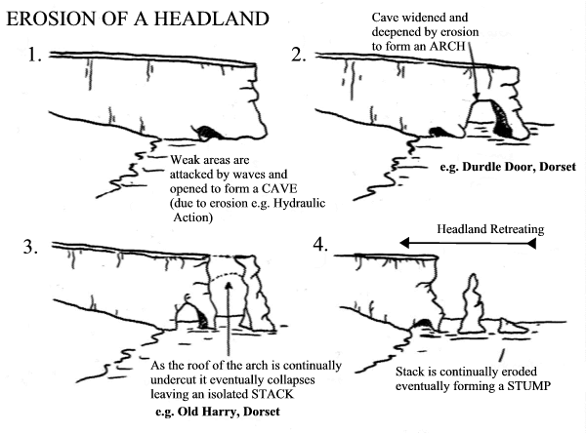

Slide 23
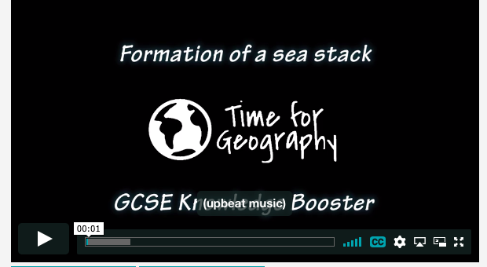
Caves, arches, stacks and stumps
https://timeforgeography.co.uk/videos_list/coasts/formation-of-a-sea-stack/
http://www.youtube.com/watch?v=UWIO90HxhEQ

Slide 24
Caves, arches, stacks and stumps
These are landforms of erosion along a coastline.
Even hard rock, that forms headlands, contains weaknesses. Hydraulic action forms cracks in the rock until an opening is formed.
As the waves continue to attack the rock is hollowed out to form a cave.
Further erosion means that the cave is widened and deepened until it becomes an arch.
Widening of the arch through undercutting means that material becomes unsupported and collapses into the sea forming a stack.
Further undercutting causes the stack to collapse leaving only a stump.
Draw a diagram/series of diagrams and annotate them to show the processes

Slide 26
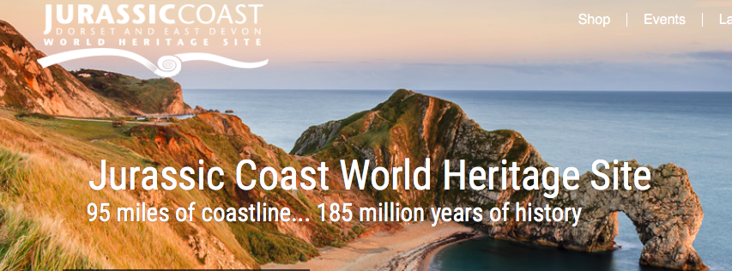
Case study: The Jurassic coastline, Dorset
https://www.youtube.com/watch?v=iTuZCiOLLtk
http://jurassiccoast.org

Slide 27
Example of an Arch :
Durdle Door, Dorset

Slide 28
Example of a Bay: Lulworth Cove

Slide 29
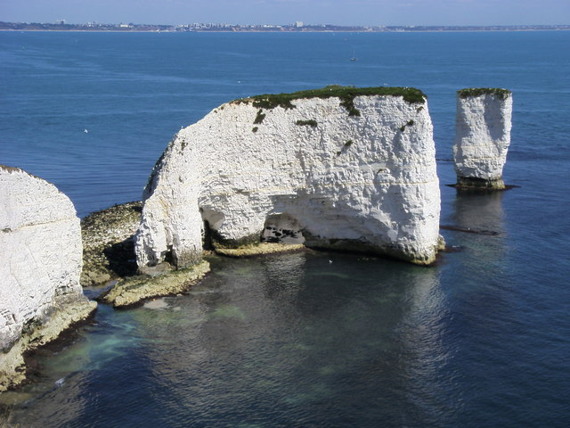
Example of Stack:
Old Harry Rocks, Dorset

Slide 30
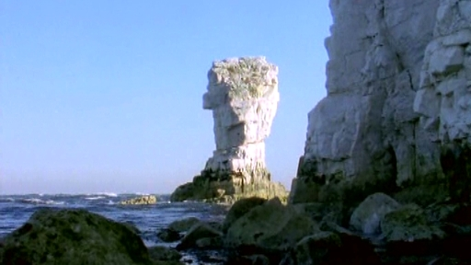
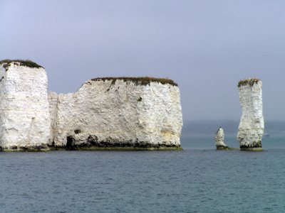
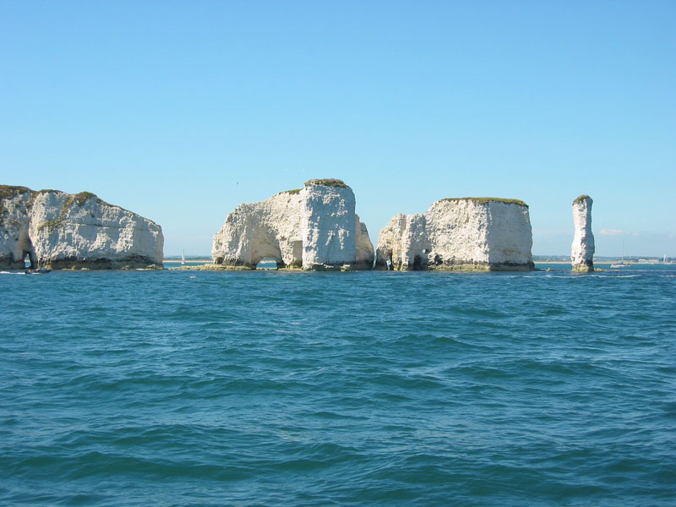

Slide 31
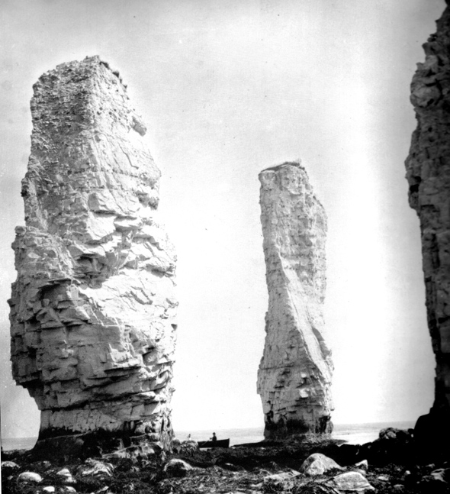
Old Harry and Wife song

Slide 32
https://timeforgeography.co.uk/videos_list/coasts/Explain-with-the-use-of-a-diagram-how-the-landform-shown-was-formed/

Slide 33
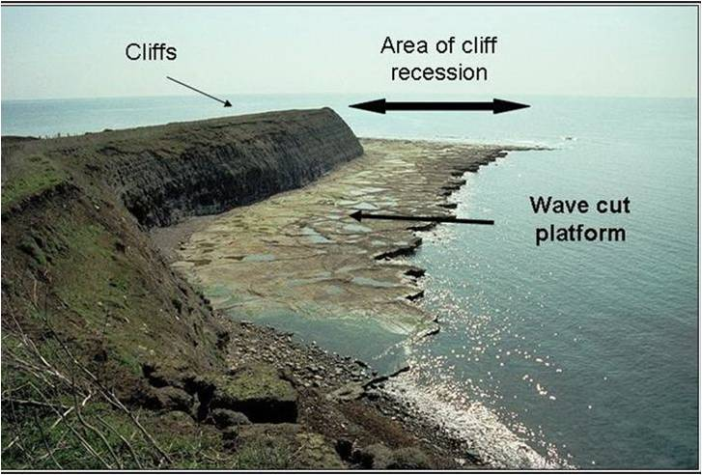
Wave cut platform http://www.youtube.com/watch?v=z1swjSvgx6A https://www.youtube.com/watch?v=5v425e1XIHA&feature=emb_logo

Slide 34
Formation of a wave cut platform

Slide 35
http://www.thegeographeronline.net/coasts.html

Slide 36
Cliffs, wave cut platforms and wave cut notches

Slide 37
Cliffs, wave cut platforms and wave cut notches
FORMATION
Organise these statements and label them on the diagram
The backwash carries the rubble towards the sea forming a wave-cut platform.
The process repeats and the cliff continues to retreat.
The sea attacks the base of the cliff forming a wave-cut notch.
The notch increases in size causing the cliff to collapse.
Weather weakens the top of the cliff.

Slide 39
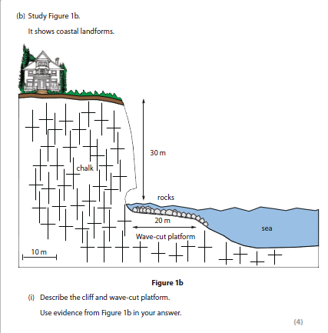

Slide 40
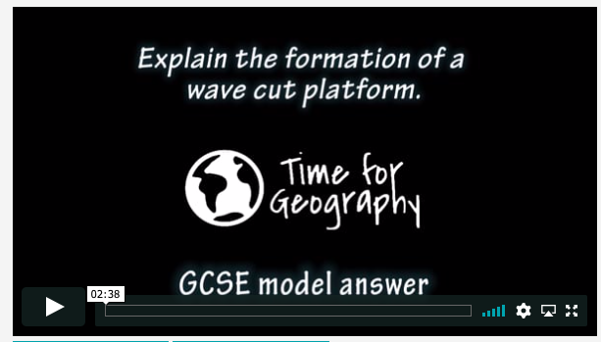

Slide 41
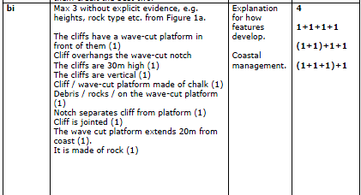

Slide 42
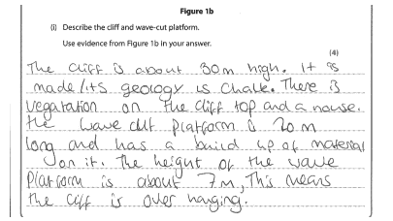
Peer assessment

Slide 43
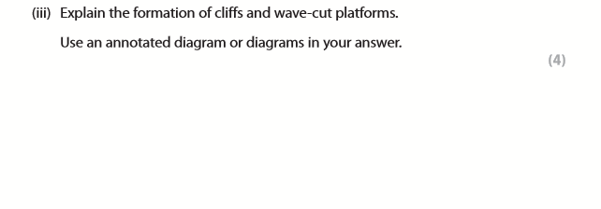

Slide 44
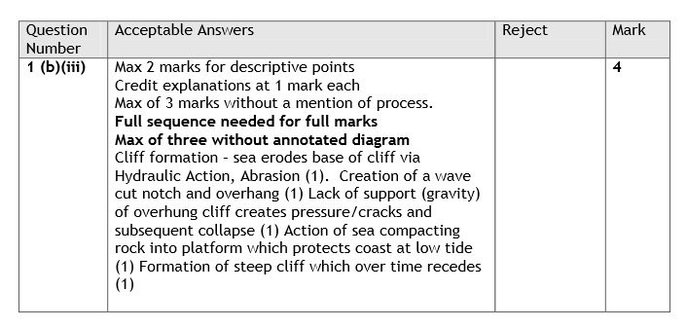

Slide 45
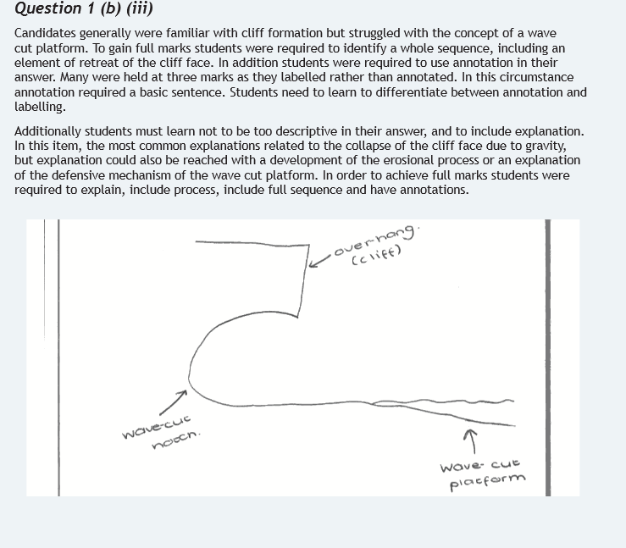
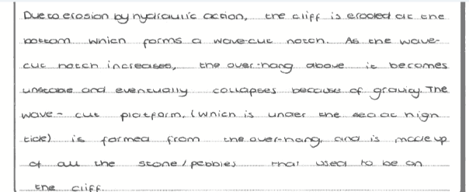

Slide 46
More resistant rock
In areas where there is more resistant/hard rock cliff collapse occurs.
In areas of more resistant cliff material erosion is greatest when waves break at the foot of a cliff. This causes erosion at the base of the cliff.
This creates a wave-cut notch in the base of the cliff. As the notch increases in size the weight of the cliffs above become too much and the cliff collapses.
The material from the cliff is broken up through attrition and some of then remains at the base of the cliff forming a terrace known as a wave cut platform.

Slide 47
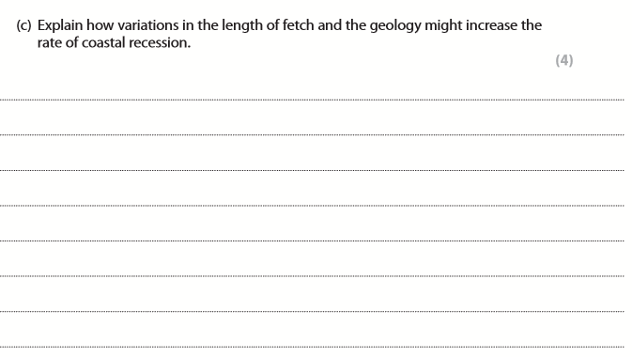

Slide 49
