Slide 1
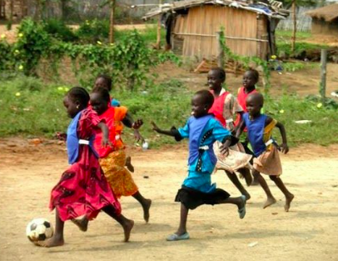
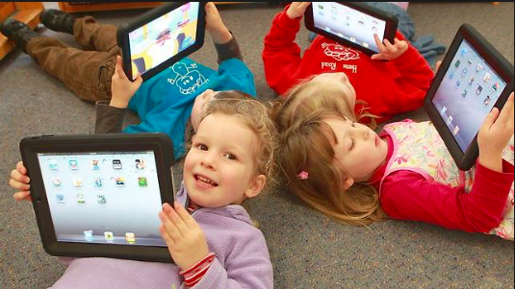
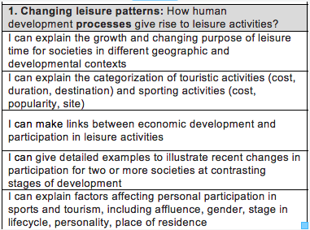
Leisure at different levels of development

Slide 2
How do leisure activities change by level of development?
Read page 217 and write a 200 word summary
Think- pair- share

Slide 3
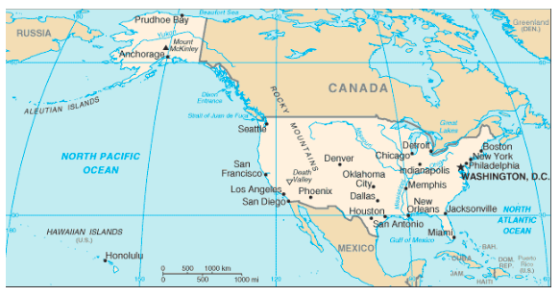
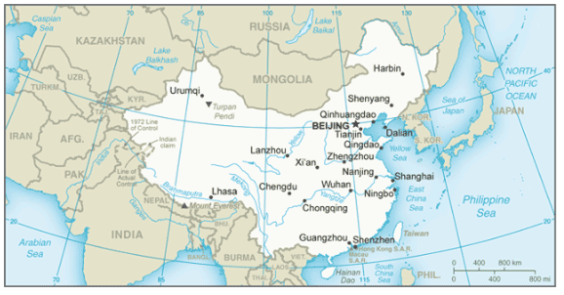
3 countries of study
Use the CIA world factbook to find the following development indictors for each country:
-GDP per capita
-Female literacy rate
-% Urban population
-% of population internet users

Slide 4
Children combing work and Leisure in Sudan
https://www.youtube.com/watch?time_continue=6&v=FtvabhdTRls
What Leisure activities does this girl do in an average day?
Why are these the activities that she does?
Read the textbook page 218-219 to add detail to child leisure time in Sudan

Slide 5
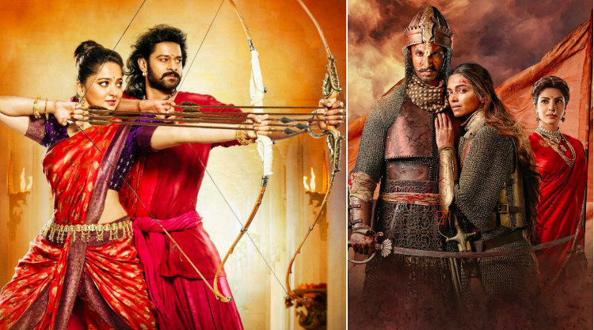
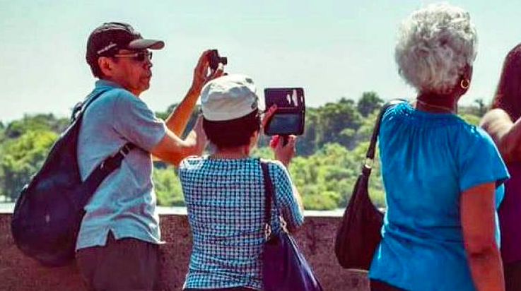
Leisure in BRICs
BRICs: Brazil, Russia, India and China
Expected to grow 132% between 2014 and 2030.
Case study: Growth of Chinese Middle class
https://www.youtube.com/watch?time_continue=24&v=8Mozu3lX3Sg&feature=emb_logo
Read page 221 and make notes on changes in China’s leisure activities

Slide 6
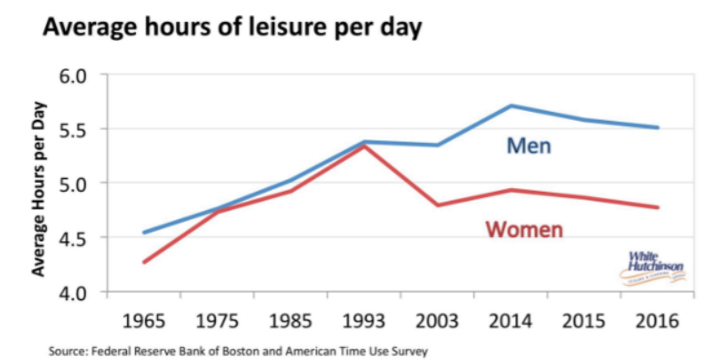
Starter Activity - Growing Leisure Time in America - Patterns and Places
Study the following graphs showing patterns of changing leisure in America. Pick out the key data to describe the main pattern shown in each graph
Discuss what the graphs tell us about growth in leisure

Slide 7
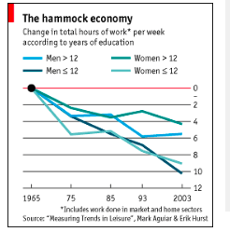
Changes in leisure in the USA

Slide 8
Student Activity - Changing Leisure Activities - Places and Processes
Study the following graph which shows American leisure time and how preferences have changed for different age groups
How is leisure changing for each demographic group?
1.Which leisure activity has increased the most?
2.Why is this?
3. Which leisure activity has decreased the most?

Slide 9
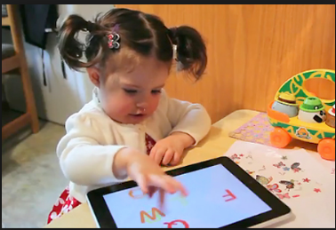
Changes in leisure in the USA
How have leisure activities changed in the USA?
- How may this vary by age?
By sex?
By level of education?
By ethnicity?
By location?
Read page 219-220

Slide 10
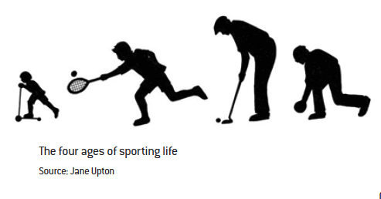
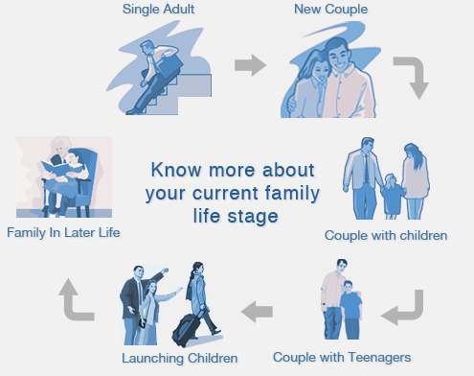
How do leisure activities change by stage in life cycle ?
Read page 218 and answer questions in activity 3 box
Think- pair- share

Slide 11
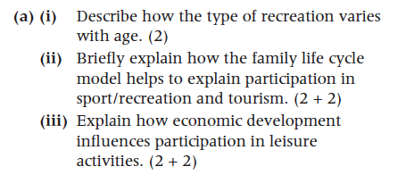
IB structured exam questions

Slide 12
Student Activity - Discussion Points - Processes and Possibilities
Discuss how the following issues influence people's leisure
How income, age, health status or human functioning shape opportunities to participate in culture and leisure activities
The shift away from traditional culture and leisure activities as time pressures increase and lifestyles change
Technological changes which may enable new forms of cultural expression
Time spent engaged in screen-based leisure activities (e.g. watching television, playing video games, using a computer, mobile phones) which may contribute to increased sedentary behavior

Slide 13
Examples of exam questions
How have human development processes given rise to the concept of leisure and leisure activities? (6)
One of the 4 key concepts in IB geography

