Slide 1
Patterns of Leisure, Sport and Tourism
Examine the relationship between urban settlements and recreational and sports facilities in terms of frequency, size, range and catchment area.

Slide 2
Examine the relationship between urban settlements and recreational and sports facilities in terms of frequency, size, range and catchment area.

Slide 3
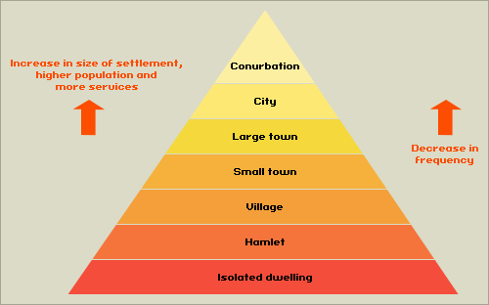
Settlement Hierarchy

Slide 4
On a copy of the settlement hierarchy …
Annotate onto it where you would find the facilities set out in the table and activities offered.
Complete a short piece of writing to explain the relationship between urban settlement size and the recreational and sports facilities provision (300 words)
Include details on the frequency, size, range, catchment area and sphere of influence.

Slide 5
Key terms
Hierarchy: Placing things in an order of importance
Threshold population: The minimum population required for a service to be offered
Sphere of influence: The size of the catchment area from which people will travel from to use a service.
Range: The distance that people are willing to travel to access a service
High order leisure facility: A specialised facility that needs a higher threshold population and has a high range.
Intra-urban: Urban means a settlement of over 10,000 people, intra means within. Therefore, intra-urban means within an urban area.
Rural-urban fringe: The boundary between the urban area and the rural area.
TBD or RBD (Tourist or Recreational Business District): The main centre of tourist activities and facilities within an urban area.

Slide 6
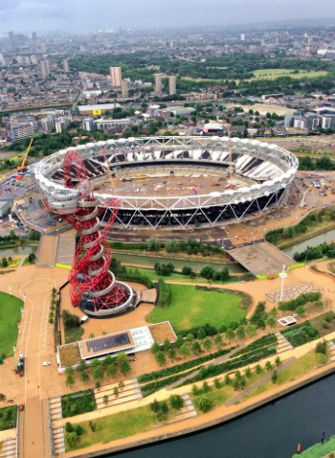
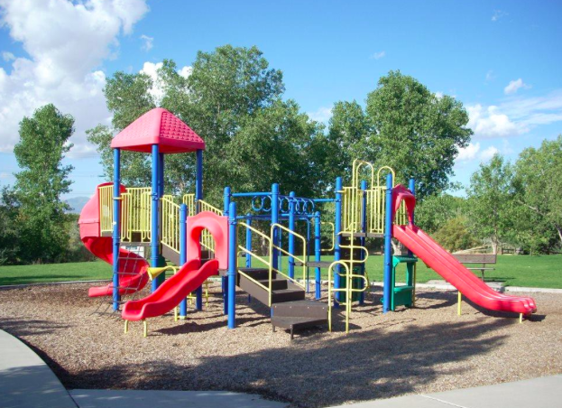
Variations in sphere of influence
The purpose of a sports/ leisure facility is the allow many people to participate in sport- this means they may be centrally located in their market areas. The greater the numbers of sports provided the higher order the sports facility.
Read page 230-231 of book and make notes on order sphere of influence and threshold population of different activities.
Playground- sphere of influence approx 1km
Multi-complex stadium could draw population from about 200 miles.

Slide 7
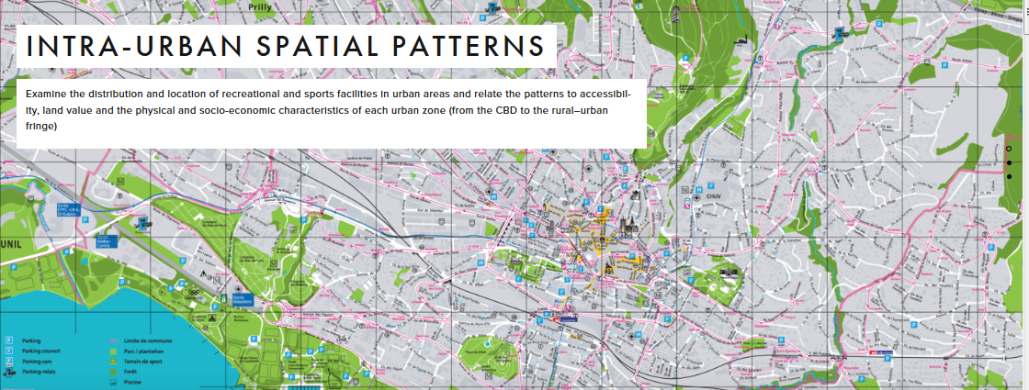

Slide 8
Leisure hierarchy

Slide 11
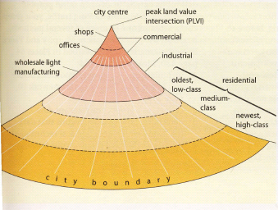
Urban Land Use Patterns
Based on Land Values

Slide 12
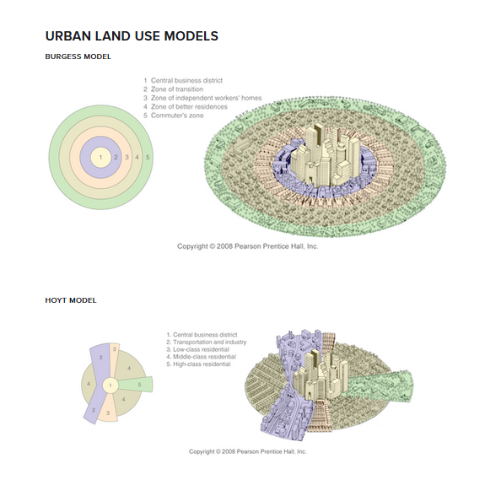

Slide 13
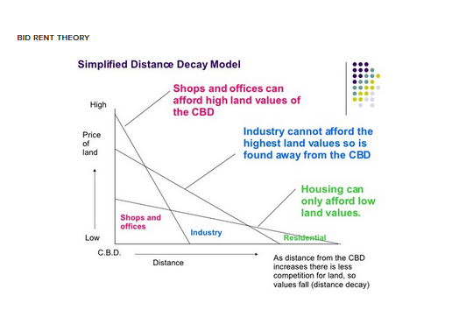
Bid-Rent Theory

Slide 14
Tourism Business District (TBD)
Most settlements will have a fairly clear CBD (central business district). The CBD is normally found in the centre of settlements and it is where the biggest concentration of businesses (shops, offices, banks, etc.) are located. The TBD is where the biggest concentration of tourist facilities can be found. The TBD is often centred around an historical building and/or square e.g. St. Mark's in Venice. The TBD will contain facilities like:
Historical buildings
Restaurants and cafes
Hotels
Tourist booking offices
Gift shops
The TBD will not only contain a lot of facilities, but it will probably also have other characteristics caused by the the concentration of tourist facilities. These characteristics may include:
Large numbers of tourists/pedestrians
Global restaurants and brands
Traffic
High land prices
Well maintained environment

Slide 15
Reasons for the patterns of leisure provision in urban areas
Space: Some recreational activities take up a lot of space e.g. golf. It would not be possible to find enough space in the centre of the town to build a golf course.
Historical Location: Historic buildings are normally found in the centre of urban areas. The reason main historic buildings e.g. castles and cathedrals were built at the same time the urban area was settled, so the urban area has grown around them.
Land value: Some recreational facilities will not be able to afford to locate on higher value land. For example a local cricket pitch would not locate on expensive land because it does not generate any income. However, a five star hotel might locate on high value land because it generates lots of income.
Land Use of Surrounding Area: Some recreational facilities will be attracted to certain locations. For example a hotel would normally be located in the TBD or on a good transport link, because this is what tourists demand. They would not locate in in the middle of a residential area, because demand would be less. Alternatively a library or sports centre is more likely to be located in a residential area, because this is where the demand will be.
Accessibility: Some recreational facilities need a higher threshold population to be offered e.g. shopping centres, therefore they need to be in a location with a large population and are easily accessible. Facilities like new sports stadiums are also built near main roads or good public transport links.

Slide 16
Reasons for the patterns of leisure provision in urban areas
Socio-economics Status: Some recreational activities e.g. golf are expensive to participate in. Because of this some facilities will locate in areas of higher socio-economic status. Alternatively football is traditional a more working class sport so football clubs (recreational not professional) maybe located in more working class areas.
Physical Characteristics: Some recreational activities are dependent on the physical environment e.g. potholing, fishing and skiing. Because of this you are not going to find some recreational facilities inside urban areas, but more in the rural-urban fringe or rural area. Areas that have outstanding natural beauty or great weather may also have above expected facilities e.g. the island of Menorca in the Mediterranean or Monteverde in Costa Rica.
Sports Events or Exhibitions: Some cities may have above expected tourist or recreation facilities because they have recently hosted a major sports event, conference or exhibition. Qatar in the Middle East has a population of only 1 million but will host the football World Cup in 2022. After the World Cup many settlements in Qatar will have more tourist and recreation and facilities than you would expect for a settlement of their size.
Advertising and Recognition: Some locations are very good at promoting themselves and attracting new customers and users and therefore have above expected facilities for their size e.g. the Bahamas, Dubai or Phuket in Thailand.

Slide 17
Sports and leisure facilities in Houston
Make a list of all of the sports and leisure facilities that may be found in Houston

Slide 18
Leisure facilities, Houston
Factors affecting the distribution of leisure facilities
Bid rent theory
Population densities
Socio-economic influences
Government grants / policies
Cultural influences
Accessibility
Transport links
Demographic considerations
Physical factors (e.g. water sports)
Availability of land
Public parks
Playgrounds
Sports stadiums
Golf course
Indoor swimming pools
Outdoor swimming pools
Skate park
Tennis courts
Running tracks
Gyms
Shopping
Restaurants
Nasa
Use this for extra Information: http://greenfieldgeography.wikispaces.com/The+leisure+hierarchy+and+intra-urban+patterns

Slide 19
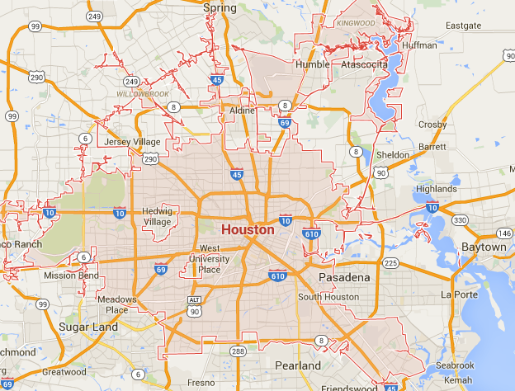
Task- the distribution of leisure facilities within Houston
TASK
Identify sports and leisure facilities on the map of Houston. Mark them. Try and create a hand draw map- could this be replicated under exam conditions?
Draw a straight line from the facility to the space on the edge of the page.
Name the Sports/leisure facility.
Note specific factors explaining its location, using factors from the second column.

Slide 20
Example of a question
Using only an annotated sketch map, describe and explain the location of leisure facilities in and around a named urban area (6)
Examine the distribution and location of recreational and sports facilities in urban areas and relate the patterns to accessibility, land value and the physical and socio-economic characteristics of each urban zone (from the CBD to the rural–urban fringe).

Slide 21
CBD leisure facilities
In Houston’s CBD there are a wide variety of leisure facilities such as the Theatre District, Sundance Cinema and the Main Street Shopping area. These are high order services that require a large threshold population. These facilities are located in the CBD as it is the most accessible part of the city and many tourists would be found staying in this location.
In Houston we also find many large sports stadiums e.g. Minute Maid Park (baseball) and the Toyota Centre (Basketball). These facilities benefit from tourist trade and the accessibility of the CBD. However, these facilities need a lot of space so we wouldn’t always expect to find them in the CBD. However, Houston is 599 square miles in size and so there is a lot of space available, even in the CBD.

Slide 22
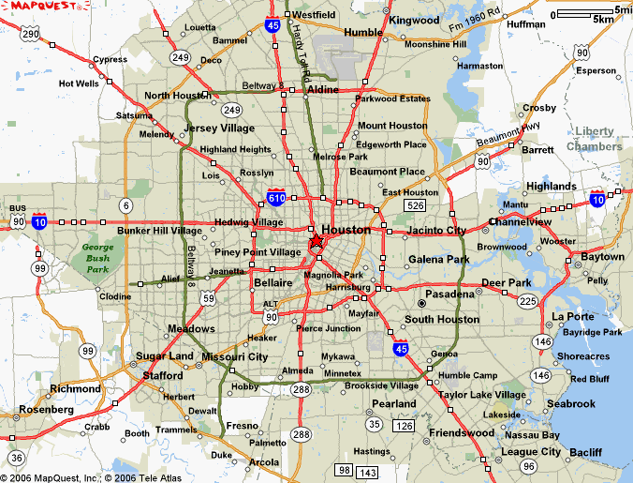
Houston’s Inner Suburbs:
The Museum District
Hermann Park
River Oaks Country Club
Galleria Shopping Mall
Houston’s CBD:
Main Street Shopping area including high order shops and department stores e.g. Macy’s.
The Toyota Centre concert venue and sports arena
Hotel chains e.g. Hilton
Bayou Place including Restaurants, House of Blues concert venue and the Sundance Cinema.
Houston’s Outer Suburbs and Rural-Urban Fringe:
Golf courses
Shopping Malls e.g. Memorial Mall
Houston’s Inner City:
BBVA Compass Soccer Stadium
Shopping Parades in Montrose and Midtown

Slide 23
Mark scheme
The sketch may consist of a sector of the urban area or a general plan. A variety of leisure facilities should be shown and these might include: (working from the centre outwards)
Entertainment such as cinemas, concert halls or theatres, which are high order facilities needing a central location in the CBD and access to a large regional or national population and possibly international tourists
Suburban leisure facilities to serve local residents and due to lower land prices may occupy a large land area e.g. sports stadiums and school playing fields
Further out in the rural urban fringe more selective and higher priced facilities may exist (golf, horse stables etc)

Slide 24

6 mark question from May 2014

Slide 25
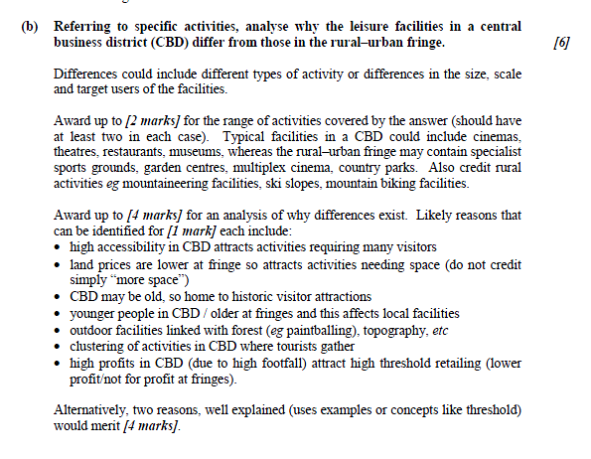

Slide 26
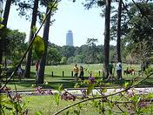
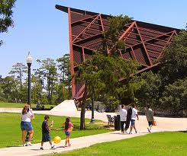
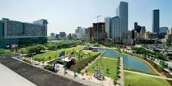
What is the importance of parks in urban areas?

Slide 27
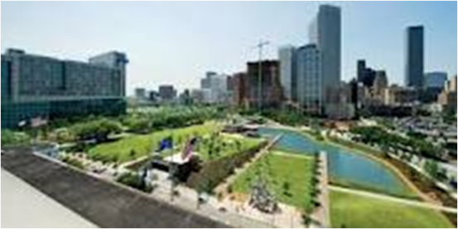
What is the importance of parks in urban areas?
Escape from urban stress
Moderate urban microclimates
Individual and community health benefits
Ecological understanding and sustainability
Preserve natural and cultural heritage- e.g. museums and woodlands
Prevent conflict in urban areas- skateboarders/ football/ cycling/ jogging etc…

Slide 28
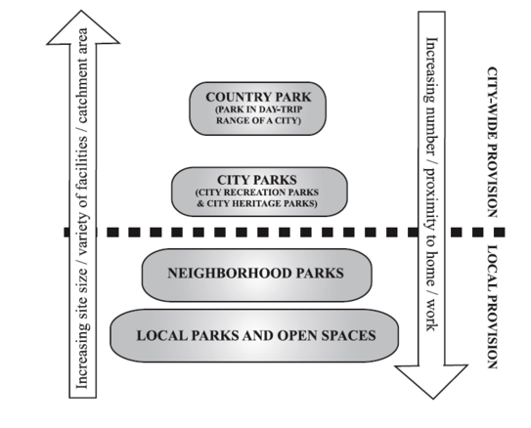
The diagram below was taken from an IB exam. It is the kind of diagram you might see in an exam. It may look unusual but if you study it carefully it is quite simple. The diagram shows that there are not many country parks (National Parks), but they are bigger in size and have a bigger sphere of influence (catchment area). At the other extreme it shows there are many local parks, but they are smaller in size and are located closer to where people live and work (have a smaller sphere of influence).

Slide 29
Exam practice 1
Referring to specific activities, analyse why the leisure facilities in a central business district (CBD) differ from those in the rural urban fringe. (10)
The patterns of accessibility
Sphere of influence and threshold population
Land values
Physical characteristics
Socio economic conditions

Slide 30
Exam practice 2

