Slide 1
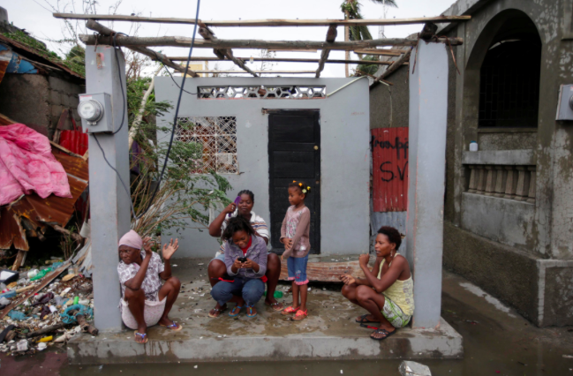
Assessment essay
Why are some countries LEDCs?
Include actual title on your essay!!!!

Slide 2
General points
Answer the question- the focus should be the reasons FOR LEDCs having a lack of development (i.e. climate, colonization, trade barriers etc…)
Back up points with development indicators- but do not just have your essay focused on evidence for lack of development
Have a good structure- there should be an introduction that highlights what development is and there should be a conclusion that brings together all the ideas in essay and answers the question
If you are using images etc in your essay you need to use them- i.e. Annotate to explain the key features linked to your essay (see next slides)

Slide 3
If using a map- don’t just stick it in…
ANNOTATE any graphs/ maps/ photos
You could highlight the countries that are mentioned in the essay
You could highlight locational factors on the essay that may impact development

Slide 4
Try not to generalize: make all visual resources relevant to the question
Dealing with flooding after storm costs a lot of money- which could be invested into development
Infrastructure etc. has been ruined which will impact trade, schools etc.
The aftermath will lead to disease (such as cholera) spreading- this will weaken population stopping them from working and will mean monetary resources will have to be invested to deal with the issue.
It is good to use figure numbers so that you can make reference to it in the main text
Figure 1: A photo to show residents of Haiti dealing with the impacts of Hurricane Matthew

Slide 5
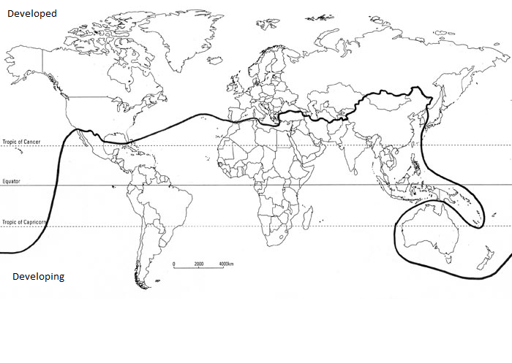
Tips for a good evaluation (level 7/8 work ideas…)
Why are some countries LEDCs?
Extension: what does development really mean

Slide 6
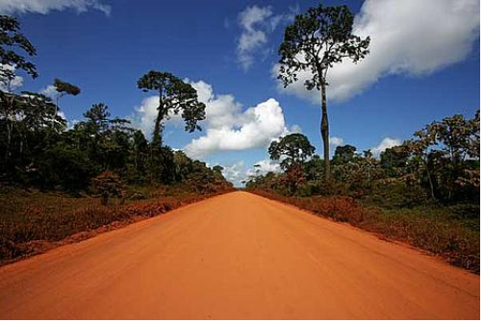
Is all development actually good?
https://www.youtube.com/watch?v=7J2f8W43gwk

Slide 7
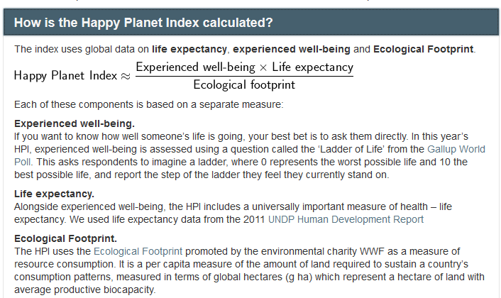

Slide 8
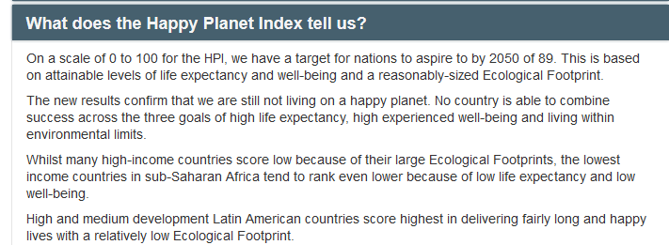

Slide 9
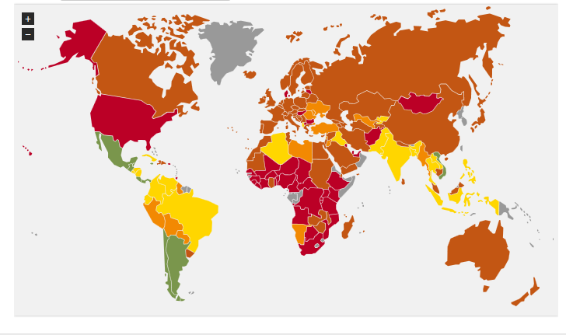
http://www.happyplanetindex.org/data/

