Slide 1
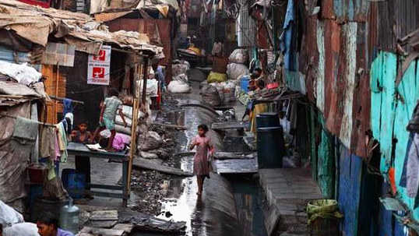
Urban growth in LEDC cities
LO:
To compare the structure of an LEDC city with an MEDC city
To explain the impacts of rapid growth in LEDC cities
To evaluate the solutions to the reduce the impacts of rapid growth

Slide 2
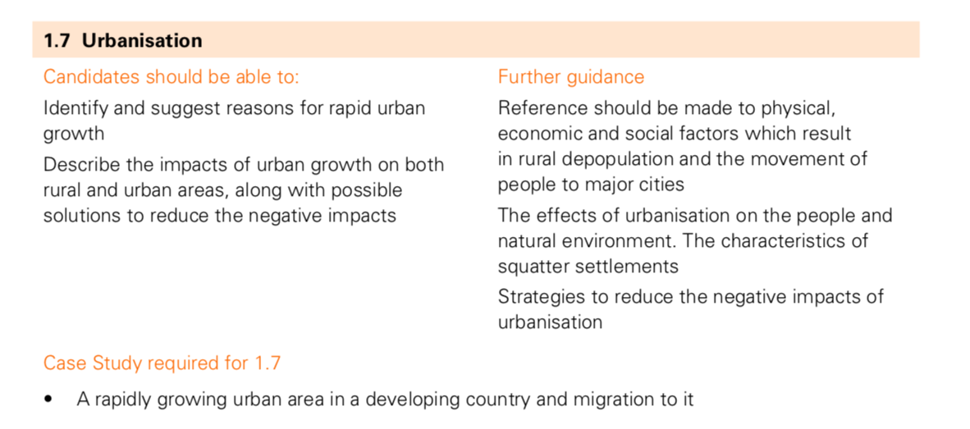

Slide 3
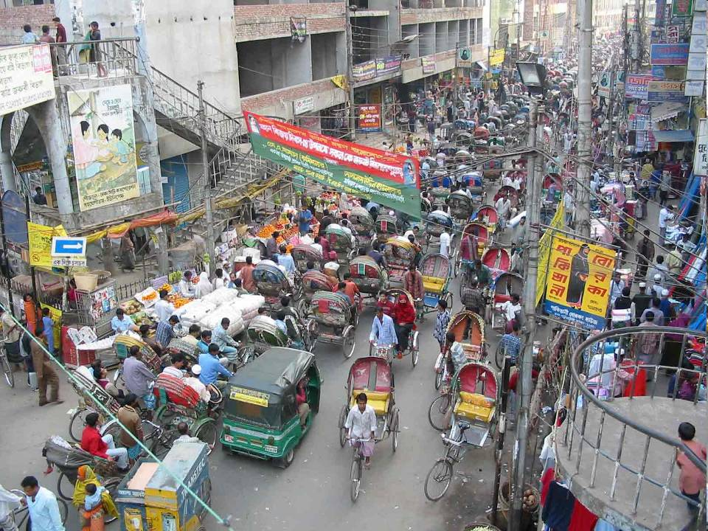
Discuss with a partner these key terms:
Urbanisation
Mega city

Slide 4
URBANISATION
The increasing proportion of people living in towns and cities
MEGA CITY
A City with over 10 million people

Slide 5
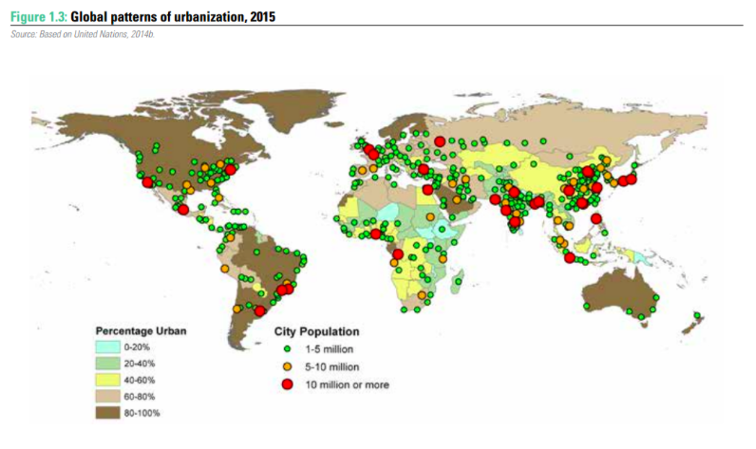

Slide 6
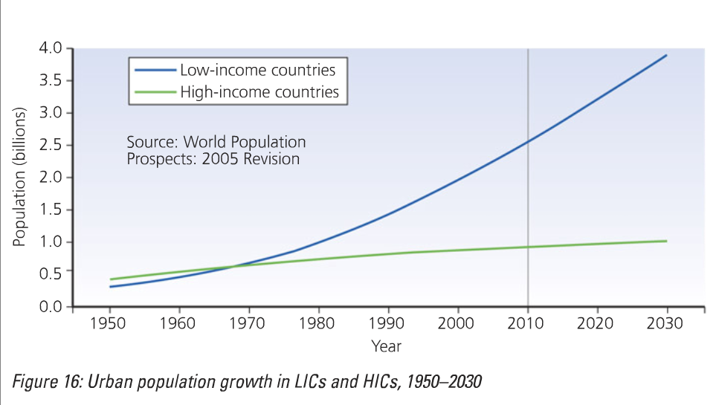
Objective 1: what are the main reasons for urban growth in LICS?
What are the reasons for this growth in LICS?
Describe the pattern shown on the graph (4)

Slide 7
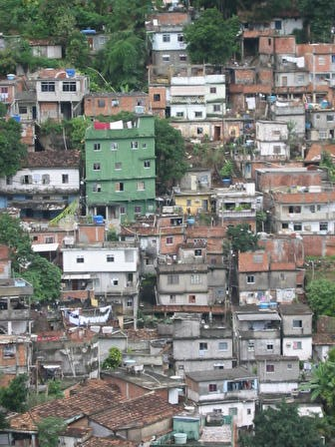
The rapid growth of urban areas in LEDCs
December 15th 2006 – from this date more people on earth live in CITIES than in RURAL areas. The first time this has happened in human history. A new milestone for humanity.
The cities which are growing fastest are in LEDCs

Slide 8

World Urbanisation – the causes
Some of the population growth in cities is from natural increase (more births than deaths to people already living in cities).
The greatest cause of urban growth is MIGRATION – from RURAL areas to URBAN areas = rural urban migration

Slide 9
Push and pull factors: rural to urban migration in an LIC
Push factors
Pull factors

Slide 10
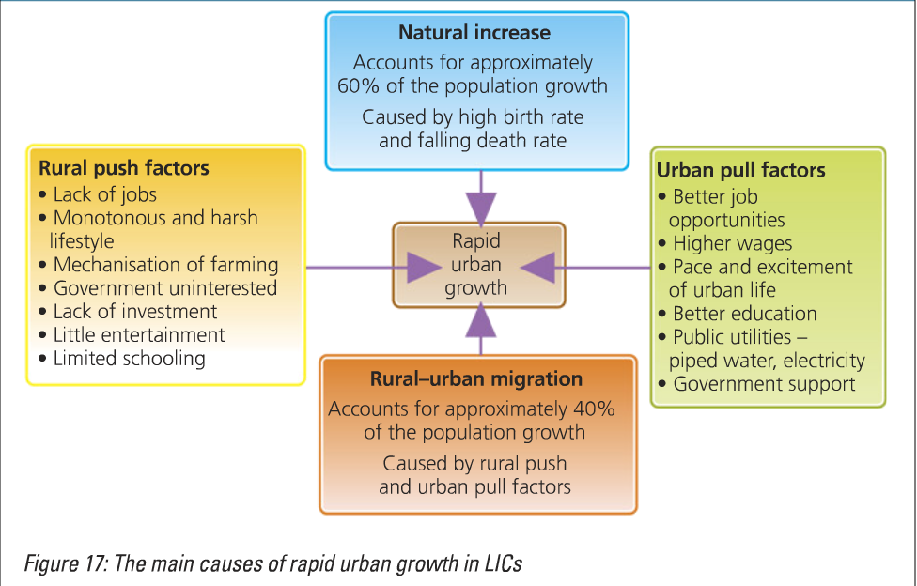

Slide 11
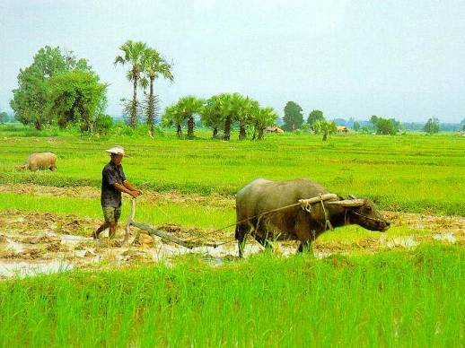
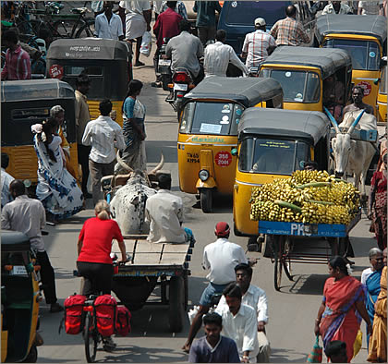
PUSH-PULL MODEL
People move because they think life will be better in Urban areas. There will be factors which PUSH them from where they live now (RURAL ORIGIN), and PULL them to a new place (URBAN DESTINATION)

Slide 12
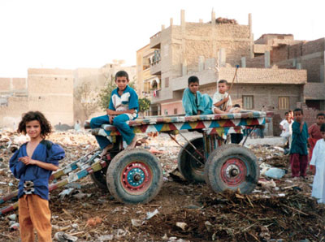
The push from the countryside:
Lack of jobs other than poorly paid farm work
Lack of services such as doctors
Lack of opportunity for life to be better for your children
The pull of the cities:
Chances of regular paid work
Chances of better health services and schools.
Chances of a more interesting life
Better prospects for children to survive and thrive
Desperation to avoid starvation in the rural areas.

Slide 13
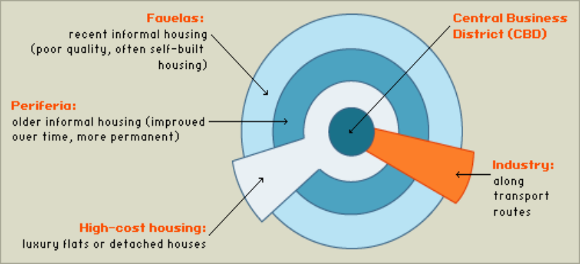
Basic urban model for an LEDC city
Higher cost housing and higher class residential areas located centrally. Historical core of colonial city. Rapid urban growth expanding the peripheral areas.

Slide 14
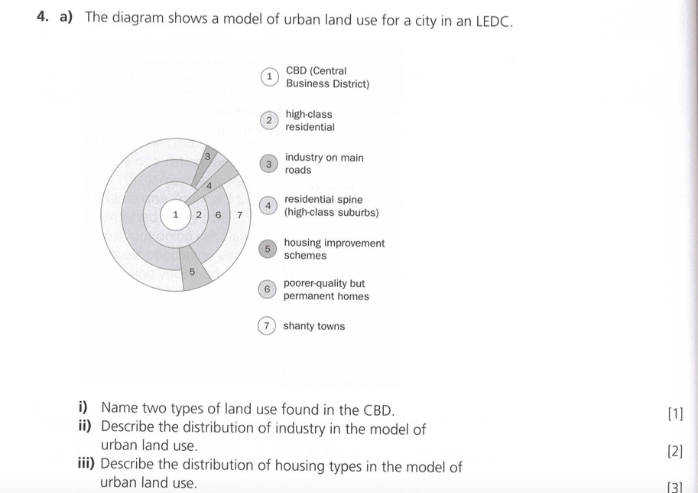

Slide 15
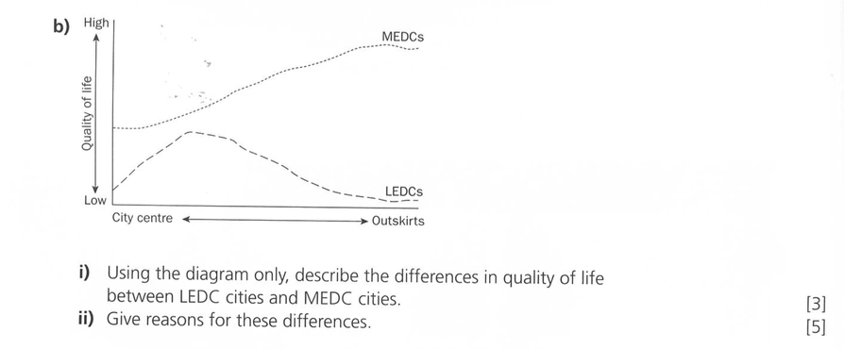

Slide 16
Name a city and describe what has been done to improve living conditions in the slums found there. (7)

Slide 17
Name a city and describe what has been done to improve living conditions in the slums found there. (7)
What would be the success critria for answering this question well?

Slide 18
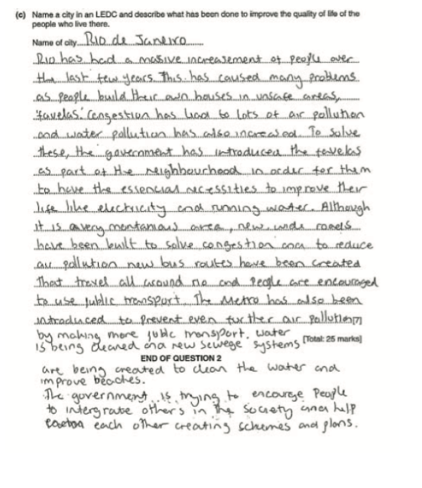
Answer 1
Rio de Janeiro was a well-chosen example, a very popular case study. The candidate was awarded mid- level 2 as he had developed two points, the references to public transport developments and improvements in water quality. Other ideas were basic (e.g. electricity, roads), had one of these been developed the candidate would have been able to reach the top of Level 2. Reference to ‘favelas’ would have enabled Level 3 access too had there been enough developed ideas, as this term is clearly associated with South American cities like Rio so it would have been accepted as place specific. (5/7)

Slide 19
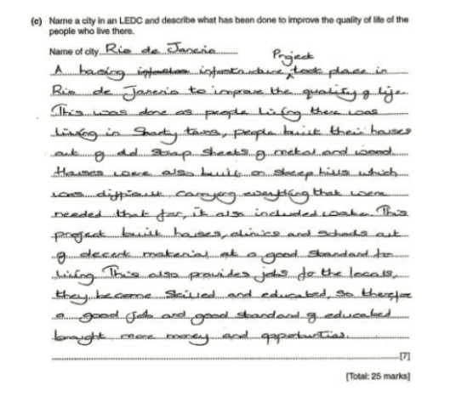
Answer 2
Rio de Janeiro was a good example but the candidate only achieved Level 1 as all the references to improvements were brief and simple statements (e.g. built houses, clinics and schools out of decent materials). The first half of the answer, where the candidate has developed ideas, is not relevant as it describes problems faced by residents rather than solutions to them. (3/7)

Slide 20
Name a city and describe what has been done to improve living conditions in the slums found there. (7)
Our ideas for success criteria
Success criteria
Use a specific named example
Comprehensive (detailed) statements on at least 2 solutions
Have a range of case study points located to this location
Clearly link solutions to the problems in that location

Slide 21
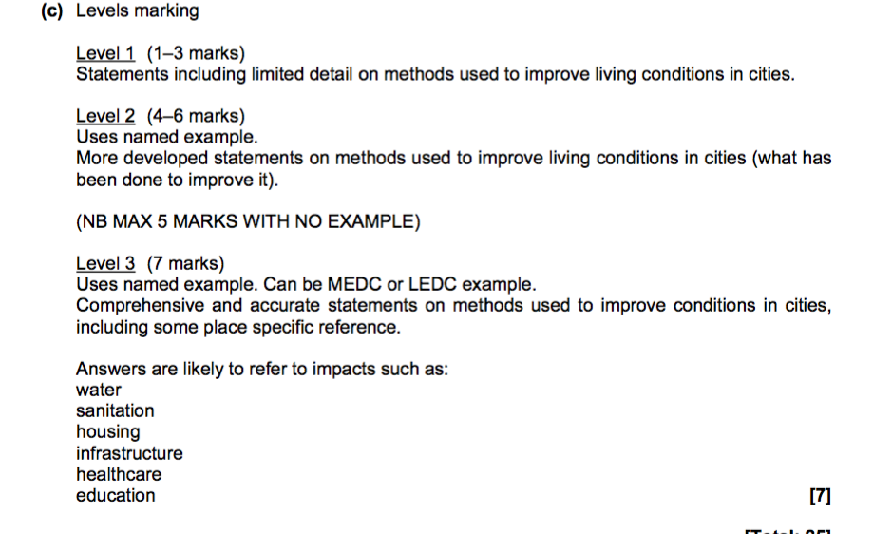
Mark scheme

