Slide 1
To Start – While watching the video, record what you see, what it makes you think, and then what it makes you wonder
Notes:
https://www.youtube.com/watch?v=tLzxJmcV4xU
https://www.youtube.com/watch?v=HbsdLI8kaWc – Contrasting View
https://data.worldbank.org/indicator/SP.URB.TOTL.IN.ZS?locations=NG

Slide 2
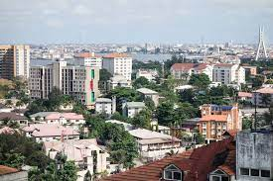
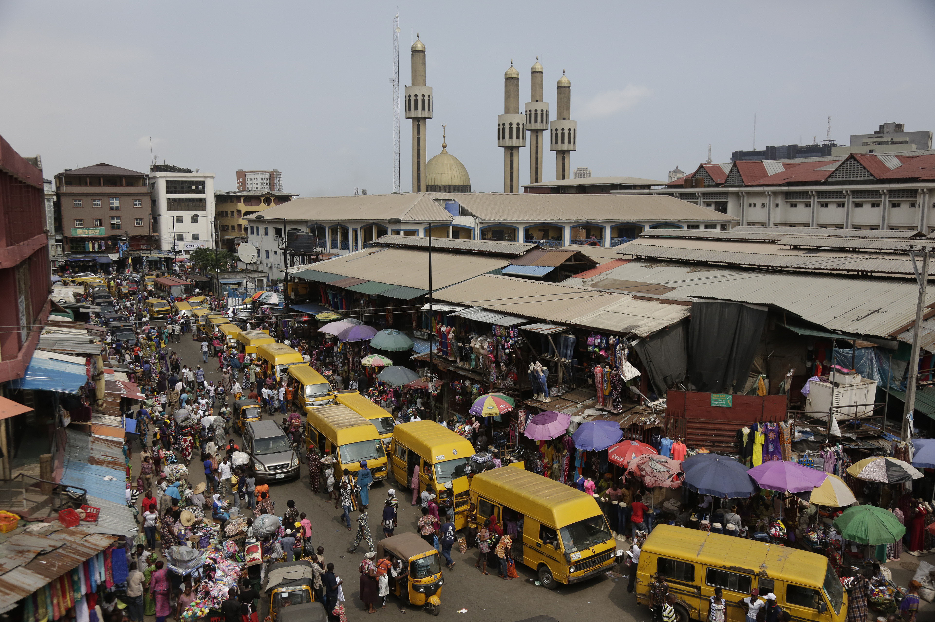
Urban Challenges in Lagos, Nigeria.
What – To understand the challenges faced in cities in developing countries with regards to squatter settlements, the informal economy, urban pollution and low quality of life.
Why – In order to appreciate the challenges faced in less developed parts of the world and to start to think about potential solutions.
How – Through media interpretation, descriptive writing, collaborative work and independent research.

Slide 3
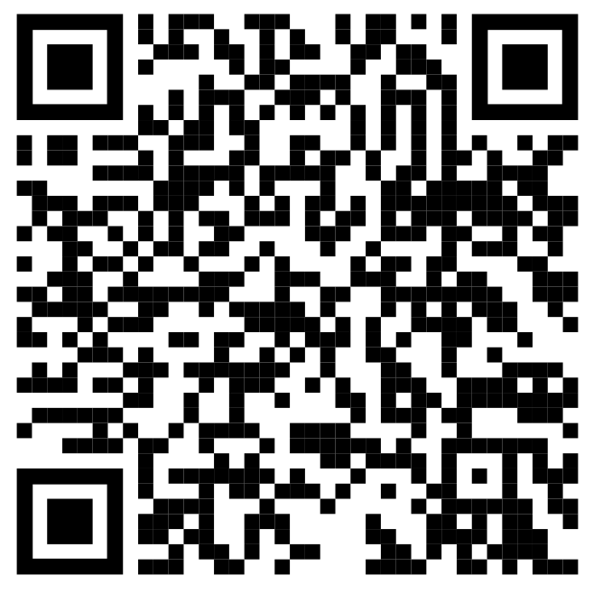
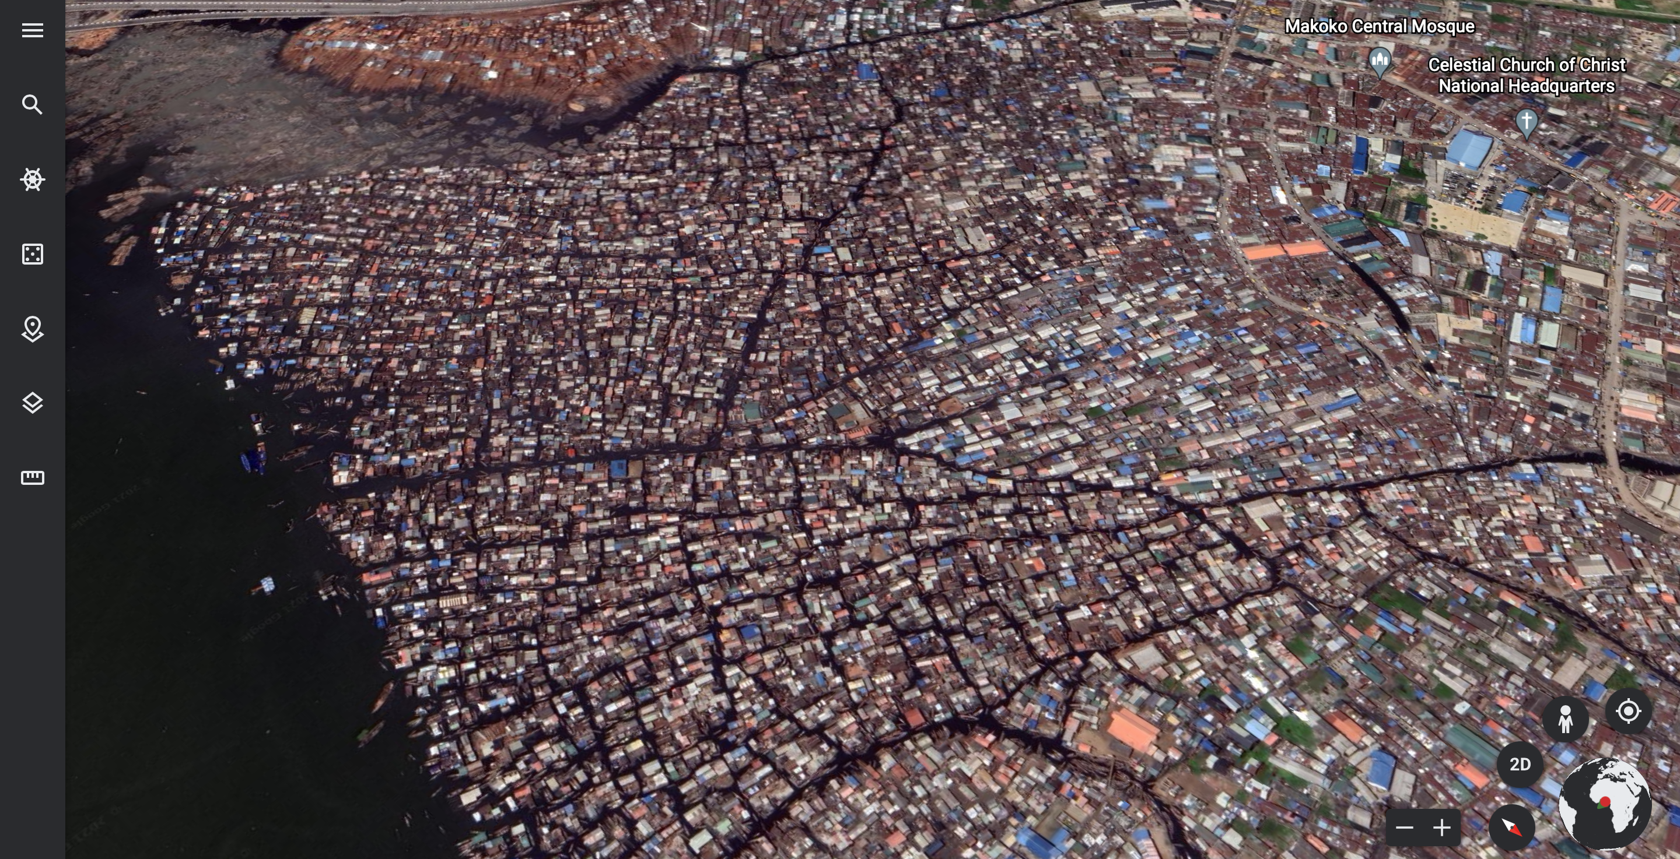
Challenge 1 – Squatter Settlements
Using the resources below, as well as your own research, answer the following questions in your OneNote. You can write on paper / on desk just make sure to upload image.
What is a squatter settlement?
How many are there in Lagos?
What are the problems of living in a squatter settlement (sanitation, vulnerability, access to water, legal rights, health, employment)?
Extra challenge
Go to ‘Makoko’ on Google Earth, have a look around the area. Describe the land use and what you would expect the area to be like.
Notes:
https://www.internetgeography.net/topics/lagos-squatter-settlements/
https://www.coolgeography.co.uk/gcsen/Lagos_Challenges.php

Slide 4
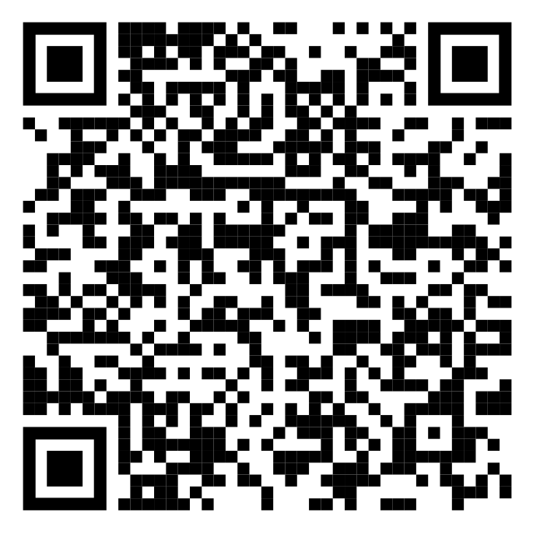
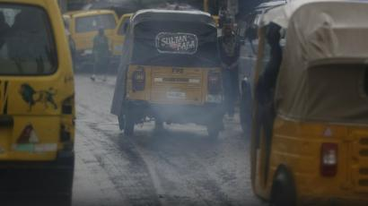
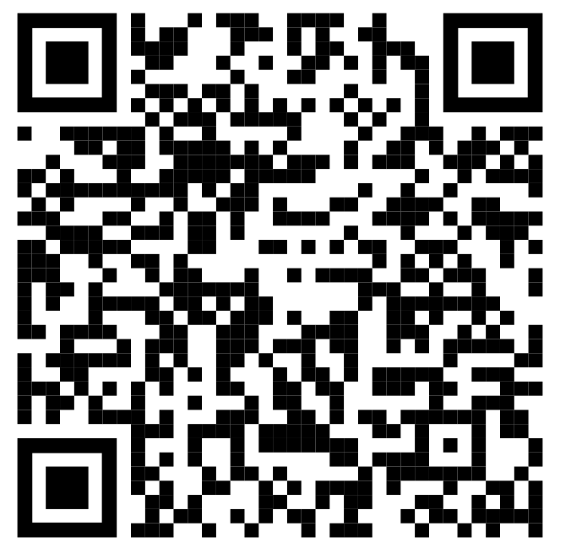
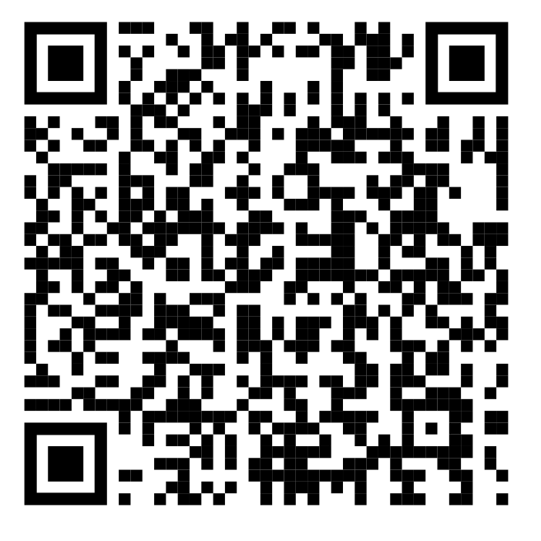
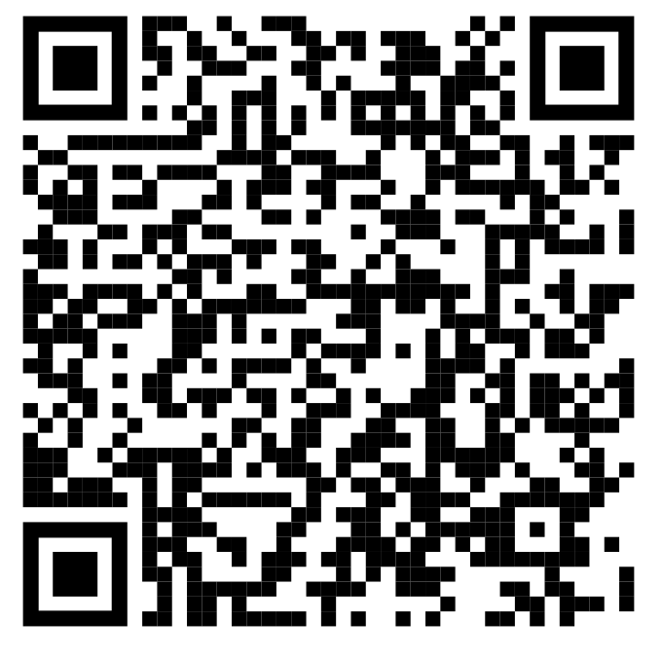
Challenge 2 – Pollution
Using the resources below, as well as your own research, answer the following questions in your OneNote. You can write on paper / on desk just make sure to upload image.
What are the main causes of pollution in Lagos?
What are the costs of this pollution, both social and economic?
Extra Challenge – Using the world Air Quality Index website, describe the current condition in Lagos. Then, travel to some of large cities in developing countries to see how their air quality is looking – record your findings.
Air Pollution Links. Green more accessible than red
Water Pollution Links. Green more accessible than red
Notes:
Air:
https://www.worldbank.org/en/topic/environment/publication/the-cost-of-air-pollution-in-lagos
https://qz.com/africa/1908936/air-pollution-in-lagos-nigeria-kills-11000-a-year-world-bank/
Water
https://www.internetgeography.net/topics/lagos-water-supply-and-pollution/
https://theconversation.com/how-we-learnt-more-about-dangerous-pollutants-in-lagos-lagoon-139987
Global AQ map
https://www.iqair.com/us/air-quality-map

Slide 5
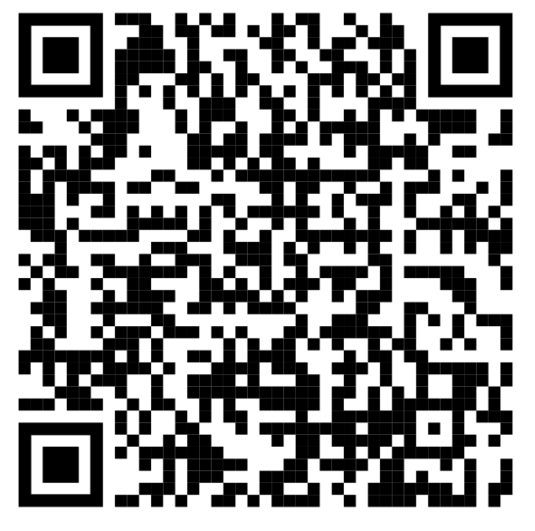
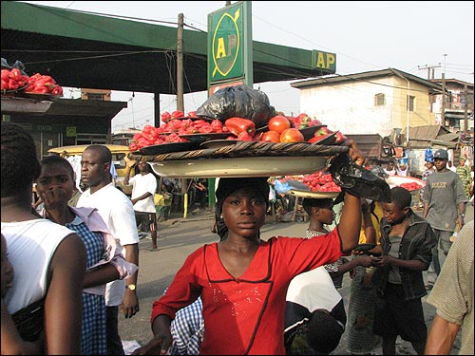
Challenge 3 – Informal Economy
Complete the challenges below to develop your understanding of the informal economy
Define informal economy. Give examples of things people might do in this economy, then give any of your own personal experiences of seeing people operating in this economy.
What challenges does the informal economy bring to a developing country. Focus on things like taxation
Notes:
https://www.coolgeography.co.uk/gcsen/Lagos_Opportunities.php
https://www.theafricareport.com/28694/coronavirus-effects-of-covid-19-on-nigerias-informal-economy/

Slide 6
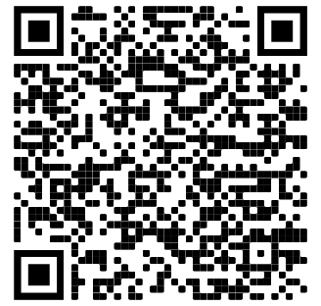
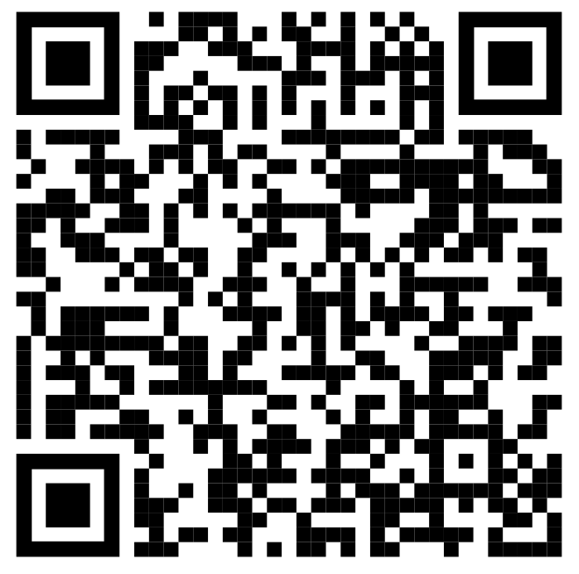
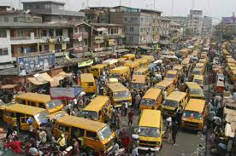
Challenge 4 – Low Quality of Life
Complete the challenges below to develop your understanding of how living in Lagos means a low quality of life for some.
Describe the factors that can contribute to a low quality of life score.
Include facts and figures to support the points about factors mentioned above.
Notes:
http://www.financialnigeria.com/lagos-abuja-rank-low-on-global-quality-of-living-index-for-cities-news-1170.html
https://www.newsweek.com/worst-places-live-nigeria-lagos-651890

Slide 7
Challenge 5 – Create a Google Earth project for your IGCSE Case Studies. You then need to add what you have learnt about Lagos into this project, in the relevant location.
Your project must include information about:
Squatter Settlements
Pollution
Informal Economy
Low Quality of Life
Images that represent each of the above in Lagos
Extra Challenge – Make a Kahoot / Blooket to use with the class to check their knowledge of Lagos. No more than 5 questions.

Slide 8
To Finish:
Write an acrostic poem or a cinquain poem to succinctly describe Lagos.

