Slide 1
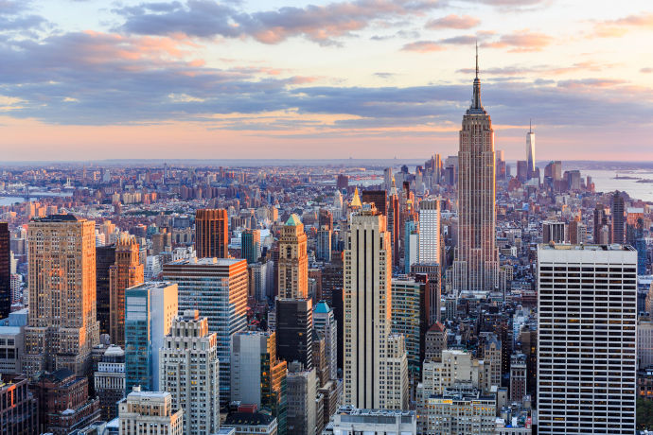
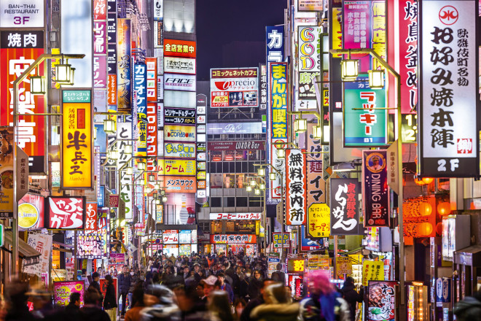
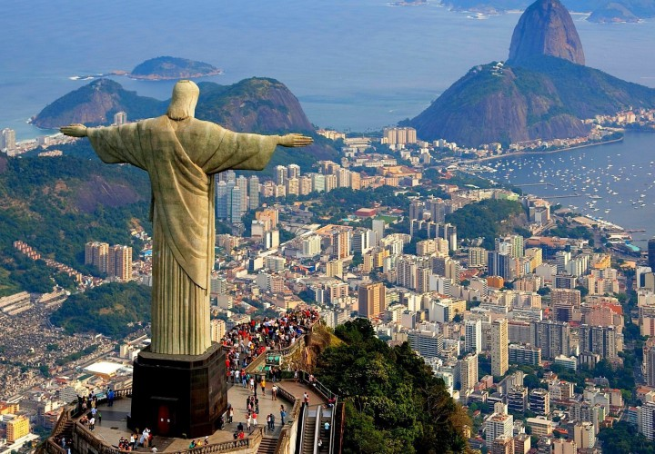
Where are these places and what have they got in common?
Notes:
https://www.visualcapitalist.com/worlds-20-largest-megacities-2100/

Slide 2
Lesson title: The emergence of Megacities
Define the word Megacity
Describe and locate the different types of megacities.
Compare the lives of people in different megacities across the world.
Notes:
https://www.youtube.com/watch?v=U7y4GlmwPLQ&t=519s

Slide 3
Write a sentence to finish the definition using the key words
A megacity is….
Population
10 million
People
Urban
Total

Slide 4
‘A mega city is a city that has a population of over ten million people.’
In 2020 there were over 34 megacities and the UN estimates by 2050 there will be as many as 50!

Slide 5
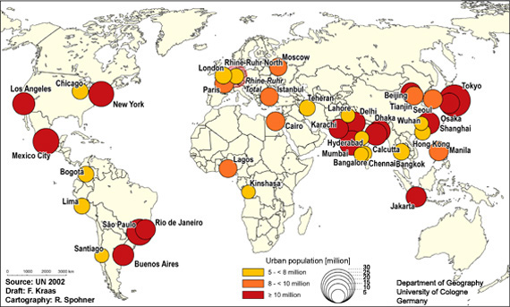
Describe the global distribution of megacities

Slide 6
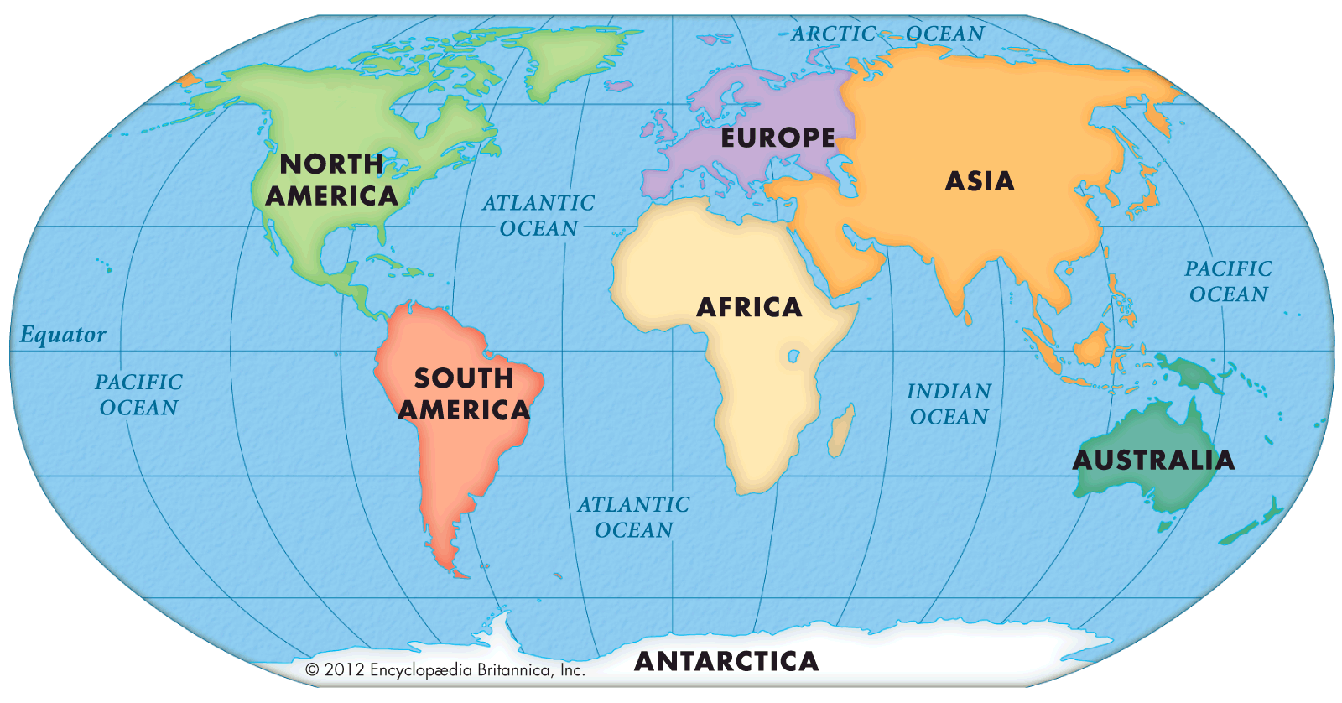
In which continent are most of these cities found?

Slide 7
There are three main types of megacity…

Slide 8
On your map colour code the cities using the three types- Use three different colours.
Make sure you include a key which shows the ‘features’ of each!

Slide 9
What is it like in a megacity?
India
https://www.youtube.com/watch?v=NLlzs4syNjc
New York
https://www.youtube.com/watch?v=zGlazD50UB0
1. Compare the two lives shown in the video clips (What are the differences? – Are there any similarities?)
2. Suggest reasons for the differences between megacities around the world
Notes:
https://www.youtube.com/watch?v=2HZZlDyZMbo
https://www.youtube.com/watch?v=9kP_l5dpqig
https://www.youtube.com/watch?v=lP75QXyMKFs

Slide 10
Key:
Slow Growing- Population at 70+ urban- No squatter settlements
Growing- Population 40-50% - under 20% in squatter settlements
Rapid Growing- Population under 50%- Over 20% in squatter settlements

Slide 11
To finish…
Describe the changes in the distribution of megacities from 2014 to 2030.
How does this link to urbanisation?

Slide 12
Types of megacities
 | Slow-growing | Growing | Rapid-growing
Where?
Features?
Examples?

Slide 13
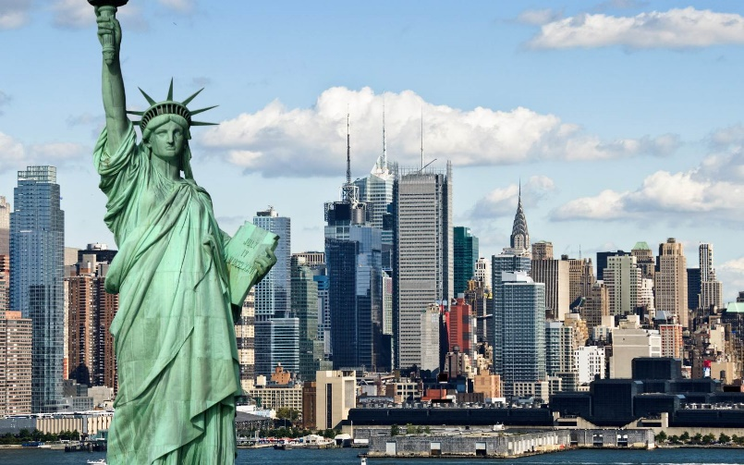
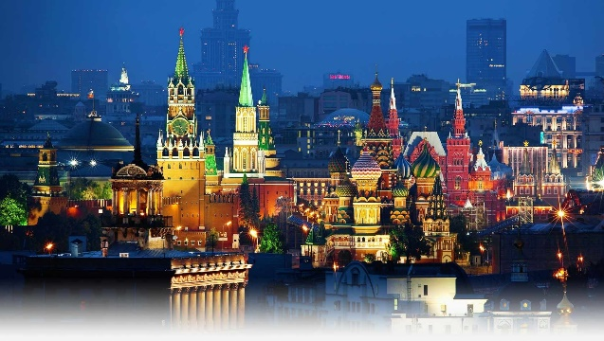
Slow-growing mega cities
Tokyo
These are mainly located in south east Asia, Europe and North America
The population of these countries are at 70%+ and they do not feature squatter settlements.
New York
Moscow

Slide 14
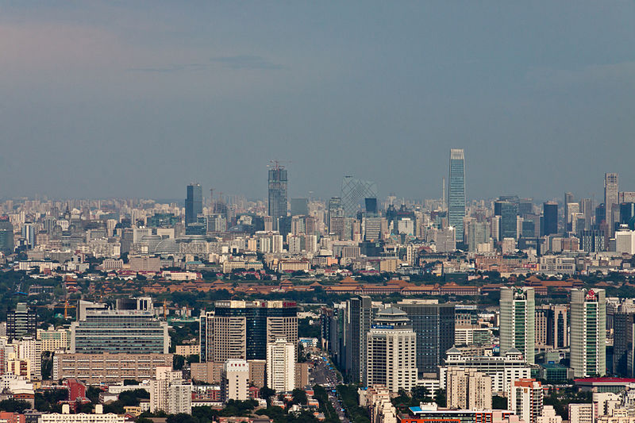
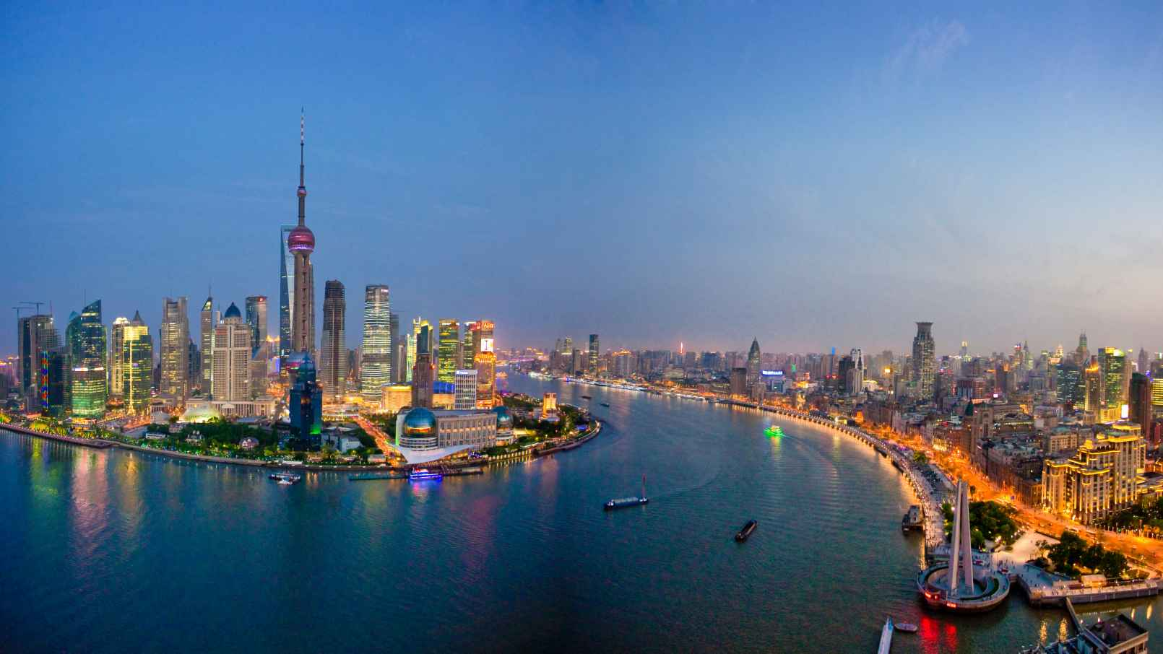
Growing mega cities
Beijing
Found in South America and South East Asia, including Brazil and China.
Between 40-50% of the population live in Urban areas. They do have some squatter settlements but these are under 20%
Shanghai
Rio de Janeiro

Slide 15
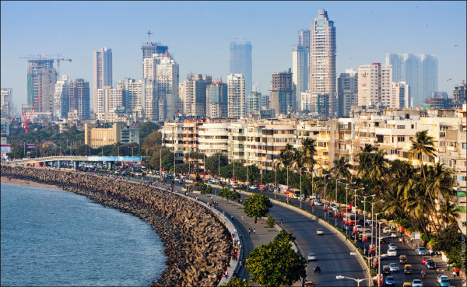
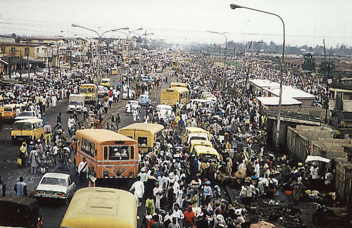
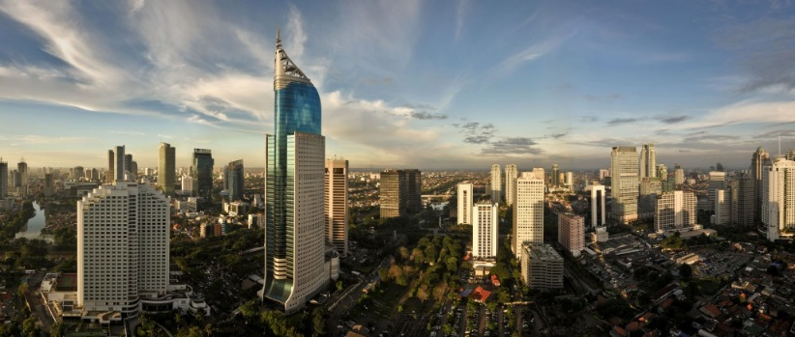
Rapid -Growing mega cities
Mumbai
Located in south-south east Asia and Africa, also includes India
Less than 50% of the population live in urban areas. There are often large squatter settlements, which account for more than 20%
Lagos
Jakarta

Slide 17
