Slide 1
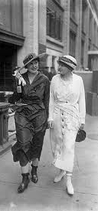
In August 1914, the First World War broke out. This was an emergency. The Suffragettes had to decide quickly what they should do now. Which of the following would you advise the women to do and for what reasons?
Carry on with their violent campaign;
Carry on, but with a peaceful campaign;
Give up the campaign during the war.

Slide 2
L27: Did women’s involvement in WWI lead to votes for women?
Learning objective:
Success Criteria:
Be able to explain how the roles that women played during the ‘Great War’ could have led to suffrage.
Keywords
World War I/Great War
Munitions
You WILL be able to describe a range of jobs done by women during the war.
You SHOULD be able to explain how this connects with women gaining the right to vote in some detail.
You COULD start to weigh up and judge ‘how far’ women’s work was responsible for changing attitudes towards women voting.

Slide 3
Task 1: Think through these points as you look at the sources of Women working during WWI
Women worked in…. | This helped the war/was important because…. | I can infer (work out) that…. | I want to question why….
Notes:
Place one between two on tables to encourage thought/discussion or for students to complete?

Slide 4
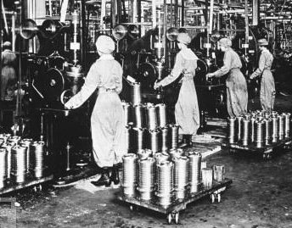
Picture A
Notes:
Munitions workers

Slide 5
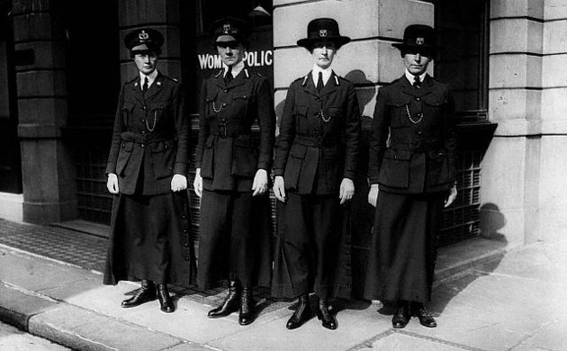
Picture B
Notes:
Police Women

Slide 6
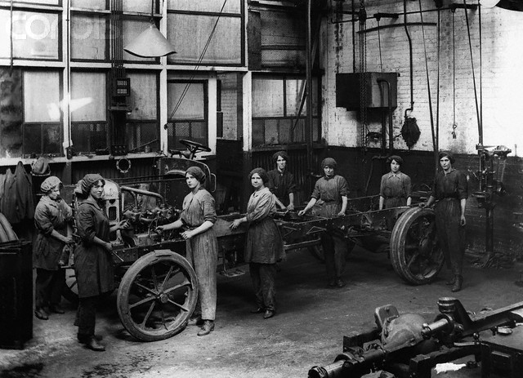
Picture C
Notes:
Engineering Vehicles

Slide 7
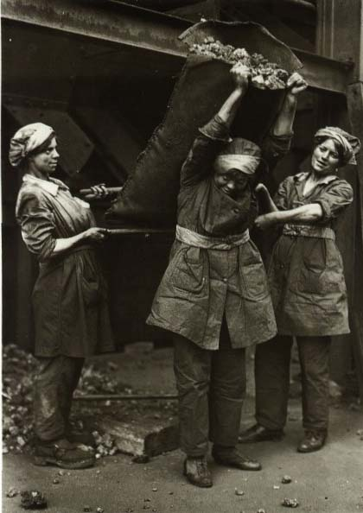
Picture D
Notes:
Shovelling Coal

Slide 8
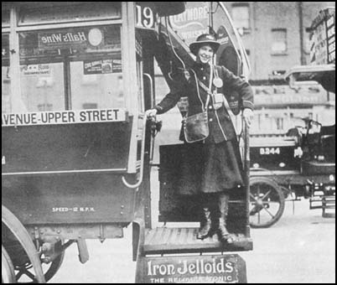
Picture E
Notes:
Bus conductor in London

Slide 9
Picture F
Notes:
Land Army – Ploughing the fields

Slide 10
Picture G
Notes:
Land Army

Slide 11
Picture H
Notes:
Auxiliary Army – Running messages

Slide 12
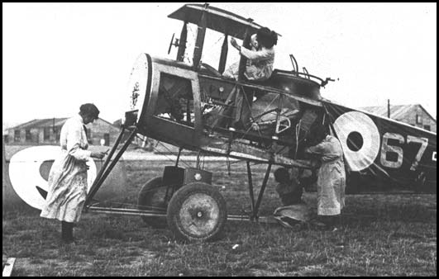
Picture I
Notes:
Auxiliary Air force – maintaining aircraft

Slide 13
Picture J
Notes:
Helping the Navy

Slide 14
Picture K
Notes:
Nursing the sick/wounded

Slide 15
Picture L
Notes:
Police women

Slide 16
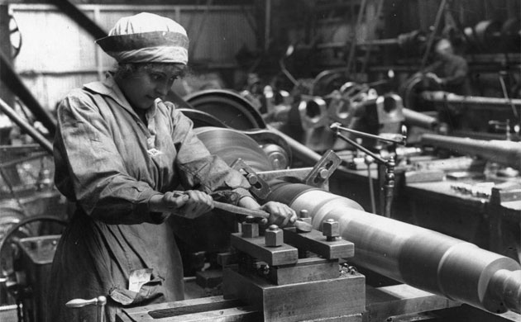
Picture M
Notes:
Heavy industry

Slide 17
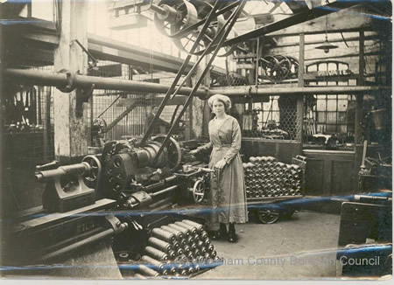
Picture N
Notes:
Munitions worker

Slide 18
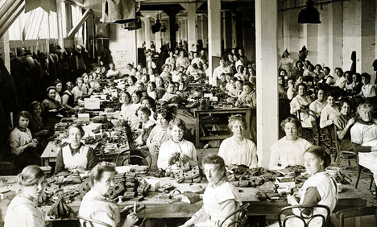
Picture O
Notes:
Manufacturing factory

Slide 19
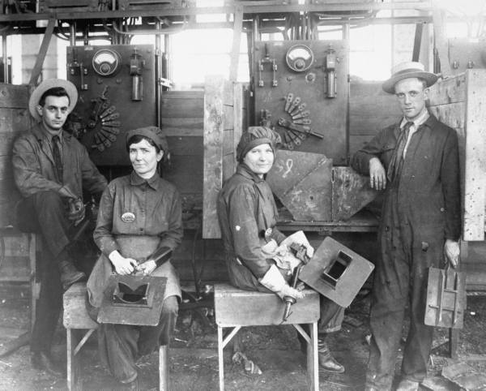
Picture P
Notes:
Transport engineer

Slide 20
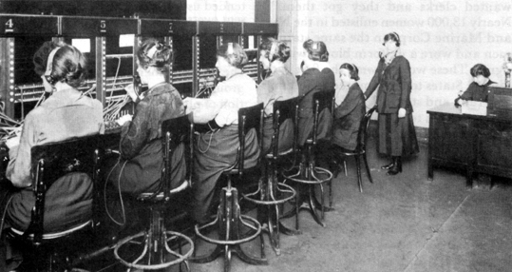
Picture Q
Notes:
Telephone operators

Slide 21
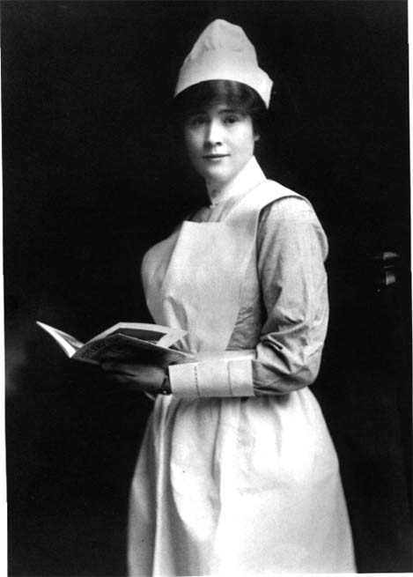
Picture R
Notes:
Nursing

Slide 22
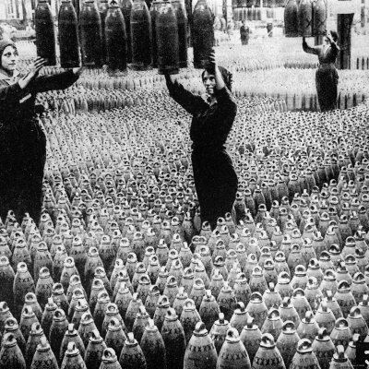
Picture S
Notes:
Munitions worker

Slide 23
Task 2: What was the impact of women’s work during WWI?
Read all your information cards and use as many details as you can to answer the appropriate level question below:
Bronze: Who could vote by 1918?
Silver: Why did the government change its’ mind about votes for some women by 1918?
Gold: Could the war have been a convenient excuse to grant women the right to vote?
Notes:
Use the cardsort – group students in ability and get them working to the appropriate challenge question OR mixed ability groups but each child persues their own question from the same cards.

Slide 24
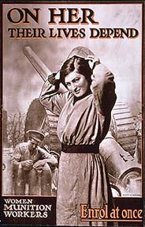
During WWI women worked in...
MUNITIONS
Many women worked first in government munitions factories making weapons and ammunition. It was skilled and very dangerous. Explosions were too common – e.g. at Silvertown in 1917. Also there were health hazards such as inhaling poisonous fumes.
Notes:
Optional extra reinforcement – same information as in the card sort

Slide 25
During WWI women worked in...
ENGINEERING & MANUFACTURING
It was harder to get women into heavy industry. Employers did not want them, because they believed them to be unskilled. Male workers feared they would lose their jobs because women were paid less. The Unions opposed women workers.
But in 1916 there was a desperate munitions crisis. Lloyd George took over production & forced factories to accept women workers. By 1918 there were 800,000 female heavy industry workers.
Notes:
Optional extra reinforcement – same information as in the card sort

Slide 26
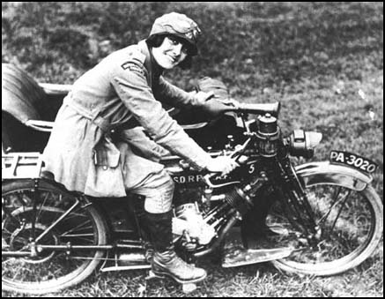
During WWI women worked in...
The ARMY
In 1918 the first ever Women’s Army unit was formed – Women’s Army Auxiliary Corps. The WAACs took over non combatant army roles such as driving, clerks, cooks, stores & supplies, signals & communication – anything to release male soldiers for front line fighting.
Notes:
Optional extra reinforcement – same information as in the card sort

Slide 27
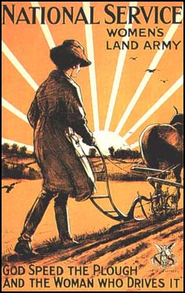
During WWI women worked in...
OTHER JOBS
Women gradually took over other jobs- anything that had been done by a man: - Bus conductors, postal workers, grave diggers, road layers, welders and police officers. Over quarter of a million were in the Land Army – farm labourers.
Notes:
Optional extra reinforcement – same information as in the card sort

Slide 28
Using the following speech from Prime Minister Asquith, create a hypothesis about the connection between women’s work during WWI and gaining Votes for Women.
Notes:
Optional extra reinforcement – same information as in the card sort

Slide 29
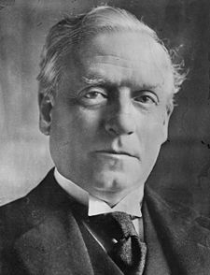
Has women’s work in WWI CHANGED
ATTITUDES in the Government?
Woman cannot fight in the sense of going out with rifles and so forth, but they fill our munitions factories, they are doing the work which the men who are fighting had to do before, and they have aided in the most effective way the prosecution of the war.
Asquith, speaking in August 1916.
Notes:
Optional extra reinforcement – same information as in the card sort

Slide 30
Why did some women get the vote in 1918?
1915: The government realised it would have to change the suffrage law to allow men serving in the army in France to vote. Women campaigners pointed out that this was an ideal opportunity to include women in the new law.
1915-17: Attitudes changed as women did more and more war work. By 1916 they were even in the army.
1918: The new law was passed. It was called The Representation of the People Act. It passed by a huge majority in the Commons and by only 63 votes in the Lords. It allowed:
All males over 21 could vote
All women over 30 could vote
All women who were over 21 AND owned a house or were married to a man who owned a house could vote
Women could now also stand for election as MPs
Notes:
Optional extra reinforcement – same information as in the card sort

Slide 31
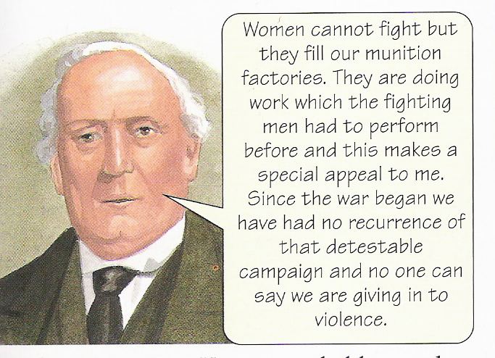
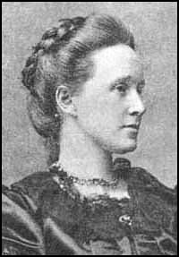
Plenary: Which reason do you agree with and why?
WAR WORK
SUFFRAGISTS: The peaceful Suffragist campaign prepared the ground over many years for women’s suffrage. Without it, people would not have believed that women were trustworthy and responsible.
SUFFRAGETTES: Without the violent campaign of the Suffragettes, no-one would ever have taken their cause seriously and the government would have kept postponing a decision. The Suffragette campaign was proof that women wanted the vote enough to go to prison for it.
Notes:
Class could divide into three groups and prepare a one minute argument for why their factor is the key reason for women gaining the right to vote

Slide 32
Homework 24: Women gain the right to vote. Due:
Bronze: What jobs did women do during WWI? Do you think this made the government want to give them a vote?
Silver: Why did Women gain the right to vote in 1918?
Gold: (GCSE) ‘The violent protests of the Suffragettes were the most important reason why women gained the right to vote.’ How far do you agree with this statement? Use your own knowledge to answer this question.
Silver/gold may find it useful to jot their knowledge around a spider diagram before writing to help you decide the most important reason.

Slide 33
How to structure your Silver answer
How to structure your Gold answer
The question asks if Violent Methods were the ‘most important’ reason for women getting the right to vote – do you agree?
Start by doing a spider diagram of reasons why women gained the right to vote. The Question tells you to consider ‘Violent Methods’ so what other reasons could you include? Aim for 1-2 other reasons.
Introduction: outline in a sentence ALL the important reasons (1,2,3) and then briefly state whether you agree or disagree that Violent Methods was most important.
First Paragraph: you should start by writing a P.E.E about ‘Violent Methods’ – explain using your factual knowledge why you believe this was/was not the most important reason.
Second/third paragraphs: Next write a P.E.E for each alternative reason for women gaining the vote e.g. the actions of…..Be sure to use evidence and explain how this factor helped women gain the right to vote.
Conclusion: Do you agree with the statement in the Question? Explain which factor you think was most important – remember to compare their importance and reach a judgement. This is the conclusion of your argument – convince me!
Writing a FANTASTIC paragraph. Try and do all of the following in EACH paragraph. You should only write about ONE point per paragraph.
Point: The first/major/main/most important reason why women gained the vote was....
Evidence: Give facts about what you learned to support this point
Explain: This gained women the vote because...
Analyse: The most important reason women gained the vote was because of ‘X’ because... Without ‘X’ women would not have got the vote because
Point
Evidence
Explain

Slide 34
Resources below

Slide 35
1918: The new law was passed. It was called The Representation of the People Act. It passed by a huge majority in the Commons and by only 63 votes in the Lords. It allowed: All males over 21 could vote. All women over 30 could vote. All women who were over 21 AND owned a house or were married to a man who owned a house could vote. Women could now also stand for election as MPs | 1915-17: Attitudes changed as women did more and more war work. By 1916 they were even in the army. | 1915: The government realised it would have to change the suffrage law to allow men serving in the army in France to vote. Women campaigners pointed out that this was an ideal opportunity to include women in the new law.
Prime Minister Asquith, speaking in August 1916 Woman cannot fight in the sense of going out with rifles and so forth, but they fill our munitions factories, they are doing the work which the men who are fighting had to do before, and they have aided in the most effective way the prosecution of the war. | Women gradually took over other jobs- anything that had been done by a man: - Bus conductors, postal workers, grave diggers, road layers, welders and police officers. Over quarter of a million were in the Land Army – farm labourers. | In 1918 the first ever Women’s Army unit was formed – Women’s Army Auxiliary Corps. The WAACs took over non combatant army roles such as driving, clerks, cooks, stores & supplies, signals & communication – anything to release male soldiers for front line fighting.

Slide 36
It was harder to get women into heavy industry. Employers did not want them, because they believed them to be unskilled. Male workers feared they would lose their jobs because women were paid less. The Unions opposed women workers. | Many women worked first in government munitions factories making weapons and ammunition. It was skilled and very dangerous. Explosions were too common – e.g. at Silvertown in 1917. Also there were health hazards such as inhaling poisonous fumes. | Women very quickly replaced men in office and shop work. This was not seen as a major problem as women had done jobs like secretarial work before.
But in 1916 there was a desperate munitions crisis. Lloyd George took over production & forced factories to accept women workers. By 1918 there were 800,000 female heavy industry workers. | Sylvia Pankhurst (a leading Suffragette) disagreed with her mother and sister over the war. She refused to support it, and became a Pacifist. | Women were particularly effective in recruitment – persuading men to join up. Women gave white feathers (the symbol of a coward) to young men who had not joined up.

Slide 37
Suffragettes called off their campaign & staged demos encouraging women to be allowed to work in munitions. The government released all prisoners. | Suffragists called an IMMEDIATE halt to their campaign & threw their organisation into supporting the war & persuading men to enlist | It would be naïve to believe that women received the vote solely for services rendered in the First World War. It must be remembered that only women over 30 were given the vote and the very women who had helped in the war effort – the young women of the munitions factories – were actually denied the vote. P. Bartley, historian.

