Slide 1
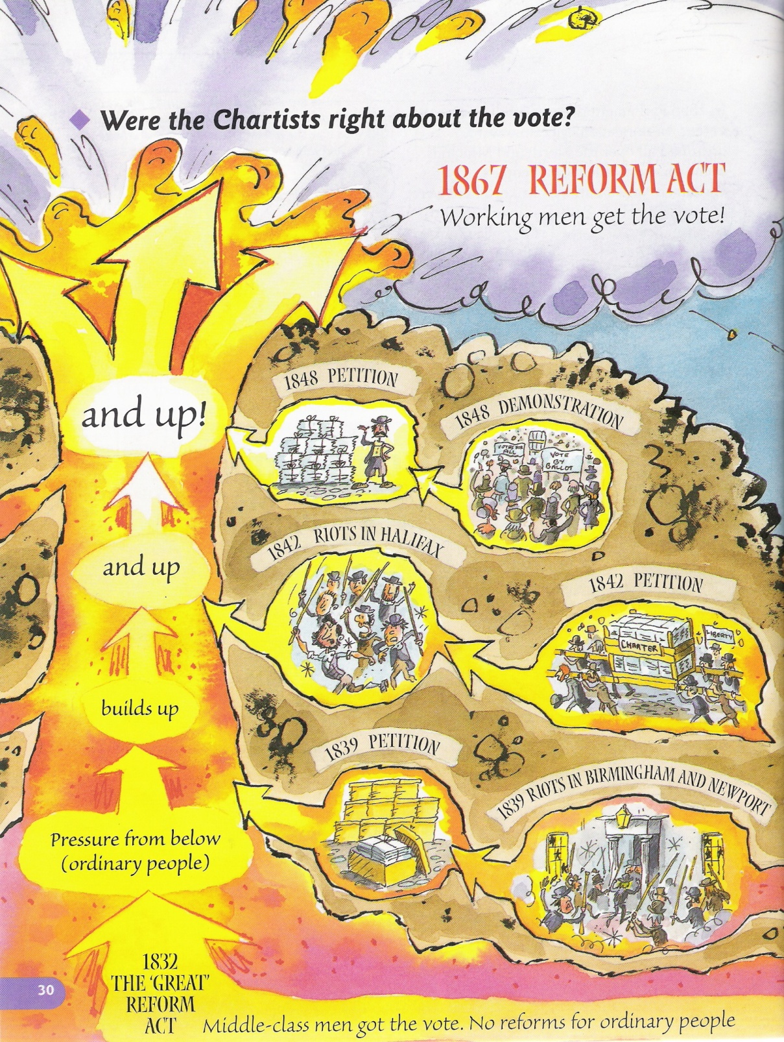
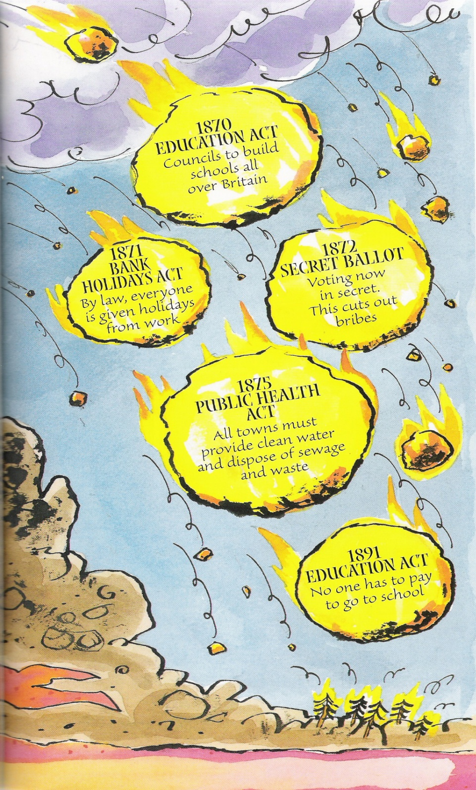
Starter: Complete your source analysis grid

Slide 2


What can I see?
2. What can I learn from this image?
3. What knowledge of my own can I link to this picture?
4. What questions could I ask to extend my learning?

Slide 3
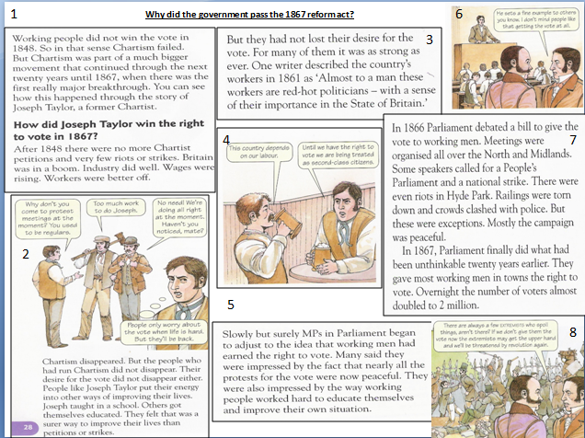
Consolidation activity: 1867 Reform Act
It is important that you know who had achieved the right to vote by 1900 and how this had been achieved.
Highlight 5 important facts about who was able to vote (or not) after the 1867 Reform Act was passed.

Slide 4
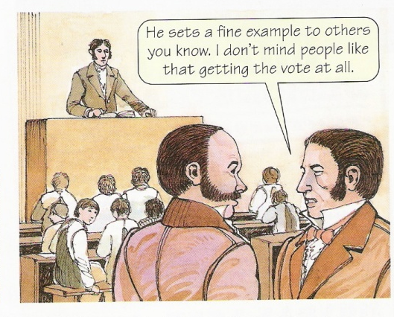
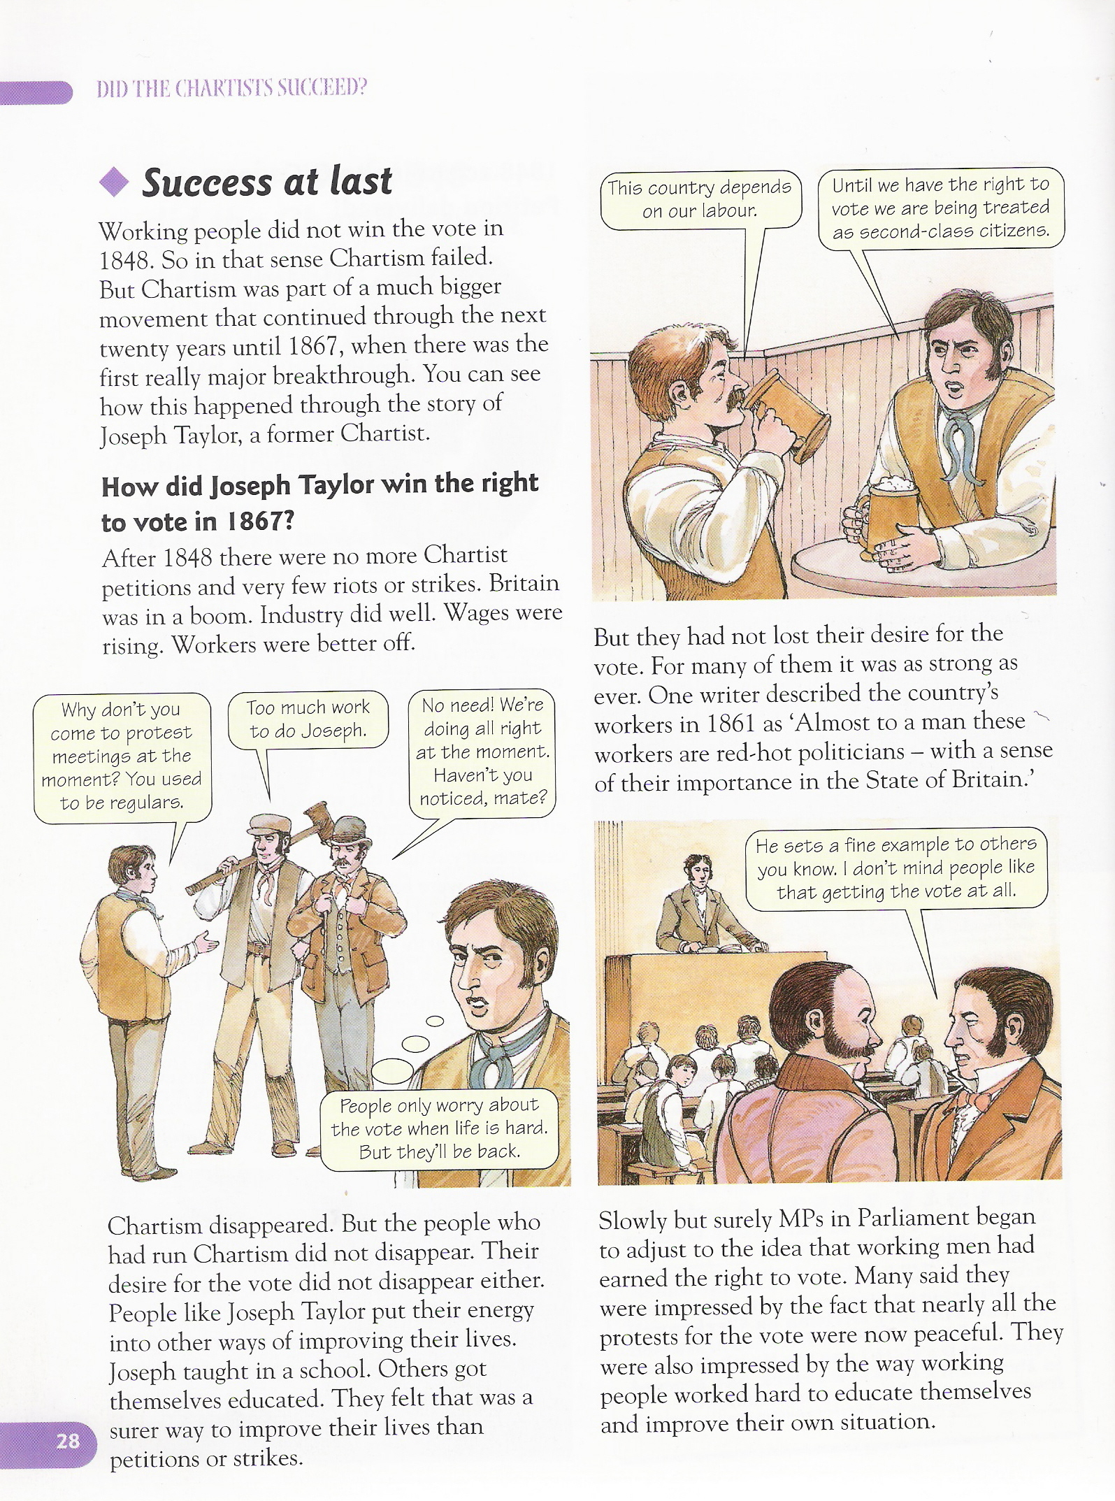
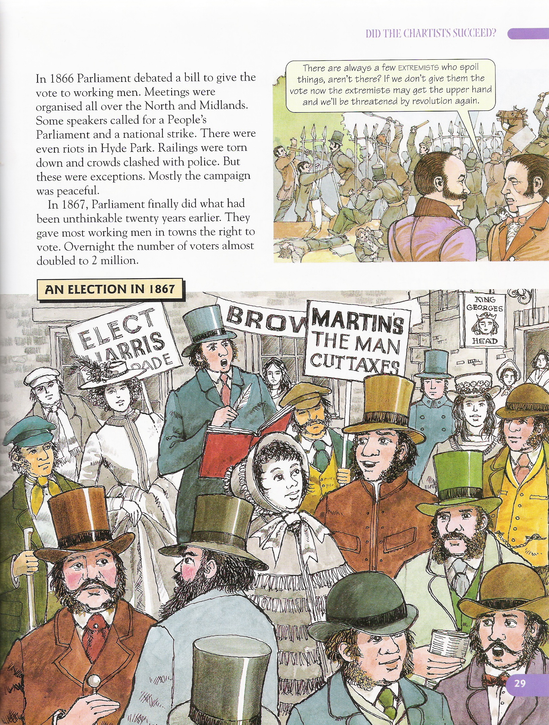


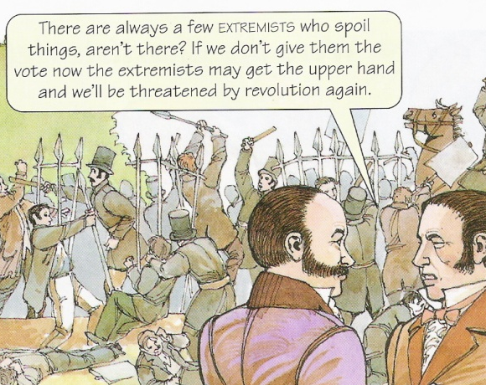
1
Why did the government pass the 1867 reform act?
6
3
4
7
2
5
8

Slide 5
Optional Consolidation activity: 1867 Reform Act
Positive changes after 1867 Reform Act | Problems that still remained
Voting now in secret
Most working men in the towns given the vote
There was still a property qualification to vote – you had to own a house in a city or pay £10 rent per year.
Countryside areas with not many residents (people living there) lost an MPs
Working men in the countryside still could not vote
Welfare Reform was brought in after working men were given the vote, e.g. Free Schools 1891 & Public Health Act 1875
More industrial towns were given an MP e.g. Sheffield, Bradford
Women still could not vote

Slide 6
Check and correct your answers
Positive changes after 1867 Reform Act | Problems that still remained
Voting now in secret Most working men in the towns given the vote Countryside areas with not many residents lost some MPs Welfare Reform was brought in after working men given the vote, e.g. Free Schools 1891 & Public Health Act 1875 More industrial towns were given an MP e.g. Bradford, Sheffield | Still some property qualification to vote – you had to own a house / pay £10 rent to be able to vote Working men in the countryside still could not vote Women still could not vote

Slide 7
Consolidation: 1884: Reform Act – What has improved?
Gladstone (the leader of the Liberal Party) was keen to expand voters rights to rural ________ class men.
The ____________ party were against this because they thought the new working class voters would vote for the _________ party and not the Conservatives.
The 1884 Reform Act gave the rural men the same voting rights as the ___________ had – all adult householders and men who ___________ a house to the value of £10 a year.
The _____________ men (men who could vote) after this act stood at_____________ – but an estimated 40% of all men still did not have the right to vote.
However, the 1884 Reform Act along with the 1832 and 1867 acts did nothing for __________ - none of whom had the right to vote regardless of their____________.
enfranchised 5,500,000 Conservative wealth working towns women liberal rented

Slide 8
What obvious reform still remains in 1900?
Women still cannot vote

Slide 9

Pictures from memory
teams of 3-4
Send one team mate in turn to look at the mystery image
accurately draw the mystery image on your A3 sheet
annotate the back of your completed drawing. What is the message of the source?

Slide 10

What topic does this connect to?
What does this tell us about people’s attitudes towards … at the time?
What is this a picture of?

Slide 11

Interpreting the message of a source
Students work in pairs
Each pair will be given a source.
Decide whether the source is supporting or opposed to giving women the vote.
Give detail from the source to support your decision.
Example: for or against?

Slide 12
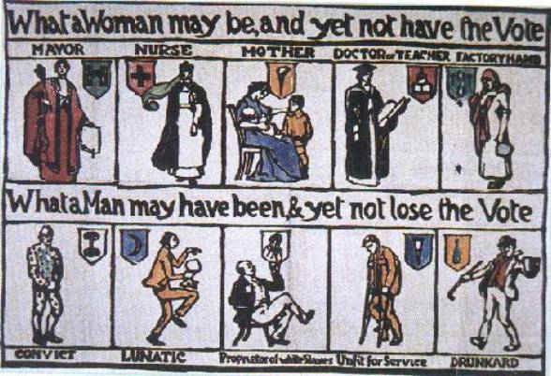
Background Information: What arguments did some put forward for why women should vote?
Women have gained new opportunities in education and work – the vote should come next
Women have special skills and expertise. They know about education and home-making , so they can help parliament make sensible decisions about these matters.
Many single and widowed women have the same responsibilities as men – so they are as responsible
Women can vote in local elections and important places like education committees – they have shown that they can be trusted with the right to vote
Parliament’s decisions affect both men AND women – so women should be able to vote for who should be in parliament
Many uneducated working class men can vote, yet an educated woman can’t.
Women pay taxes just like men – it’s a basic right not to be taxed unless you have the vote
Notes:
Print this slide on A5 for students books

Slide 13

Background Information: What arguments were put forward for why women should not vote?
If women get the vote, they will want careers as well and neglect their families – so only dull stupid women will have children.
Women are noble and pure – they should be protected from the grubby world of politics
There are too many other important issues in politics – Ireland & Trade Unions
Women are not rational – too giddy and emotional to be trusted with the right to vote
Only middle class women really want the vote. Once they have it, they won’t be interested in helping working class women
Women don’t fight in wars risking their lives for their country, so they don’t deserve the vote, because it might affect whether or not their country goes to war.
Men & women have different interests & responsibilities – men in the world of business and politics, women at home
Notes:
Print this slide on A5 for students books

Slide 14
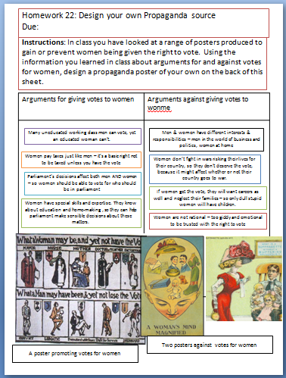
Homework: Design your own Propaganda source Due: ________________________
Instructions: In class you have looked at a range of posters produced to gain or prevent women being given the right to vote.
Using the information you learned in class about arguments for and against votes for women, design a propaganda poster of your own. It can be for or against giving votes for women

Slide 15





Opinion line
the opinion line runs from Anti votes for women to Pro votes for women.
Peg your source to the line to show how vehemently (intensely) it supports or opposes giving women the vote.
Be prepared to explain the message of your source using detail from the source

Slide 16
Plenary: What is the message of this source?

Slide 17
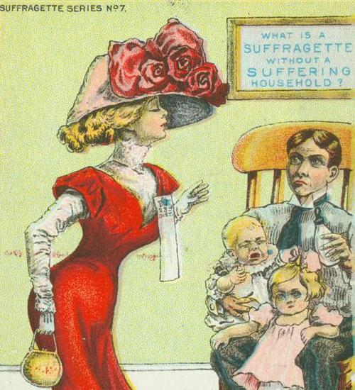
Plenary: What is the message of this source?

Slide 18
Resources below

Slide 19
What can I see?
2. What can I learn from this image?
3. What knowledge of my own can I link to this picture?
4. What questions could I ask to extend my learning?

Slide 20
1
Why did the government pass the 1867 reform act?
6
3
4
7
2
5
8

Slide 21
What were the pros and cons of the 1867 Reform Act
Positive changes after 1867 Reform Act | Problems that still remained
Voting now in secret
Most working men in the towns given the vote
There was still a property qualification to vote – you had to own a house in a city or pay £10 rent per year.
Countryside areas with not many residents (people living there) lost an MPs
Working men in the countryside still could not vote
Welfare Reform was brought in after working men were given the vote, e.g. Free Schools 1891 & Public Health Act 1875
More industrial towns were given an MP e.g. Sheffield, Bradford
Women still could not vote

Slide 22
What does the picture show?
2. What message was the author making about votes for women? Were they for or against it? How can you tell?
3. What knowledge of your own can you link to this picture?(use your arguments for/against sheets)
4. Who might have produced a source like this? Why?

