Slide 1
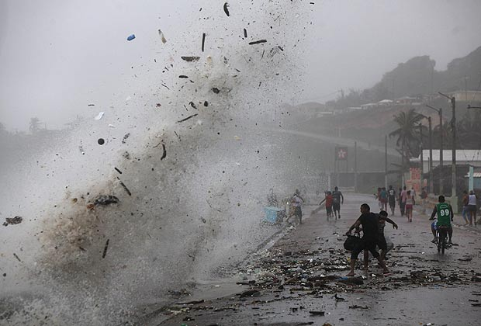
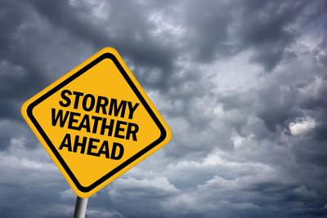
Learning Point 2: How do we measure Tropical Storms and what are their effects?
To understand and explain how Tropical Storms are measured.

Slide 2
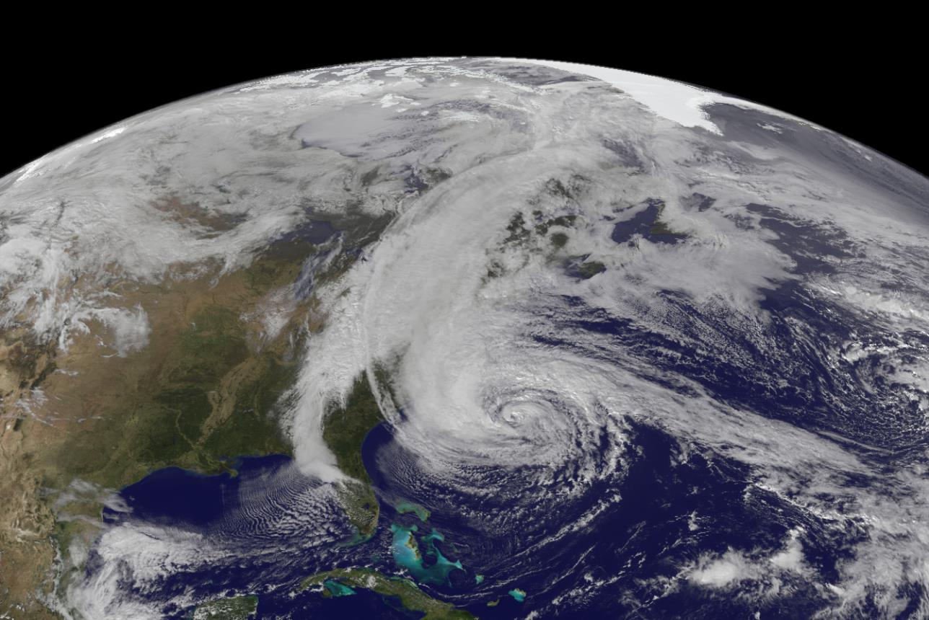
Buzz with your partners – what 5 words would you give to describe the physical geography happening in this photograph?

Slide 3
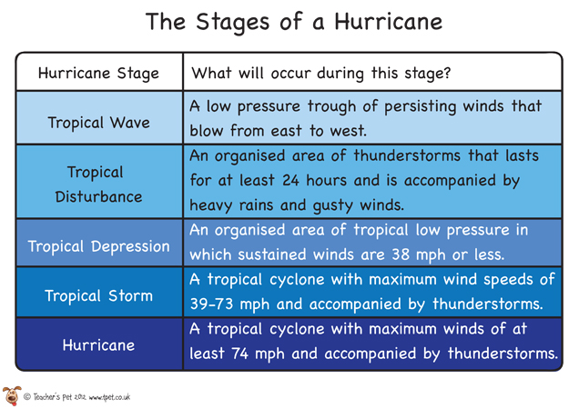

Slide 4
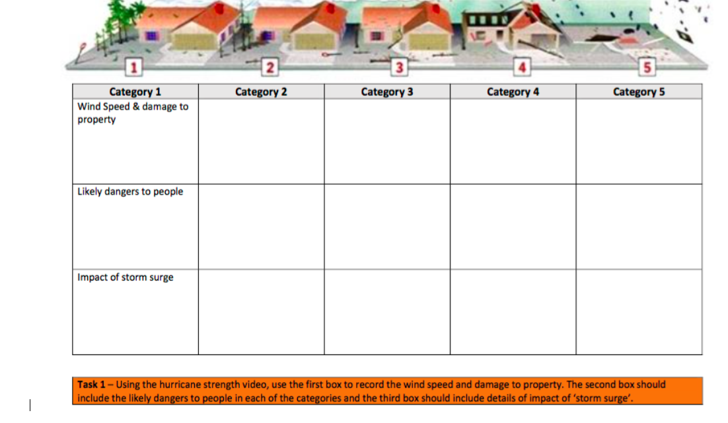
Why Hurricane Categories Make a Difference
Watch the video above and while doing so compete the sheet on hurricane dangers at different categories
https://www.youtube.com/watch?v=BwIlmUOsU9M
https://www.youtube.com/watch?v=ptXyLkRevw4
https://www.youtube.com/watch?v=lqfExHpvLRY

Slide 6
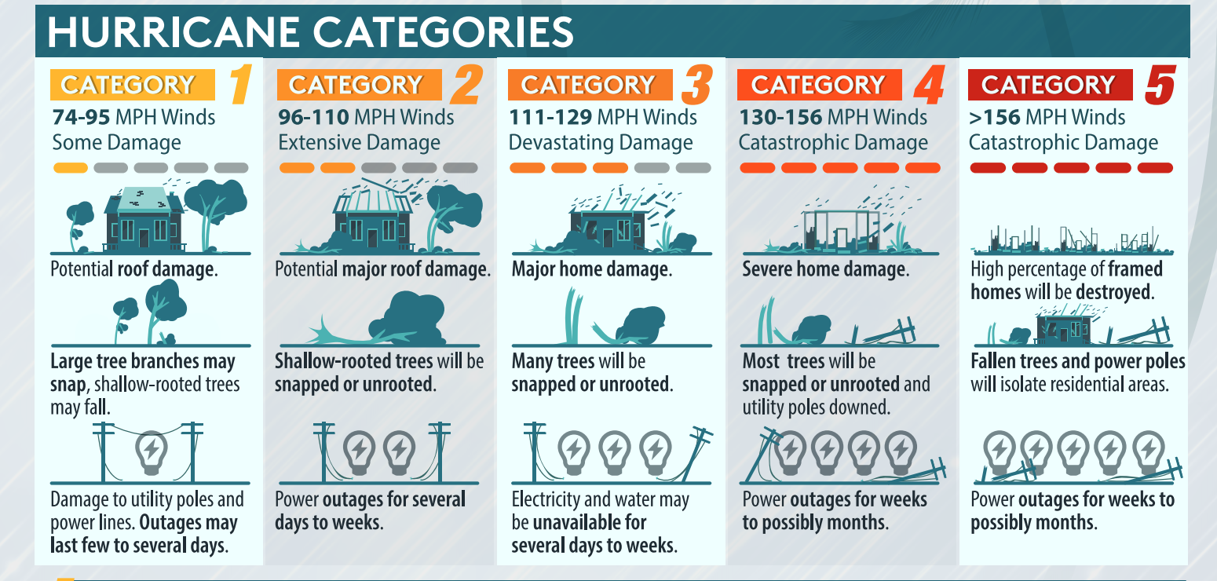

Slide 7
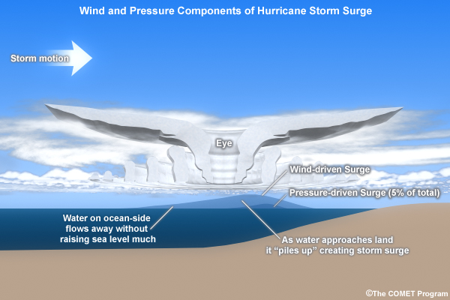
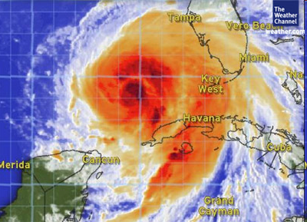
What is storm surge and why is it so dangerous?
https://www.youtube.com/watch?v=txt8wUznyJM
https://www.youtube.com/watch?v=TJ5C7TsBsao
https://www.youtube.com/watch?v=kfjKsfbLitY.

Slide 8
Creating a Tropical storm
The warm ____ heats air above it. Warm, moist air ________ quickly creating low __________ at the surface. More air sweeps in, then starts ____________ upwards (caused by the Earth’s rotation). The rising air _______ and condenses as it goes higher into the sky. Huge spinning thunderclouds are created which are carried across the sea by _______ winds.
The ___ of the storm is in the middle of the hurricane and is an area of ___ pressure with no winds. The _________ winds are found in the eye wall and can cause extensive damage
Understanding check
spiralling rises eye trade pressure Water
cools high strongest
http://www.geographypods.com/4-tropical-storms.html

