Slide 1
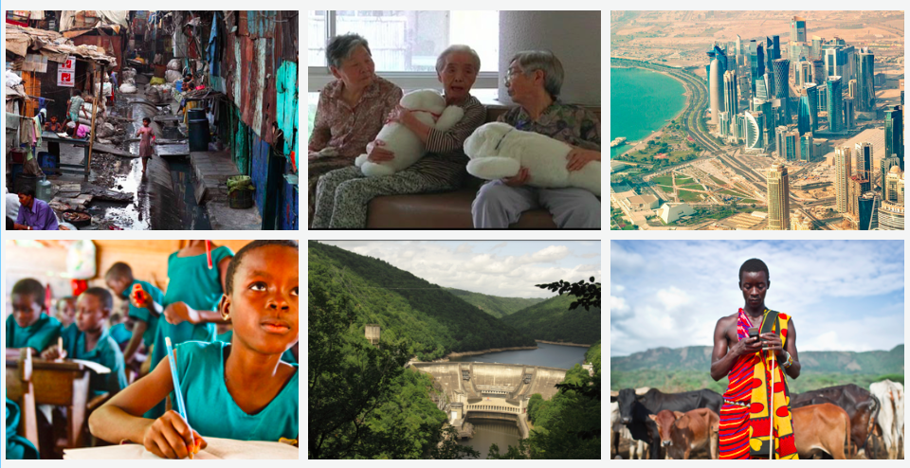
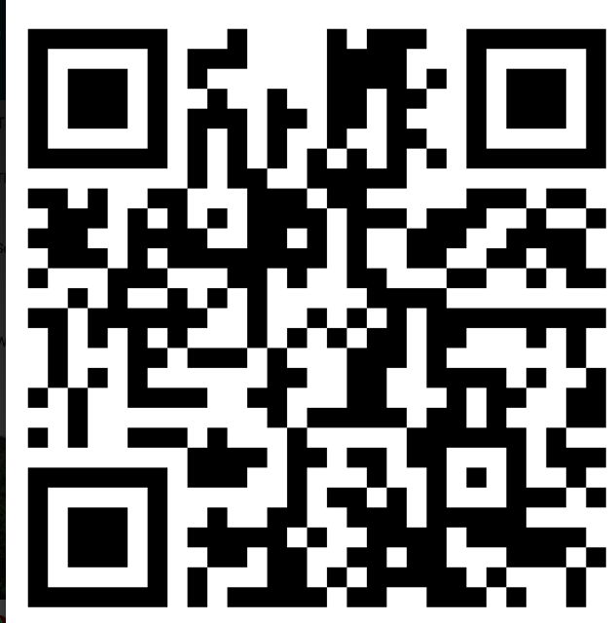
Think, see, wonder

Slide 2
The key question we will be answering in this unit:
Is Development a good thing?
Development only has negative effects
Development only has positive effects
Where do you stand on this continuum and why?

Slide 3
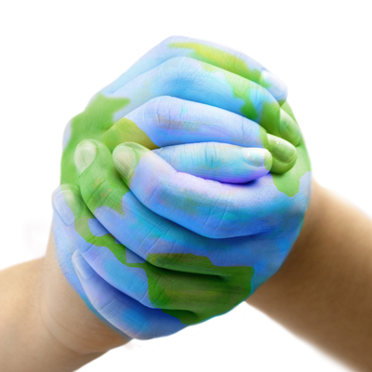
What is development?
What: To find out what the word development means
Why: To explore how there are differing ways of viewing the world
How: Using a range of resources to understand the different levels of development

Slide 4
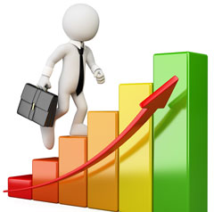
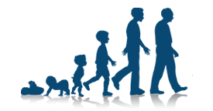
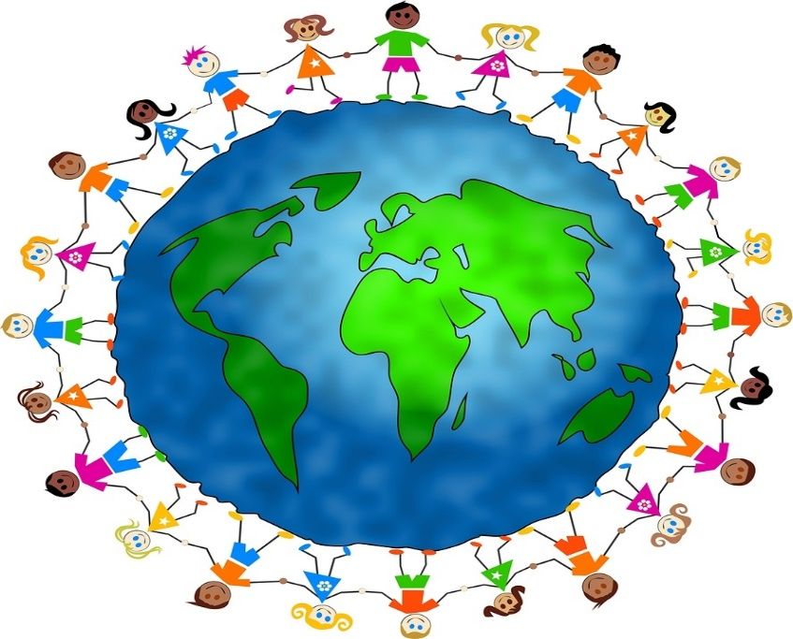
What is development?
CAN YOU CREATE A DEFINITION FOR WHAT DEVELOPMENT MEANS?
Improvement
Change
Advancement
Progress
Growth

Slide 5
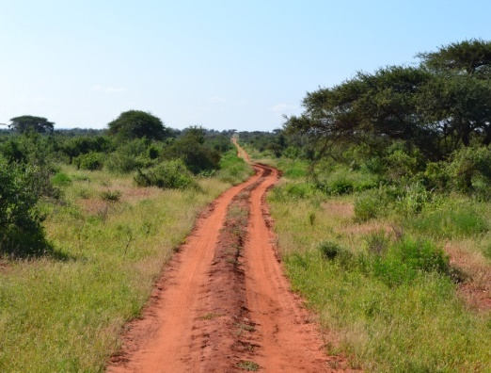
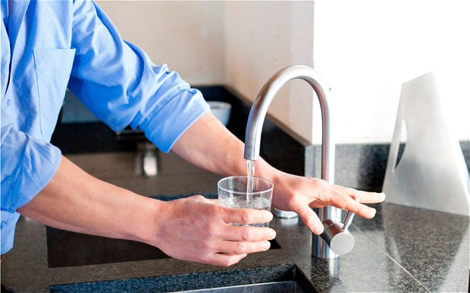
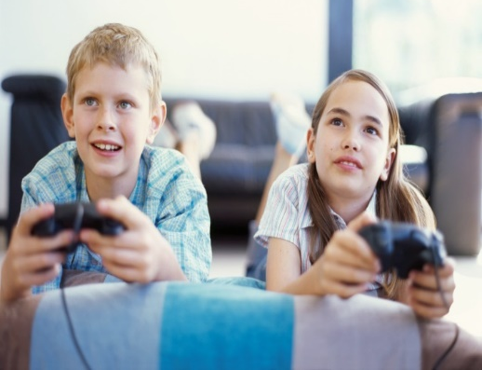
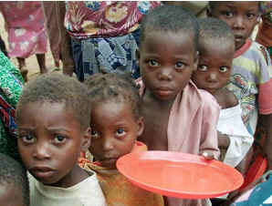
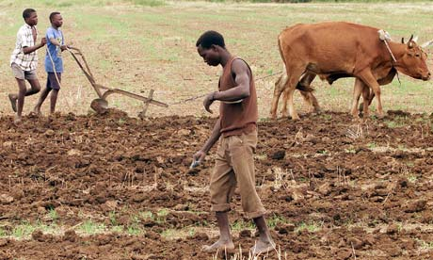
What is development?
DEVELOPMENT:
GEOGRAPHY DEFINITION
Development is a part of geography which looks at the standard of living and quality of life of people. Development is a process of change that affects people's lives.
Development is measured by looking at economic, political and social factors.
EXTENSION ONE:
WHAT ARE ECONOMIC, POLITICAL AND SOCIAL FACTORS?

Slide 6
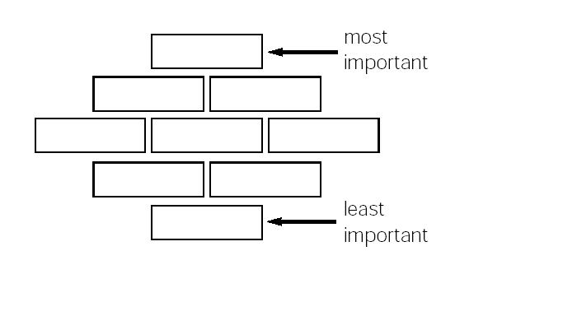
Diamond Nine ranking activity
1. Cut out the cards that list the different aspects of development on your sheet.
2. In your pairs discuss where you feel you should place the cards. (Be prepared to justify your choice!)
3. Glue your order onto your diamond and then glue the diamond into your books.
4. Explain why you chose to place your most important card at the top.

Slide 7
Thinking:
Here you can see a range of different countries. List as many words as you can to describe/classify these countries

Slide 8
Thinking:
What kind of words have you listed?
fIRST WORLD & Third world
Poor and Rich
Developed &
Underdeveloped
MORE DEVELOPED & less developed
Can you think of any problems with using these words?
High income & Low income

Slide 9
Realising
The Gap Instinct
Rich
Poor
MORE DEVELOPED
Less DEVELOPED
We have an almost irresistible temptation to divide all things into 2 distinct and often conflicting groups with an imagined gap in-between: rich and poor, developed and underdeveloped, us and them. It completely distorts our worldview…
High income
Low income
Developed
Underdeveloped
fIRST WORLD
US
Third world
Them

Slide 10
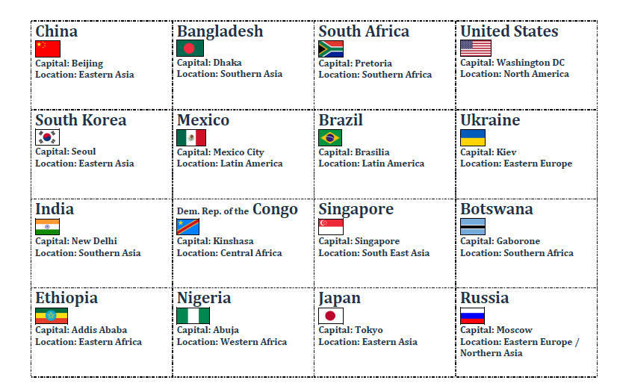
Put these countries in order of development…..

Slide 11
Realising
200 countries over 200 years
Hans Rosling presents a much clearer way of thinking about different countries around the world. Hans makes an important point that ‘poor developing’ countries do not exist as a distinct group anymore. Today, most people around the world (75%) live in middle-income countries. Not poor, not rich, but somewhere in the middle.
https://www.youtube.com/watch?v=jbkSRLYSojo&feature=emb_logo

Slide 12
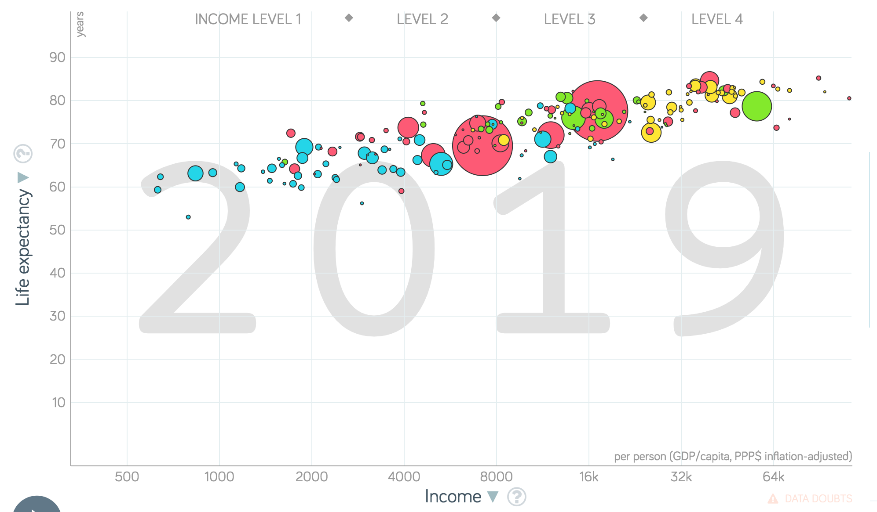
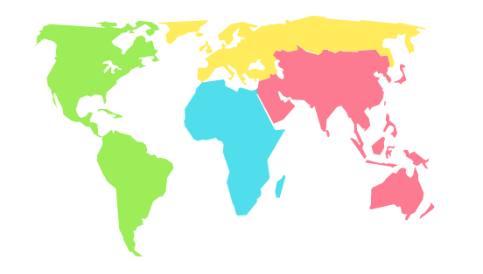
Realising
This data proves why we should no longer refer to ‘rich’ and ‘poor’ countries.
What patterns and trends can you take from this graph?
He also created a great tool for helping us to better understand this…
https://www.gapminder.org/tools/#$chart-type=bubbles

Slide 13
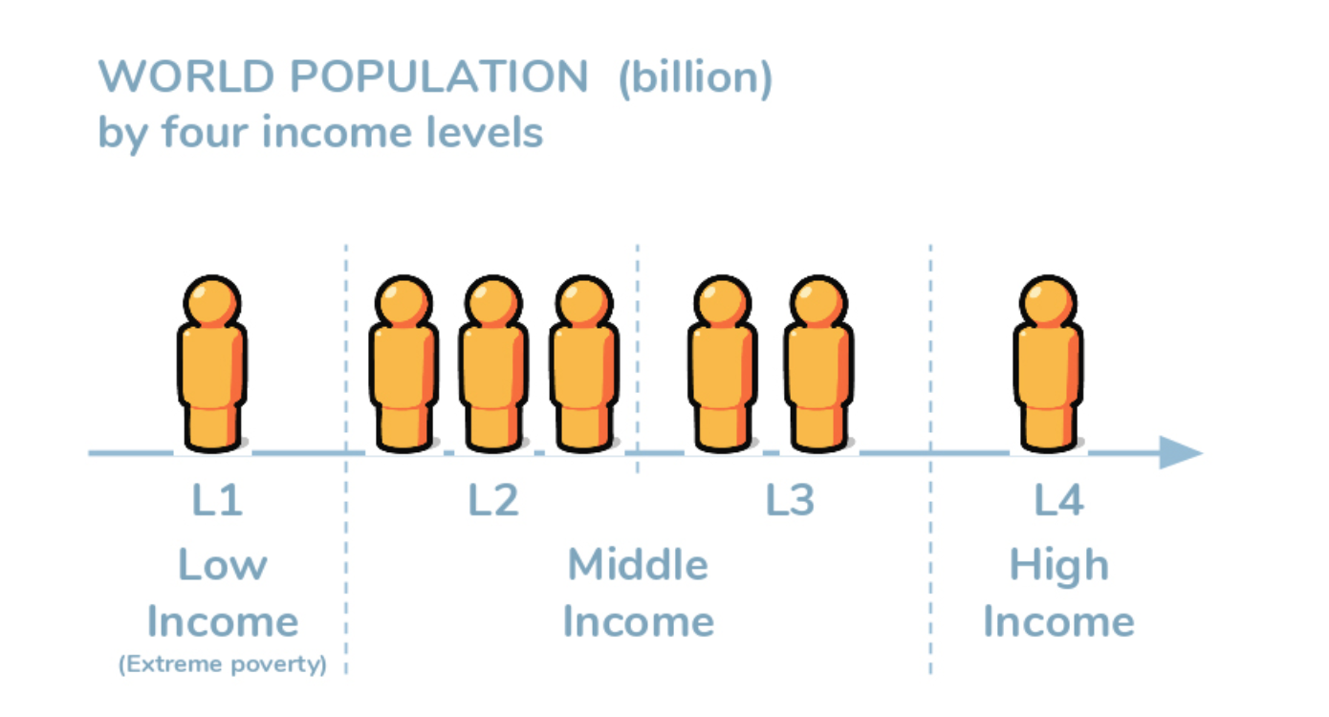
Realising
Four Income Levels
Each figure in the chart represents 1 billion people, and the seven figures show how the current world population is spread out across four income levels, expressed n terms of $ income per day.
But what does this look like in real terms??
$2
$8
$32

Slide 14
Realising
Four Income Levels
Think of the four income levels as the levels of a computer game. Everyone wants to move from Level 1 to Level 2 and upward through the levels from there. Only, it’s a very strange computer game, because Level 1 is the hardest. Let’s play!

Slide 15
Four Income Levels | Level 1 | Level 2 | Level 3 | Level 4
Drinking Water
Transport
Cooking
Eating
Sleeping

Slide 16
Realising
Four Income Levels- Level 1
Level 1
$2
Drinking Water
LEVEL 1. You start on Level 1 with $1 per day. Your five children have to spend hours walking barefoot with your single plastic bucket, back and forth, to fetch water from a dirty mud hole an hour’s walk away. On their way home they gather firewood, and you prepare the same gray porridge that you’ve been eating at every meal, every day, for your whole life— except during the months when the meager soil yielded no crops and you went to bed hungry. One day your youngest daughter develops a nasty cough. Smoke from the indoor fire is weakening her lungs. You can’t afford antibiotics, and one month later she is dead. This is extreme poverty. Yet you keep struggling on. If you are lucky and the yields are good, you can maybe sell some surplus crops and manage to earn more than $2 a day, which would move you to the next level. Good luck! (Roughly 1 billion people live like this today.)
Transport
Cooking
Eating
Sleeping

Slide 17
Realising
Four Income Levels- Level 2
Level 2
$2 $8
Drinking Water
LEVEL 2. You’ve made it. In fact, you’ve quadrupled your income and now you earn $4 a day. Three extra dollars every day. What are you going to do with all this money? Now you can buy food that you didn’t grow yourself, and you can afford chickens, which means eggs. You save some money and buy sandals for your children, and a bike, and more plastic buckets. Now it takes you only half an hour to fetch water for the day. You buy a gas stove so your children can attend school instead of gathering wood. When there’s power they do their homework under a bulb. But the electricity is too unstable for a freezer. You save up for mattresses so you don’t have to sleep on the mud floor. Life is much better now, but still very uncertain. A single illness and you would have to sell most of your possessions to buy medicine. That would throw you back to Level 1 again. Another three dollars a day would be good, but to experience really drastic improvement you need to quadruple again. If you can land a job in the local garment industry you will be the first member of your family to bring home a salary. (Roughly 3 billion people live like this today.)
Transport
Cooking
Eating
Sleeping

Slide 18
Realising
Four Income Levels- Level 3
Level 3
$8 $32
Drinking Water
LEVEL 3. Wow! You did it! You work multiple jobs, 16 hours a day, seven days a week, and manage to quadruple your income again, to $16 a day. Your savings are impressive and you install a cold-water tap. No more fetching water. With a stable electric line the kids’ homework improves and you can buy a fridge that lets you store food and serve different dishes each day. You save to buy a motorcycle, which means you can travel to a better-paying job at a factory in town. Unfortunately you crash on your way there one day and you have to use money you had saved for your children’s education to pay the medical bills. You recover, and thanks to your savings you are not thrown back a level. Two of your children start high school. If they manage to finish, they will be able to get better-paying jobs than you have ever had. To celebrate, you take the whole family on its first-ever vacation, one afternoon to the beach, just for fun. (Roughly 2 billion people live like this today.)
Transport
Cooking
Eating
Sleeping

Slide 19
Realising
Four Income Levels- Level 4
Level 4
$32
Drinking Water
LEVEL 4. You have more than $64 a day. You are a rich consumer and three more dollars a day makes very little difference to your everyday life. That’s why you think three dollars, which can change the life of someone living in extreme poverty, is not a lot of money. You have more than twelve years of education and you have been on an airplane on vacation. You can eat out once a month and you can buy a car. Of course you have hot and cold water indoors.
Transport
Cooking
Eating
Sleeping

Slide 20
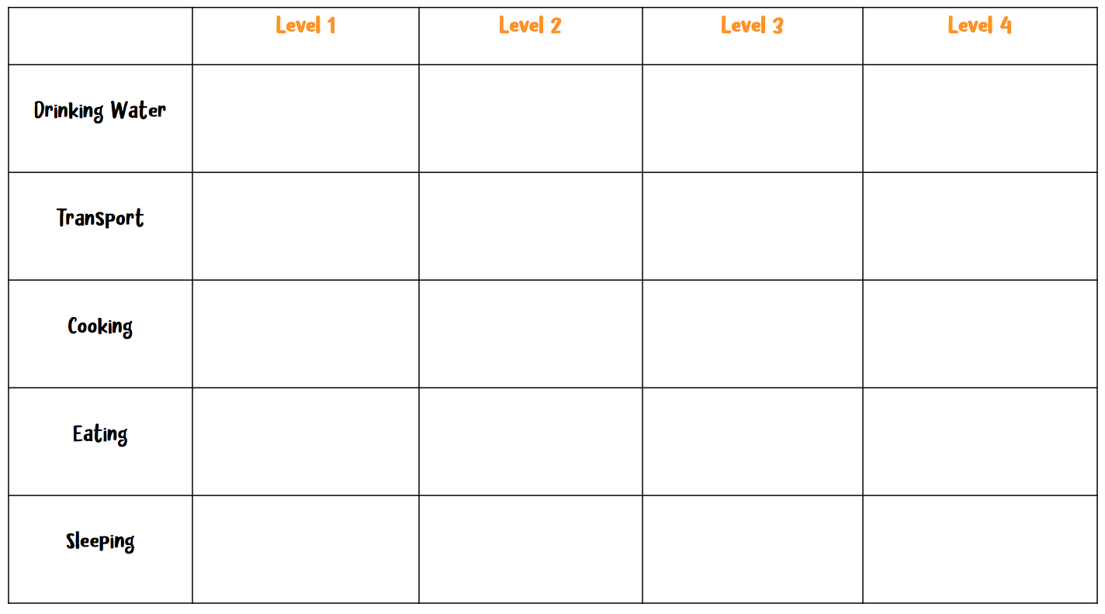
Creating
So today, where do most people live? Level 1, 2, 3 or 4?
Task: Using the information on the level handouts, complete a summary of the four levels using either pictures, descriptions or both.
https://vimeo.com/127511255

Slide 21
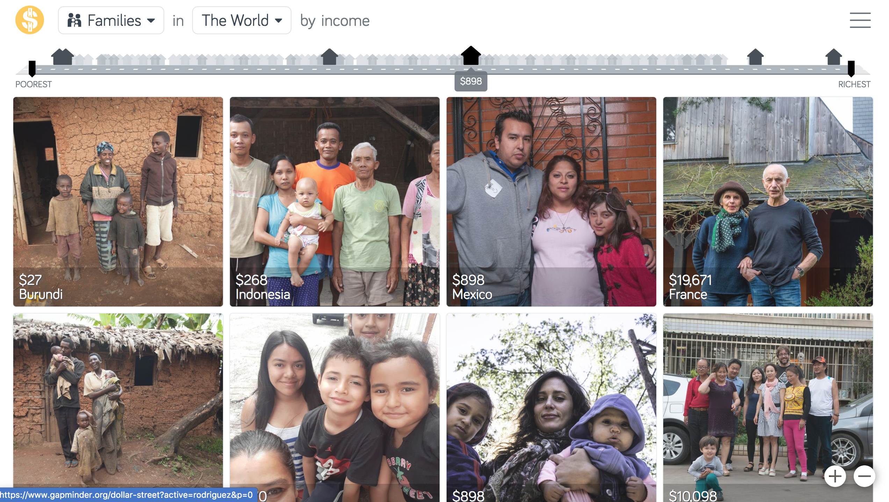
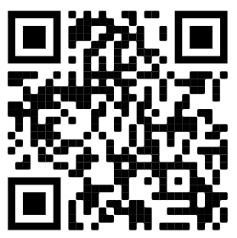
Analysing
Dollar Street- how do other people around the world live?
Imagine the world as a street ordered by income. Everyone lives somewhere on the street. The poorest lives to the left and the richest to the right. Everybody else live somewhere in between. Welcome to visit all homes on Dollar Street!
Task: Explore Dollar Street first of all! Use the ‘Visit this family’ tab to do this!
Then, you are going to choose 4 families (one from each income level approximately) and create a comparison of how they live.
This can be in the form of a picture collage, descriptions, a venn diagram, a table, or even a matrix. The choice is yours!
https://www.gapminder.org/dollar-street/

Slide 22
Reflecting
Controlling the gap instinct
Remember, we are lucky enough to live on level 4. When you live on Level 4, everyone on Levels 3, 2, and 1 can look equally poor, and the word poor can lose any specific meaning. Even a person on Level 4 can appear poor: maybe the paint on their walls is peeling, or maybe they are driving a used car.
Anyone who has looked down from the top of a 1 tall building knows that it is difficult to assess from there the differences in height of the buildings nearer the ground. They all look kind of small. In the same way, it is natural for people living on Level 4 to see the world as divided into just two categories: rich (at the top of the building, like you) and poor (down there, not like you). It is natural to look down and say “oh, they are all poor.” It is natural to miss the distinctions between the people with cars, the people with motorbikes and bicycles, the people with sandals, and
the people with no shoes at all.
TASK: The tall building analogy is so powerful in helping us control our gap instinct. Translate it into your own words in your exercise books.
https://www.youtube.com/watch?v=QpdyCJi3Ib4

Slide 23
Reflecting
Controlling the gap instinct
Task- Based on today’s learning and the extract summarise how we can control the gap instinct in your exercise book/on the next slide.
We can control the gap instinct by recognizing when a story talks about a gap, and remembering that this paints a picture of two separate groups, with a gap in between. The reality is often not polarized at all. Usually the majority is right there in the middle, where the gap is supposed to be.
To control the gap instinct, look for the majority.
• Beware comparisons of averages. If you could check the spreads you would probably find they overlap. There is probably no gap at all.
• Beware comparisons of extremes. In all groups, of countries or people, there are some at the top and some at the bottom. The difference is sometimes extremely unfair. But even then the majority is usually somewhere in between, right where the gap is supposed to be.
• The view from up here. Remember, looking down from above distorts the view. Everything else looks equally short, but it’s not.

