Slide 1
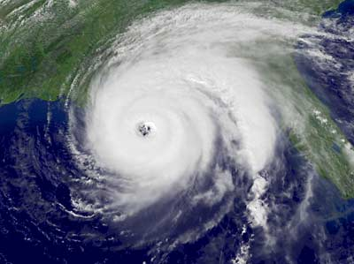
Tropical storms
What: Where, when and how tropical storms form and why they form in these locations.
Why: So that we can understand which areas of the USA are most at risk from hurricanes.
How: Create a cartoon strip to show the steps of hurricane formation.

Slide 2
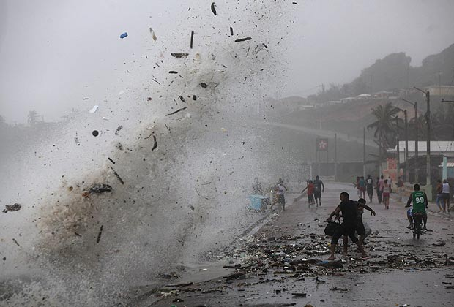
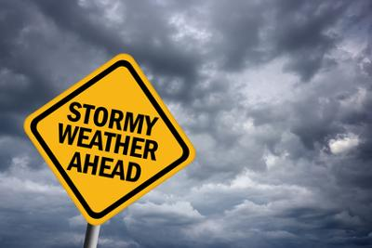
Learning Point 1: What and where and how do Tropical Storms form?
To explain the formation of tropical storms and their distribution.

Slide 3
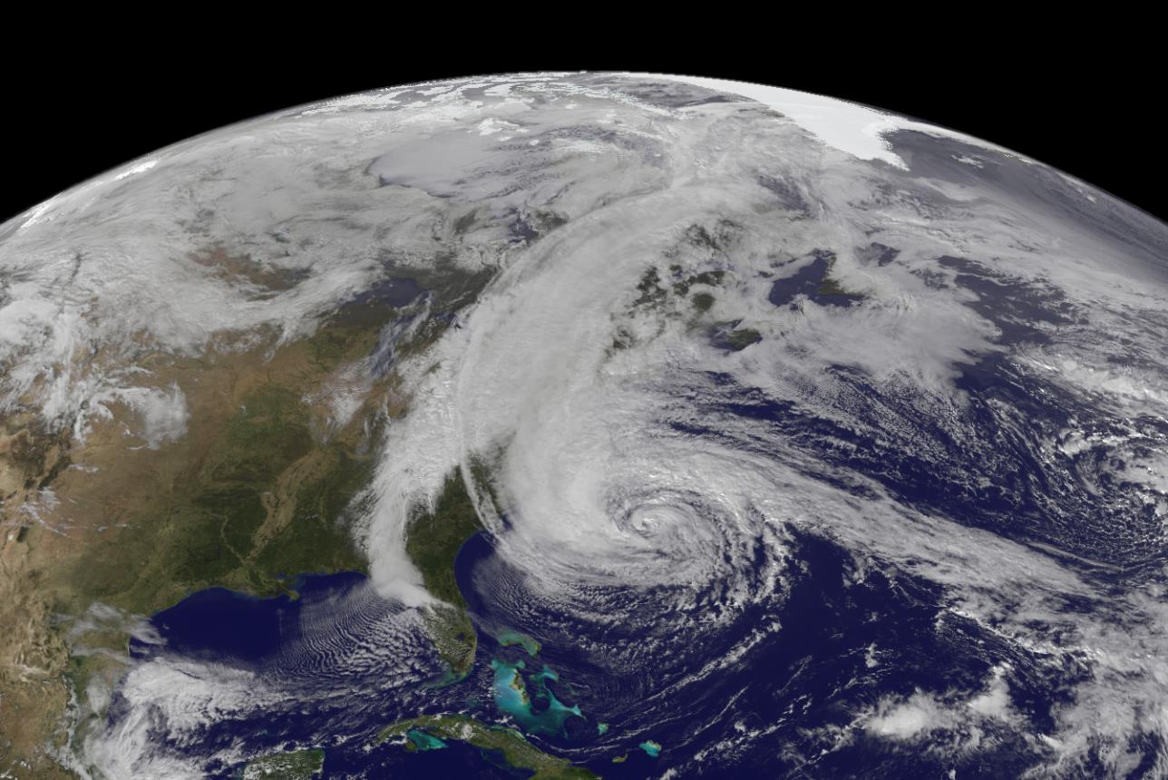
Quick Quiz: Spot the difference
Tropical Storm
Cyclone
Typhoon
Hurricane

Slide 4
Tropical storms are known by many names, including hurricanes (North America), cyclones (India) and typhoons (Japan and East Asia). They all occur in a band that lies roughly between the tropics of Cancer and Capricorn and despite varying wind speeds are ferocious storms. Some storms can form just outside of the tropics, but in general the distribution (location) of these storms is controlled by the places where sea temperatures rise above 27°C and is heated to a sufficient depth.
The key information being, they form in the tropics and over warm oceans of 27°C and above; Tropical storms do not form over land!

Slide 5
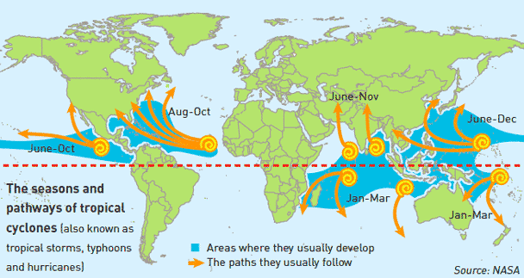
What do you notice about the pattern of Tropical Storms?
What questions would you like to ask?

Slide 6
Why do Hurricanes form here?
Collaborative Challenge – in small groups get a whiteboard and try to work out for yourself how hurricanes form.
Watch the following videos and take notes on how hurricanes form.
http://www.bbc.co.uk/weather/features/24056514
https://www.youtube.com/watch?v=wPDoIrGUrEc
https://www.youtube.com/watch?time_continue=4&v=kjd9Fa1H9dg
https://www.youtube.com/watch?v=Yj240oulsc8
https://www.youtube.com/watch?v=UKL9NIxLIIE

Slide 7
Make a spider diagram of key parts in the formation of a tropical storm.
Work together to create a full sequential explanation as to the formation of tropical storms.
Extra challenge? Try and incorporate some of the additional information into your explanation.
Objective(s):
To explain the formation of tropical storms and their distribution..

Slide 8
Tasks – To print

Slide 9
Tropical storms begin when thunderstorms move over tropical ocean water. | Tropical oceans (at least 27°C) warm the air above it. | This warm, moist air starts to rise.
Because this air is evaporating, there is less air left near the surface. This causes an area of low air pressure. | Surrounding air rapidly moves into the low pressure area to fill the space, causing wind speeds to increase. | As the warmed, moist air rises and cools off, the water in the air forms clouds.
The whole system of clouds and wind spins due to the trade winds and the earth’s rotation. | As the storm moves over the ocean, it picks up more warm moist air and grows. The speed of its winds increases as more air is sucked in. | It can take hours or days to fully form a tropical storm. The eye has is an area of calm winds which are surrounded by the deadly Eye wall of high winds and heavy rain.

Slide 10
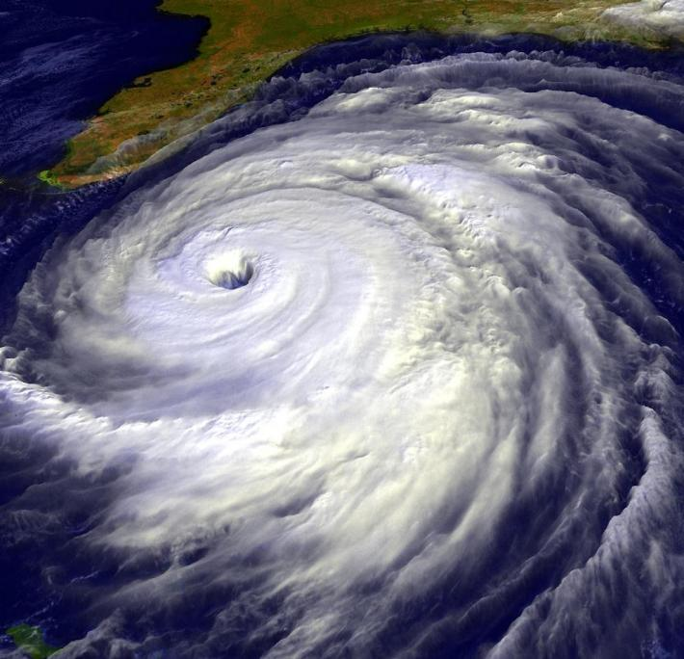
1) Make a small sketch of this hurricane in the blank box
2) Label the following: The eye Spiralling rain bands Rising air Fastest winds
3) Use arrows to show the direction of movement (the spin)
4) Label Florida with a description of what will happen when it makes landfall
Florida

