Slide 1
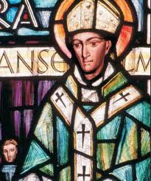
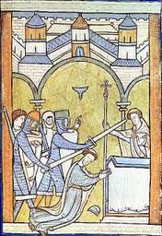
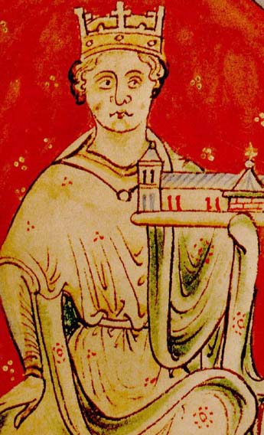
Could the Christian Church limit the power of medieval monarchs?
Famous Incident 1: William II and Anselm
William II was unusual for his time because he did not have respect for the Church. The Church did not like William because he stole from churches where there was no priest or bishop. This made the Catholic Church angry.
William II asked a man called Anselm to be Archbishop of Canterbury but they soon fell out.
A meeting was called in 1095 to deal with the argument between Anselm and William II. Anselm asked the Pope to help. The King continued to make Anselm’s life difficult and in 1097 Anselm left for Europe.
Medieval Monarchs are generally remembered as being REALLY powerful – but were they? Your task this week is to decide whether the Christian Church was more powerful than the king!
YOU WILL NEED YOUR CLASSWORK NOTES TO HELP YOU
Archbishop Anselm
Famous Incident 2: Henry II and Thomas Becket
In Medieval England the Church was all powerful and the Archbishop was the most important job in the church.
In 1162, Henry II appointed Thomas Becket, as Archbishop of Canterbury. Henry believed that Church courts did not set a good example as they were too soft on offenders. Henry hoped that by appointing his good friend Becket, he might have more of a say in how the Church punished people.
In 1164 Henry and Thomas quarrelled. Henry passed a law which said that any person found guilty in a Church court would be punished by a royal court. Becket refused to agree to this and he fled to Europe. It took six years before Becket felt safe enough to return to England. However, they quickly fell out again. Henry was furious and shouted "will no-one rid me of this troublesome priest?" Four knights heard what Henry had shouted and thought that the king wanted Becket dead. On December 29th 1170 they killed Becket in Canterbury Cathedral.
The pope quickly made Becket a saint. Henry II asked the pope for forgiveness and he walked bare foot to Canterbury to pray at the spot where Becket was killed.
Becket’s Murder
Famous Incident 3 King John and Pope Innocent III
John quarrelled with the pope in 1207 over who should be Archbishop of Canterbury. King John wanted it to be his choice. The Pope refused to accept John's choice. In 1208, the pope excommunicated John and put England under a Church law which said that no christening or marriage would be legal until the time the pope said that they would be. Church law said that only christened people could get to Heaven while children born out of marriage were doomed to Hell. The people of England blamed one person for this – King John.
In 1213 John gave in but the pope never fully trusted John and in 1214, the pope said that anybody could try to overthrow John. In 1214 John lost another expensive battle to the French. This was too much for the powerful English barons. In 1214, they rebelled.
King John depicted with the Church

Slide 2
Could the Christian Church limit the power of medieval monarchs?
Instructions: There are a number of questions below that ask you to THINK HARD about the facts you have studied in the lesson. You should use the questions to help you answer the KEY QUESTION at the top of the page. You do not have to do all the questions. Chose 3-4 to answer e.g. Bronze Bronze Bronze or Bronze Silver Silver Gold etc. Make sure you challenge yourself as this thinking will help toward your first assessment.
BRONZE:
COMPARE: What did the fall outs between King and Church have in common?
DESECIBE/EXPLAIN: Why do you think the King and the Church repeatedly fell out? What were the common issues?
DESCRIBE: How did the Church usually get the King to obey their decisions – e.g. what did the Pope threaten to do to the King or Country?
SILVER:
EXPLAIN: How did Kings try to cut the power of the Church? Why might this have been?
EXPLAIN: How did the Church try to cut the power of the monarchs? Why might this have been?
INFER: There were disputes between the Catholic Church and Medieval kings from 1095 until 1214 – (and these are just the ones that have been selected for you to study). Use your INFERENCE SKILLS - What does this suggest about the disputes between kings and the church?
GOLD:
ANALYSE: Who had the upper hand in terms of power? Justify your decision with reference to the case studies and your own research.
PREDICT: What might happen as a result of these tensions over power?
RESEARCH: Which king would end the power of the Catholic Church over the English Monarchy?
__________________________________________________________________________________________________________________________________________________________________________________________________________________________________________________________________________________________________________________________________________________________________________________________________________________________________________________________________________________________________________________________________________________________________________________________________________________________________________________________________________________________________________________________________________________________________________________________________________________________________________________________________________________________________________________________________________________________________________________________________________________________________________________________________________________________________________________________________________________________________________________________________________________________________________________________________________________________________________________________

Slide 3
Could the Christian Church limit the power of medieval monarchs?
__________________________________________________________________________________________________________________________________________________________________________________________________________________________________________________________________________________________________________________________________________________________________________________________________________________________________________________________________________________________________________________________________________________________________________________________________________________________________________________________________________________________________________________________________________________________________________________________________________________________________________________________________________________________________________________________________________________________________________________________________________________________________________________________________________________________________________________________________________________________________________________________________________________________________________________________________________________________________________________________
__________________________________________________________________________________________________________________________________________________________________________________________________________________________________________________________________________________________________________________________________________________________________________________________________________________________________________________________________________________________________________________________________________________________________________________________________________________________________________________________________________________________________________________________________________________________________________________________________________________________________________________________________________________________________________________________________________________________________________________________________________________________________________________________________________________________________________________________________________________________________________________________________________________________________________________________________________________________________________________________
________________________________________________________________________________________________________________________________________________________________________________________________________________________________________________________________________________________________________________________________________________________________________________________________________________________________________________________________________________________________________________________________________________________________________________________________________________________

