Slide 1
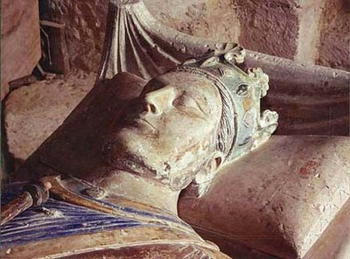
King Henry II’s Family
Intrigue, Rebellion and Treachery

Slide 2
Henry The Man
Quick tempered; determined; stubborn; proud of his ability to inspire fear
Hyperactive
Successful warrior
Many mistresses and illegitimate children
Law maker – founding father of English common law
Law breaker, unwilling to recognise the constraints upon his sovereignty, which he saw as God-given
Understood, but would not speak, English
Talent for picking talented subordinates
Talent for administration
Few close friends
Religious – devotee of relics, pilgrimages, mass
Couldn’t control sons; wife
Notes:
Most famous mistress = Rosamund de Clifford; affair probably began summer 1165 probably when staying with Walter de Clifford, her father. Affair lasted at least 9 years, according to Giraldus Cambrensis for it was publicly acknowledged in 1174. she died in 1176. It is suggested that she bore Henry two sons, Geoffrey and William Longsword – both Henry's natural sons but no evidence she was their mother. The love affair has spawned much romantic literature over the centuries, especially in Elizabethan England. Rosamund was said to have repented of her affair and retired to a nunnery circa 1174. He had a beautiful mausoleum built for her after she died.

Slide 3
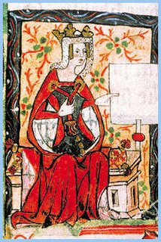
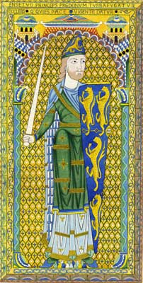
Henry Plantagenet
Born 1133, son of Empress Maud and Count Geoffrey of Anjou
  Younger brother, also called Geoffrey
  Grandson of Henry I
Inherited Normandy, Maine and the Touraine from his father
England he claimed through his mother and took from Stephen’s heirs
  Treaty of Winchester
Anjou he took from his brother
Aquitaine he got through marriage

Slide 4
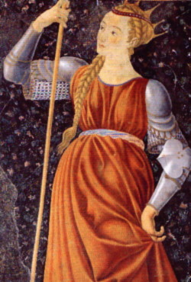
Eleanor of Aquitaine
Born 1122: “brought up with delicacy and reared with an abundance of all delights”
Intelligent, educated, headstrong, sophisticated; not always self-disciplined
Energetic; skilled sportswoman
Beautiful, flirtatious, tall and slender; probably red, or auburn, hair
Scandalous reputation – accused of many love affairs, including with her uncle
Fiery temper
Determined to stake her own claim to rule her own lands
“An exceedingly shrewd and clever woman ... But unstable and flighty.” – Gervase of Canterbury
Notes:
Aquitaine more liberal than other northern European states; women fared better here – e.g. were allowed to own and inherit property in their own right – and rule autonomously in lands they inherited. They took part in public life and, unlike women in northern France, were not kept secluded from men or mainstream society. High born women renowned for elegance of dress but censured by Church for wearing charcoal eyeliner and rouged cheeks. Attitudes towards sex and morality more lax in Aquitaine and it was described by disapproving northerners as one large brothel!
Eleanor said to be jealous of Henry’s philandering – some even accuse her of murdering Rosamund de Clifford in very lurid tales including ...
Roasting her naked between two fires and then leaving her to bleed to death in a hot bath with venomous toads on her breasts
Poisoning her
Offering Rosamund the choice between a dagger and a bowl of poison
Tearing out her eyes
However Eleanor could not possibly have murdered Rosamund as she was in captivity herself at the time!

Slide 5
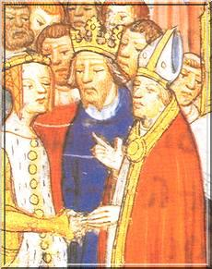
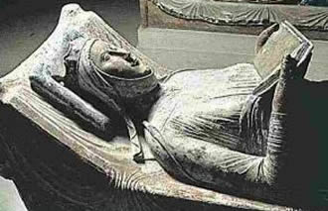
Marriage
Eleanor of Aquitaine in 1152
  6 weeks after divorcing Louis VII
  Brought Aquitaine with her
    Giving Henry more power in France than Louis
    Louis and Henry’s younger brother, Geoffrey, went to war against him
    Geoffrey claimed Anjou
    Henry II won easily – and took Anjou
Eleanor bore 5 sons and 3 daughters
  William; Henry; Mathilda; Richard; Geoffrey; Eleanor; Joan; John

Slide 6
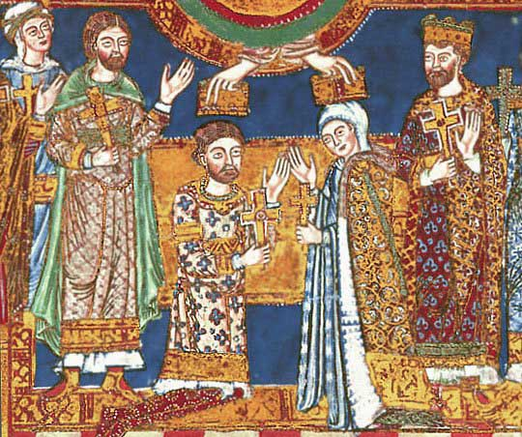
Children
4 sons lived to adult hood:
Henry, Richard, Geoffrey, John
  Two became kings: Richard and John
  All had rebelled against him before he died
All 3 daughters lived to marry
  Mathilda married Henry of Saxony
  Eleanor married King Alphonso of Castille
  Joan married King William of Sicily and then Raymond VI, count of Toulouse

Slide 7
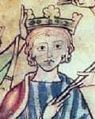
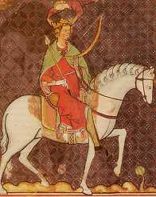
Henry II’s Legacy
Did not see his “Empire” as such; instead, territories to settle on his sons
January 1169 – announced succession
  Henry “The Young King” (born 1155)
    England, Normandy, Maine, Anjou
    Crowned 1170 to establish his position though no real power to go with it
  Richard – northern part of Eleanor’s lands
    Count of Poitou
  Geoffrey – count of Brittany through marriage
  John – Lackland
    Not even 2 so no plans as yet

Slide 8
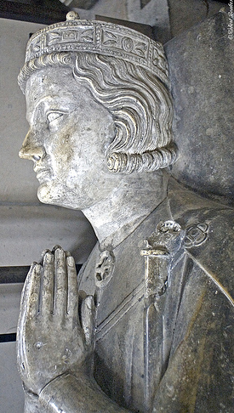
Family Feud ~ 1
1173: Henry II agreed betrothal John to daughter and heir of Count of Marienne
Granted John 3 castles in heart of the Young King’s Anjou lands without consulting him
  Chinon; Loudon; Mirabeau
  Richard & Geoffrey joined the Young King in rebelling against their father
  Eleanor of Aquitaine, now estranged from her husband, joined them
    As did the King of Scotland
    Counts of Flanders, Boulogne and Blois
    Earls of Chester, Norfolk and Leicester

Slide 9
Causes of the Rebellion
Family
Baronial Unrest
Continental Rivalry
Can we give details to show how the above headings caused the 1173/4 Rebellion? Which heading is most significant?

Slide 10
Events of the Rebellion
1173
July
Aug
Sept
Oct
1174
April
May
June
July
Aug
Sept

Slide 11
Reasons for Victory?
Success?
Support
Money
Lack of Co-ordination
Public Opinion
Henry II

Slide 12
Consequences
Royal Forest encroached – many fined
Sons forgiven – would later be the ruin of Henry
Henry failed to solve the succession issue
He forgave rebel barons – destroyed castles but returned land
Welsh were rewarded for their support
Treaty of Falaise 1174 King William suffered – he lost Scotland as a fief held from Henry. He also lost Roxburgh, Berwick, Jedburgh, Edinburgh and Stirling. Encroached into Scotland. The fact that he never took advantage of these claims shows that Henry was not interested in Empire – just wanted to prevent future invasion with a buffer zone.
Apperance of victory – in control and expanded lands
‘All of his enemies now laid bare’ – Henry now knew where and who his enemies were.

Slide 13
Did Henry Learn from the Rebellion?
Yes
Treatment of Scotland
Eleanor?
Baronial power
Assize of Arms 1181
No
Succession plans
Mercenaries
Rivalry with France

Slide 14
“The Rebellion of 1173/74 was a serious attack on the authority of Henry II”
How valid is the statement?

Slide 15
1175
Makes peace with Louis VII
Christmas at Argentan – all 4 attend
Henry makes YH stay with him – pair return to England, visit Canterbury and go on a progress – to show public unity and to keep an eye on Henry and show the people that his heir is now loyal.

Slide 16
1176-77
Assize of Northampton
YH began complaining once again and visited Paris and Flanders, complaining about his lack of control
Henry’s affair with Alys becomes famous and angers Louis VII. The Pope demands she marry Richard immediately.
Henry meets Louis at Ivry – Henry agrees to the marriage of Alys and Richard and they agree to crusade together.
IRELAND is assigned to John.

Slide 17
1178 - 79
YH follows European tournament circuit.
YH returns to England and is honoured by Henry.
Richard is dealing with Aquitaine rebels harshly – Taillebourg Castle raised to the ground
King Louis visits England to visit Becket’s tomb

Slide 18
1180 - 81
Glanville elected Justiciar
YH visits England to warn his father that Philip is no Louis. Henry travels to France in June to meet with Philip they renew promises made at Ivry. Before the meeting Henry makes YH swear allegiance on the tomb of Henry I.
Sept - King Louis VII died and was replaced by his young son Philip.
‘Philip was wiley, unscrupulous and unwaveringly clear about his main objective: to increase his power and diminish that of Henry II and his successors’ – Carpenter
Geoffrey married Constance and ruled Brittany in her name. Henry returned to England and elected Geoffrey the bastard as his chancellor.
Richard spent time in Aquitaine

Slide 19
1182
March Henry returned to Normandy to watch events in the south. Richard’s harsh rule was upsetting vassals. They began to plot against him and seduced the Young Henry to join. De Borne again was instrumental in persuading Young Henry to rebel. Duke Geoffrey joined YH in invading Poitou and launched a civil war against Richard.
In the Summer Henry rode south to make peace between his sons
Henry returned to Normandy to help William the Lion and Matilda who were in exile. At the end of the campaigning season YH returned to Normandy and demanded control of Anjou – when refused he ran to Philip in Paris.
He returned to Normandy for Christmas as all sons were required to attend.
YH, fuelled by De Borne exploded and in trying to placate him Henry offered to make Rich and Geoff swear allegiance to him. Geoff agreed but Richard flatly refused – Christmas was ruined and it was not long before the brothers were at war

Slide 20
1183 - 84
War continued and Henry in attempting to solve the dispute was shot at by YH’s men. Henry cut his funds but he joined a mercenary force with Geoff.
Young Henry contracted Dysentery and died – Henry was contacted but thought it was a plot and refused to attend but sent a ring.
Eleanor was summoned to Normandy to claim ancestral land that Philip was demanding – this saw the beginning of the relaxing of her imprisionment.
Henry returns to England
Richard fights off an invasion by John and Geoff.

Slide 21
1185 - 87
Henry refuses the crusade(85)
Geoffrey was killed in a tournament. Richard wanted to be announced as Heir to the Empire but Henry would not unless Richard promised Aquitaine for John. He refused (86)
Philip of France invaded Anjou and Henry was forced to concede territory (for the first time in his reign)
Richard put down a rebellion in Aquitaine – Philip appealed to Henry to control his son but Henry was unable to so.
Philip then invaded Berry, Auvergne and Touraine
Capture of Jerusalem – Henry, Richard and Philip take up the cross. Richard is determined to go but wanted to settle succession before he left. Henry refused so Richard through in his lot with Philip (87)

Slide 22
1188 - 89
Philip recognised Richard as the heir to the Angevin Empire.
Henry was forced to sue for peace in late 1188.(88)
June Philip and Richard invaded Maine and Anjou.
July Henry was forced into unconditional surrender. Philip had exploited the poor relations between Henry and his sons.
The inflexibility of Henry left him in an impossible situation. Propped up on his horse with fever Henry surrendered lands, castles and payments for Philip’s expenses.
As he kissed Richard he whispered in his ear – ‘May the Lord spare me until I have taken vengeance on you’
Henry was shown a list of traitors and when seeing John’s name lost the will to live. He died in the great fortress at Chinon, deserted by his wife and sons and his lands in tatters. (89)

Slide 23
Many contemporary chroniclers saw Henry’s death as punishment for the Becket murder
‘The whole of human fate seemed to respond to the nod of the king’ Here was also a king with a real sense of care for his kingdom, who had restored its mutilated frontiers, recovered the rights of the crown, restored peace and order and built the common law. His successor was to be very different’ - Carpenter

Slide 24
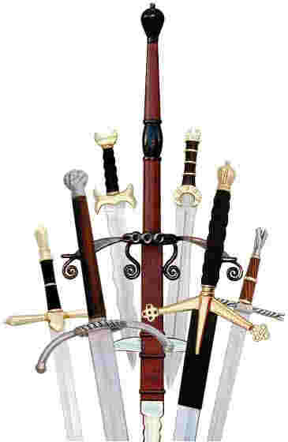
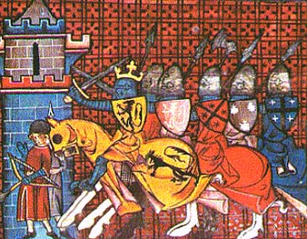
Family Feud ~ 2
Henry II beat down the first revolt
  After which at height of his powers
  Next family quarrel = 1182 → 1183 after the Young King invaded Poitou – Richard’s territory
    Henry II tried negotiate settlement – failed
    Geoffrey joined the Young King against Henry II and Richard
    The Young King died June 1183
      Richard now heir to England, Normandy and Anjou
      But Henry II wanted Anjou for John
      Richard refused and now fought his father
Notes:
After beat down first revolt, Henry II at height of his powers: Young King cowed; Richard pre-occupied in Poitou; Louis VII of France old and ineffectual – died 1180; and Henry supreme over Scotland after its king had been captured in 1174, during rebellion, and signed Treaty of Falaise under which he surrendered Scotland to Henry II and received it back from him as his vassal – public act of homage done; in addition, English garrisons in castles at Edinburgh, Roxburgh and Berwick.

Slide 25
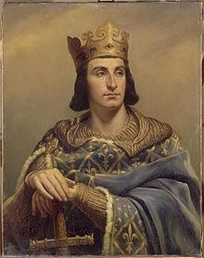
Philip Augustus
1165-1223 (1180-1223)
Son of Louis VII
Crowned 1 Nov 1180 at the age of 15.
Not a great soldier but an unscrupulous diplomat.
He was skilled at using the mistakes of others.
1183 – Henry paid homage to Philip for his continental lands.
1186 – Began to plot his attack on the Angevins using his sister Alice.
“He was ambitious, full of energy, and possessed of great political sagacity – qualities lacking in his father” – Poole
“..his plan (Philip) was to bring about the ruin of the Angevins by fomenting the discord in Henry’s family circle” Poole

Slide 26
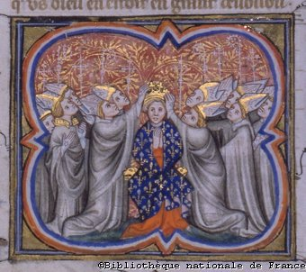
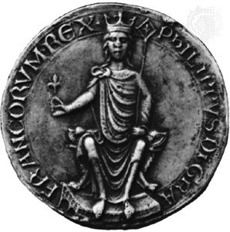
A Divided Family
Geoffrey and John now fought Richard
  Without success
  Geoffrey died 1186
  Richard convinced Henry II wanted John as principal heir
    Encouraged in this by Philip II of France
    Philip II also claimed Brittany now Geoffrey dead
      Overlord; took Geoffrey's daughters into his custody
    Philip II and Richard formed bond and fought Henry II
    Lasted until Henry II’s death
When Henry II died he had just given in to Richard and Philip – a day after learning that they had won John over to their side

Slide 27
Essay
“A belligerent [aggressive] ruler mainly interested in territorial expansion at the expense of his neighbours.” To what extent do you agree with this judgment of Henry II as King of England and ruler of the Angevin Commonwealth from 1154 to 1189?

