Slide 1
Kerala, India – Population policy
LO: to understand a different way of dealing with population issues
To evaluate the policy in comparison to the Chinese one child policy

Slide 2
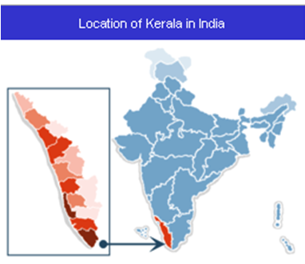
http://www.youtube.com/watch?v=0VF4knOMj0I
The state is poor with a low per capita income
BUT……
Low infant mortality
Declining population growth
High literacy rate for men and women
High status of women- tradition of female schooling

Slide 3
What has the Indian Government done?
The policy makers assumed that excessive family size was part and parcel of poverty and had to be dealt with as integral to a general development strategy. Education about the population problem became part of school curriculum under the Fifth Five-Year Plan (FY 1974-78).

Slide 4
What has the Indian Government done?
During the 1980s, an increased number of family planning programmes were implemented through the state governments with financial assistance from the central government.
In rural areas, the programmes were further extended through a network of primary health centres.
By 1991, India had more than 150,000 public health facilities through which family planning programs were offered.

Slide 5
The family planning programmes included:
Cash incentives for those who are willing to be sterilised.
Commissions for health workers.
New schools, drinking water and roads for areas that meet their targets.
Proposal to only allow people with two or less children to run for public office.

Slide 6
Education of Women
Literacy rates amongst women have increased to 55%.
They can get better jobs and wages.
Women have fewer children because they are more interested in careers.
Women are able to read and understand advice about family planning-they are more aware of contraception available and are having fewer children.
Women have a greater role and lead within the family and can make decisions about how many children they want.

Slide 7
Increasing the number of health clinics.
There are now more health clinics in Kerala than any other area in India. Most neighbourhoods have good access to medical attention and supplies. As a result infant mortality has decreased as children can be treated quicker and receive inoculations. Therefore families are realising that they do not need large families in the hope some children will survive. This has brought about a significant decrease in Keralas' birthrate.

Slide 8
Improving availability of contraception.
Free contraception and education about family planning has reduced the average family size in Kerala. As well as reducing population growth it has also reduced pressure on the health centres so even more people can have quick access to treatment. This further reduces the need for large families.

Slide 9
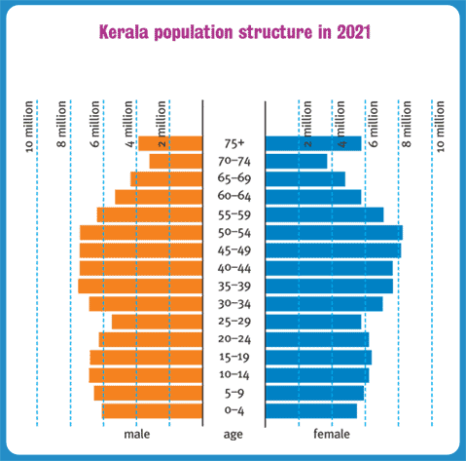

Slide 10
What impact has this had on people and the population?
1. The population structure of Kerala has changed significantly.
2. Quality of life has increased as the decreasing demand for services means there is more to go round for the people of Kerala, such as health care.
3. The role of women has changed. Better education means they have better access to jobs and can earn more money and make informed lifestyle decisions about family size for example.
4. The above policies have been successful in reducing population size and quality of life in Kerala.

Slide 11
Figures to show the success of the policy…..
Kerala has had dramatic success in lowering its birth rate; without regulation like China or financial incentives like the rest of India.
India’s birth rate: 1975 38.2 per 1000
1995 29.1 per 1000
2000 25.2 per 1000
Significant regional differences:
Utah Pradesh 40 per 1000
Kerala 18 per 1000

Slide 12
Exam question practice:
“Government attempts to control population are ineffective.” Discuss this statement…
15 marks

