Slide 1
Was James II really a tyrant or was he actually a popular King?
Draw this line – including the headings – across a double page spread
Place the cards along the line
Challenges: 1. What was the English interpretation of James II?
2. How could your interpretation be different if you were Scottish or Irish?
3. How could different countries have different interpretations?
Tyrant
Popular King

Slide 3
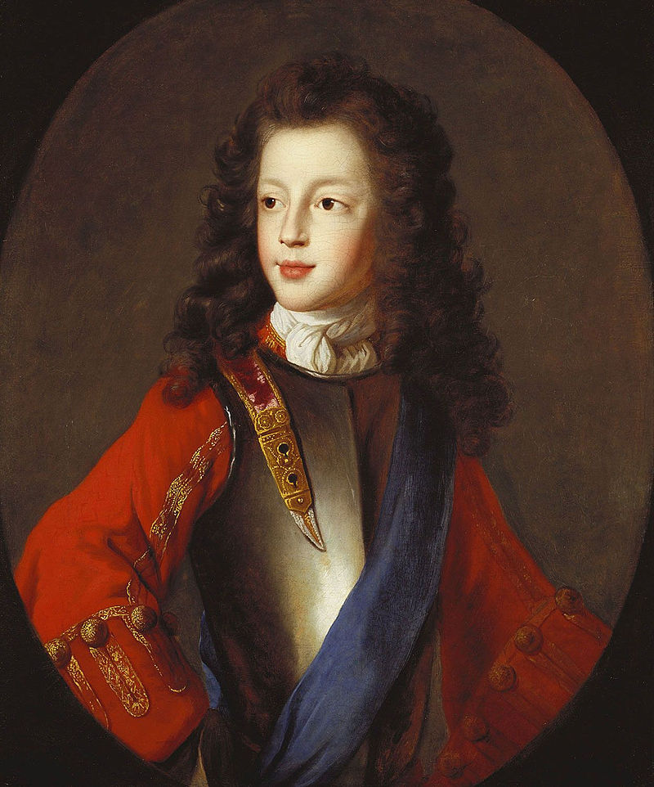
10th June 1688, James II and his Catholic wife, Mary of Modena had a son. They named him James Stuart. James II now had a Catholic heir to the throne!
How might Parliament have reacted to this? Happy? Scared? Angry?
Why might Parliament have reacted this way?
Challenges: 1. Who could have been happy about this event?
2. Why might there have been different interpretations about this event?

