Slide 1
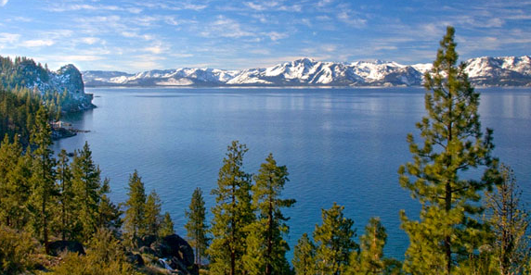
Section 2: The Natural Environment

Slide 2
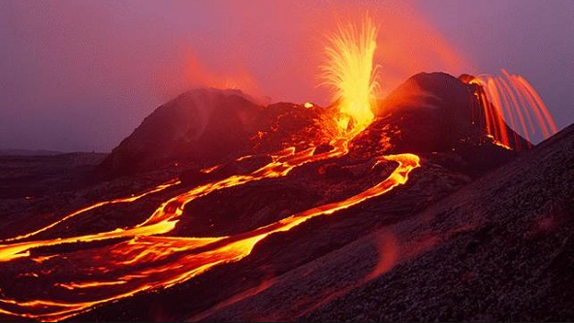
Section 1: Volcanoes and Earthquakes
Complete the learning objective sheet
Create a page in your book that will become your earthquakes and volcanoes GLOSSARY

Slide 3
What: Plate tectonic theory Why: To be able to explain the different ways in which plates move and their resulting activity How: To explore plate tectonic theory, the 3 main types of plate movement and hotspots

Slide 4
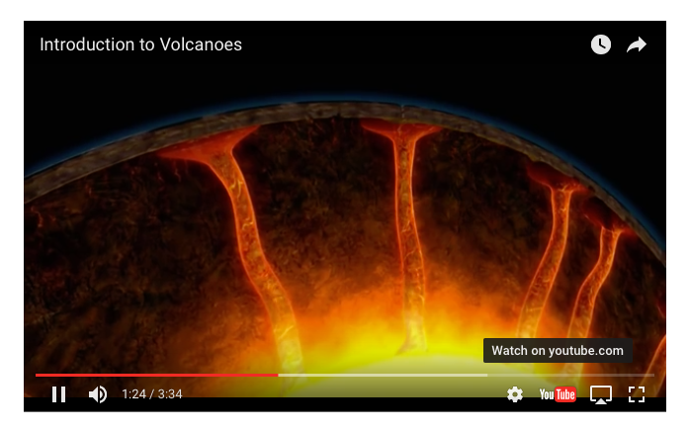
https://www.youtube.com/watch?v=Be7o6BYVOzA

Slide 5
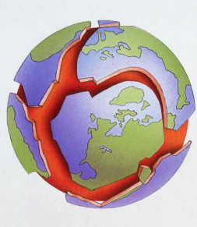
An Introduction to plate tectonics

Slide 6
THE EARTH'S STRUCTURE

Slide 7
THE EARTH'S STRUCTURE

Slide 8
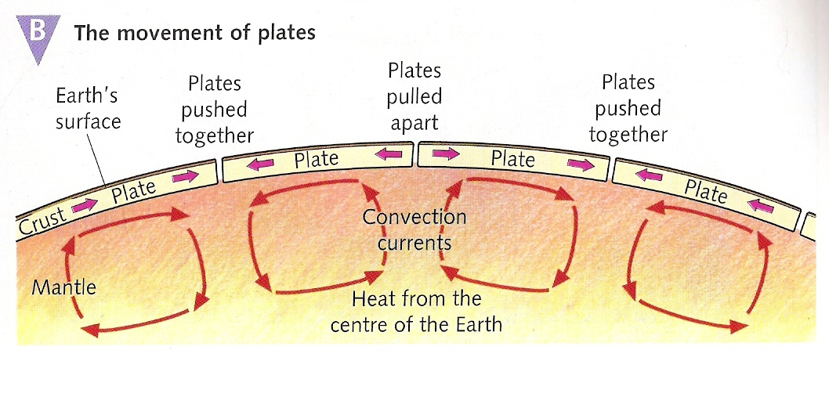
Tectonic Plates
The Earth’s crust is divided up into plates
These plates ‘float’ or move very slowly (a few mm per year) on the molten material of the mantle. This movement is caused by convection currents in the mantle.

Slide 9
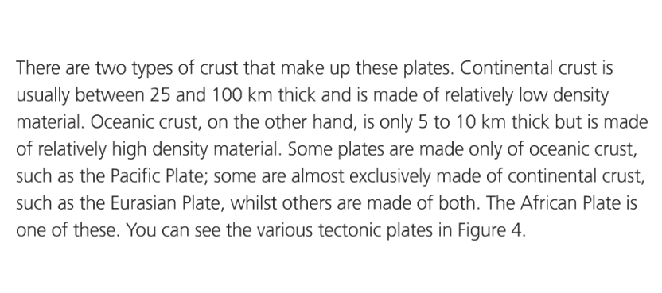
In your own words explain the difference between continental crust and oceanic crust

Slide 10
Convection currents
https://www.youtube.com/watch?time_continue=316&v=QDqskltCixA
https://www.youtube.com/watch?v=Kpoko_l34ZE
Complete the convection currents worksheet

Slide 11
On the Move - Continental Drift
Task 1 - Watch the video: https://www.youtube.com/watch?v=uGcDed4xVD4. Stop the video when you recognise any landmass e.g. North America. What period was that?
Task 2 - Take a screenshot of now and 100 million years from now on the YouTube video. Annotate the major differences between now and in the future. Try to find at least five differences. How has the location of your home country changed?

Slide 12
Explain the difference between continental crust and oceanic crust

Slide 13
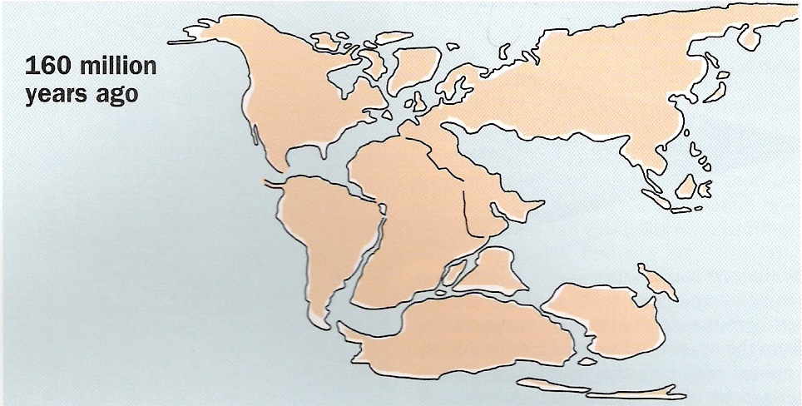
Image of the world 160 million years ago

Slide 14
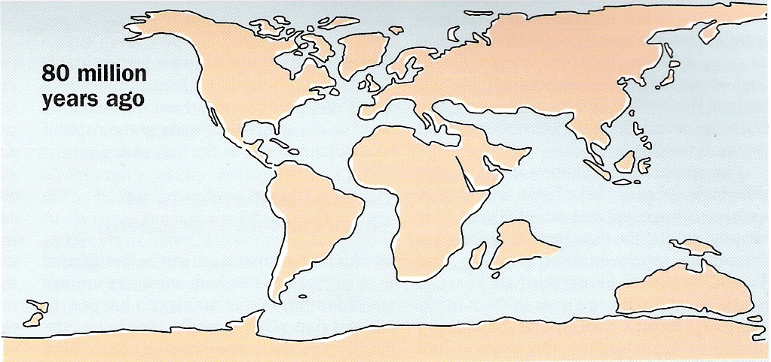
Image of the world 80 million years ago

Slide 15
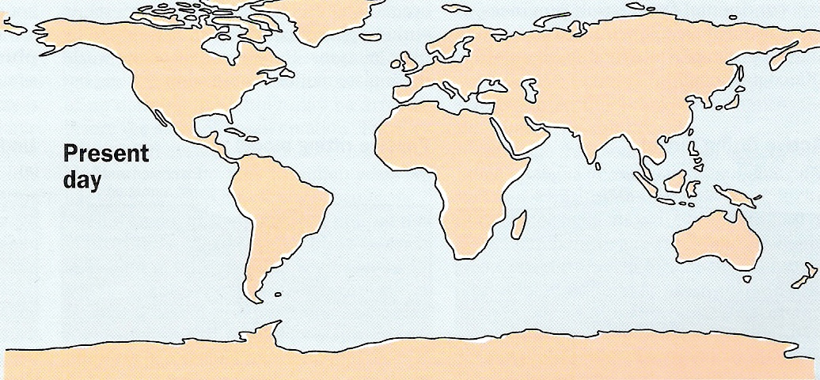
Image of the world today

Slide 16
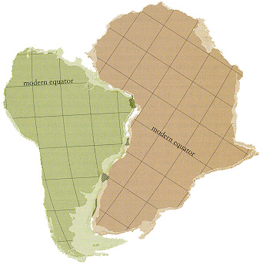
Evidence

Slide 17
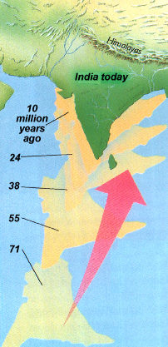
Evidence

Slide 18
The location of volcanoes and earthquakes
Name 10 locations where volcanoes and earthquakes occur

Slide 19
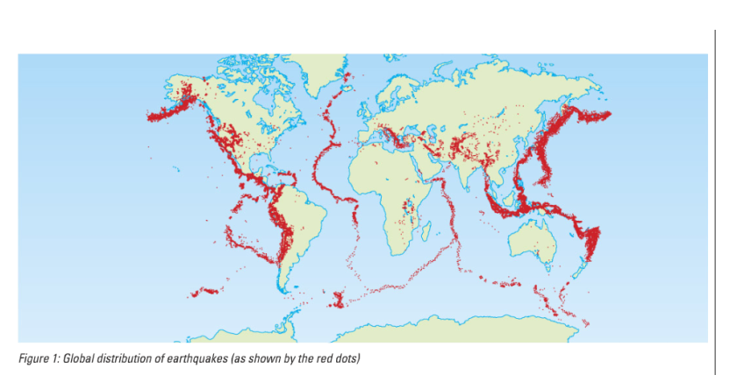
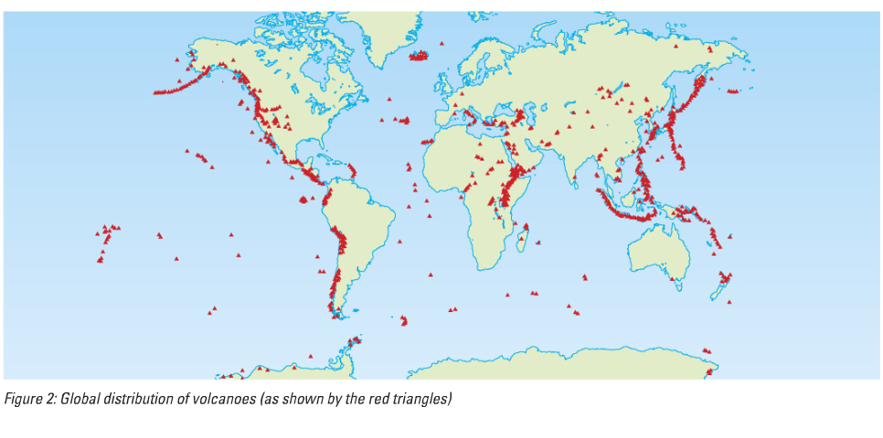
Complete the mapping activity locating earthquakes and volcanoes

Slide 23
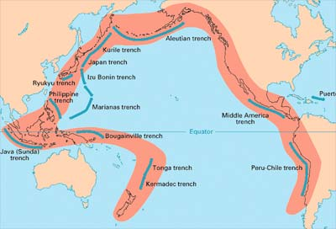

Slide 24
Where do earthquakes and volcanoes occur?

Slide 25
Skills Builder 1- model answers
(a) Earthquakes occur in broad belts. Tend to be found in the middle of oceans e.g. Atlantic or along the edges of continents e.g. West coast of North America. Can also occur just off-shore of continental landmasses, e.g. western Pacific Ocean. There are some exceptions; there are earthquakes inland such as in eastern Africa.
(b) Volcanoes also occur in broad belts. Found along the edges of continents e.g. West coast of South America. Can be found just off-shore of continental landmasses, e.g. western Pacific Ocean. Anomalies include cluster of volcanoes in the mid-Pacific around Hawaii and band of volcanoes inland in eastern Africa.
N.B. Able students might note that earthquakes and volcanoes often occur in the same locations.

