Slide 1
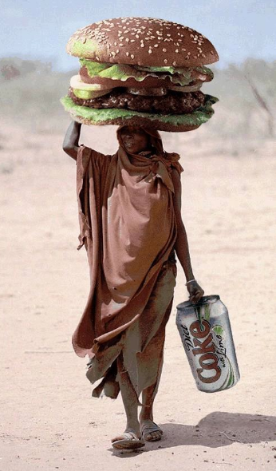
IB HL paper 3:
Global interactions
HL TOPIC 1: POWER, PLACES AND NETWORKS
Introduction to the impact of globalization on economic, cultural, environmental and political spheres

Slide 2
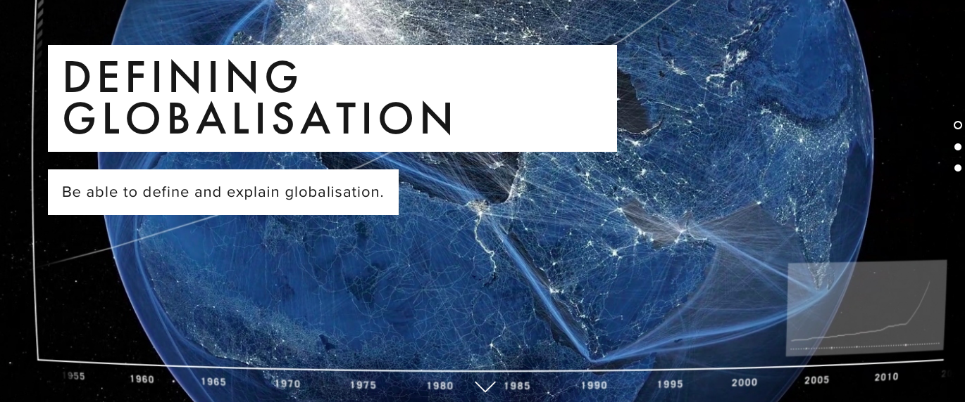

Slide 3
Globalisation

Slide 4
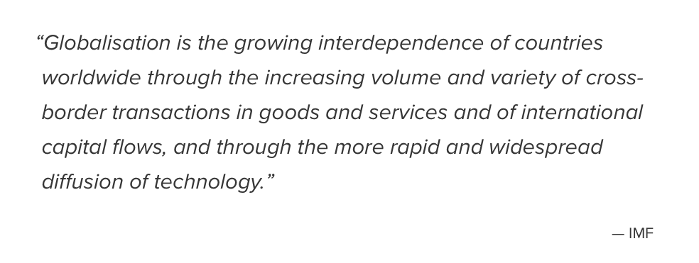
Definition of globalisation

Slide 5
Global interactions
The study of global interactions in this syllabus has a broader perspective.
A more conventional study of globalisation places emphasis on a linear process involving the domination and the imposition of western culture on the world.
In the context of this syllabus:
Global interaction suggests a two‑way and complex
process whereby cultural traits and commodities may be
adopted, adapted or resisted by societies.
The process is neither inevitable nor universal.

Slide 6
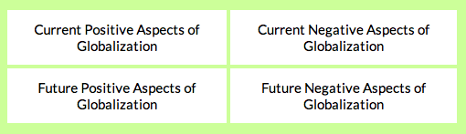
Key aspects that are key to the course…..
In groups list 3- 5 points you think you could add to each of these headings

Slide 7
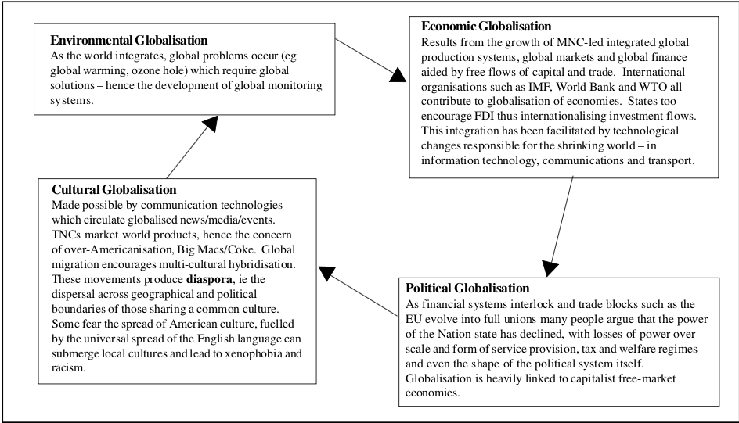
Types of globalisation
Take brief bullet points notes on the 4 types of globalisation.

Slide 8
Example HL IB Exam question:
"Our world is now connected beyond the point of no return. Halting globalization would lead to the collapse of society" - To what extent do you agree with this statement? (15MKS – 16MKS in new IB course.)
FYI:
You will answer 2x essay questions in paper 3
One 12 mark and one 16 mark
12 mark more straightforward/16 mark more synoptic

Slide 9
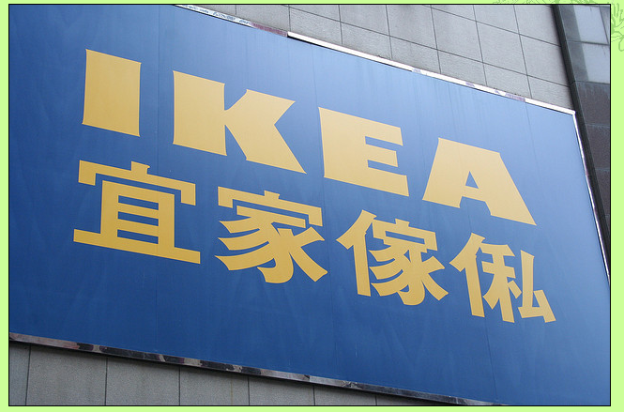
Which country do you think is the 'most globalised'?

Slide 10
Measuring globalisation
What: Globalisation indices showing how countries participate in global interactions.
Why: Wealthy and powerful places exist at varying scales; the global map is complex and subject to change.

Slide 11
Measuring globalisation
Levels of globalisation can be measured to show to what extent countries participate in global interactions.
There is considerable spatial variation in levels of globalisation: some countries can be considered to be 'cores' (at the centre) of global interactions, initiating and receiving high volumes of interactions.
Other areas may be considered to be 'peripheral' (on the edge or periphery), initiating and/or receiving low volumes of global interactions.
In between these extremes are the semi-peripheral or transitional regions, in the process of becoming more or less globalised.

Slide 12
How would you measure globalization?
  Think of approx. 5-10 ways of measuring the degree to which a country is globalized.
  In each case justify your choice of measure.
  Try to group the measures - come up with your own group headings.

Slide 13
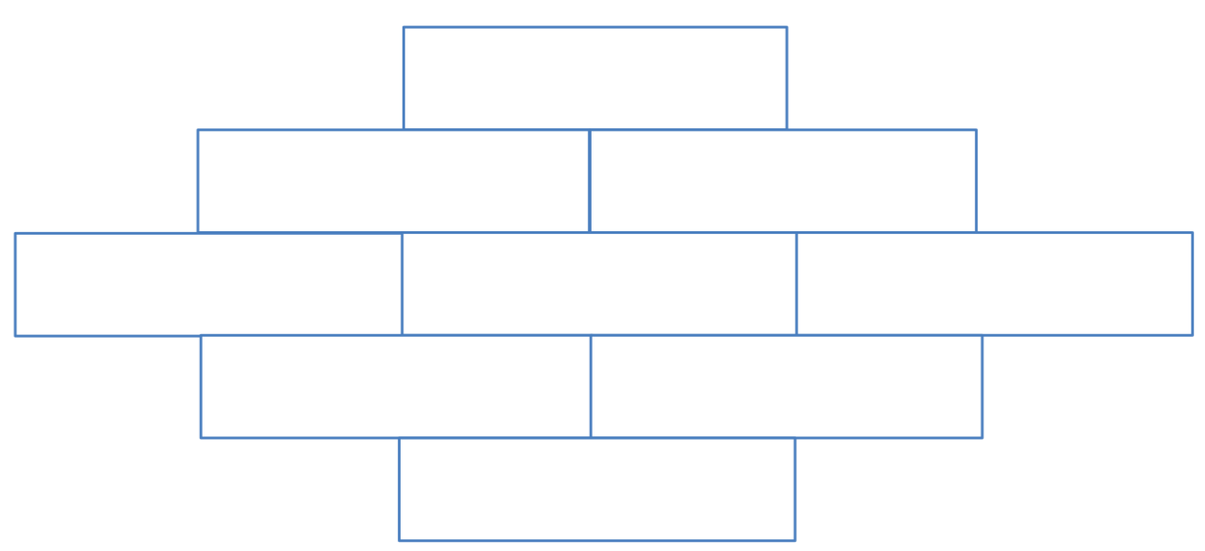
Rank the following characteristics of globalization in order of importance in a 9-card diamond ranking.
Flows of trade
Flows of foreign direct investment (FDI) and portfolio investment
Level of barriers to trade and flows
International telephone traffic
Tourism both to and from a place
Size of foreign population
Information flows (Internet users, television ownership, trade in newspapers)
The number of embassies
Membership of international organizations

Slide 14
KOF Index
The KOF Index of Globalization is an index of the degree of globalization of 122 countries.
It was conceived by Axel Dreher at the Konjunkturforschungsstelle of ETH Zurich, in Switzerland.
It was first published in 2002, and covered the period from 1970 until that year.
A new version of it was published in 2017 . It is measured on a scale from 0.00 – 100.00

Slide 15
3 Dimensions Of The KOF Index
Economic Globalisation: Long distance flows of goods, capital and services, as well as information and perceptions that a company market exchanges.
Political Globalisation: Diffusion of government policies.
Social Globalisation: Expressed as the spread of ideas, information, images, and people.

Slide 16
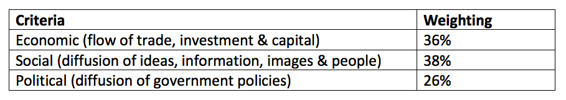
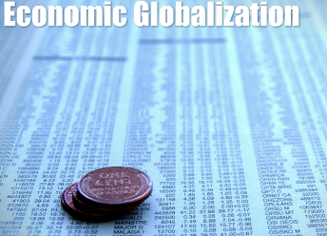
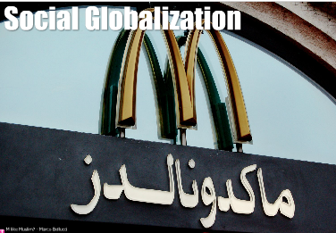
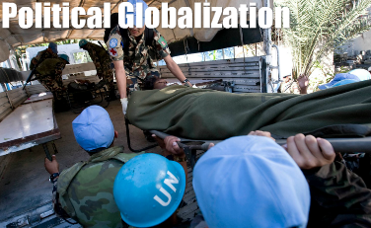
Weightings of the KOF index

Slide 17
What factors are included in the KOF index?
The KOF index uses many variables for each criterion, and these are individually weighted too. Can you correctly classify them into the three criteria?

Slide 18
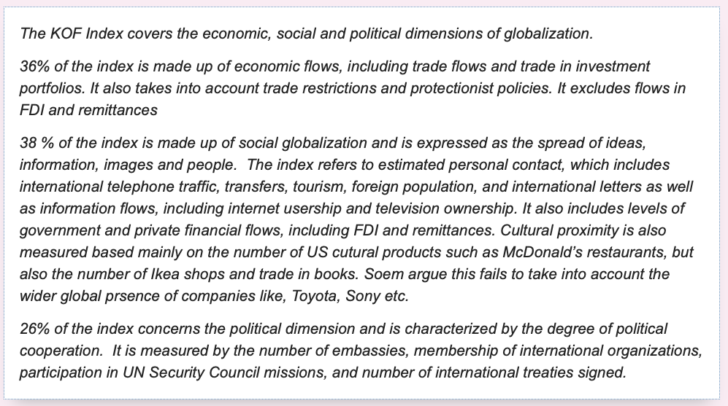

Slide 19
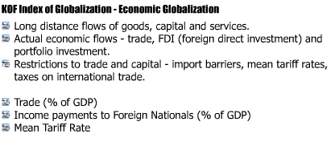

Slide 20
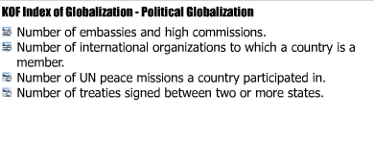

Slide 21
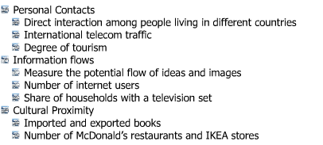

Slide 22
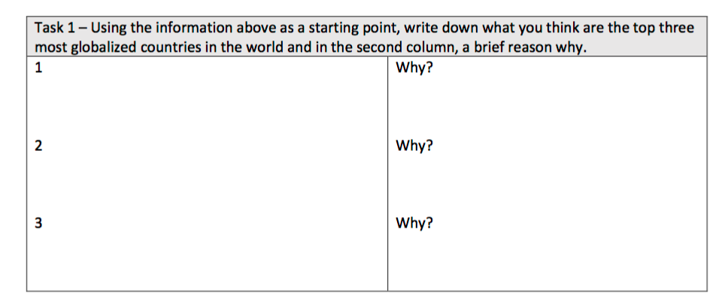
Predict – top 5 globalised countries according to KOF……

Slide 23
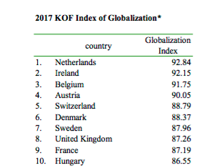
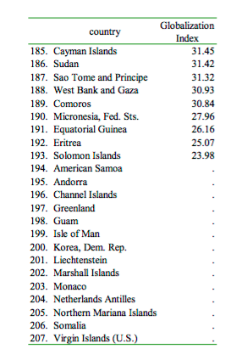
2017 KOF rankings
What are the most and least globalised countries according to the KOF Index?
What are the reasons behind low-globalisation status?
Read this KOF press release to help with your analysis

Slide 24
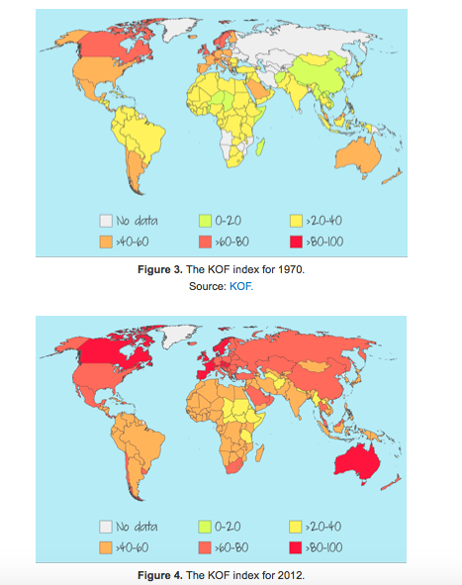
Animated version
Task
1. Describe how the worldwide level of globalisation changed between 1970 and 2012.
2. How may we explain the pattern shown on this map?

Slide 25
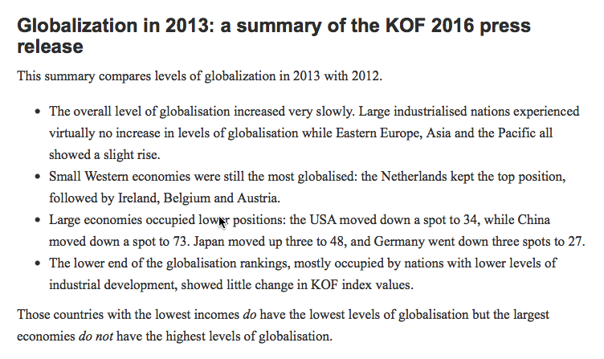

Slide 26
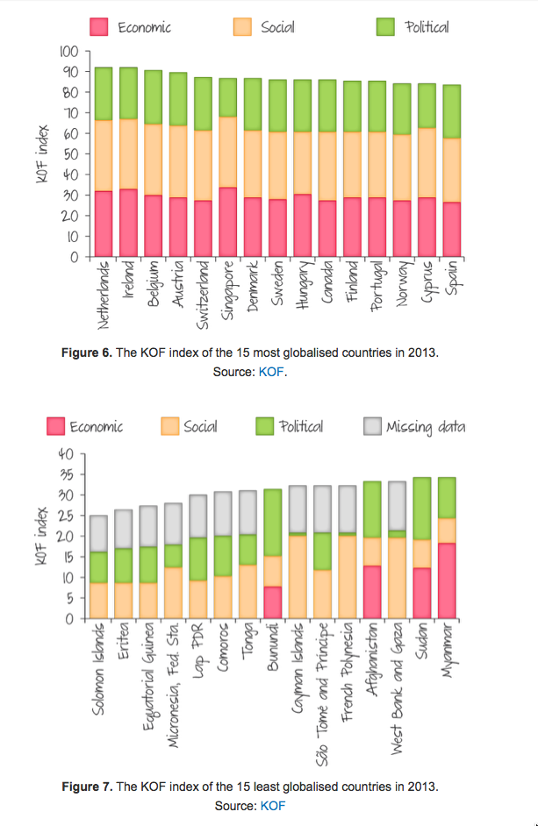
Globalisation
patterns

Slide 27
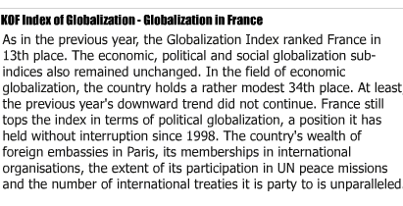

Slide 28
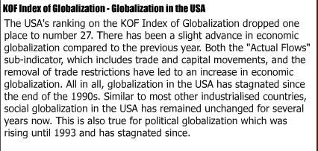

Slide 29
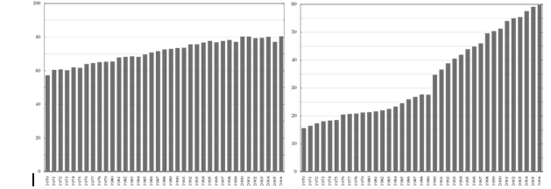
KOF – Globalization Index for Australia and China 1970 – 2006 (Left and right graphs)
(a) Describe the trends for Australia and China between 1970 and 2006.
(b) Suggest reasons for the differences in the trends.
(c) Referring to the two maps below select one country which shows a different trend in its level and rate of globalization.
(d) Examine the reasons why the level and rate of globalization varies between countries.

Slide 30
Example questions
Using examples, explain how a country’s global interactions can be measured [12]
Give an example of a measurement of globalization and evaluate its effectiveness in describing patterns of globalization. (12)
Describe the spread of globalization using one official index that you have studied (12)
Describe how one prominent index measures global interaction. (12 marks)
You can see that these questions rely on your understanding of how the KOF index measures globalization, as well as the strengths and weaknesses of the approach.
We will now look at the strengths and weaknesses of the index.
Kognity 4.1.1 can be used to help you further develop this case study.

Slide 31
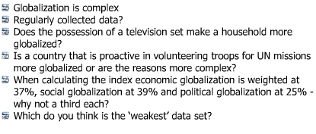
Evaluation….

Slide 32
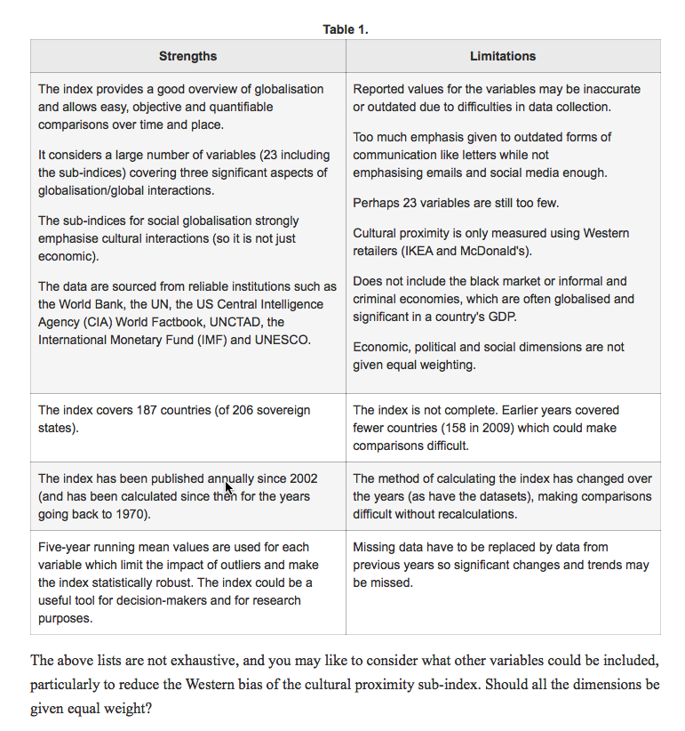
Source:
Kognity 4.1.1

Slide 33
Past paper question from Nov 2013

