Slide 1
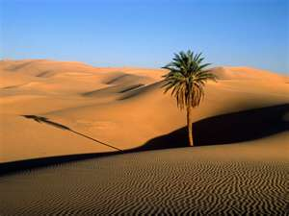
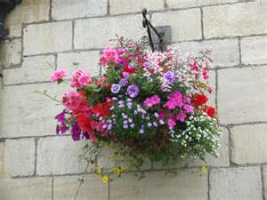
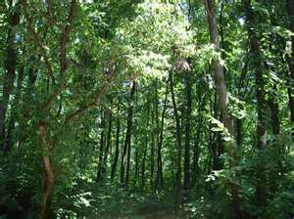
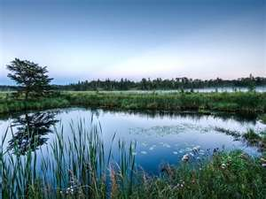
To start... Think the link?
They are all Ecosystems!!!

Slide 2
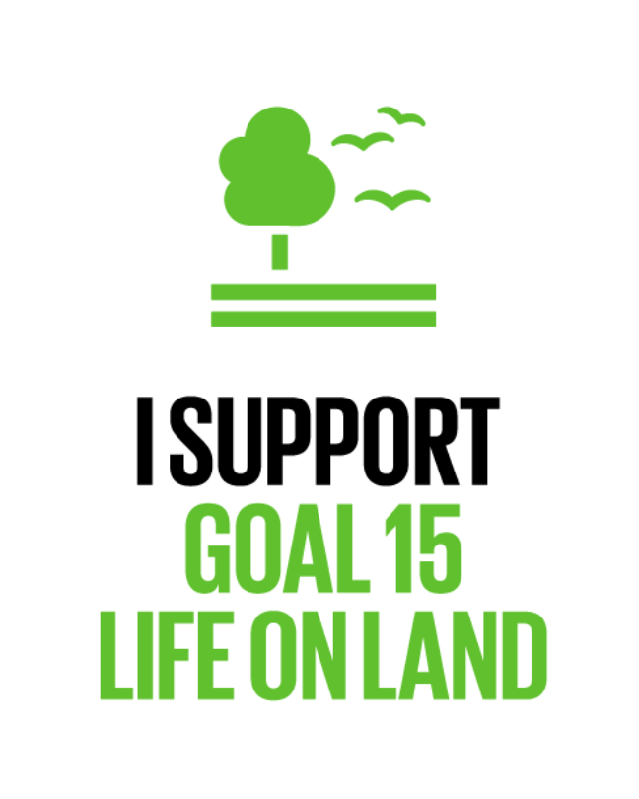
What: is a biome and an ecosystem
Why: To develop our understanding of the importance of biodiversity
How: By learning what an ecosystem and biome are and preparing a biome backpack

Slide 3
Monday, 9 November 2020
Ecosystems – What is an ecosystem?
Write what you think an ecosystem is…

Slide 4
What are ecosystems?

Slide 5
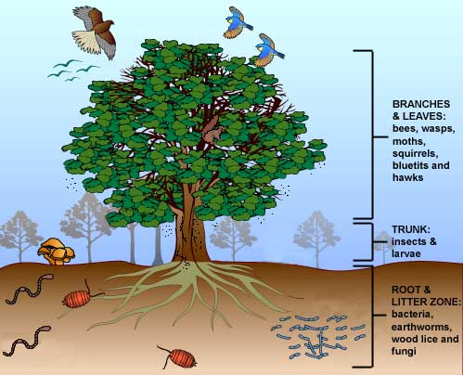
An ecosystem is a system of plants and animals whose lives are closely linked to each other and to the climate and soil of the area in which they grow or live.
Clip: What is an ecosystem?

Slide 6
Update your definition of what an ecosystem. Try to give an example

Slide 7
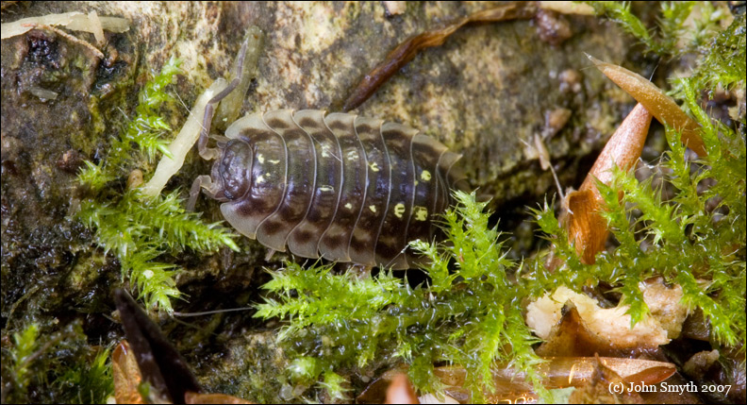
Small, or micro scale, e.g. under a leaf or a stone …

Slide 8
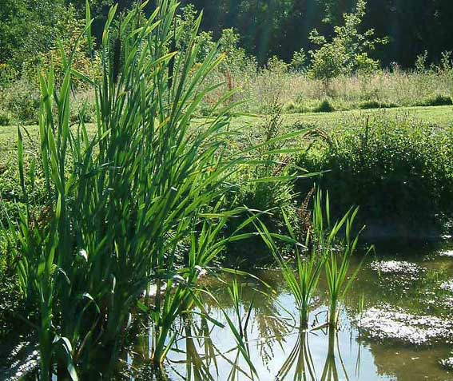
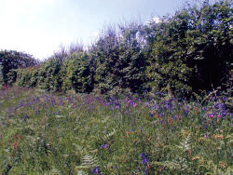
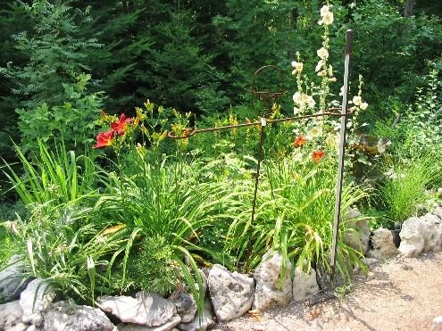
Small pond, a hedgerow,
a garden …

Slide 9
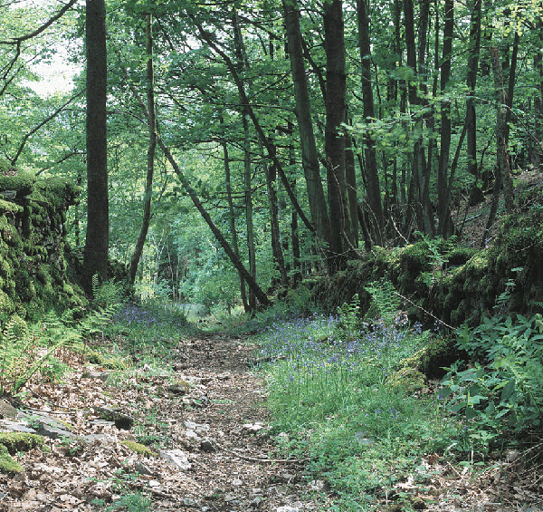
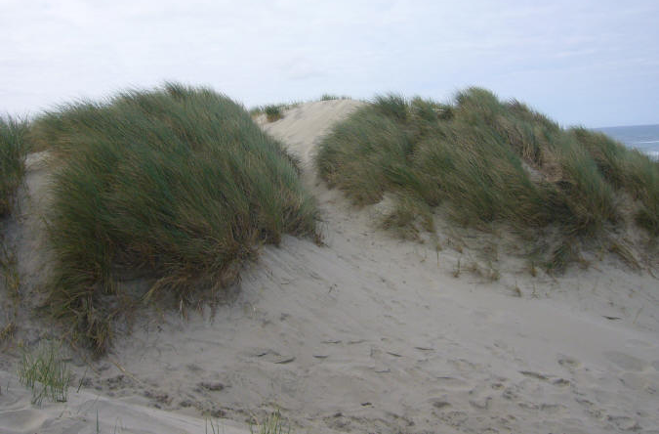
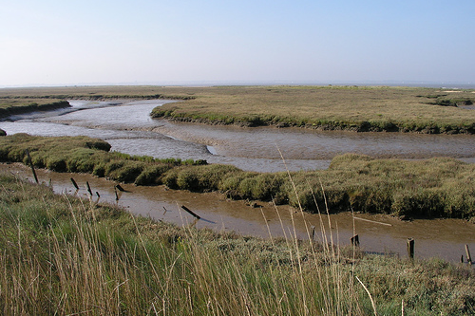
Medium scale (meso ecosystem), e.g. a woodland, a sand-dune, a salt marsh …

Slide 10
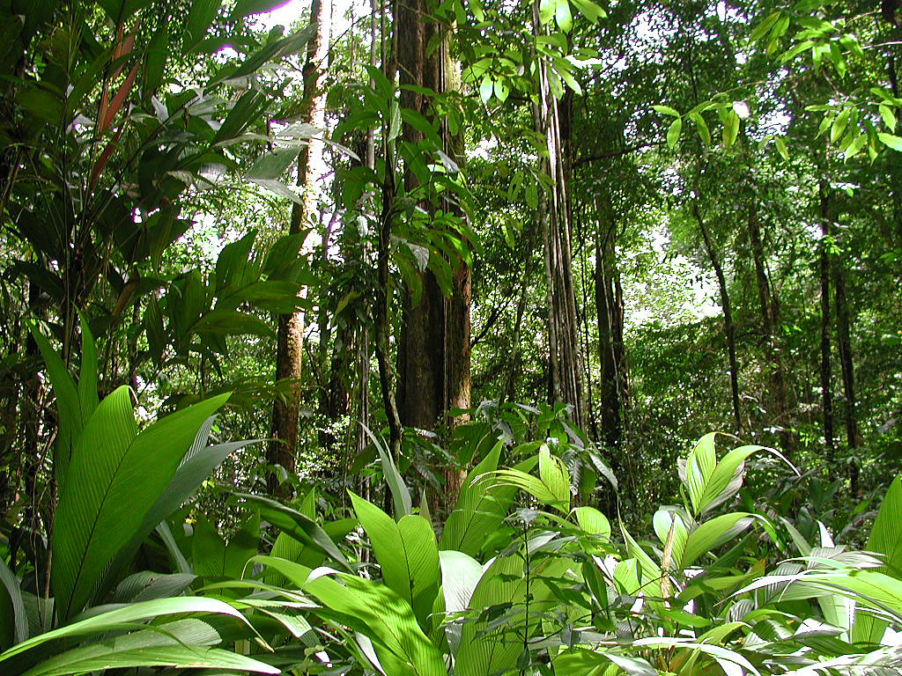
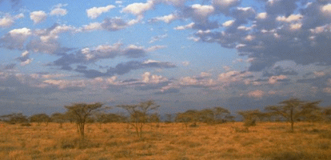
Large, or global scale or biome
e.g. tropical rainforest, tropical grassland.

Slide 11
Kahoot quiz – ecosystems!

Slide 12
Can you match the words to the definitions?
1. Environment
2. Habitat
3. Community
4. Ecosystems
5. Biome
A large ecosystem
where an organism lives e.g. woodlands
Everything around you; the air, soil, rivers and climate are part of our natural environment.
A unit made up of living things and their non-living environment
all the living things in a habitat

Slide 13
Word | Definition
Environment | Everything around you; the air, soil, rivers and climate are part of our natural environment.
Habitat | where an organism lives e.g. woodlands
Community | all the living things in a habitat
Ecosystems | A unit made up of living things and their non-living environment
Biome | A large ecosystem

Slide 14
Summary
An ecosystem is a system of plants and animals whose lives are closely linked to each other and to the climate and soil of the area in which they grow or live. Ecosystems may be changed by human activity.

Slide 15
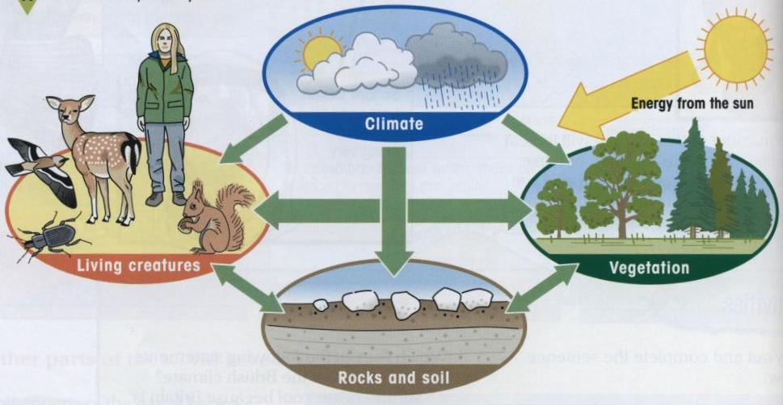
SOURCE B
This diagram shows the links between the different components of an ecosystem….
Discussion – how do these different aspects of an ecosystem work together?

Slide 16
What happens if something changes?
There is suddenly much less rainfall?
Trees are cut down?
Soil is dug up and taken away?
All of the beetles die?
People start tidying a woodland and getting moving rotting leaves out of the wood?

Slide 17
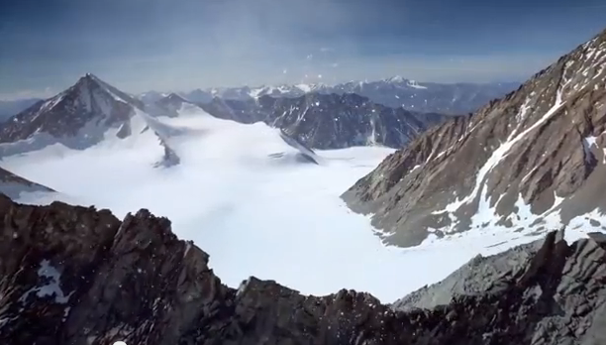
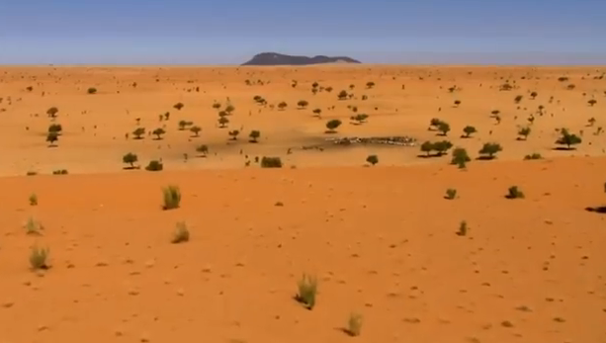
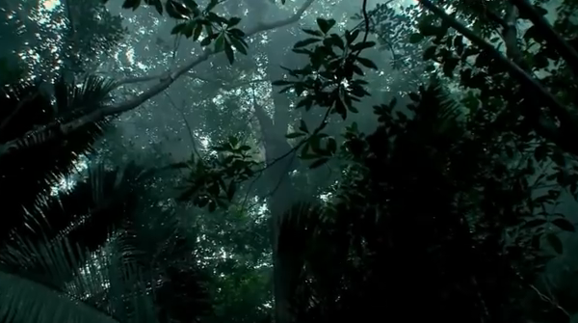
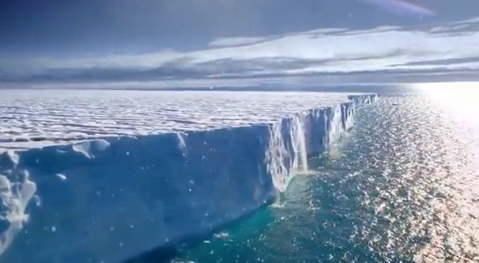
World biomes
Watch this video clip
List as many biomes as you can see.

Slide 18
Desert
Polar
Tundra
Tropical Rainforest
Savanna

Slide 20
Which colour represents each ecosystem?
Tropical Rainforest
Hot Desert
Deciduous Forest

Slide 21
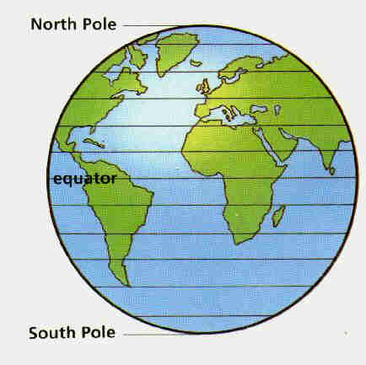
Different biomes are found at different latitudes around the world.
The latitude effects the climate of a place. The further north or south you travel from the equator, the colder it gets.

Slide 22
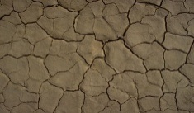
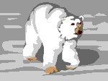
Why are ecosystems (or biomes) so different?
The Soil
How thick and rich the soil is depends a lot on the climate. In a hot, damp climate soil can form fastest.
The Vegetation
It develops and adapts to suit the climate and soil. They grow fastest and thickest in a hot, damp, sunny climate.
The Climate
The climate is the main driving force in an ecosystem as it affects…
The Animals
They adapt to feed on the plants or each other, and to cope with the climate.

Slide 23
The ………………………………………………. is very important in an ecosystem. It influences the soil, the plants and the animals. In a ……………………… climate the soil will be thicker and more fertile. This in turn influences the vegetation. There will be more vegetation in a hot climate than a ……………………………………. climate and more in a ………………………………………. climate than a ………………………………………….. climate. The animals then adapt to cope with the climate conditions and to feed on the vegetation or each other.
dry cold climate wet hot
Fill in this paragraph with the correct words in the spaces. Underline the words you have added.

Slide 24
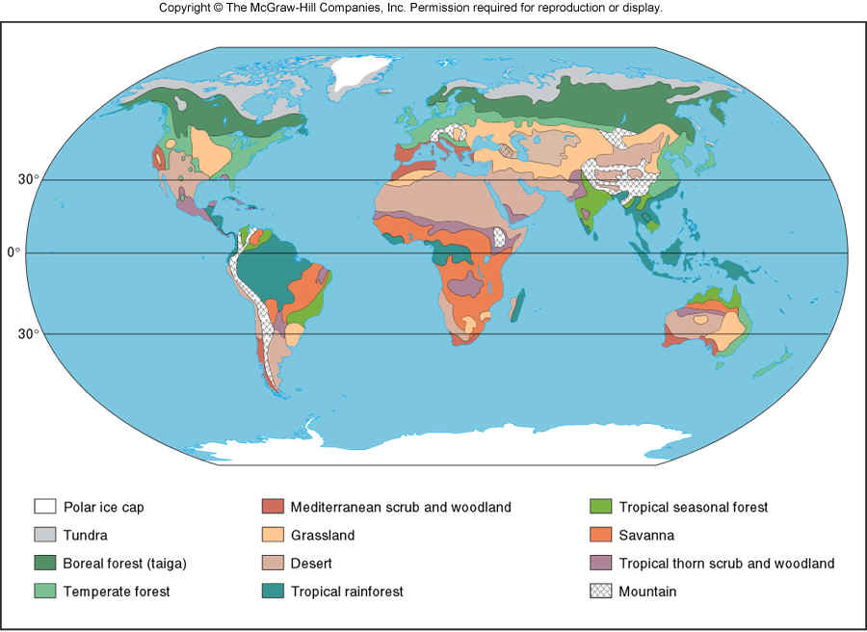
Describe the world distribution of biomes.
Questions to help you focus:
Where are the tropical rainforests found?
Where are the polar and tundra biomes found?
Where are the deserts found?
Geographical information you could use:
Places names, lines of latitude, Compass directions (North and South)

Slide 25
An ecosystem forms because of specific climate conditions.
The climate in a particular location relates to, and is affected by;
Temperature
Precipitation
Local Factors.
Factors that influence climate
Summary: give an example of 3 factors that impact climate:

Slide 26
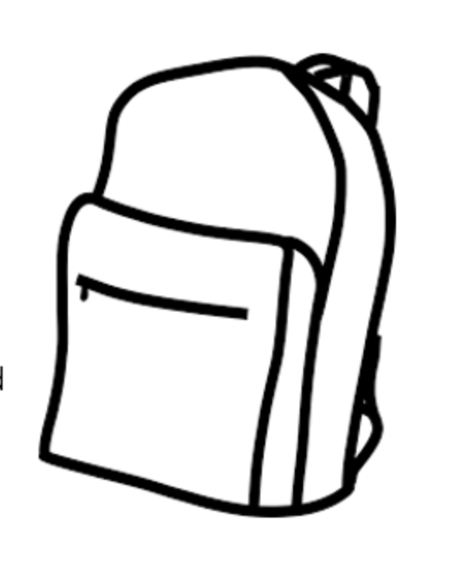
Biomes backpack
What: Learning about the characteristics of a biome of your choice
Why: So that we can understand the major natural vegetation or marine ecosystems that exist on earth and how people interact with these systems.
How: Through the investigation of a chosen biome’s characteristics including, climate, flora and fauna and human interactions and creating a backpack to show what you may need to survive in the biome

Slide 27
Biomes backpack- introduction to your biome
First research and introduce your biome
Describe the location of your chosen biome.
What is the temperature and precipitation of your biome?
Describe the flora, and fauna of this region and give reasons for this type of 'life' being found here (adaptations/ food chain)
Who lives here/how it is used by people?
What are the threats to the biome?
Resources: http://kids.nceas.ucsb.edu/biomes/

Slide 28
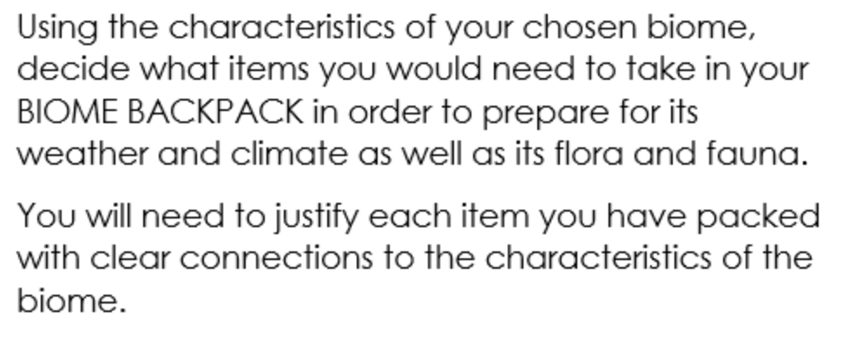
Biomes backpack- what would you need to survive in your biome?

Slide 29
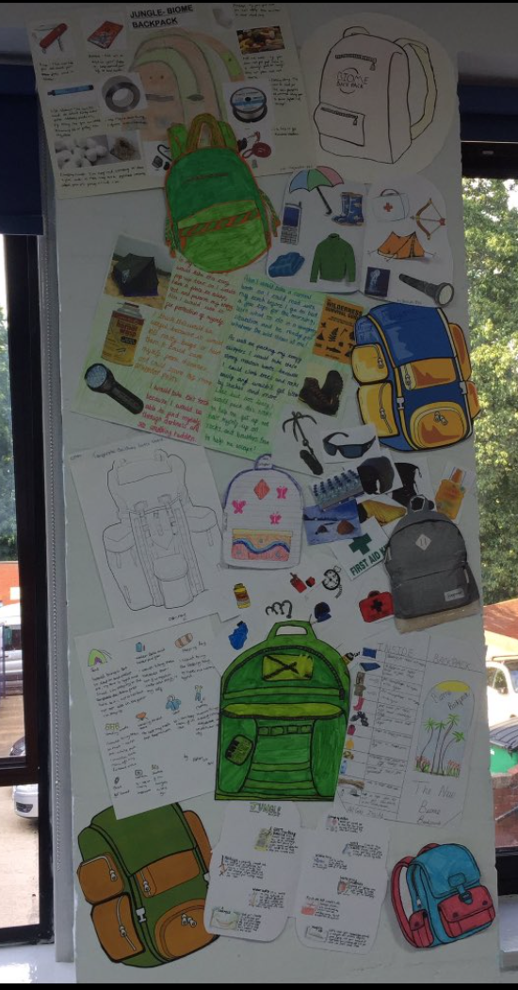
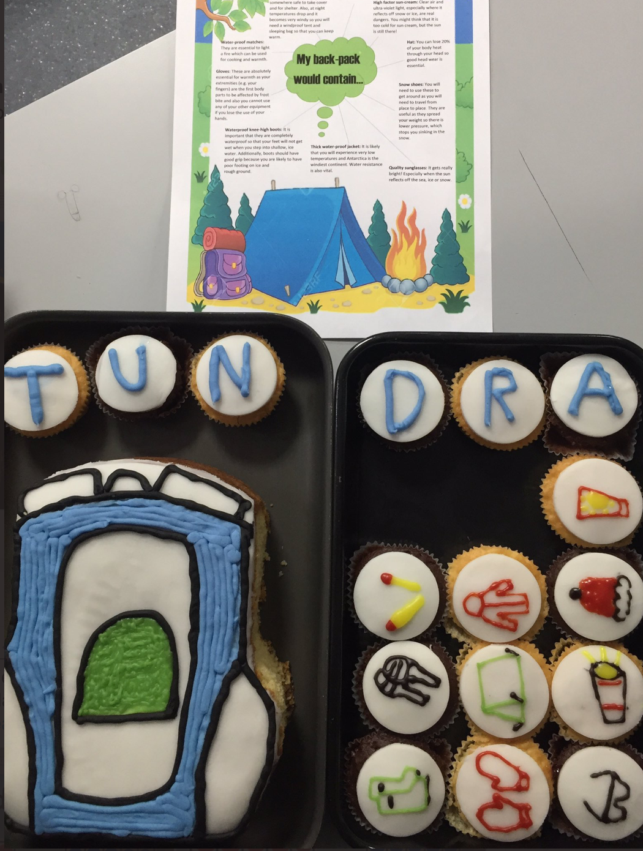
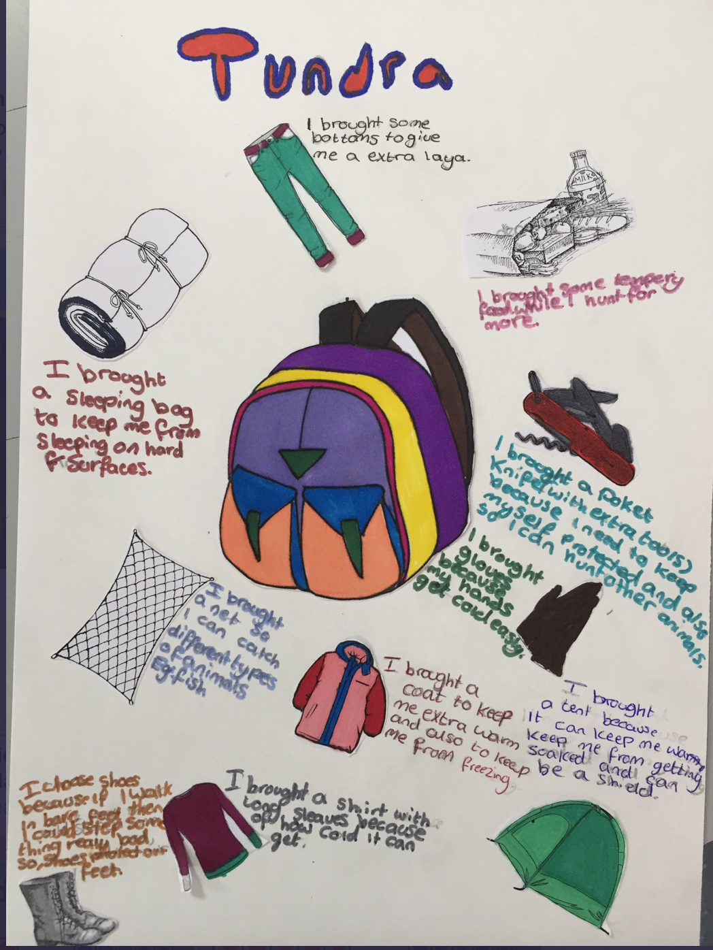
Example biomes backpacks

Slide 30
Biomes to choose from
Desert
Tundra
Savanna
Boreal Forest/Coniferous Forest/ Taiga
Deciduous Forest/Temperate Forest
Mediterranean

Slide 31
Presentation success criteria :
Communication skills:
•Speak clearly, stand still, avoid giggling/fidgeting, practice your words, presentation shouldn’t be too long/short.
Quality of material included in the presentation:
•Detailed information should be provided, all of the topic sections should be present (location, flora, fauna, climate, human use, threats), it should be clear that the group has understood the presented material, geographical terminology should be used, graphs and images should be used to illustrate ideas.

Slide 32
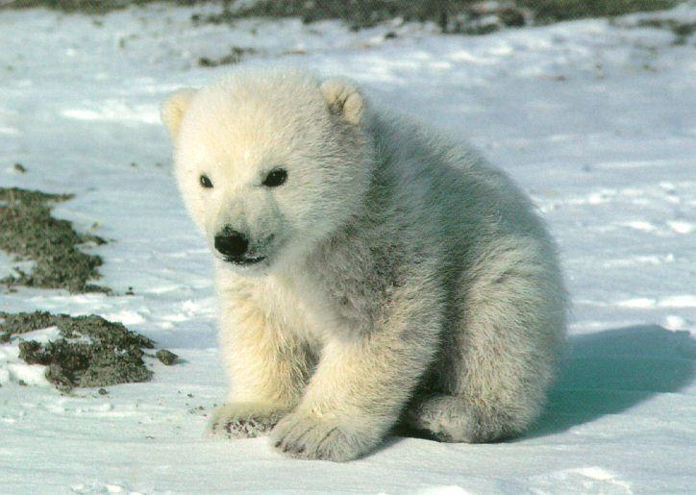
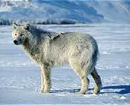
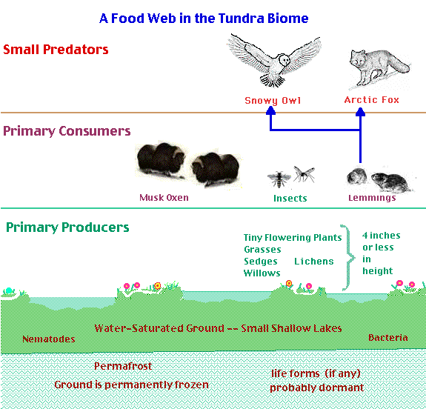
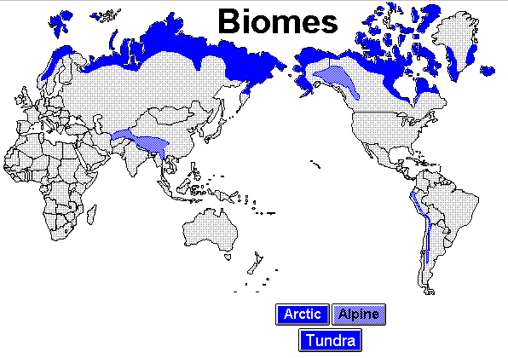
Tundra biome

Slide 33
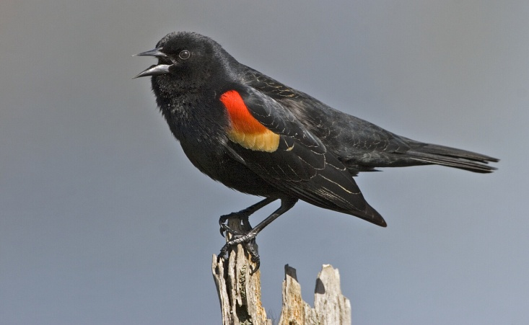
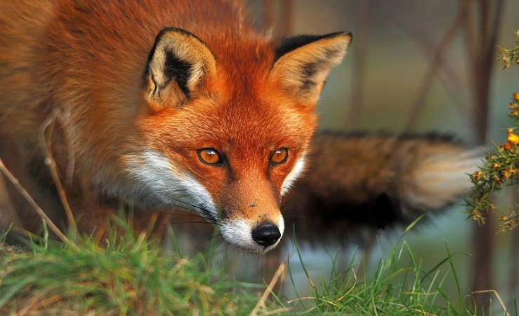
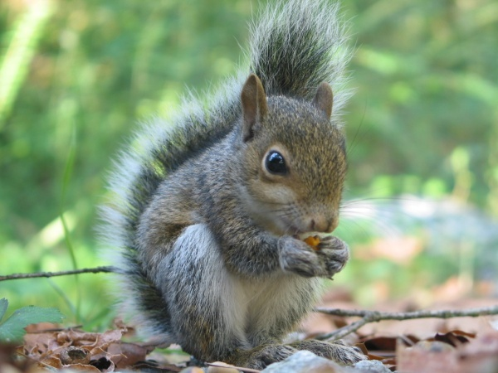
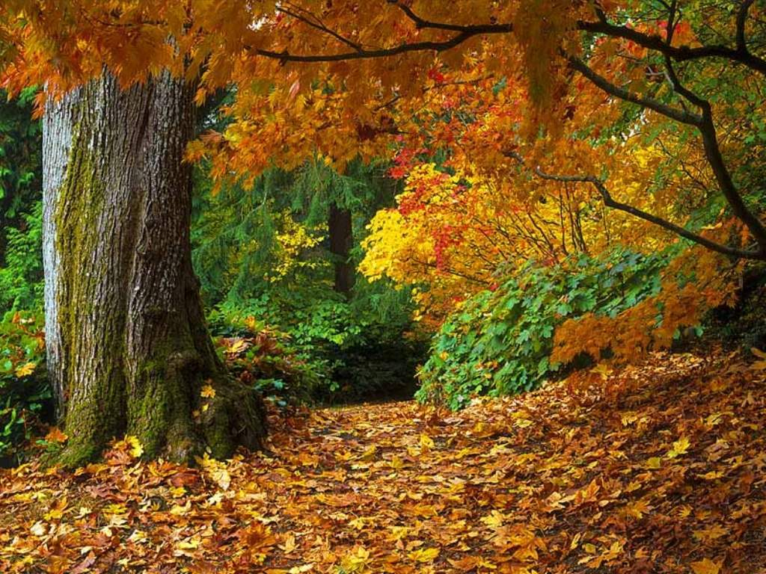
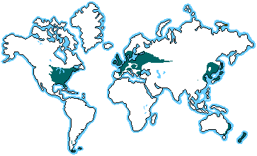
Temperate forest
UK

Slide 34
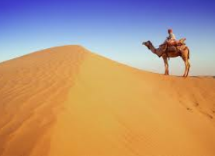
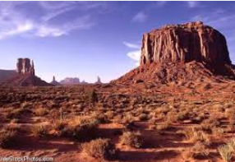
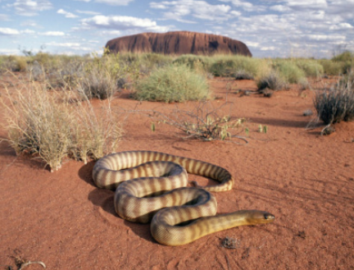
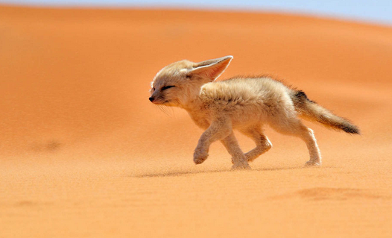
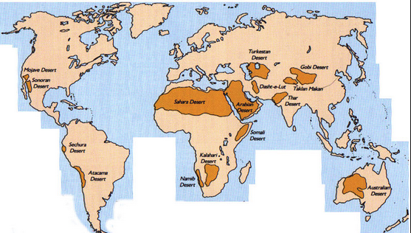
Deserts

Slide 35
More on the factors that affect temperature

Slide 36
Temperature
Temperatures vary around the world according to latitude. This means distance from the equator.
This is because the earth has a curved surface. Places near the equator are much warmer than places near the poles.
This is known as the Angle of Incidence (AOI).

Slide 37
Precipitation
Explaining variations in precipitation around the world is much harder. The differences in the tropical regions are mainly due to the inter-tropical convergence zone (ITCZ).
It is a band of wet-weather conditions caused by colliding winds. It runs right around the globe. In the equatorial areas where the tropical rainforests are located it leads to low pressure and causes lots of rain.
At 30° north and south it creates a zone of high pressure. These are therefore very dry regions – the world’s hot deserts are found at these latitudes.
Further north there is a more clear wet and dry season, where decidious forests and it is dry again due to high pressure at the poles.

Slide 38
Local Factors
Altitude – temperature decreases by 1°C for every 100m climbed.
Continentality – this means distance from the sea. Away from the sea the land is warmer in summer and colder in winter. The further you are from the sea the less precipitation you receive and the greater the range of temperatures you will experience.
Nutrients within the soil
Geology, soils, relief and drainage.

Slide 39
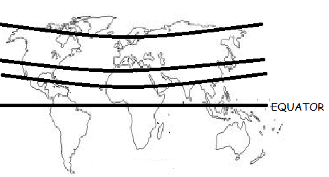
Tundra
Deciduous Forest
Hot Desert
Tropical Rainforest
Hot/Cold/Mild Wet/Dry Much/Little Vegetation
Hot/Cold/Mild Wet/Dry Much/Little Vegetation
Hot/Cold/Mild Wet/Dry Much/Little Vegetation
Hot/Cold/Mild Wet/Dry Much/Little Vegetation
Complete a sentence for each to explain where it is on Earth and what the climate is like.

