Slide 1
Overall question:
How can we become positive change makers?
Key concept: Change

Slide 2
Wednesday, 4 March 2020
What matters to me?
L/O – To develop an understanding of the different types and scale of issues
Write a list of all the issues that matter to you.
No matter how big or small, write them down.

Slide 3
To develop an understanding of the different types and scale of issues
Scale of the Issue
A question to Ponder
If you were to categorise the issues by the scale of their effect, what categorises could you use?
Key terminology

Slide 4
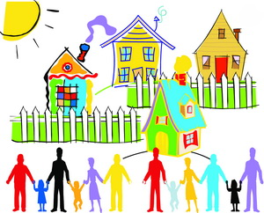
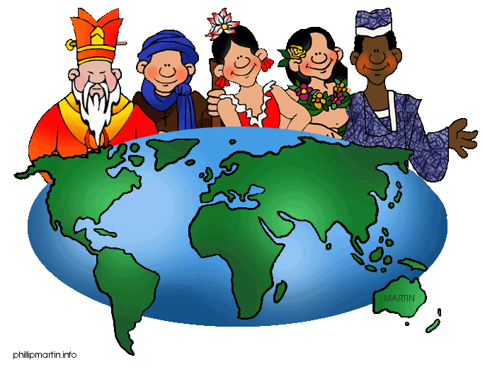
To develop an understanding of the different types and scale of issues
Scale of the Issue
Next sort the cards into the categories.
Where would your each of your issues fit?
Personal Issue
Something that only affects you
Local Issue
Something that affects people within a community or a small area within a country
National Issue
Something that affects all people within a whole country
Global Issue
Something that affects a lot of people all over the world
Key terminology

Slide 5
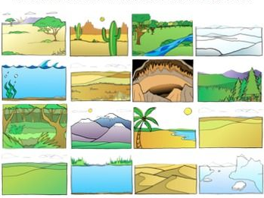
To develop an understanding of the different types and scale of issues
Types of Issue
We can also sort issues by type. Use the clues to see if you can work out what S.E.E.P stands for.
S E E P
Key terminology

Slide 6
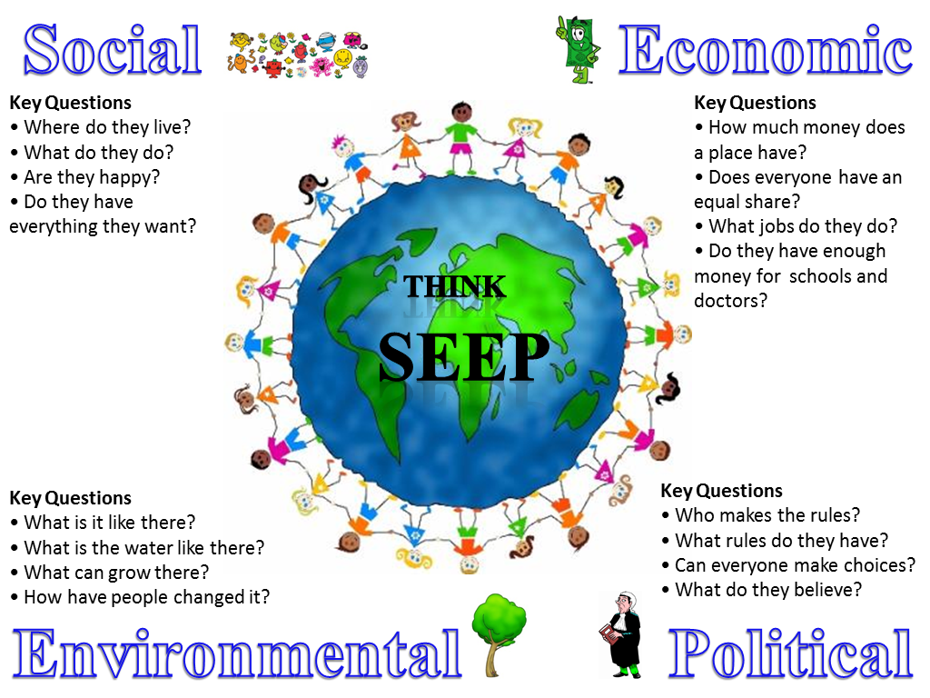
To develop an understanding of the different types and scale of issues
Sort the cards into the SEEP categories.
You might find that some fit into more than one.
Key terminology

Slide 7
To develop an understanding of the different types and scale of issues
Does it really matter?
Sort the cards into the following categories.
Will only affect me
Will affect me and others
Will only affect others
Key terminology

Slide 8
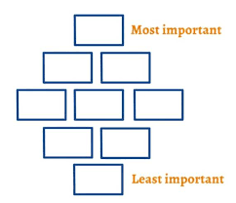
To develop an understanding of the different types and scale of issues
Does it really matter?
Next select the 9 issues you think would be most important to deal with.
Sort them into a diamond 9 like the one shown here →
You need to be able to justify your opinions.
Key terminology

Slide 9
To develop an understanding of the different types and scale of issues
To conclude…
Write down the 4 scale categories – give an example of an issue that fits into each one
Write down the 4 SEEP categories – give an example of an issue that fits into each one
Write down 3 issues that matter to you!!!
Key terminology

Slide 10
Enquiry question:
How can we be become positive change makers?
Key concept: Change
How may our learning about different scales of issues help answer our key enquiry question?
Which issues could be changed?
Is anything already being done to change the issue?
Will the changes happen quickly?
What could be the scale of the change?
Who would need to be involved in the change ?

