Slide 1
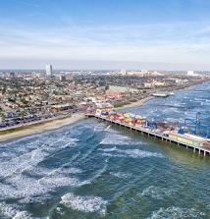
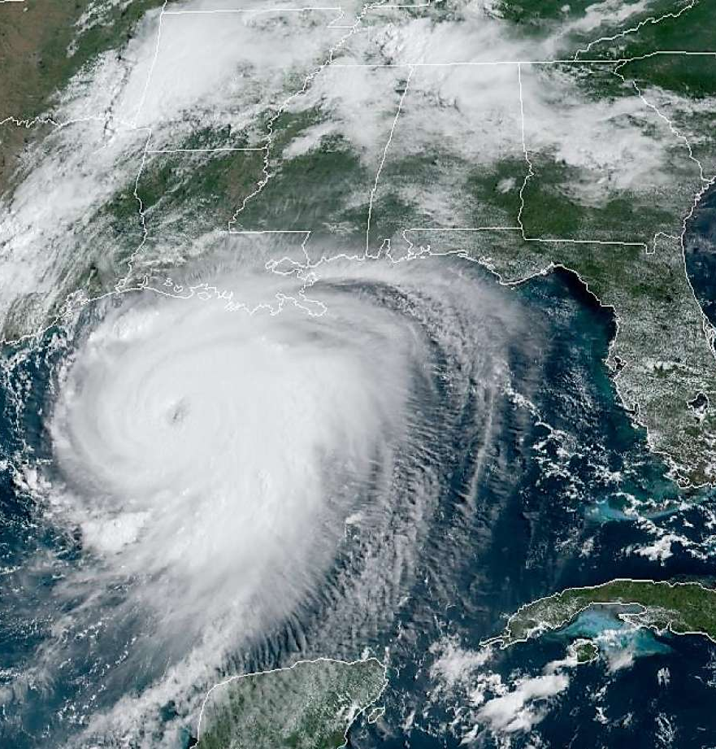
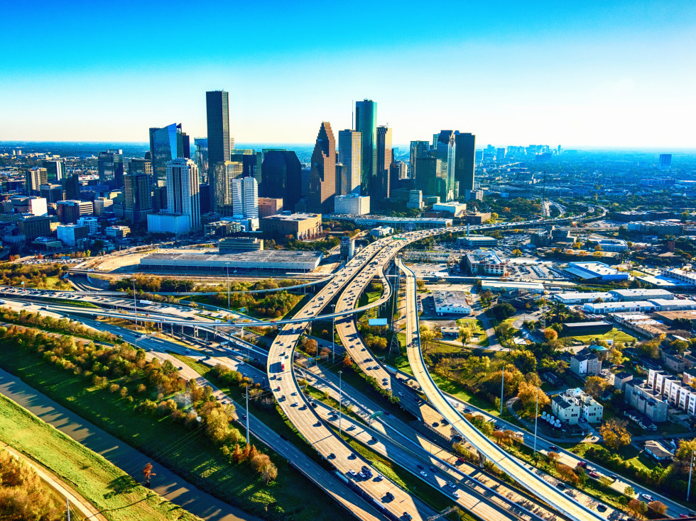
Welcome to iGCSE Geography!

Slide 2
Why IGCSE Geography?
With the person next to you, talk about some of the reasons for choosing to do Geography at IGCSE, we’ll then feedback some ideas as a class!

Slide 4
Course Overview
2 Test Papers
1 for Physical
1 for Human

Slide 5
What will you be learning this year?
Topic 1: Urban Environments
Topic 2: Hazardous Environments
Topic 3: Coastal Environments

Slide 6
Be polite and respectful to all members of the class
Always attempt challenges to the best of your ability
Do not talk when other people are sharing information.
Always complete homework on time and to a high standard
Be on time, on task, and prepared to learn, everyday!
Be willing to try new things
What should you expect from me?

Slide 7
Urban Environments
Glue this in and we will refer back to it throughout the topic to check our progress.
This will also inform your revision throughout your IGCSE

Slide 9
So, what is urbanisation?
Lesson Outcomes
All students will be able to:
Identify and define what the process of urbanisation is.
Explain why understanding urbanisation is important.

Slide 10
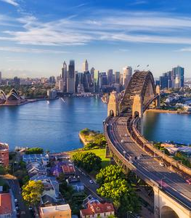
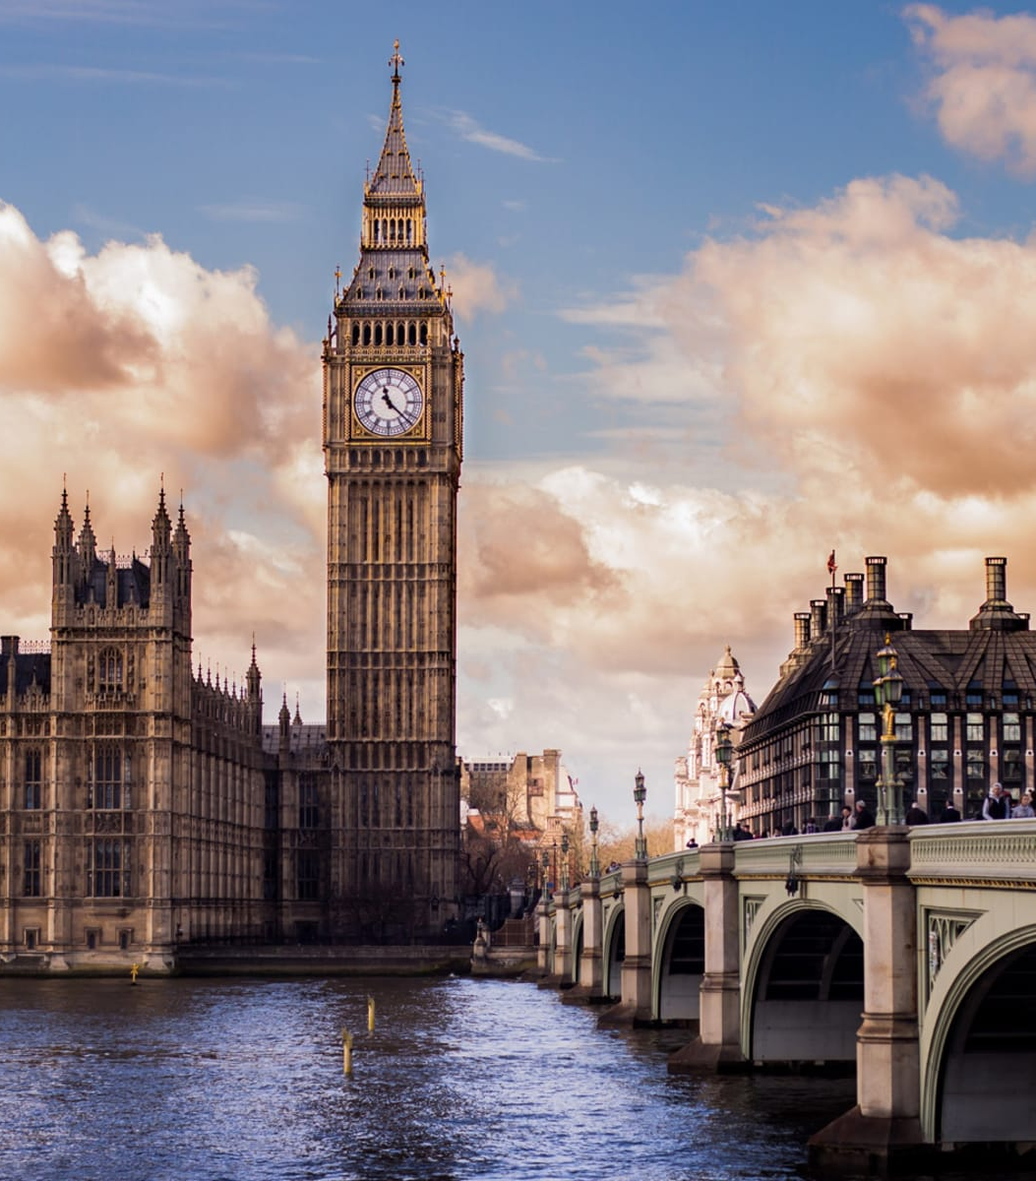
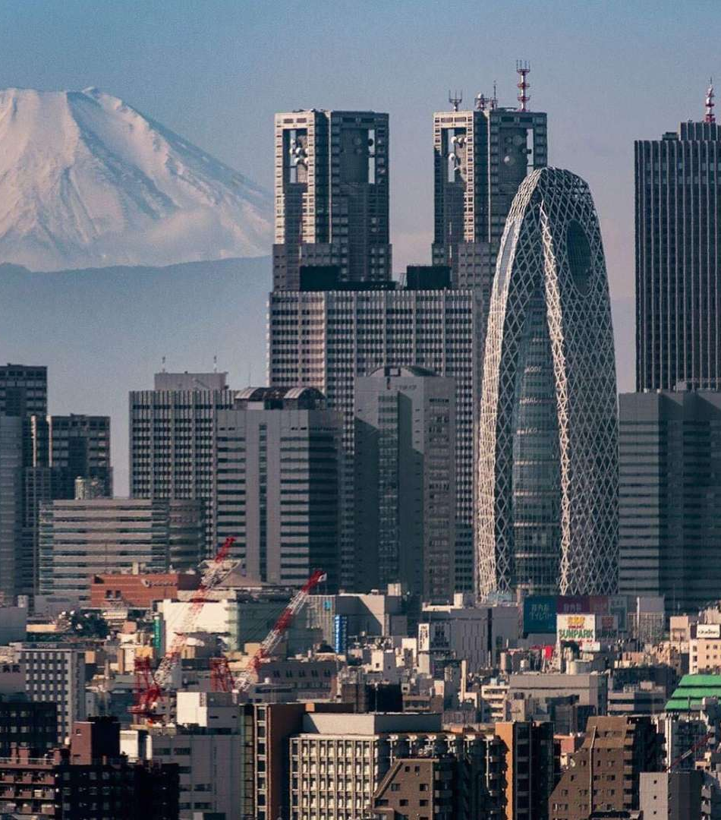
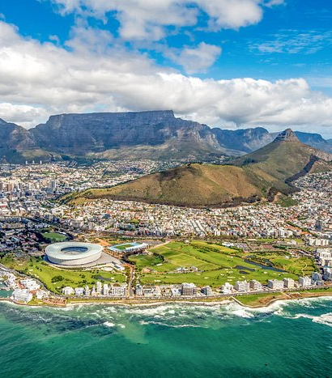
Starter Challenge - How many of the 6 cities can you name? List them in your notes.
Extension Challenge – Choose 2 of the cities and describe their similarities and differences. Consider social, economic and environmental factors in your comparison. Feel free to do a quick research for this.
Super Challenge - Give reasons for the differences you have mentioned in your descriptive differences.

Slide 11
Challenge 1:
Use either the video (first 30 seconds only) or the Britannica link to come up with a 1 sentence definiton for what urbanisation is.
Extra Challenge – Add one sentence to your defintion that includes a statistic from whichever source you used.
Notes:
https://www.britannica.com/topic/urbanization
https://www.youtube.com/watch?v=U3hHdunQLuM

Slide 12
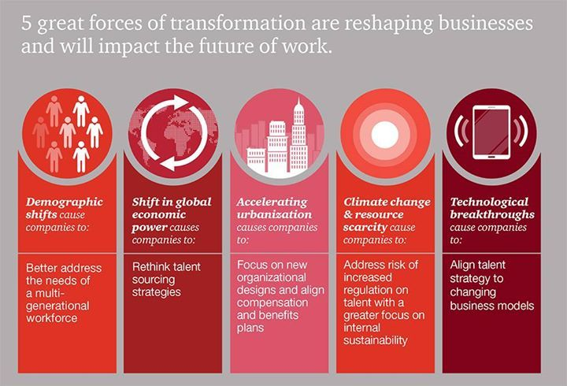
Challenge 2:
Watch the video and answer the following questions:
1 – What percentage of the world’s population lived in cities in 1800?
2 - For what reasons are people moving from the countryside to cities?
3 – What percentage of the world’s population will live in cities in 2050?
Extension Challenge – Open the QR for National Geographic and describe some of the challenges that might arise due to urbanization. This can be a table, bullet points, paragraph etc.
Notes:
https://www.nationalgeographic.com/environment/article/urban-threats
https://www.youtube.com/watch?v=B5qUcQo85sQ

Slide 13
To finish
Either, write either a Haiku poem or an acrostic poem to describe urbanisation, it’s causes and impacts.
Remember, a Haiku is a poem that has 3 lines, 5 syllables in the first, 7 in the 2nd and 5 in the 3rd.
An acrostic is a poem that uses the first letter of a word (URBANISATION) for each line. Lines can be differing in length and don’t usually rhyme.

