Slide 1
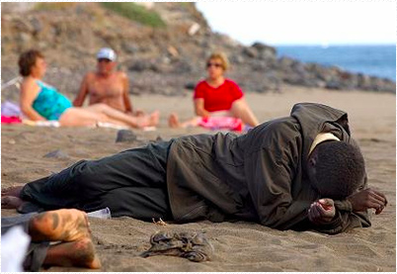
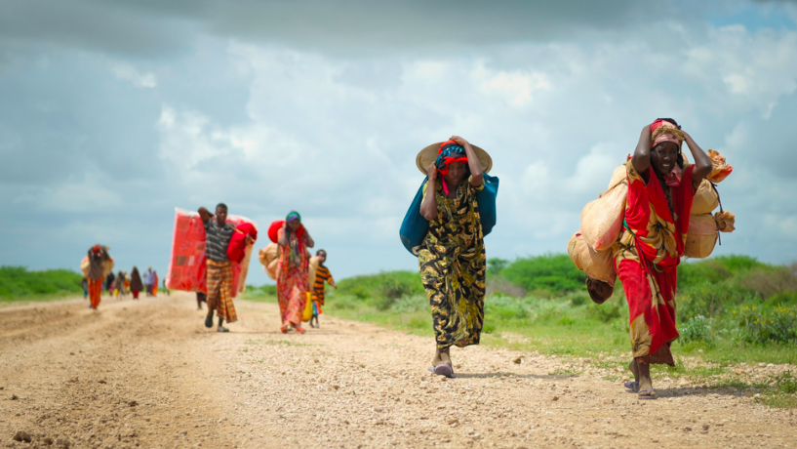
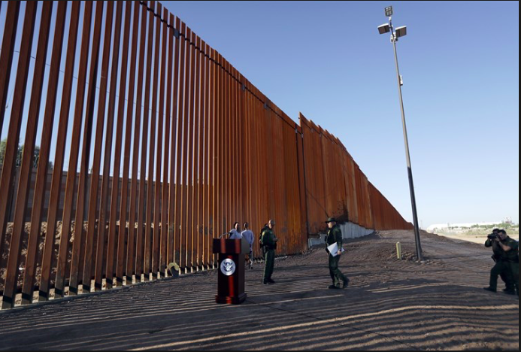
Introduction to Migration
Objective: To find out what makes people move within and outside of their home country.

Slide 2
Write down the key ideas that come to mind when you think of the word migration….

Slide 3
Migration statements: Read the statements and decide if you agree or disagree with them
\
The main reason people move to another country is so they can earn more money
You can belong to more than one country
People coming to other countries by illegal means should be sent back
Migration causes conflict in communities
People should be allowed to live where there want in the world
Having people from different countries living together in the same community is a great thing
People should have to learn the language of the country they are moving to before they are allowed to migrate
Canada allows more refugees than any other country in the world
Rich countries take in more immigrants. Poor countries cannot afford to take in migrants
Immigrants take away more from the country they move to than they give

Slide 4
Migration statements- agree or disagree
The main reason people move to another country is so they can earn more money
You can belong to more than one country
People coming to other countries by illegal means should be sent back
Migration causes conflict in communities
People should be allowed to live where there want in the world
Having people from different countries living together in the same community is a great thing
People should have to learn the language of the country they are moving to before they are allowed to migrate
Canada allows more refugees than any other country in the world
Rich countries take in more immigrants. Poor countries cannot afford to take in migrants
Immigrants take away more from the country they move to than they give

Slide 6
A school full of migrants
Where have we lived? Where have we migrated from. Locate every home country of the students in our class (this may be places you have lived too).
How could we collect this data?
Speak to your classmates- what are some of the reasons why they have migrated?
Geographical enquiry

Slide 7
Geographical skills

Slide 8
Where do people move from and to?
http://peoplemov.in/#f_DZ
Click on your home country and list the top five groups of migrants who arrive there. Conduct some research to find out why people migrate to your country from the number 1 destination.

