Slide 1
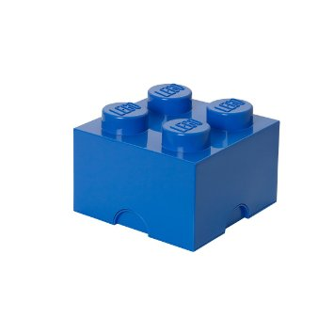
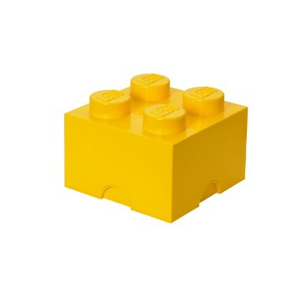
International Trade Game

Slide 2
Blockland

Slide 3
Brickland

Slide 4
Tileland

Slide 5
Slabland

Slide 6
For your country fill in the following ’Production Possibilities’ from your countries PPC

Slide 7
Year One…
Choose the combination of ’Block’s that you country chooses to produce in Year One and record below…
Can you think of any economic issues that arise following round one (Record Below) Think of the 3 Economic Questions (What, How for Whom?)

Slide 8
Year Two…
Choose the combination of ’Block’s that you country chooses to produce in Year One and record below…
Can you think of any economic issues that arise following round one (Record Below) Think of the 3 Economic Questions (What, How for Whom?)

Slide 9
Year Three…
Choose the combination of ’Block’s that you country chooses to produce in Year One and record below…
Can you think of any economic issues that arise following round one (Record Below) Think of the 3 Economic Questions (What, How for Whom?)

Slide 10
Year Four…
Choose the combination of ’Block’s that you country chooses to produce in Year One and record below…
Can you think of any economic issues that arise following round one (Record Below) Think of the 3 Economic Questions (What, How for Whom?)

Slide 11
Keep a Tally below of all of the blocks that you have at the end of each year…
Year
1
2
3
4
5
6

Slide 102
What were the Benefits of international trade? (complete the sheet)

Slide 203
What if…
Purple Blocks were high value tertiary services like: Legal services, Financial services and were cost 100 Lego bucks per Block?
Blue Blocks were mid to high value secondary manufactures like: TV’s, washing machines and toasters and cost 25 Lego bucks per Block?
Green Blocks were mid value primary goods like: iron ore, copper, and fruit and veg and cost 5 Lego bucks per Block?
Yellow blocks were low value primary goods like: wheat, rice, and cocoa and cost 1 Lego bucks per Block?

Slide 204
If you see this slide you are issued with a spoiler alert, do not tell other students!!!!

Slide 205
Then…
Blockland would be Switzerland
Brickland would be USA
Tileland would be Brazil
Slabland would be Ethiopia

Slide 206
What are the disadvantages of international trade? (What, How and for Whom?)

Slide 207
Create an extra column on the right hand side of your tally chart for YEAR 6 and label this as ‘GDP’. Copy and paste your tally chart below…

Slide 208
What is the difference between free trade and fair trade?

Slide 209
How can we facilitate a better system of international trade?

