Slide 1
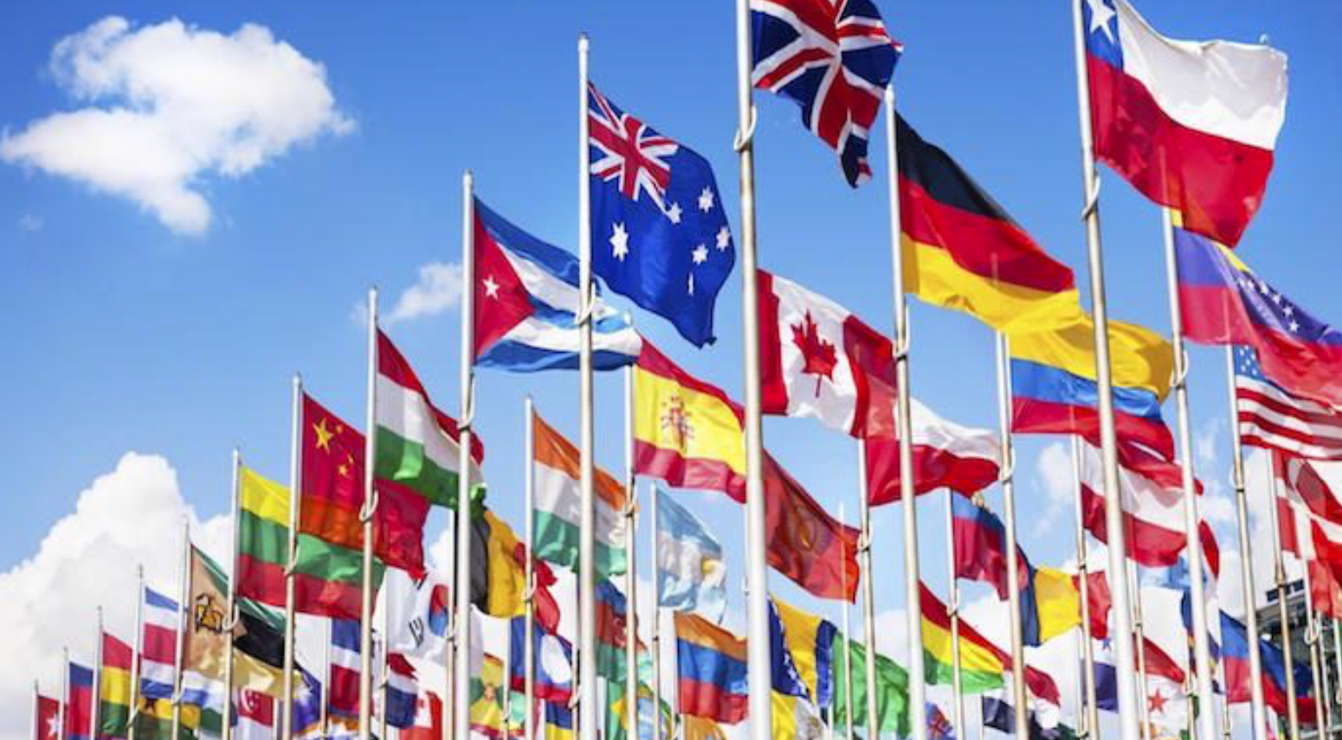
International law
The origins, development, sources of and milestones in the emergence of international law; the role of international laws, institutions and agreements in protecting the rights and freedoms of people.

Slide 2
Key things you need to know
To understand the role of the United Nations in shaping international law.
To investigate why international laws and institutions are needed, and how they impact on states and people’s everyday lives.
To consider how international laws are made, and how they differ from agreements.

Slide 3
https://www.youtube.com/watch?v=8Zeein83DdU
https://www.asil.org/resources/100Ways
Resources to help:
How have international laws impacted you today?
Draw a picture of what the world may look like without international law
What is the difference between an law and an agreement?
How are international laws upheld?

Slide 4
How international law impacts on our daily lives
Flying
Post
Car Safety
Adoption
GPS and other phone apps
Trading fresh food

Slide 5
International law
Why is it important to have laws that cross international boundaries?
A set of rules that are recognized and followed by a country that agrees to their terms.
Modern versions of international law have developed since, such as the league of Nations, which was set up in 1919 after the First World war. Its aim was to keep peace and settle international disputes the negotiation. It finally broke down at the outset of Second World War in 1939. After the war ended in 1945, the United Nations (UN) was set up. This lead the the development of International law as we know it today.

Slide 6
Among the greatest achievements of the United Nations is the development of a body of international law—conventions, treaties and standards—central to promoting economic and social development, as well as to advancing international peace and security. Many of the treaties brought about by the United Nations form the basis of the law that governs relations among nations. While the work of the UN in this area does not always receive attention, it has a daily impact on the lives of people everywhere.
The Charter of the United Nations specifically calls on the Organization to help in the settlement of international disputes by peaceful means, including arbitration and judicial settlement (Article 33), and to encourage the progressive development of international law and its codification (Article 13).
Over the years, more than 560 multilateral treaties have been deposited with the Secretary-General of the United Nations. Many other treaties are deposited with governments or other entities. The treaties cover a broad range of subject matters such as human rights, disarmament and protection of the environment.

Slide 7
The UN charter
Asks the UN to help settle international disputes and to encourage the development of international law.
Apart from human rights and peacekeeping the UN has worked to provide a set of laws that protect different areas, such as the environment or protecting migrant labour.

Slide 9
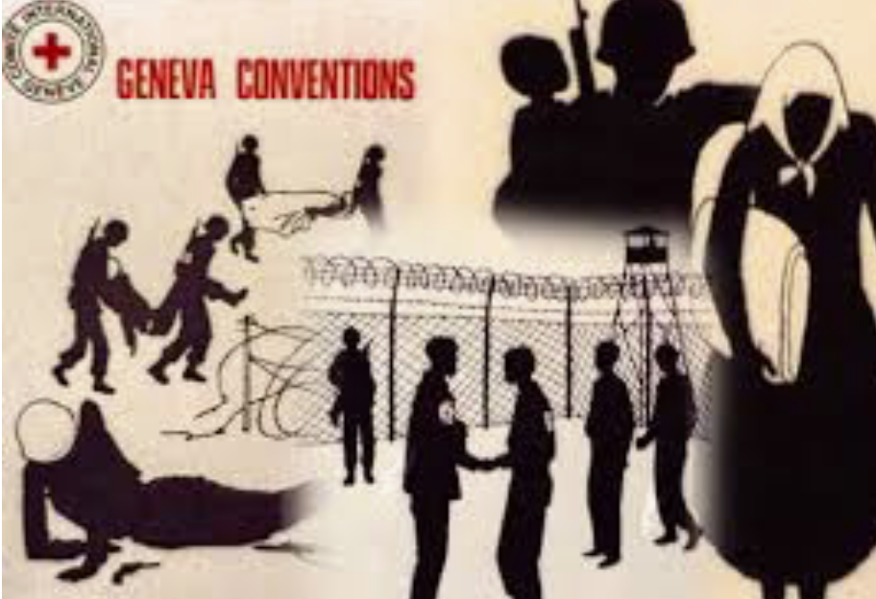
The Geneva Convention
https://www.youtube.com/watch?v=HwpzzAefx9M&t=1s
Rules on that set out how people, such as enemy soldiers, doctors and civilians, should be treated in times of war to protect them as much as possible. For example, they should not be mistreated, they should be offered food and are allowed to communicate with family. It has been updated on several occasions since. It has been signed by 196 counties.
What is the role of the Geneva Convention:
Why is it important
Why it should be amended over time
Relevant examples

Slide 10
Treaties, conventions and declarations
Treaties and conventions are formal written agreements between countries that can be enforced by law.
A declaration is a similar agreement, but it does not carry the weight of the law.
The convention on the rights of the child can therefore be enforced but the Universal declaration on Human rights (UDHR) my be signed by countries by it cannot be legally enforced.

Slide 11
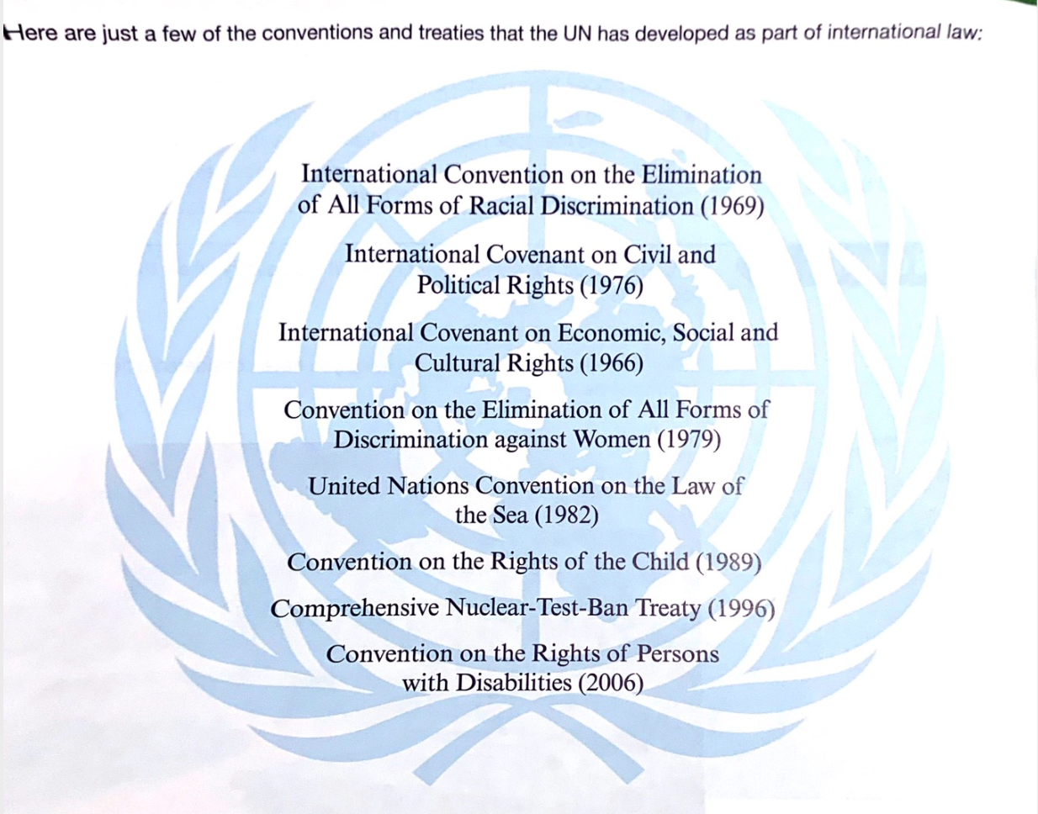
What are the conventions and treaties trying to achieve?
What is the importance of having laws for these topics? What would be the consequences if the laws did not exist?
What other issues may need international agreements?

Slide 13
The General assembly
The main forum for the UN. It is made up of representatives from each member state and it is the place where international law is discussed and approved.
The general assembly has the power to call a conference to bring all countries together so they can sign an agreement.

Slide 14
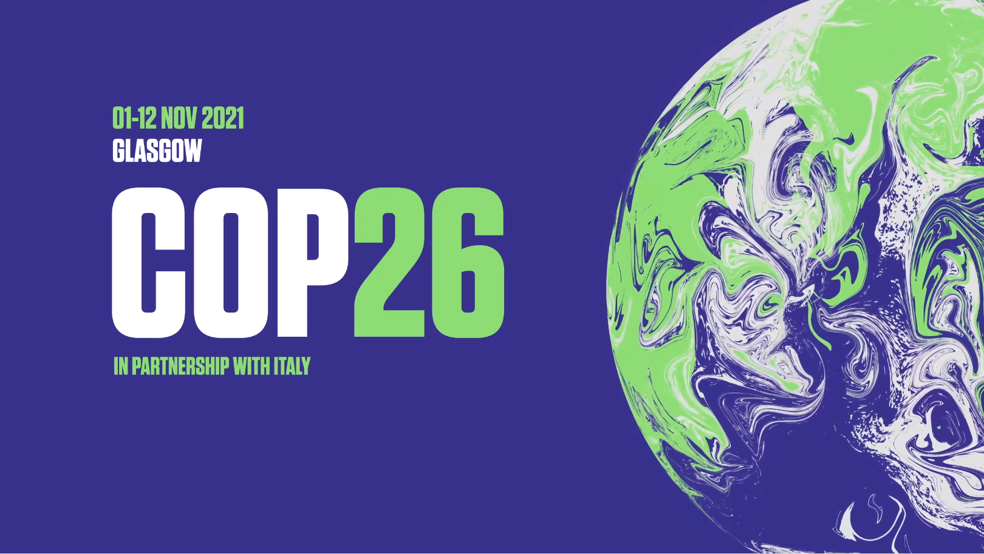
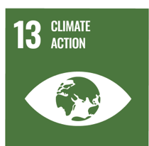
Read the opening statement of COP 26 here (the 76th General assembly)
https://www.un.org/pga/76/2021/10/31/opening-of-cop26-climate-conference/

Slide 15
GLASGOW, SCOTLAND
Notes:
What is COP26 promo video:
https://www.youtube.com/watch?v=hNzr75MbzZs

Slide 16
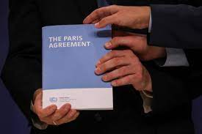
COP26
Why do we need COP26?
One of the main goals of COP26 is to review the targets set at COP21 in Paris in 2015.
In Paris, all countries present agreed to prevent global temperatures from warming by more than 2°C, and try to keep the increase as low as 1.5°C.
Why is 1.5C warming so important
Global warming of 1.5C would still mean sea-level rise and climate change impacts on humans and the environment.
For every tiny increase in global temperature the impacts of climate change become harder to manage.
Notes:
1. Reduce their greenhouse gas emissions, and invest in renewable energy sources, like wind and solar power.
2. Prevent global temperatures from warming by more than 2°C, and try to keep the increase as low as 1.5°C.
3. Help less-developed countries become more environmentally friendly, by supporting them financially.
4. Review progress on the Agreement every five years.

Slide 17
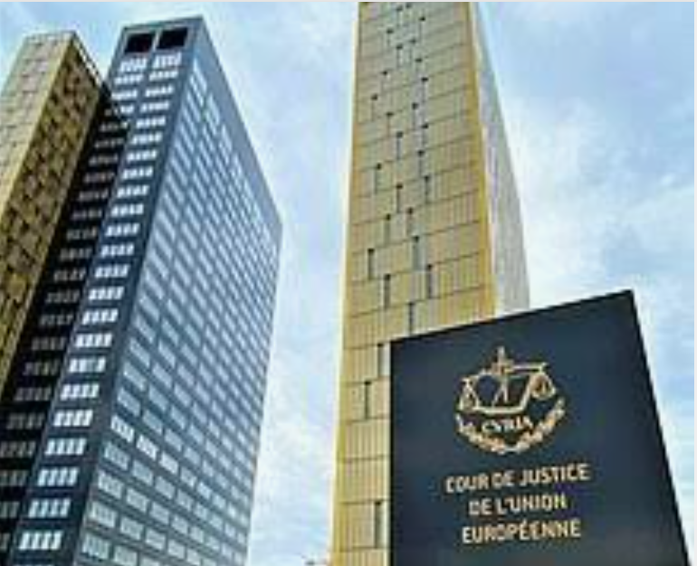
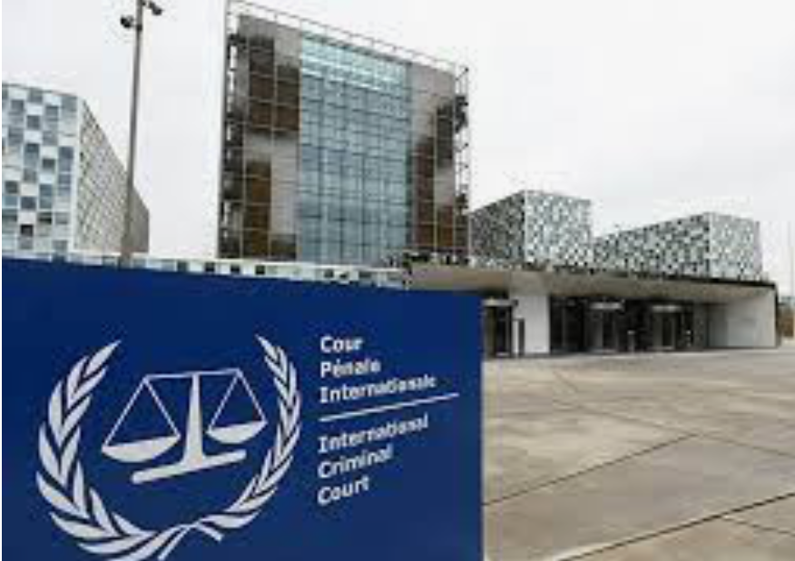
International courts
European court of Justice
International court of Justice
Why is there a need for international courts?
Why do you think some counties are opposed to the courts?
Use the information from the textbook, the resources on the weebly and your own research to create a fact file explaining the work and responsibilities of each court.
Do you think international courts are always effective? Why or why not?
International criminal court

Slide 18
Campaigning for International law
LO: To find out the importance of organisations in campaigning for international law

Slide 19
Uncontacted remote tribes…
https://www.youtube.com/watch?v=sLErPqqCC54&list=PLCF0DC64F6AFAE157

Slide 20
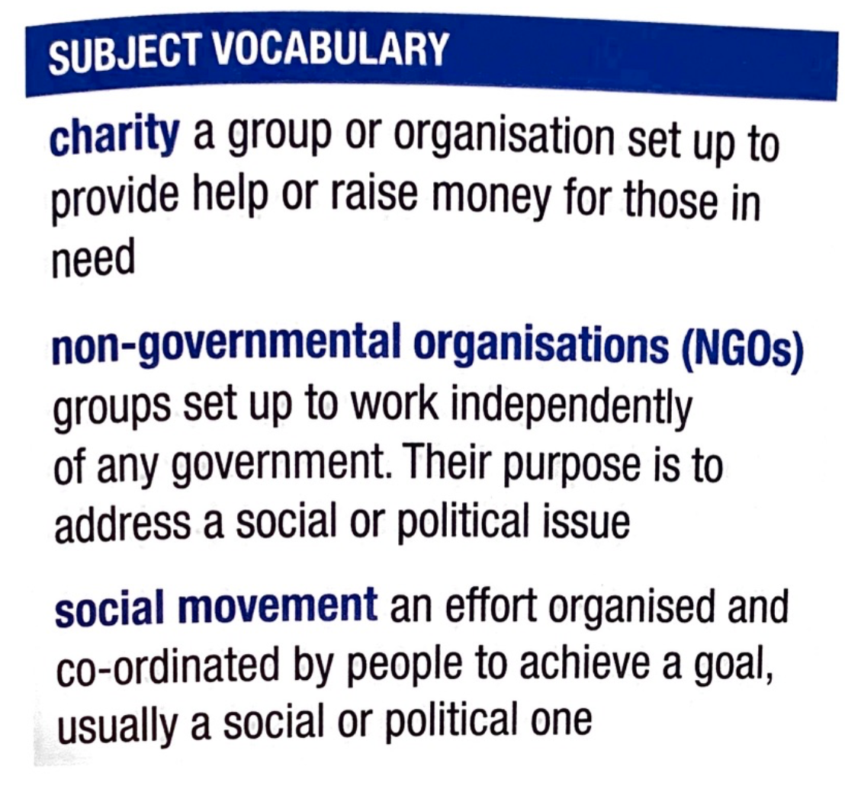
Making a difference
The UN has a wide range of laws that support people all over the world. However, attitudes and ideas change so laws need to be adapted to reflect this.

Slide 21
Should the Sentinelese be tried under international law?
”Doing this to establish the kingdom of Jesus on the island … Do not blame the natives if I am killed"
https://www.news.com.au/world/asia/traumatic-history-of-isolated-tribe-who-killed-american-missionary/news-story/75120b92130bcea44642156bffd60059
https://www.bbc.com/news/world-asia-india-46337353
https://www.survivalinternational.org/tribes/sentinelese

Slide 23
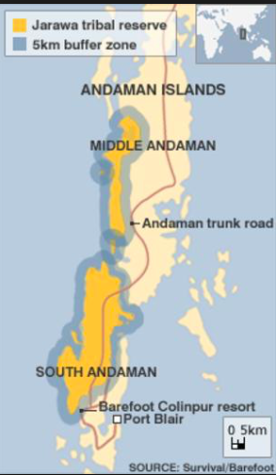
The road that cuts through their territory brings thousands of outsiders, including tourists, into their land. The tourists treat the Jarawa like animas in a safari park.

Slide 24
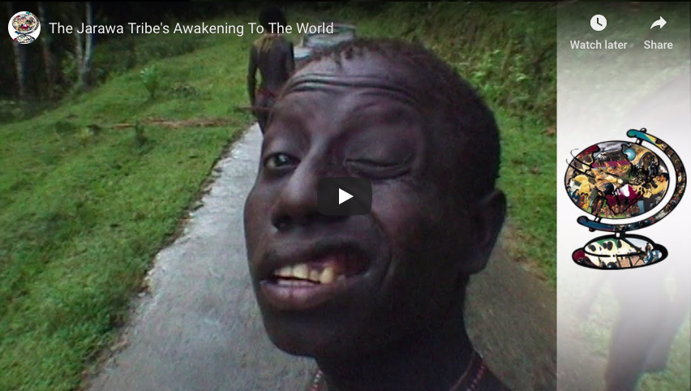
Watch…
What are the cultural traits of the Jarawa?
How are these being impacted? – what are the global influences that are impacting this group?
What is being done to protect them?
Should the Jarawa be tried under the same laws as others?

Slide 26
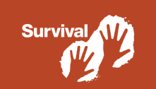
Survival International: Civil Society
https://www.survivalinternational.org/tribes/jarawa
Why is it important for Survival international to protect the cultural traits of a tribe such as the Jarawa?
How are tribes such as this being influence under international law?
How can the work of Survival international be seen as civil society action or as a NGO?

Slide 27
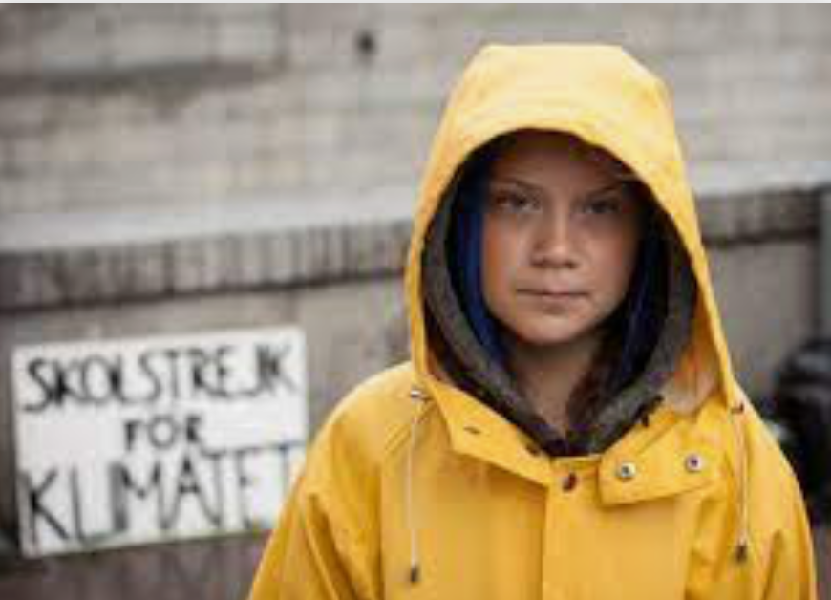
Climate activism
Consider examples where social movements have successfully exerted pressure on international law-makers resulting in a legislative change, e.g. 20th century progress towards environmental law.
https://www.youtube.com/watch?v=sP9TGpBGy08
https://en.wikipedia.org/wiki/Individual_and_political_action_on_climate_change

Slide 28
‘People should rely on governments to stand up for their rights rather than depend on charities’
How far do you agree with this view?

