Slide 1
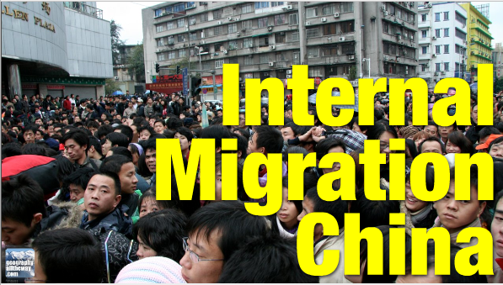
What are the impacts on China?

Slide 2
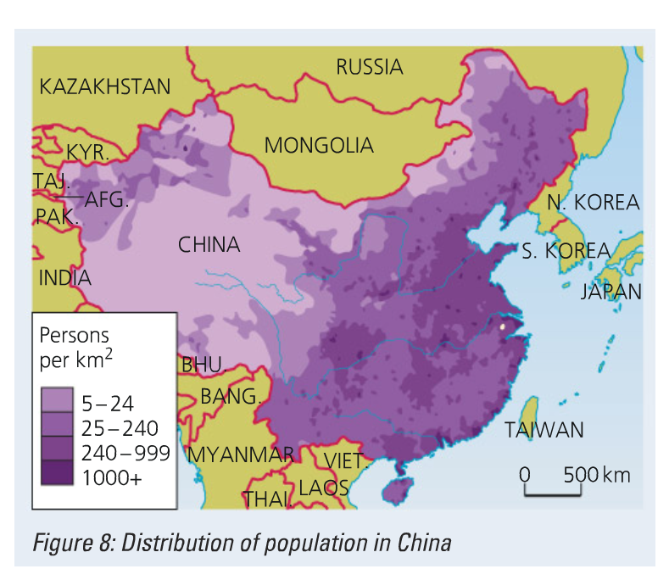

Slide 3
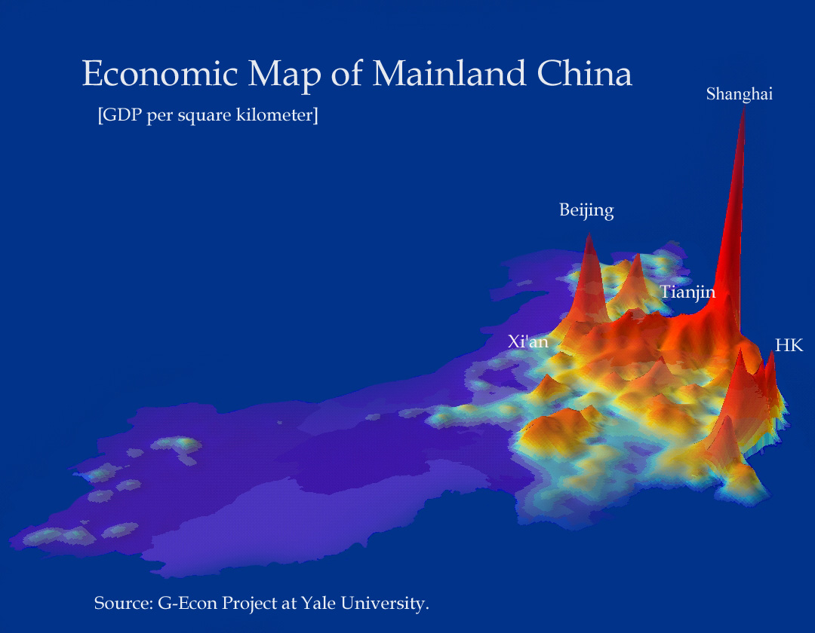
What do these maps tell us?

Slide 4
http://www.telegraph.co.uk/news/worldnews/asia/china/9648698/Two-million-to-be-moved-in-one-of-largest-relocations-in-Chinese-history.html

Slide 6
Push Factors
Lower standard of living
Rural areas- less chance to develop and increase salary due to low economic growth in middle Chinese regions
Less fertile land
Problems with water supply due to water shortages and polluted water
Slow economy and decreasing trade
Less career opportunities for youth due to the low level of economy

Slide 8
Conditions for migrant workers
https://www.youtube.com/watch?v=VAKFR5uksgo
This video shows the hardships that migrant workers in Shanghai and in other cities in China undergo. This relates to the negative aspects of migrating to Shanghai, which is a trading center with advantages as well as disadvantages to it.

Slide 9
CASE STUDY: China, Internal Migration Text p.391-393
In jigsaw groups of three, take notes on the following in collaborative space:
View this video and
Read: The Guardian
3. Read: Megacities

Slide 10
Impact on rural parts of China (origin)
Lower economic growth due to the lack of the working force population in rural areas
Decrease in population as people migrate to Shanghai
Ageing population as a result of the youth that emigrate to Shanghai for various reasons such as obtaining income, job opportunities, a better lifestyle etc.
Increase in rural household income
Fall in agricultural production- due to the lack of youth available to work in the field
Less modern technology and new ideas due to large number of elderly people left in rural area

Slide 11
Impact on Shanghai (destination)
Increase in working population leading to higher economic growth
Strain on resources due to over consumption
Water shortage due to increasing consumption
More potential for crime
Need for more government services and social services such as medical care, housing, education etc.
Effort to control the number of migrants who enter Shanghai
More risk of contracting certain diseases and illness due to increase in density of population
Overcrowding and dissatisfaction with living conditions and sanitation services of Shanghai

Slide 12
Annotate model in relation to China case study

Slide 13
Examples of exam questions….
Short response exam style question:
Referring to a specific example, describe the positive | negative impacts that national (internal) migrations have at their origins | destinations. [6 Marks]
Extended response exam style question:
"Migrations within a county's borders have greater negative impacts at their origin than their destination.' Discuss this statement. [15 Marks]

