Slide 1
The Internal Assessment

Slide 2
Economics Internal Assessment
Purpose of internal assessment
Internal assessment is an integral part of the course and is compulsory for both SL and HL students. It
enables students to demonstrate the application of their skills and knowledge, and to pursue their personal
interests, without the time limitations and other constraints that are associated with written examinations.
The internal assessment should, as far as possible, be woven into normal classroom teaching and not be a
separate activity conducted after a course has been taught.
The internal assessment requirements at SL and at HL are the same.

Slide 3
Internal Assessment
1. Word limit
Students must produce a portfolio of three commentaries. Each commentary must not exceed 800 words.
2. Articles
Each article must be based on a different section of the syllabus.
3. Sources
Students must use a different source for each commentary.
4. Contemporary articles
Students need to look for articles relating to current events and these must be published no earlier than one
year before the writing of the commentary.

Slide 4
A note on the Assessment Criteria
Teachers must judge the internally assessed work at SL and at HL against the criteria using the level
descriptors.
The same assessment criteria are provided for SL and HL.
The highest level descriptors do not imply faultless performance but should be achievable by a
student. Teachers should not hesitate to use the extremes if they are appropriate descriptions of the
work being assessed.
• A student who attains a high level of achievement in relation to one criterion will not necessarily
attain high levels of achievement in relation to the other criteria. Similarly, a student who attains a low
level of achievement for one criterion will not necessarily attain low achievement levels for the other
criteria. Teachers should not assume that the overall assessment of the students will produce any
particular distribution of marks.

Slide 5
Overview
There are five internal assessment criteria for each commentary.
Criterion A Diagrams 3 marks
Criterion B Terminology 2 marks
Criterion C Application and Analysis 3 marks
Criterion D Concepts 3 marks
Criterion E Evaluation 3 marks
Total 14 marks
There is one internal assessment criterion for the whole portfolio.
Criterion F Rubric requirements 3 marks
Each commentary is assessed individually for the first five assessment criteria (criteria A–E) and then criterion
F is applied to the whole portfolio.
The maximum for the portfolio is 45 marks: (14 marks x 3 commentaries) + 3 marks = 42 + 3 marks.
The assessment criteria are related to the assessment objectives.

Slide 6
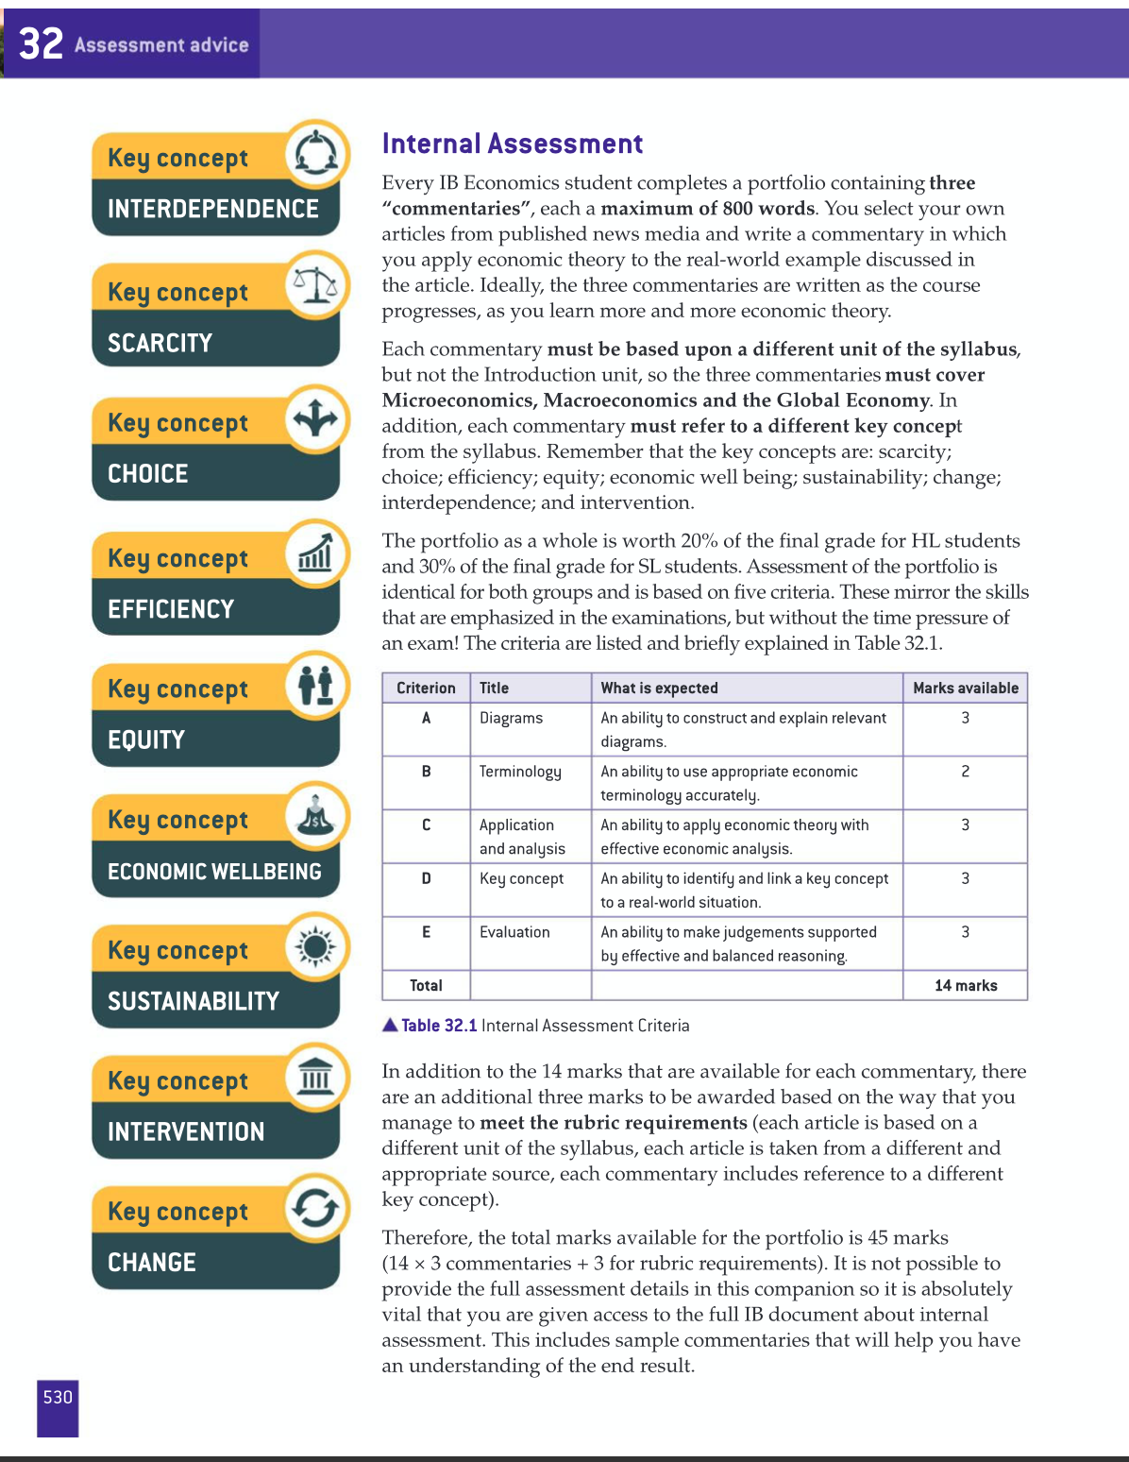

Slide 7
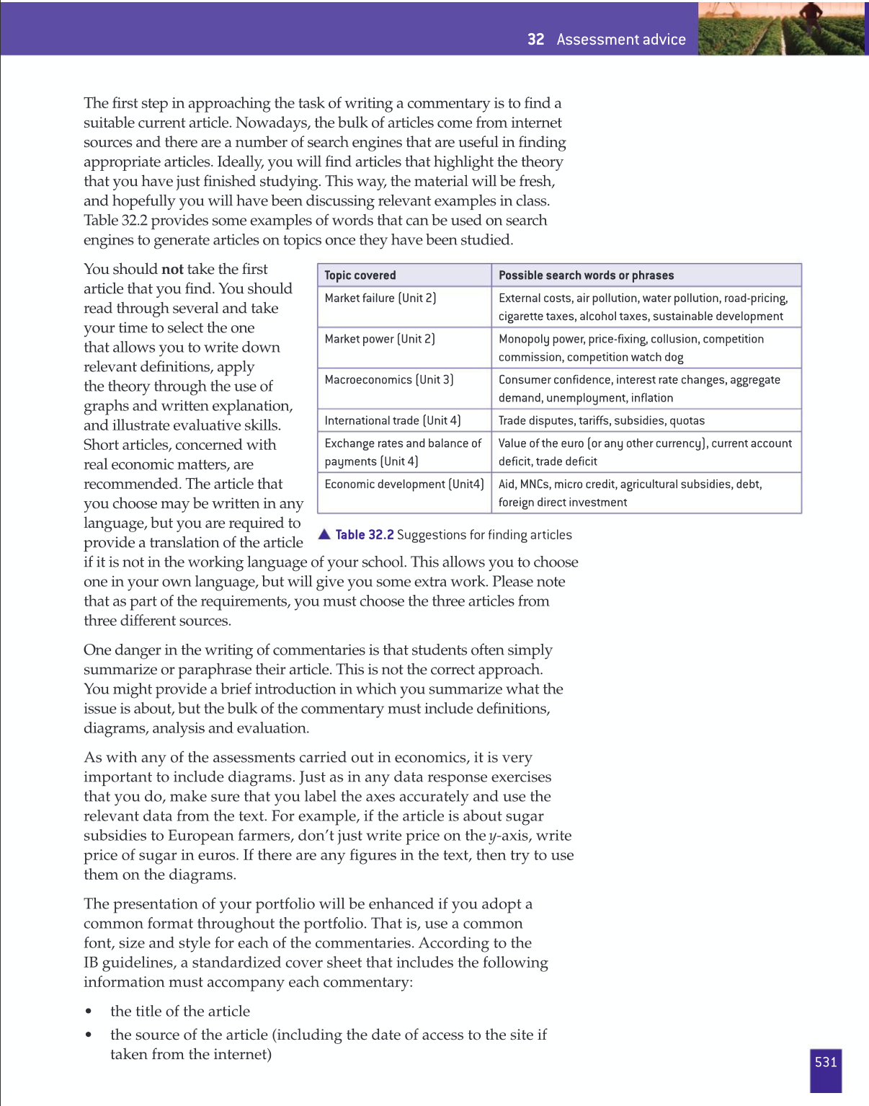

Slide 8
