Slide 1
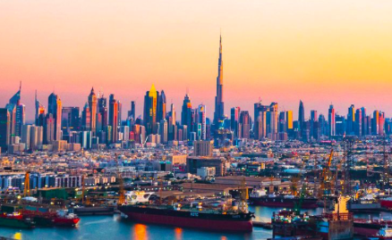
How does the physical environment influence the level of global interaction?
Lesson Objectives:
To explain how the distribution of natural resources influences the level of global interaction
To explain how remoteness and accessibility influence global interaction at a variety of scale

Slide 2
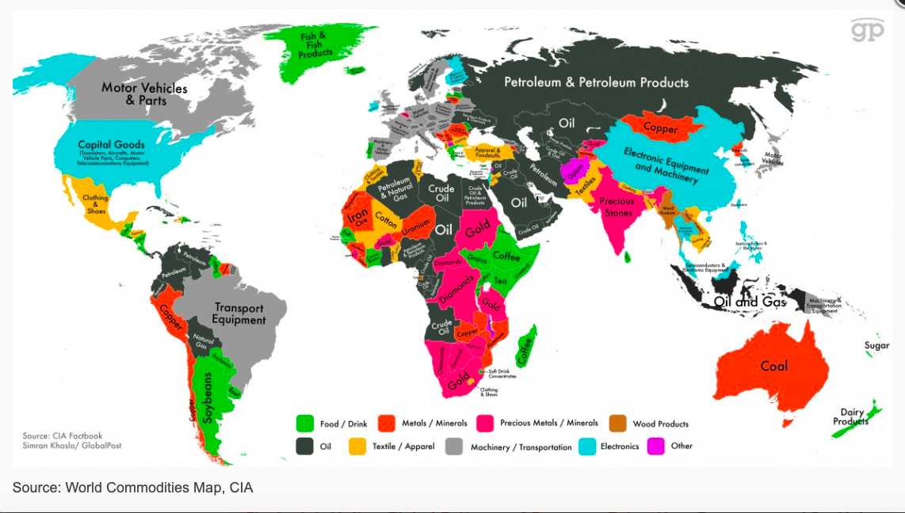

Slide 3
Natural Resource availability
Spatial availability, where a resource may be found and in what quality and in what quantity:
spatial availability could be measured in terms of reserves of the resource or perhaps more importantly production levels
the question of availability is further complicated by whether the reserves are proven or estimated and by whether the reserves are recoverable or non-recoverable under prevailing economic, technological, political and cultural conditions.
Temporal availability, when and for how long a resource is available:
for example, there may be seasonal variations in the availability of fresh water from rivers and streams.
Both spatial and temporal availability are determined to a large extent by the physical environment.

Slide 4
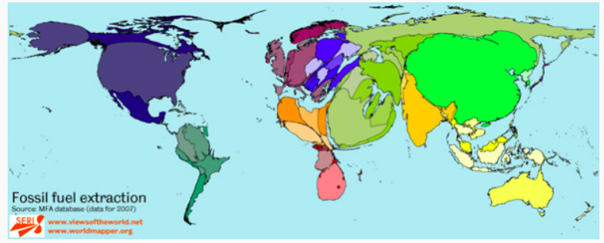
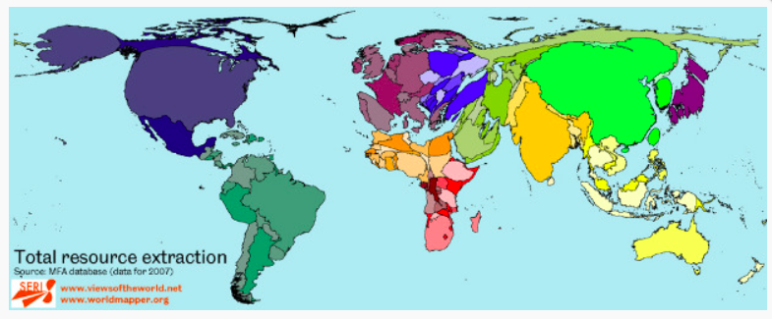

Slide 5
The physical environment ultimately determines the availability of a resource despite the importance of other human factors, which determine the level of exploitation, such as:
ownership of reserves
patterns and trends in supply and demand
political relationships
technology.

Slide 6
Oil

Slide 7
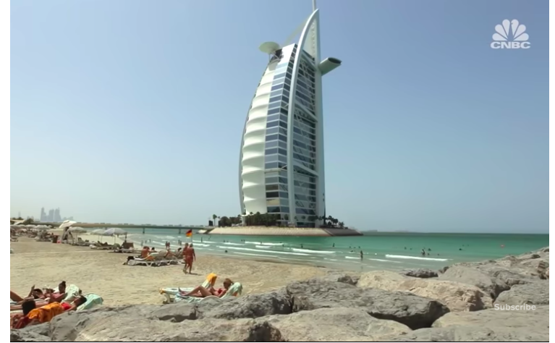
Read Kognity and watch videos on weebly
How did oil help development and global interactions in the UAE.

Slide 8
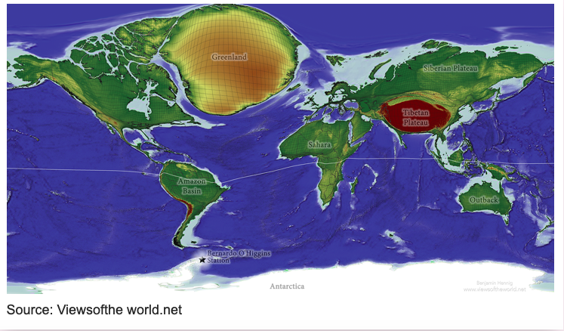
Geographical Isolation
Level of remoteness scaled up in proportion to land areas

Slide 9
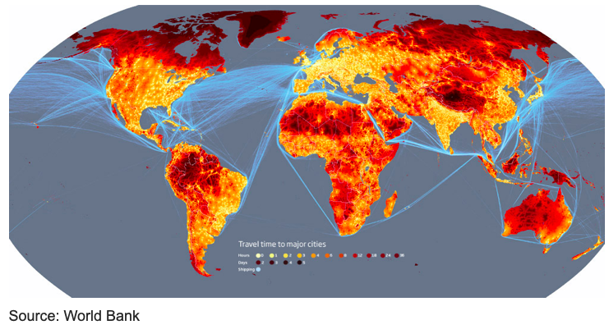
Remoteness by travel times.

Slide 10
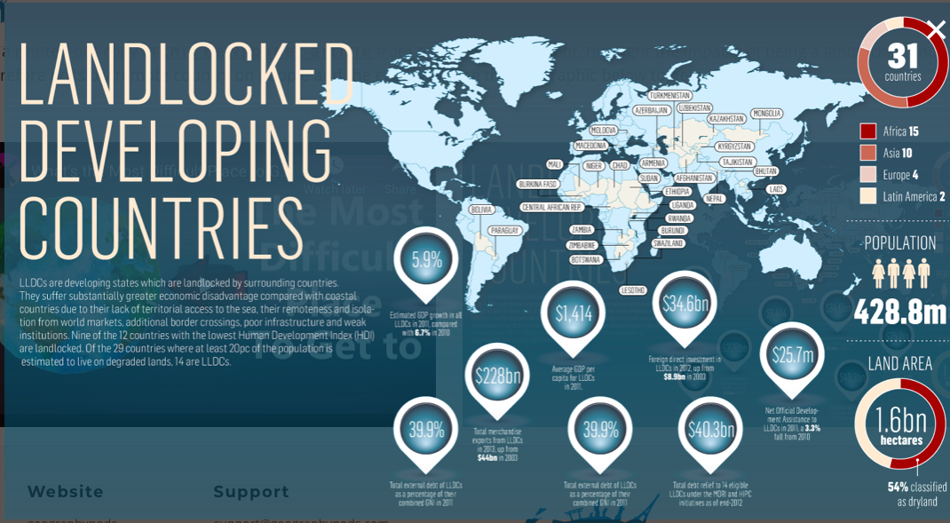

Slide 11
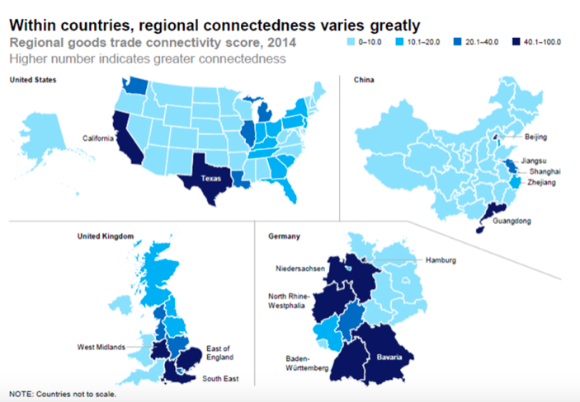

Slide 12
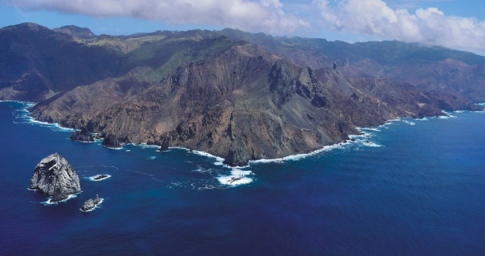
Make notes on a country that has barriers due to geographical isolation
St Helena
South Sudan
Kyrgyzstan

Slide 13
Exam question
“The physical environment has a greater influence than political and technological processes upon global interactions.” Discuss this statement. [16]

