Slide 1
Indian Independence
A timeline

Slide 2
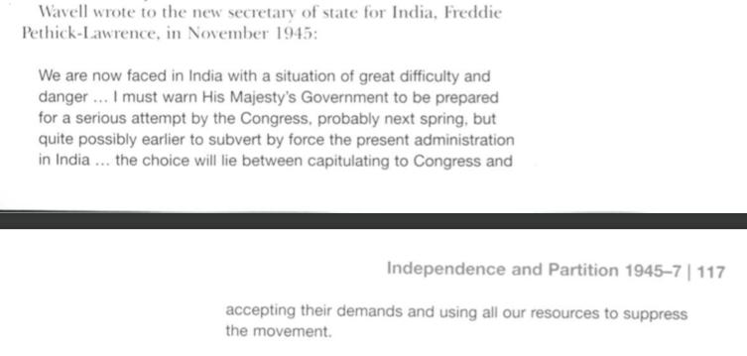
The end of WWII
New Labour Government – eager to press ahead for independence.
Unrest and threat of a growth in civil disobedience – created an urgency. The British did not have the troops to deal with such events.
Labour urgency to hand power to Congress was creating fear in the Muslim League. Viceroy Wavell was afraid that this would lead to communal violence.

Slide 3
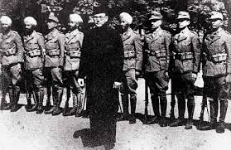
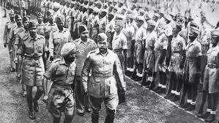
1945 - 1947
Rise in Nationalism
Anti-British feeling at the end of the war were very high. Bose and his Indian National Army who had fought with the Japanese were put on trial for treason. The trial turned them into heroes – Indians fighting for freedom and being unfairly treated by the colonial power. There were huge riots and the British were forced to reduce the sentence to suspended sentences.
This failed to stop the protests and spread to a mutiny of the Royal Indian Navy including twenty naval bases and 74 ships. The rapidly worsening situation led the British to realise that they needed a solution/agreement as soon as possible as they did not have the economic or military resources to maintain control in such difficult circumstances.

Slide 4
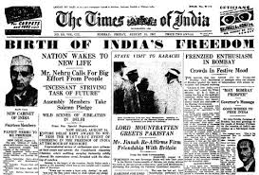
1945 - 1947
Political Divisions
The situation was complicated by the divisions and tensions between the nationalists. Congress wanted the creation of a single, secular state – with no significant religious affiliation. The Muslim League wanted India to be divided. Muslims made up only 20% of the population and they feared they would get ignored in a Hindu dominant state. They wanted a separate state – Pakistan. Congress vigorously opposed the concept of a divided India. Gandhi and Nehru tried to persuade Muslim leaders that they would be safe in a unified state.
Jinnah put pressure on the British to agree to a divided state.

Slide 5
1946 Elections
In 1946 elections Congress called for hope and social peace and economic prosperity.
The ML played on fears for the safety and political position of Muslims. This created great tension and encourage Muslims to support the League out of fear.
Congress won 90% of the seats, however the ML won 75% of all Muslim votes and took all 30 protected seats.
Most support for the ML came from Muslims in Hindu dominated states – clear they were looking for protection.

Slide 6
The British Commission 1946
The Prime Minister Atlee sent a commission to hear demands and to work out a solution.
Various leaders were invited. Gandhi called for power to transfer to Congress to make decisions for India.
Jinnah realized there would be no independent Pakistan if power transferred and would only come from the British.
The British needed Muslim support for any deal so Jinnah avoided confrontation and waited.
There was no Sikh representation and none for the leaders of the Princely States who had agreements with the British agreeing they could not be forced to join an independent India and could remain autonomous.

Slide 7
Simla Conference – May 1946
A meeting to discuss 2 proposals for India.
3 men represented Britain including Wavell
4 representatives from each party. Congress and the ML.
The mood was not good.
Jinnah would not talk to Azad a ML representative.
Gandhi was not involved but turned up on a special train and announced he would block any moves toward partition.
There were 2 proposals
1. A single state with a 3 tier constitutional structure.
- Union government – Foreign affairs, defence and communication
- Self selected regional groupings for all other government
- the existing provinces
A proposal was that regional groupings could secede after a certain time via plebiscite and become independent.
2. A partitioned two state option
- Hindustan and Pakistan
The two states would conclude formal treaties with each other but have no shared government.
The British hoped the second option would scare them into supporting the first. Congress was dead against both options.
Jinnah, ailing in health could not afford to wait decades for secession and favoured the partition.
Britain worried about the survival of an independent Pakistan but did see the benefit of a loyal state in the region.

Slide 8
May Statement
Failure to reach a decision at Simla led commission to release a statement of intent.
They would create a constituent Assembly of elected representatives that would draft a constitution for a single state with regional groupings.
Congress would not agree but the ML did.
This led to delay as the groups could not agree on who should choose the representatives.
26th June – Congress announced a partial acceptance of the May Statement with a different proposal. Allowing individual provinces the right to opt out of regional groupings if they chose to secede.
This angered the ML and they withdrew from the process.
Wavell and the commission left India
Wavell announced the imminent formation of an interim government based on
6 Congress
5 ML
3 to represent minorities
The ML refused to select anyone – Wavell gave Congress the authority to select Muslim reps.
Jinnah was outraged and made all Muslims resign.
The political process collapsed and the country slid towards civil war.
The Indian Armed forces could not be relied upon to keep order.
Wavell wanted to announce a withdrawal but the British Government did not want panic and refused to organise evacuation of British families.

Slide 9
Jinnah’s first and last misjudgement
Jinnah decided that it was time to show that the ML could use mass action like Gandhi and Congress.
Up until now Jinnah had preferred constitutional negotiation.
He felt it was a time for a show of strength.
Maybe he was not aware of what he was about to unleash.

Slide 10
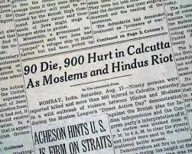
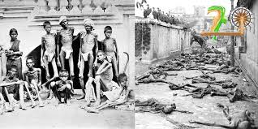
1945 - 1947
Methods of Protest
“Direct Action Day’ – August 1946. The ML called for ‘direct action’ in support of partition. On this day there was rioting in Calcutta which soon erupted into widespread communal violence. Both Muslims and Hindus committed atrocities. In Calcutta 4,000 were killed and thousands more injured or made homeless. Other violent attacks occurred across India. The British saw this as evidence that there were irreconcilable differences between Hindu and Muslims.

Slide 11
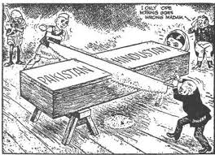
1945 - 1947
Negotiation
In an atmosphere of escalating violence Congress accepted that participation was the only solution. The violence also showed the British that they could not maintain control and decided to quit India as quickly as possible.
Feb 1947 – Lord Mountbatten was sent as the last Viceroy to India – to facilitate and oversee the transfer of power by June 1948. He brought the date forward to August 1947. In only 6 months, Mountbatten had to decide how many states, where borders would be and what would happen to the princely states.
Mountbatten opted for the Muslim two-state solution and created two enclaves in North western India and eastern Bengal – containing large numbers of Muslims to form Pakistan. Princley states were allowed to choose which state to join. It was not this simple and the religious/ethnic picture was much more complex and the solution would mean millions of people would have to relocate to one country or the other – depending on their ethnicity and religion.

