Slide 1
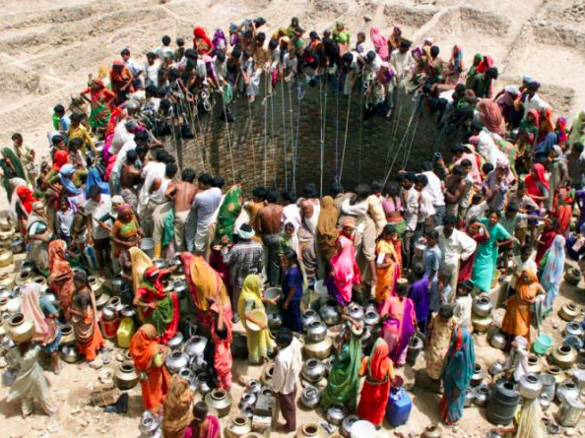
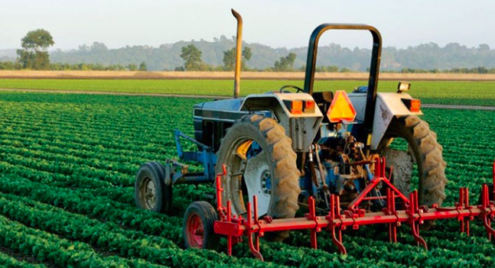
Contrasting the resource security of two countries
Subject guide: ​
The water–food–energy “nexus” and how its complex interactions affect: • national water security, including access to safe water • national food security, including food availability • national energy security, including energy pathways and geopolitical issues The implications of global climate change for the water–food–energy nexus • Detailed examples of two countries with contrasting levels of resource security

Slide 2
What? (enquiry question): How does the resource security contrast between 2 countries
Why: To understand the water–food–energy “nexus” and how its complex interactions manifest themselves in different locations
How: By studying water, food and energy security in India and Canada and comparing and contrasting their situations
Example assessment questions:
“Water, food and energy security can no longer be viewed as isolated global problems” – critically examine this statement (10)
Compare and contrast the national resource security of two countries that you have studied [10 marks]

Slide 3
The World Economic Forum description of the FEW Nexus

Slide 4
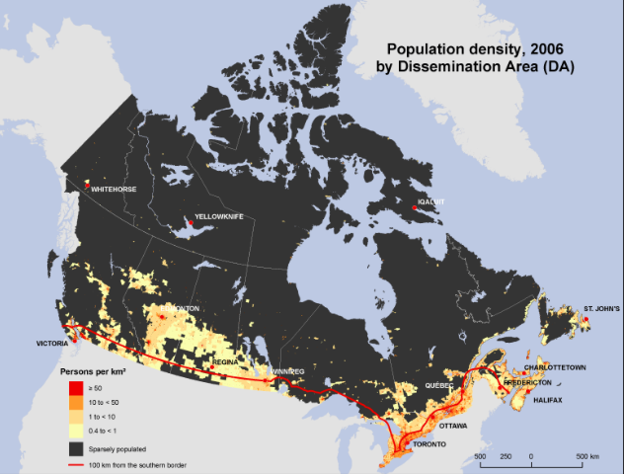
The 2 countries: India v Canada
Think- pair- share: What differences may these countries face linked to the nexus?

Slide 5
Data collection

Slide 6
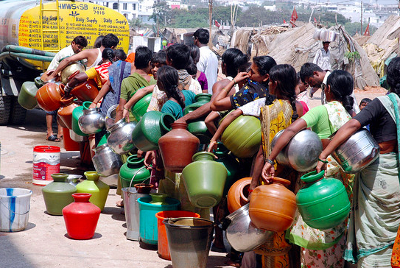
WFE resource insecurity in India
India, due to high population and low level of economic development and rapid urbanisation and industralisation is viewed as having high vulnerability to, and limited resilience against more severe IPCC climate projections.

Slide 7
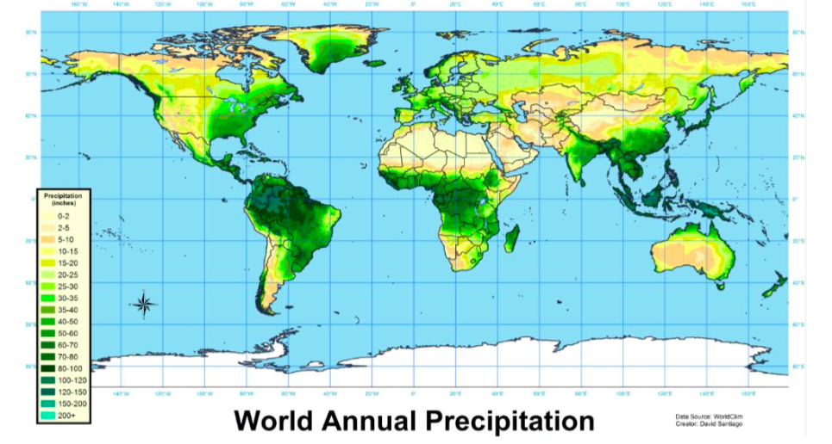
Water security
How do our 2 case study countries compare? Why?

Slide 8
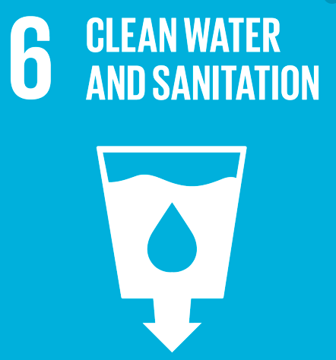
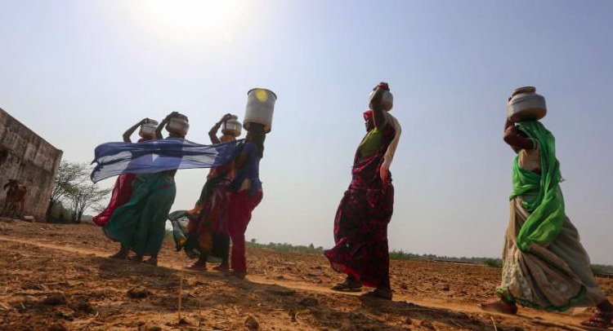
India facing its worst water shortage in history, report says
https://www.cnn.com/2018/06/15/health/india-water-shortage-crisis-intl/index.html
https://www.reuters.com/article/us-india-water-crisis/indias-worst-water-crisis-in-history-leaves-millions-thirsty-idUSKBN1JV01G
http://time.com/5302661/water-crisis-drinking-india-drought-dry/
600 million people - nearly half India’s population - face acute water shortage, with close to 200,000 dying each year from polluted water.

Slide 9
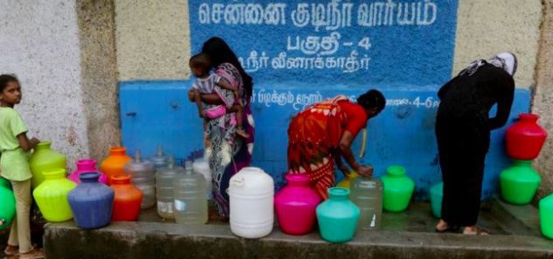
Chennai, 2019. Reservoirs run dry
https://www.youtube.com/watch?v=ayrNyaVMvvg
The four reservoirs supplying the bulk of the city’s drinking water have completely dried up. The crisis in India’s sixth largest city comes as the country struggles to deal with a heatwave that has caused hundreds of deaths…temperatures reached 50 degrees centigrade.
https://www.theguardian.com/world/2019/jun/19/chennai-in-crisis-water-shortage-with-authorities-blamed-india
https://www.bbc.com/news/world-asia-india-48674775
https://www.youtube.com/watch?v=11kERB3XAIM

Slide 10
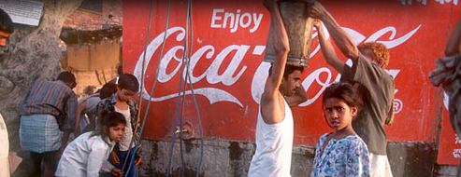
Coca Cola and water issues in India
FEW NEXUS and environmental issues of globalisation : Synoptic links
Coca-Cola established a bottling plant in the village of Kaladera in Rajasthan at the end of 1999. Rajasthan is well known as a desert state, and Kaladera is a small, impoverished village characterised by semi-arid conditions. Farmers rely on access to groundwater for the cultivation of their crops. but since Coca-Cola's arrival, they have been confronted with a serious decline in water levels. Locals are increasingly unable to irrigate their lands and sustain their crops, putting whole families at risk of losing their livelihoods.
http://www.waronwant.org/media/coca-cola-drinking-world-dryhttps://bassaleggeography.wordpress.com/2012/01/18/coca-cola-causes-water-shortages/
https://www.youtube.com/watch?v=tlfMBQGZUvQ&vl=en- 8.25

Slide 11
Possibilities: Ice Stupas
Meet the engineers who build glaciers from scratch to help isolated villages in Ladakh, the northern most province of India.
https://www.youtube.com/watch?v=2xuBvI98-n4

Slide 12
Water security
For more reading on increasing water security (i.e. desalinization, water transfer schemes and fog harvesting) use Kognity 3.2.2

Slide 13
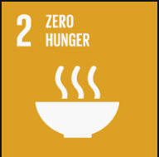
Food security
Because of rising temperatures India’s agricultural productivity could fall by 35 to 40% by 2080.
Insecurity problems will be felt the most amongst the poorest communities.

Slide 14
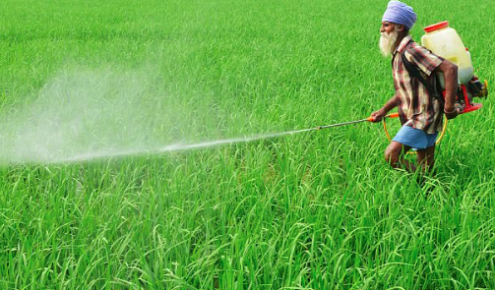
Possibilities: The Green Revolution
Between the 1940s and 1970s there was a series of technological breakthroughs and transfers that were the result of years of research and development. Most of the initiatives that were introduced began in the late 1960s in poorer, densely-populated parts of the world.
The Green Revolution spread modern agricultural technologies around the world, changed the amount of food that could be produced, improved food security and, in some cases, turned previously-food-scarce countries into exporters of staple crops.

Slide 15
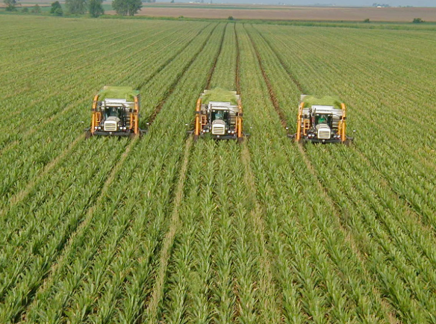
Possibilities: The Green Revolution
Technology
Modern irrigation techniques, pesticides and the cultivation of high-yielding varieties of cereal crops were the three main technological breakthroughs of the Green Revolution. The advent of diesel and electric motors led for the first time to systems that could pump groundwater out of major aquifers faster than it was recharged, which, though providing much water for irrigation, can lead to problems such as the permanent loss of aquifer capacity, worse water quality and ground subsistence.
Pesticides are chemicals that prevent, destroy or repel pests such as insects, plant pathogens, weeds, roundworms and microbes. In some cases pesticides are designed to remove molluscs, and most have been proven to have a damaging effect on other animals and humans. Despite these drawbacks, both heavy aquifer and pesticide use persist because of the benefit to food stability.
Increased Yield
Between the early 1960s and the mid 1980s the production of cereal crops more than doubled in developing countries. The introduction of a high-yield dwarf rice variety called IR-8 increased the annual production of rice in the Philippines from 3.7 to 7.7 million tonnes in two decades, making the country a rice exporter for the first time in its history.
Evaluation and link to nexus:
https://www.youtube.com/watch?v=gIdMMwTTklc

Slide 16
Food security
For more reading on increasing food (i.e. solar irrigation) use Kognity 3.2.5

Slide 17
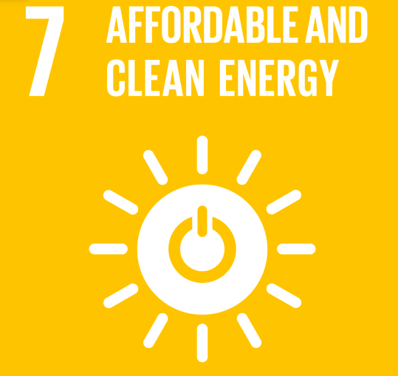
Energy security India
India’s critical need for power Severe power shortage is one of the greatest obstacles to India’s development. Over 40 percent of the country’s people -- most living in the rural areas -- do not have access to electricity and one-third of Indian businesses cite expensive and unreliable power as one of their main business constraints. India’s energy shortfall of 10 percent (rising to 13.5 percent at peak demand) also works to keep the poor entrenched in poverty. Power shortages and disruptions prevent farmers from improving their agricultural incomes, deprive children of opportunities to study, and adversely affect the health of families in India’s tropical climate. Poor electricity supply thus stifles economic growth by increasing the costs of doing business in India, reducing productivity, and hampering the development of industry and commerce which are the major creators of employment in the country.

Slide 18
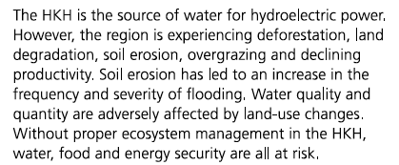
Hydroelectricity potential
Out of the total power generation installed capacity in India of 1,76,990 MW (June, 2011), hydro power contributes about 21.5%.
India is blessed with immense amount of hydro-electric potential and ranks 5th in terms of exploitable hydro-potential on global scenario
Conflict between India and Pakistan over hydro-electiricty in Indus Basin (POWER)
https://www.youtube.com/watch?time_continue=20&v=0A6sgQ7yLNk

Slide 19
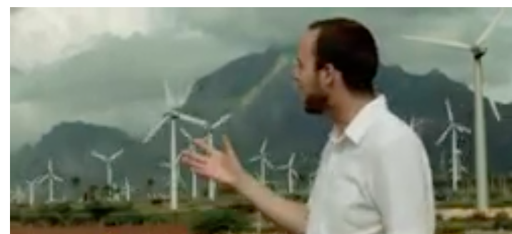
Wind power
Watch the video and make notes on the potential of Muppendal wind farm in Tamil Nadu , India
Additional/ alternative case study: Wind energy in India in the energy section

Slide 20
Electrifying India: Energy Innovation in the Countryside
Watch the video about using sustainable husk power in rural India to provide energy to rural India
Additional/ alternative case study: Biogas in rural India in the energy section

Slide 21
India’s Food, Water, Energy Conundrum: Conclusions From a Two-Year Reporting Project: https://www.newsecuritybeat.org/2015/03/indias-food-water-energy-conundrum-part-1-2/

Slide 22
Summary: WFE resource insecurity in India
Add any relevant points to your Nexus hexagons diagram

Slide 23
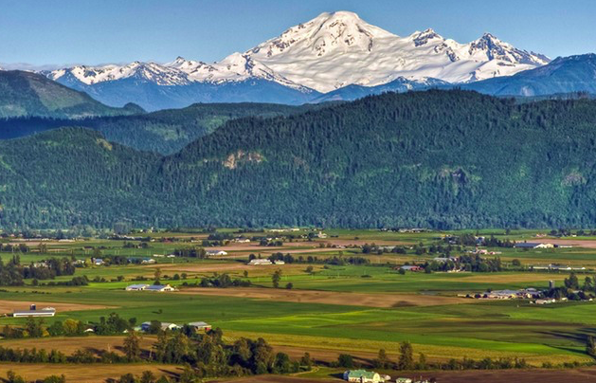
WFE resource security in Canada
Canada is seen to be resilient to climate change (in some cases it may even benefit from it. Also, its underpopulation (population density on 4 per sq km) and and low growth rate (stage 4 DTM) mean it will not face population pressures in the future.

Slide 25
Energy pathways
Transport of energy from one area to another. Normally from resource secure to resource insecure areas.

Slide 26
Environmental issues with PIPE TRANSPORT
The Keystone Pipeline System is an oil pipeline system in Canada and the United States, commissioned since 2010.
It runs from the Western Canadian Sedimentary Basin in Alberta to refineries in Illinois and Texas, and also to oil tank farms and oil pipeline distribution centre in Cushing, Oklahoma.
The US is currently trying to pass an extension to the pipeline to increase transport of oil, called Keystone XL.
Different environmental groups, citizens, and politicians have raised concerns about the potential negative impacts of the Keystone XL project. The main issues are the risk of oil spills along the pipeline, which would traverse highly sensitive terrain, and 17% higher greenhouse gas emissions from the extraction of oil sands compared to extraction of conventional oil.
PIPELINE SPILLS IN NORTH DAKOTA, USA: https://www.youtube.com/watch?v=Jo-r4oXwnGg

Slide 27
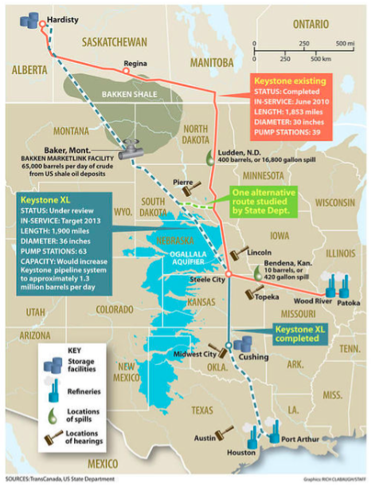

Slide 28
Summary: WFE resource security in Canada
Add any relevant points to your Nexus hexagons

Slide 29
Example assessment questions:
“Water, food and energy security can no longer be viewed as isolated global problems” – critically examine this statement (10)
Compare and contrast the national resource security of two countries that you have studied [10 marks]

Slide 30
Essay Question - Discuss the challenges relating to the application of the water, food and energy nexus in regard to resource security at different scale. (10)

