Slide 1
Social Impacts of Genghis Khan and the Mongols
William Berglund and Emmet Moore

Slide 2
Slavery
Genghis enlisted slaves to become part of the empire and war machine
Slaves were tasked to three jobs, laborer's, specialist artisans and cannon fodder
In battle, captured townsfolk from the previous town were put at the front of the army, their bodies used to fill moats or to stop enemy archers from firing their arrows as they didn’t know which ones was their enemies or friends
Mongols could not be slaves

Slide 3
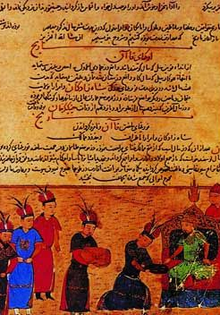
Laws
Forbids the selling of women into marriage
All children are legitimate
Forbids theft of animals
Turn in found goods or face the punishment of execution
Hunting was banned between March and October
Complete religious freedom
Khan is elected by Khuriltai
Group responsibility and group guilt
The Yassa, a scripture announcing the laws put in place by Genghis after being elected leader of the united Mongol tribes

Slide 4
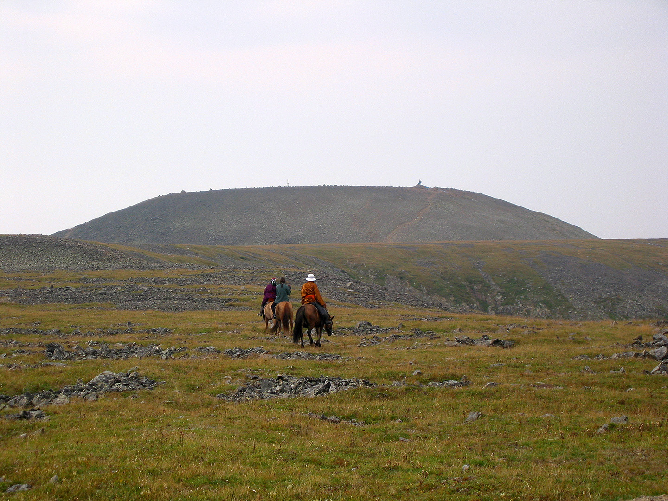
Religion
Genghis had appointed religious freedom across the empire
Much of the Muslim population in Khwarazm and the Khara Khitai empire supported Genghis as he was religiously tolerant, unlike Kuchlug who was hostile to Islam
Many people believed that the winner in battle was chosen by god
Due to his many battle successes, Genghis was viewed as a 'mandate of god' by much of the opposing forces, rallying more support for him
Burkhan Khaldun, the mountain Genghis used to pray for victory at before embarking on his many conquests

Slide 5
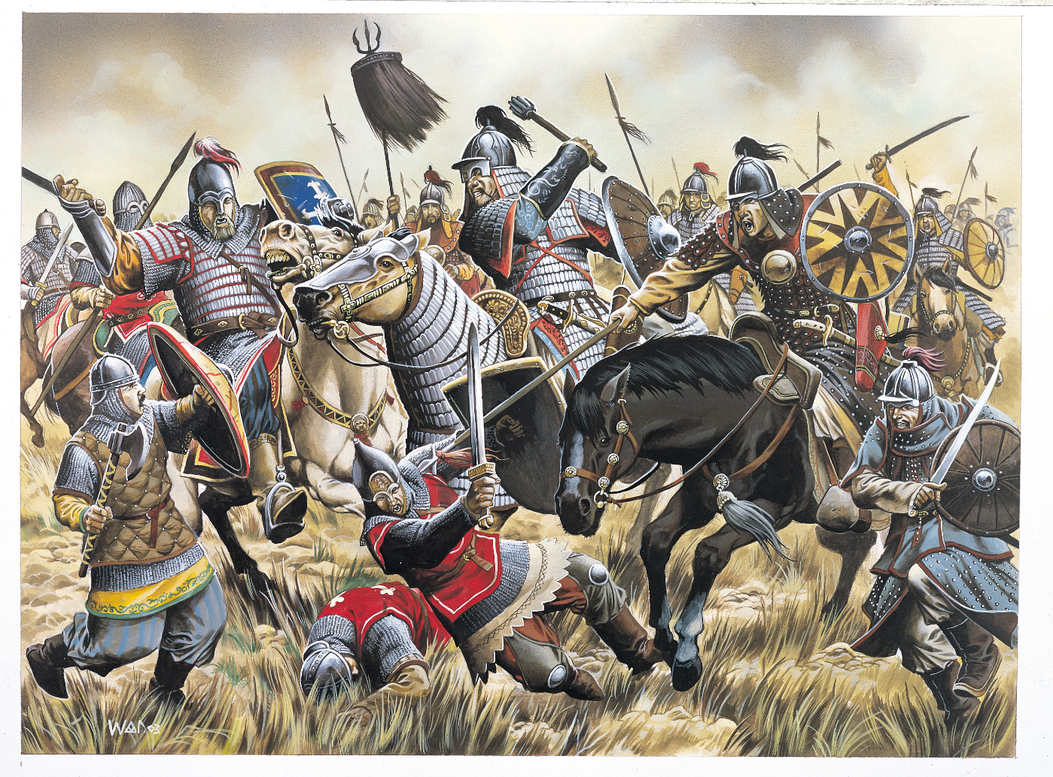
Loyalty and fear
Genghis had gained support in two ways, either you were loyal to him or you submitted to him through fear
17 out of the 19 at the Baljuna covenant were not of kin, which meant that they were they out of loyalty
Many of the generals and leaders were appointed on loyally and not whether there were family
Religious freedom allowed Genghis to gain support all over the empire, especially in the Islamic world
Many of the neighboring lands of the Mongol's supported Genghis's ideas such as the khitai and thus swore loyalty to him

