Slide 1
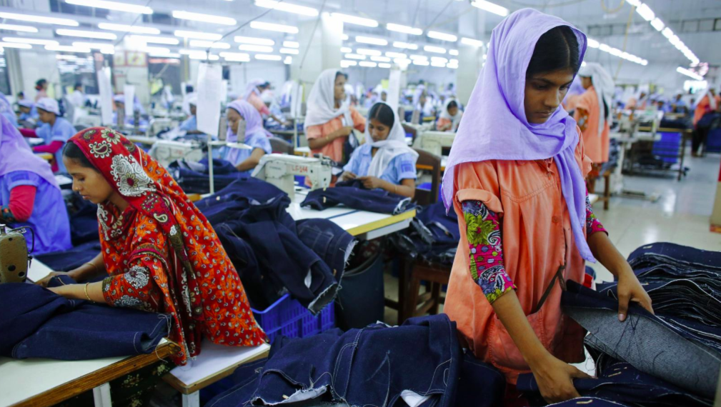
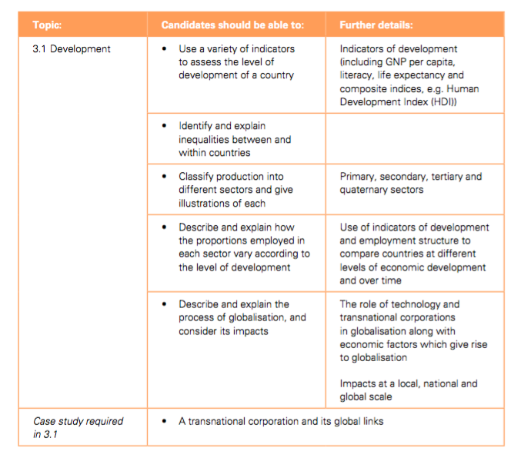
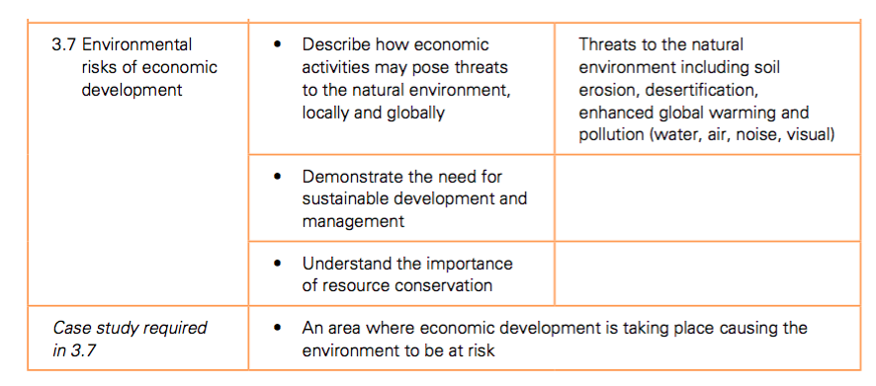
The impacts of Globalisation

Slide 2
Today’s Lesson:
Globalisation: Are TNC’s a good or
bad thing for the global economy??
Today’s Aim:
To evaluate the activity of transnational corporations.
Starter Challenge: In your books, write a definition of a TNC. How many of these words can you include?
Global Company Business Country Host Origin Economy Globalisation
Good words
Expert words

Slide 3
Thinking
Last lesson we learnt about Transnational Corporations (TNCs) and you should have a definition from today’s starter challenge that reads a little something like this…
“TNCs are large businesses that operate in a number of countries. They often separate their production between various locations. The country in which the company was founded is often called the country of origin. The country/ies where the factories are located, and the production takes place is called the host country. TNCs have been a big driving force behind globalisation (which we will learn more about later on in this unit!)”
So for Walmart, founded in Arkansas, America in 1962 by Sam Walton who import Lauren Miller’s radio amongst millions of other products from China, what is the country of origin and what is the host country?

Slide 4
Thinking
Why do you think these Walmart workers are protesting??
The Walmart workers are unhappy about the wages they are paid. They receive (on average) $11 per hour. The workers believe it is too low (it is worth noting this is still $5 above America’s minimum wage of $7.25). The workers are also unhappy about the amount of foreign goods that Walmart import as it has caused huge job losses and unemployment across America….

Slide 5
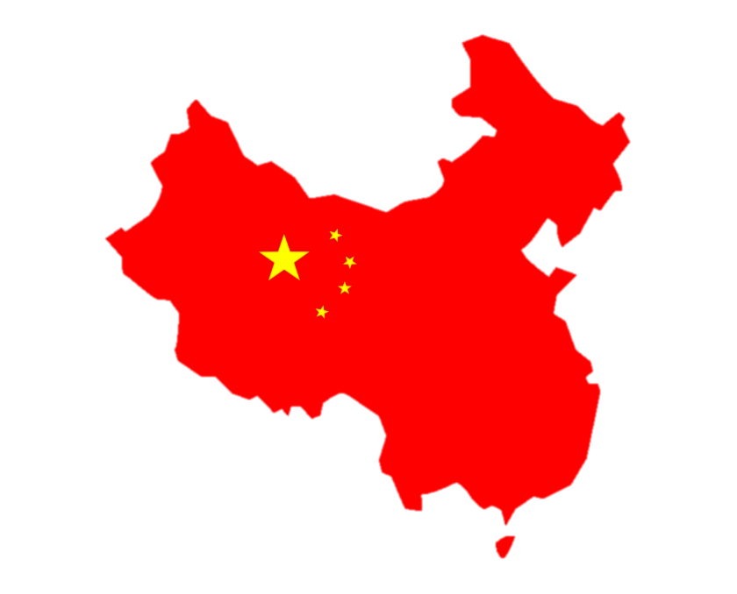
Linking
Since the early 1990s, more than 4.5 million manufacturing jobs have disappeared in the USA with one study claiming that Walmart is responsible for the loss of 400,000 jobs in the last 12 years by choosing to import goods from China.
Let's think about Lauren Miller’s recently purchased radio. Why do you think Walmart choose to import the radio all the way from China instead of manufacturing it at home in America? Task: Use the picture clues on the next slide to make a list to describe why Walmart choose to import their goods from China.
Key Words:
Import- bring goods or services into a country
Export – To sell a good or service to another country
Manufacturing- The making of items on a large scale

Slide 6
Linking
?????

Slide 7
Linking
Wages are much cheaper in China. Chinese factory workers are 5 times cheaper than an equivalent American worker.
TNCs in America have to follow very strict environmental laws. This is not the case for factories in China.
There are 900 million Chinese people of working age- 5 times more than America.
?????
China has a plentiful young workforce. Although sometimes they have been accused of using children in factories to keep costs even lower.
Unlike America, there is no minimum wage in China.
Land is much cheaper to buy in China.
Notes:
Encourage students to write in books ahead of next task

Slide 8
Explaining
So far we have DESCRIBED why Walmart chooses to import from China. We are now going to EXPLAIN why. This is a key skill which you will regularly need to employ in Geography.
TNCs such as Walmart can afford to build much larger factories which can employ more workers and produce more goods than smaller factories in America. More products can then be sold to America at a lower cost as they are produced on mass.
Land is much cheaper to buy in China.
This means that….
?????
Description of reason
Connecting sentence starter
Explanation
Task: Choose 3 more reasons and explain them in full sentences in your books/on a blank slide.

Slide 9
Explaining
Wages are much cheaper in China. Chinese factory workers are 5 times cheaper than an equivalent American worker.
TNCs in America have to follow very strict environmental laws. This is not the case for factories in China.
There are 900 million Chinese people of working age- 5 times more than America.
?????
China has a plentiful young workforce. Although sometimes they have been accused of using children in factories to keep costs even lower.
Unlike America, there is no minimum wage in China.
Land is much cheaper to buy in China.
Notes:
Encourage students to write in books ahead of next task

Slide 10
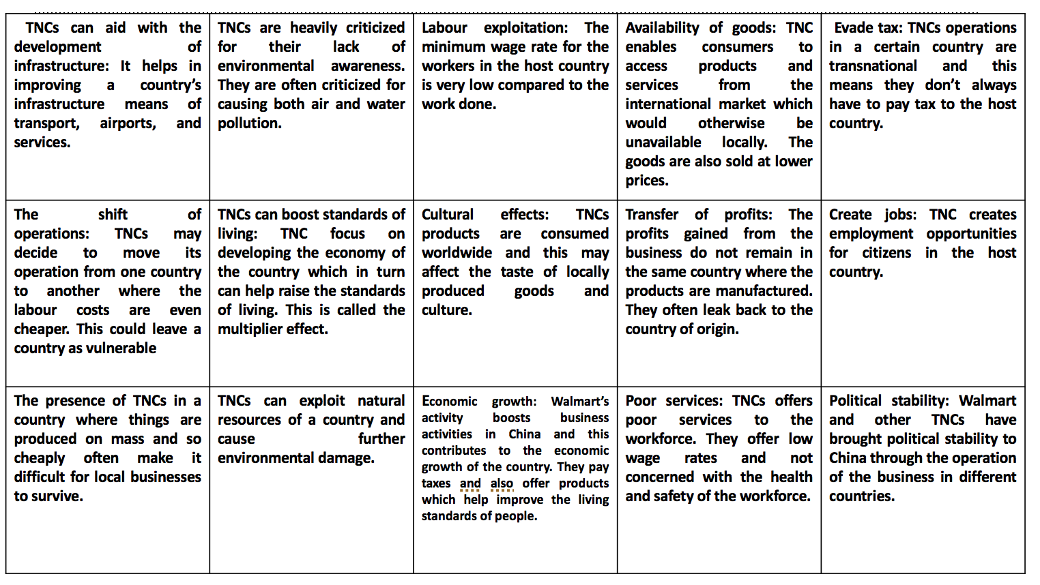
Explaining
As we can see with Walmart’s activity in China, TNC activity can be problematic for all countries involved. But there can also be positive consequences. Task: Organise the statements into either pros and cons.
Are there any consequences which are both a good and bad thing when it comes to TNC activity?
In your opinion, which is the most important advantage of TNC activity? Why do you think this.
In your opinion, which is the most important disadvantage of TNC activity? Why do you think this.
Notes:
Encourage students to write in books ahead of next task

Slide 11
Reflecting
Today’s aim was to: evaluate the activity of transnational corporations by answering the question ‘are TNCs a good or bad thing for the global economy’?
Bad thing
Good thing
Make a copy of the opinion line in your books. Plot your own opinion on the line and underneath JUSTIFY why you have that view. Your justification should include facts, figures and examples from today’s lesson!
Notes:
Encourage students to write in books ahead of next task

Slide 12
TNCs can aid with the development of infrastructure: It helps in improving a country’s infrastructure means of transport, airports, and services. | TNCs are heavily criticized for their lack of environmental awareness. They are often criticized for causing both air and water pollution. | Labour exploitation: The minimum wage rate for the workers in the host country is very low compared to the work done. | Availability of goods: TNC enables consumers to access products and services from the international market which would otherwise be unavailable locally. The goods are also sold at lower prices. | Evade tax: TNCs operations in a certain country are transnational and this means they don’t always have to pay tax to the host country.
The shift of operations: TNCs may decide to move its operation from one country to another where the labour costs are even cheaper. This could leave a country as vulnerable | TNCs can boost standards of living: TNC focus on developing the economy of the country which in turn can help raise the standards of living. This is called the multiplier effect. | Cultural effects: TNCs products are consumed worldwide and this may affect the taste of locally produced goods and culture. | Transfer of profits: The profits gained from the business do not remain in the same country where the products are manufactured. They often leak back to the country of origin. | Create jobs: TNC creates employment opportunities for citizens in the host country.
The presence of TNCs in a country where things are produced on mass and so cheaply often make it difficult for local businesses to survive. | TNCs can exploit natural resources of a country and cause further environmental damage. | Economic growth: Walmart’s activity boosts business activities in China and this contributes to the economic growth of the country. They pay taxes and also offer products which help improve the living standards of people. | Poor services: TNCs offers poor services to the workforce. They offer low wage rates and not concerned with the health and safety of the workforce. | Political stability: Walmart and other TNCs have brought political stability to China through the operation of the business in different countries.

Slide 13
Today’s Lesson:
Globalisation: What other factors are
responsible for accelerating globalisation?
Today’s Aim:
To explain how a range of factors have accelerated the process of globlisation
Starter Challenge: NO WORDS!
Draw a picture which illustrates what is meant by the term ‘globalisation’.

Slide 14
Defining
Globalisation: Defined
Watch me first
https://www.youtube.com/watch?v=JJ0nFD19eT8
Task: This is a great definition of the term. But do we understand it? You are going to write this definition in your books and then annotate it with the answers to the questions to show your understanding.
How has the world become more interconnected both metaphorically and in real life?
Can you give an example of a company which has increased global trade?
Globalisation is the process by which the world is becoming increasingly interconnected as a result of massively increased trade and cultural exchange. Globalisation has been taking place for hundreds of years, but has sped up enormously over the last half-century.
What is cultural exchange?
Can you give an example of historical globalisation?
Why has globalisation accelerated so much in the last 70 years?

Slide 15
Analysing
But WHY do you think this has happened?
Task: Complete the mindmap with reasons why globalisation has accelerated so much in recent years? The picture clues might help
Why has globalisation accelerated?

Slide 16
Analysing
We have discussed a range of accelerating factors, many of which you will see below. Now, we are going to create a globalisation Timeline!
Task: We have identified these things as factors which have accelerated globalisation. Create a timeline in your books to show the chronology of these developments.
The development of container ships
The development of fibre optic cables which can transfer huge amounts of information
The availability of Smart Phones
Improved peace time relations following the end of WW2
The invention of the steam engine
The first flight of a commercial passenger plane
The development of the world wide web
The emergence of social media such as Facebook, Instagram and Twitter
Increased global trade through international agreements signed at the end of WW2
The invention of the Television
1800s
1900’s
2000’s
Present Day

Slide 17
Analysing
Globalisation: A Timeline
How does your chronology compare?
1950s
Increased global trade through international agreements signed at the end of WW2
1970s
The development of fibre optic cables which can transfer huge amounts of information
1820s
The invention of the steam engine
1920s
The invention of the Television
1950s
The development of container ships
2000s
The availability of Smart Phones
1940s
Improved peace time relations following the end of WW2
1960’s
The first flight of a commercial passenger plane
1980s
The development of the world wide web
2010s
The emergence of social media such as Facebook, Instagram and Twitter
1800s
1900s
2000s
Present Day

Slide 18
Reflecting
You are now going to critically reflect on the factors responsible for accelerating globalisation. Task: You are going to rank them using a Diamond 9. You must also justify your top and bottom choice.
Most Significant Factor
Least Significant Factor

Slide 19
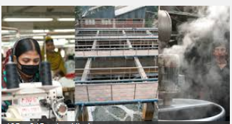
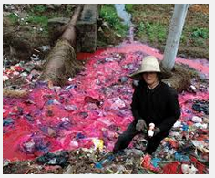
Garment manufacturing in Bangladesh

Slide 20
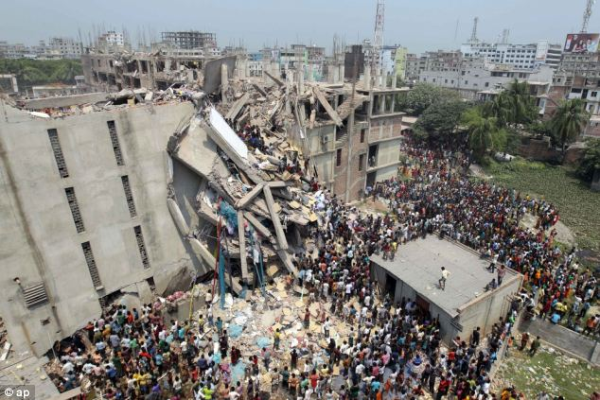
or
What is the connection?
Play the unfair factory game

Slide 22
Negative externalities usually affect poor people the most. Poor people tend to be people who are forced to live near polluting factories because they can't afford to live anywhere else. The old/young and sick are also vulnerable to pollution caused by industry. Many polluting industries also choose to locate in LEDCs for a number of reasons including: More relaxed environmental regulations
Less enforcement of environmental regulations (this might be because they can't afford to enforce, because they are being paid to overlook (corruption), or they are worried about losing FDI.
Access to a new potential marketplace
Access to raw materials (which again might be extracted using polluting methods)
Availability of cheap labour
Cheap land and building materials (possibly relaxed building regulations)

Slide 23
AIR pollution
According to the dictionary, air pollution is the contamination of air by smoke and harmful gases, mainly oxides of carbon, sulfur, and nitrogen. Some examples of air pollution include: Exhaust fumes from vehicles
The burning of fossil fuels, such as coal, oil, or gas
Harmful off-gasing from things such as paint, plastic production, and so on
Radiation spills or nuclear accidents

Slide 24
WATER pollution
Water pollution is the contamination of any body of water (lakes, groundwater, oceans, etc). Some examples of water pollution: Raw sewage running into lake or streams
Industrial waste spills contaminating groundwater
Radiation spills or nuclear accidents
Illegal dumping of substances or items within bodies of water
Biological contamination, such as bacteria growth
Farm runoff into nearby bodies of water

Slide 25
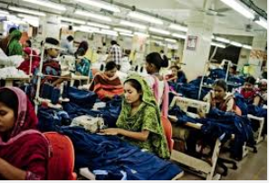
Case study: the textiles Industry in Bangladesh
What you need to know: Success criteria
Why has manufacturing industry located in Bangladesh?
What are the positive impacts for Bangladesh?
What are the negative social impacts?
What are the negative environmental effects?
What is being done to reduce the negative social impacts?
What is being done to reduce the negative environmental impacts?

Slide 26
Water pollution in Bangladesh
https://www.nytimes.com/2013/07/15/world/asia/bangladesh-pollution-told-in-colors-and-smells.html
Bangladesh’s garment and textile industries have contributed heavily to what experts describe as a water pollution disaster, especially in the large industrial areas of Dhaka, the capital. Many rice paddies are now inundated with toxic wastewater. Fish stocks are dying. And many smaller waterways are being filled with sand and garbage, as developers sell off plots for factories or housing.
Some factories treat their wastewater, but many do not have treatment plants or chose not to operate them to save on utility costs.
Task: Use the interactive ‘water pollution in Bangladesh’ and make notes on the causes and issues of water pollution

Slide 28
7 mark questions
Name an area which you have studied and state an economic activity which is causing the environment to be at risk and explain the risks it is causing
For an example of an economic activity in a named area you have studied, describe how the threats to the natural environment are being managed.
Name an area which you have studied and state an economic activity which is causing the environment to be at risk. Explain how it is being managed so that it is more sustainable.

