Slide 1
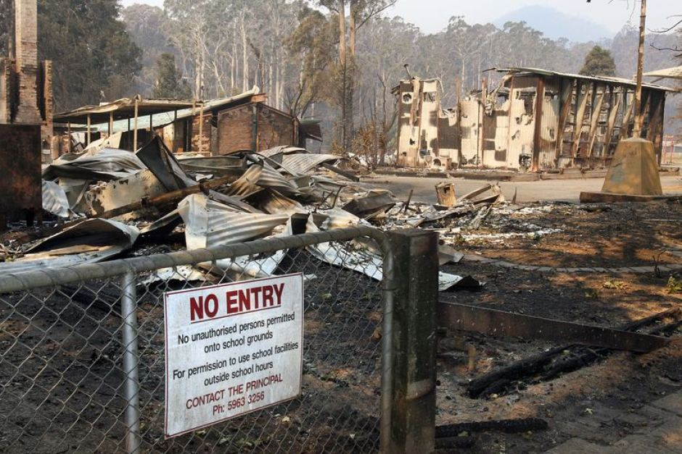
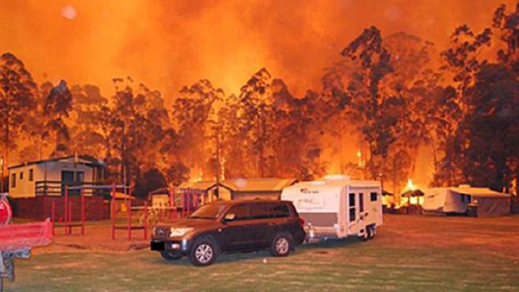
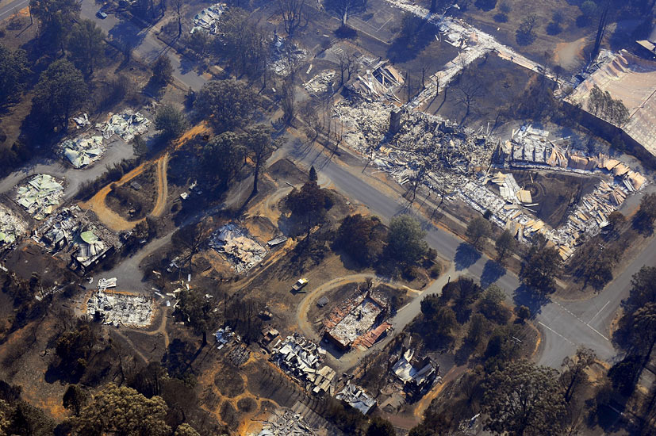
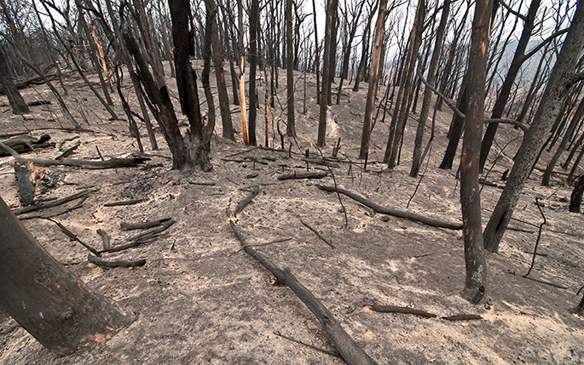
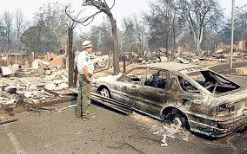
Impacts of wildfires

Slide 2
General impacts
Key | People may be killed or injured if they don’t evacuate in time | Wildfires can discourage tourists from visiting an area, reducing income | Businesses can be destroyed leading to loss of jobs and income
 | Governments can face criticism when wildfires have severe impacts | Smoke causes air pollution and water sources can be contaminated with ash | Governments have to change forest management practices to reduce the risk of wildfire, e.g. clear vegetation to limit fuel
Habitats are destroyed and some species may not return to an area after a fire, reducing the biodiversity | Damage to soil structure and nutrient content over a wide area | Homes are destroyed so people may be left homeless | Some ecosystems rely on wildfires to clear dead vegetation; some plant seeds need fire to germinate
Loss of timber, livestock and crops | Insurance premiums can increase dramatically after a wildfire | Loss of vegetation can lead to an increased risk of flooding | Toxic gases and smoke particles create air pollution
Power lines can be destroyed and reservoirs damaged, leaving people without electricity or clean water | Soils are damaged as fire removes organic matter | The cost of fighting wildfires is huge | Health problems from inhaling smoke, e.g. long-term breathing difficulties
 | Environmental
 | Social
 | Economic
 | Political

