Slide 1
Classwork
Date: Sunday, 14 January 2018
Title: The Nike Operation
LO: To explore how Nike has spread around the world.
Revenue
Marketing
Globalisation
Trade
Transnational Company
SUCCESS CRITERIA:
I can define globalisation and transnational company.
I can list five countries where Nike goods are made.
I can suggest why Nike operates in these countries.
I can explain four factors that influence the process of globalisation.
I can outline how my life is affected by globalisation.

Slide 2
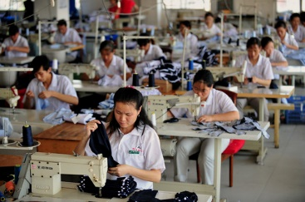
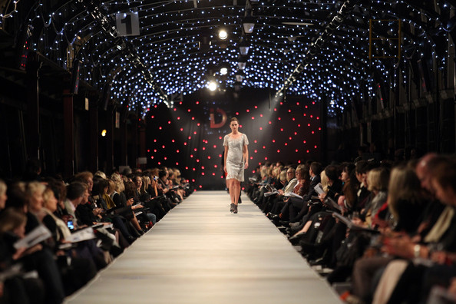
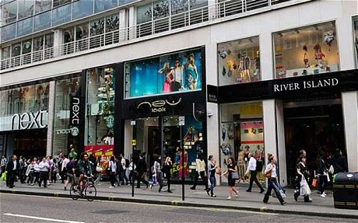
ACTIVATE
How do these pictures show fashion as a global industry?
Consumerism
Production
Labour
Industry
Trend
Fashion
Marketing
Buying
Consumerism
Consumerism
Distribution
LO: To explore what is meant by the global fashion industry.

Slide 3
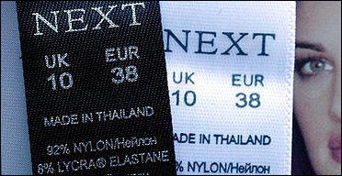
ACTIVATE
What is the Global Fashion Industry?
Global Fashion Industry
When clothes are made in one country and then sold all around the world.
Why?
Why are our clothes not made in the UK?
Why can we buy clothes from other countries?
LO: To explore what is meant by the global fashion industry.

Slide 4
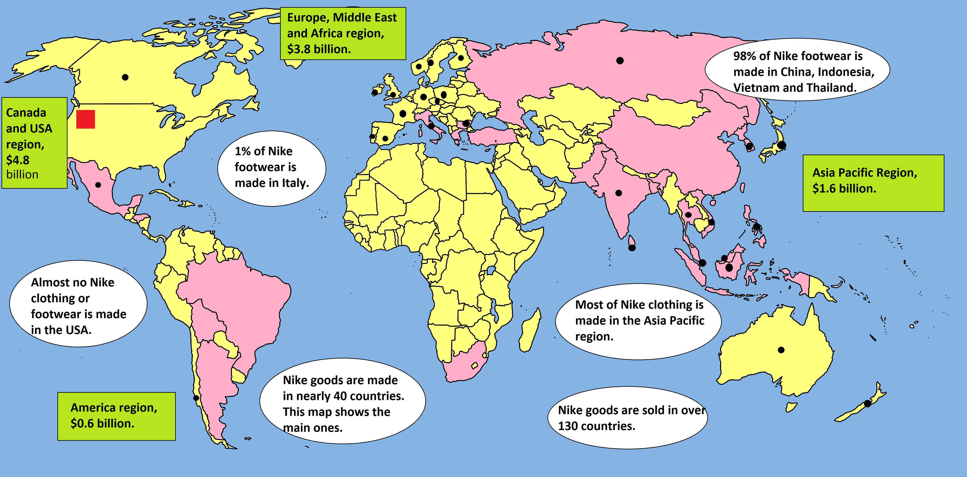
ACTIVATE
Nike around the World (Use the map in your planner).
TASK:
In your books list 5 countries where Nike goods are made.
Shows sales for year 2004.
Countries where Nike has set up a branch.
Main countries where Nike goods are made.

Slide 5
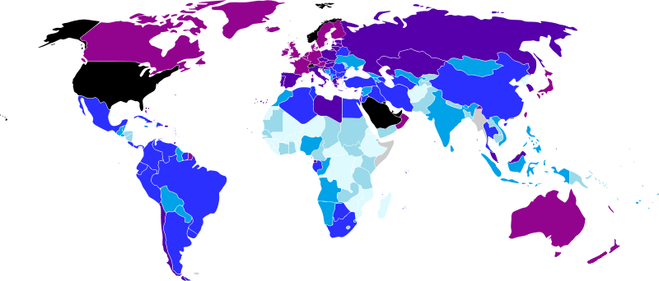
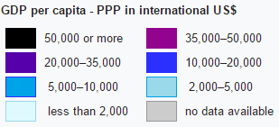
TASK: Suggest a reason why Nike chooses to operate in these countries.
DEMONSTRATE
Look at the GDP per capita for the 5 countries you have just
listed. What do you notice?

Slide 6
DEMONSTRATE
Nike aims to increase it’s profits.
Justify why this is the best way to increase sales.
Write the letters where you think they come in order of increases sales and reducing costs. As long as you can justify your answer, it is not wrong.
Increase its sales the most.
It gets 40% of its trainers made in China.
It runs a website.
It sponsors top schools sports teams.
It closed its trainers factories in the USA.
It now owns no trainer or clothing factories.
It employs sports scientists.
It brings out new styles regularly.
It opened a branch office in Australia.
It offers a 20% off deal for students.
Justify why this is the best way to reduce costs.
Reduce its costs the most.

Slide 7
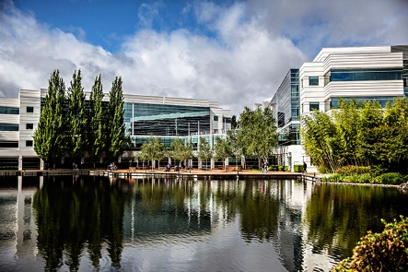
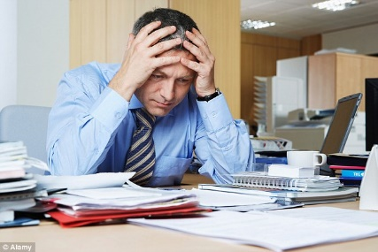
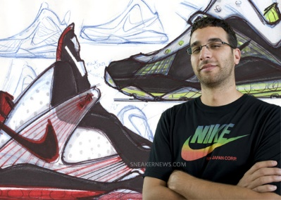
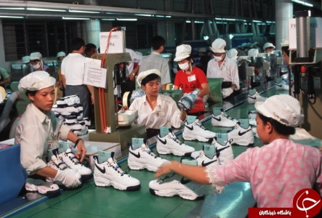
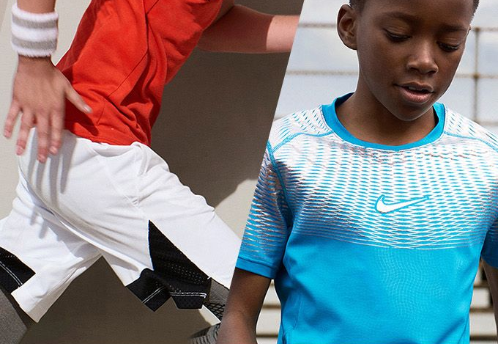
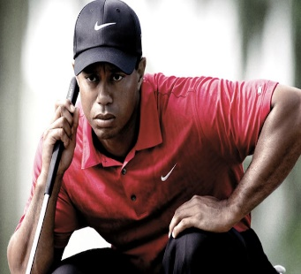
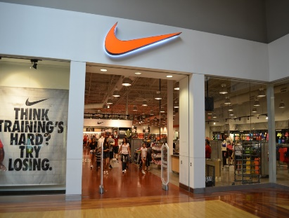
ACTIVATE
The Nike Operation
Nike is based in Oregon, USA. This is the headquarters from which the business is controlled.
The people who run Nike are anxious to make as much money as possible.
So Nike keeps on bringing out new designs for its clothing and trainers. But it does not make these things itself.
Instead it searches the world for places to get things made on the cheap in factories owned by other companies.
Nike goods are made in nearly 40 countries, mostly by women like these.
While they are working really hard, so is Nike – getting people to buy their clothes.
Nike spends over 1 billion dollars in advertising in around 140 countries. It pays top athletes millions to wear Nike products, as another way to advertise.
It sells its goods to 47,000 shops round the world.
LO: To explore how Nike has spread around the world.

Slide 8
The Nike Operation: What are the impacts in China?
Read the embedded file about Nike on the Weebly and watch the videos:
Case Study: Nike - a transnational corporation What is Nike - Brief overview
How is Nike a Transnational Corporation (TNC). Examine where the raw materials come from, where their factories are and where they sell their goods.
What positive and negative impacts has Nike had on the world (Look closely at China and South East Asia)

Slide 9
Exam practice

Slide 10
Mark scheme

Slide 11
Exam question
Describe the impacts of a named TNC on a country where it’s
goods and service are produced (7)
B
ox the command word (s)
Step 2: On one hand...
Step 3: On the other hand...
Opportunities of the globalisation:
Issues of Globalisation:
U
nderline the key words
M
Because
Challenge
Because
arks- How many?
Example
Example
This means
Can you explain what conclusion you would reach?
This means
Levels1 (Basic) 1-3
Link
Limited detail
Point
Link
Point
Uses an example and includes 2 developed points
Level 2 (Clear) 4-6
Literacy
As above, with specific case study detail such as figure
Can you use these key terms:
Whereas
However
On the other hand
Level 3 (Detailed) 7

