Slide 1

IB History 2021 – 23 Course Overview
Year 12 | Aug - Oct | OCT - Dec | Jan - April | April - June
Mr Bish 6 Periods per 2 wk | Paper 2 Authoritarian States | Paper 2 Authoritarian States | Paper 3 French Revolution | Paper 3 French Revolution
Mrs Morgan 3 Periods per 2 wk | Paper 1 Genghis Khan | Paper 1 Genghis Khan | Paper 2 Independence Movements | Paper 2 Independence Movements
Year 13 | Aug - Oct | OCT - Dec | Jan - April | Exam Period
Mr Bish 6 Periods per 2 wk | Paper 3 Imperial Russia | Paper 3 Imperial Russia | Revision
Mrs Morgan 3 Periods per 2 wk | Paper 1 Richard 1 | Paper 1 Richard 1 | Paper 2 Independence Movements - Cuba

Slide 2
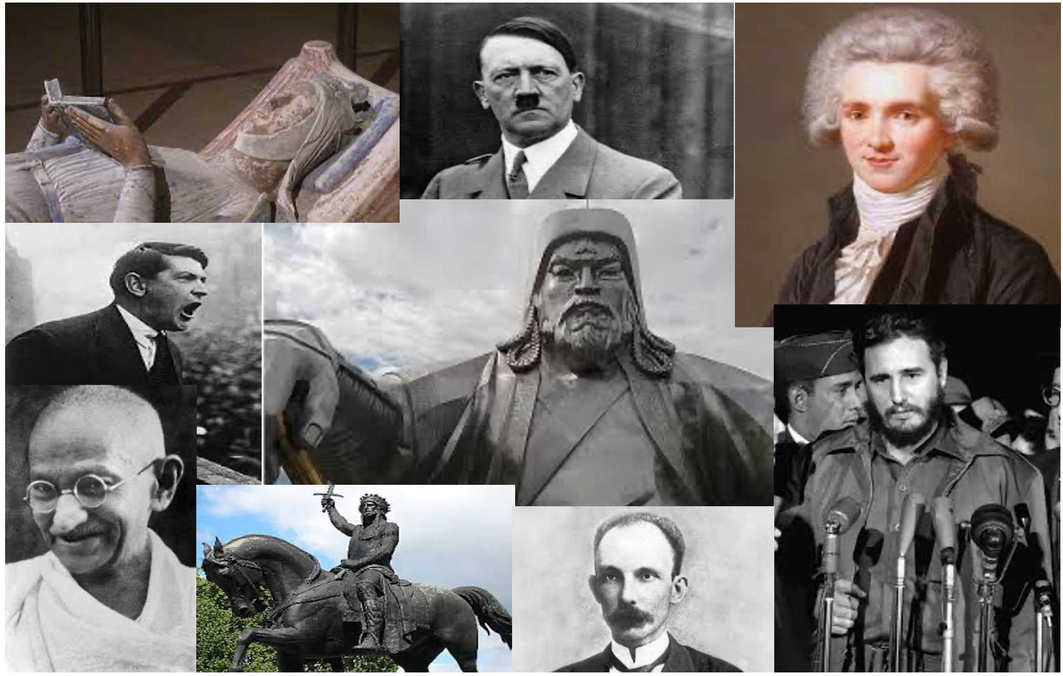
Welcome to IB History

Slide 3
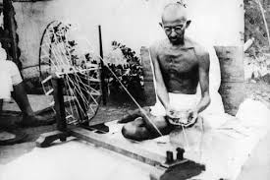
IB History – The Development of Power, protest and Leadership The IB curriculum has been designed to challenge students to question the concepts or power, protest and leadership across a wide range of topic areas that span both the chronological time frame and the geographical demands of international world history. Students will develop their understanding and application of the key historical skills of cause and consequence, change and continuity, significance and perspective in order to critically analyse the events and historiography of the topics studied.

Slide 4
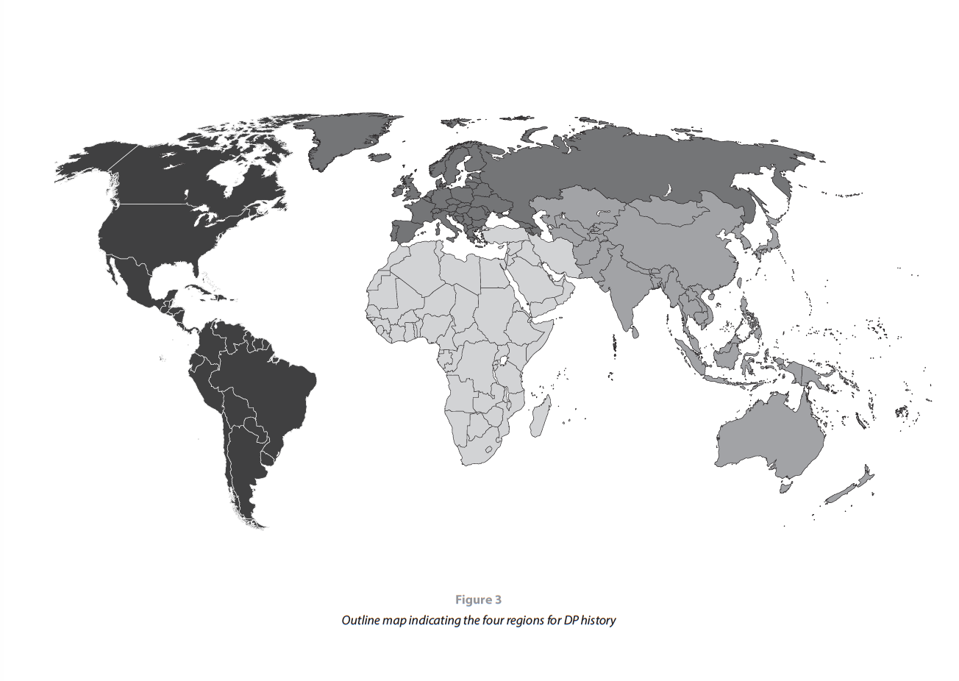

The IB World
Europe
Asia and Oceania
The Americas
For the purposes of course design IB History divide the World into 4 regions.
Africa and the Middle East

Slide 5
Individuals and Societies
Group 6
Your History course makes up one sixth of your formal studies along side Core

Slide 6
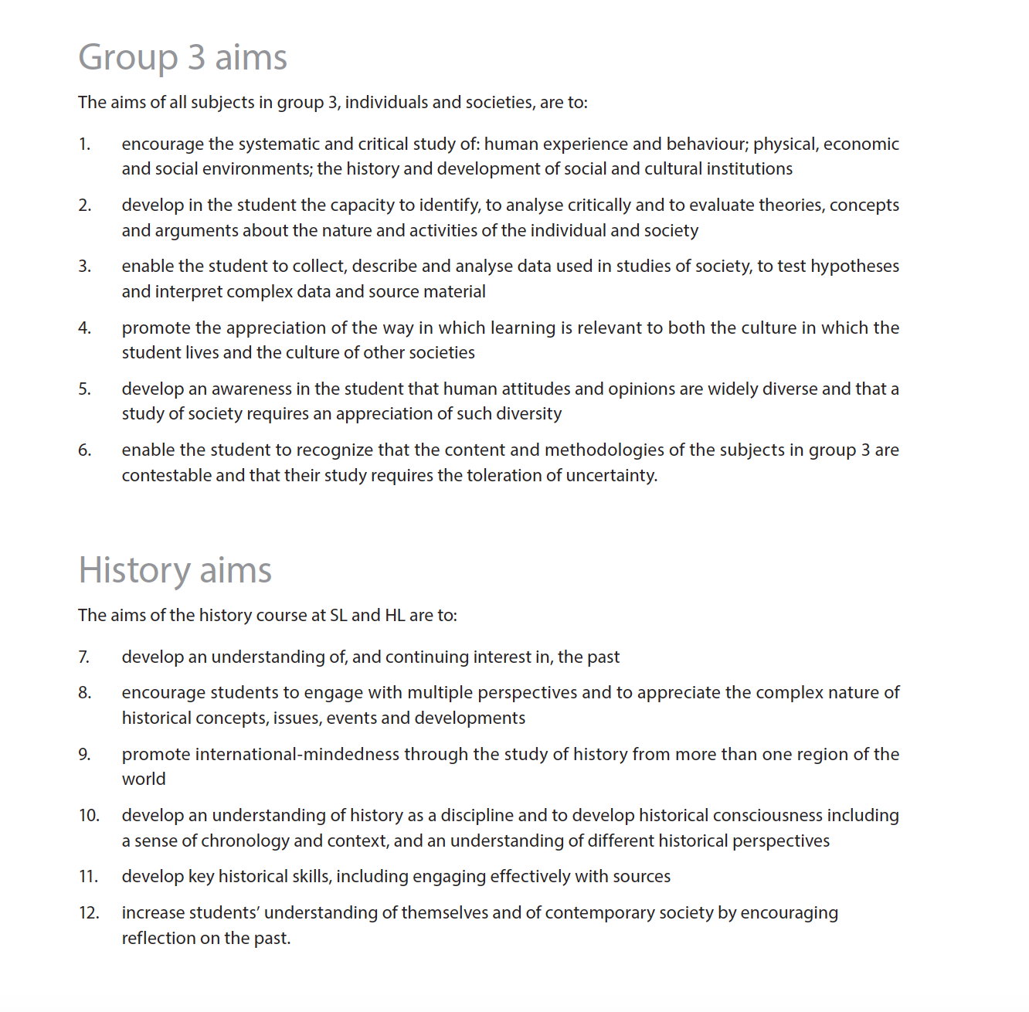
All Individuals and Societies subjects share common aims.
There are further aims specific to the History course.

Slide 7
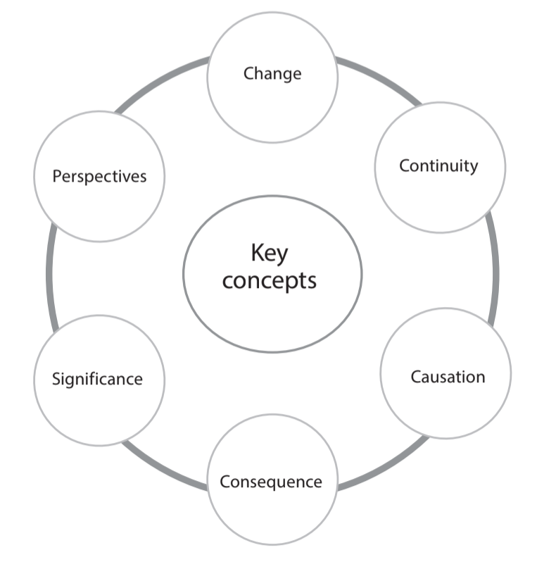
The IB History course is centered on the 6 key concepts within the discipline of History. All inquiries and studies should focus on one or more of these concepts.

Slide 8
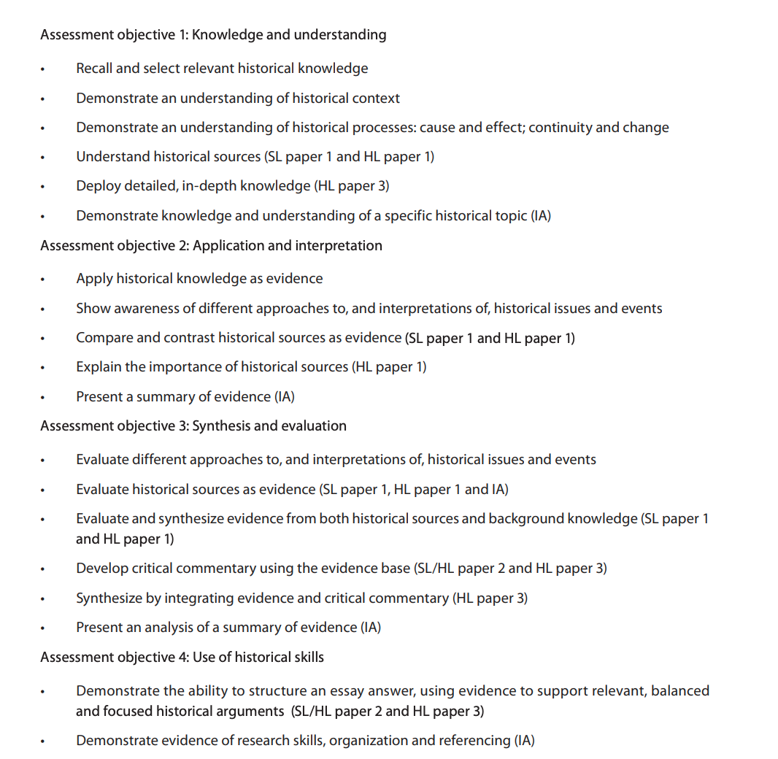

Assessment aims
Knowledge and Understanding
Application and Interpretation
Synthesis and Evaluation
Use of Historical Skills

Slide 9

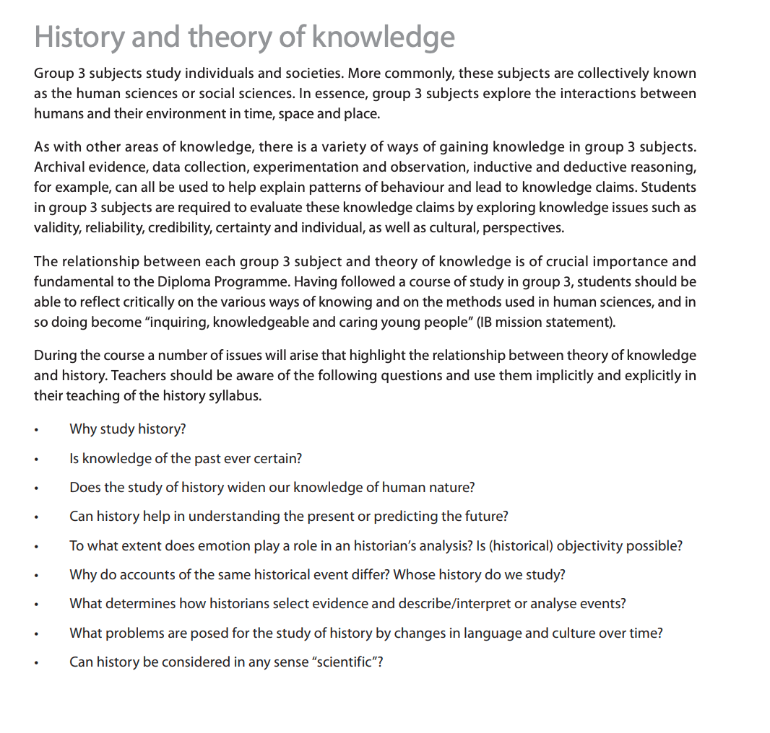
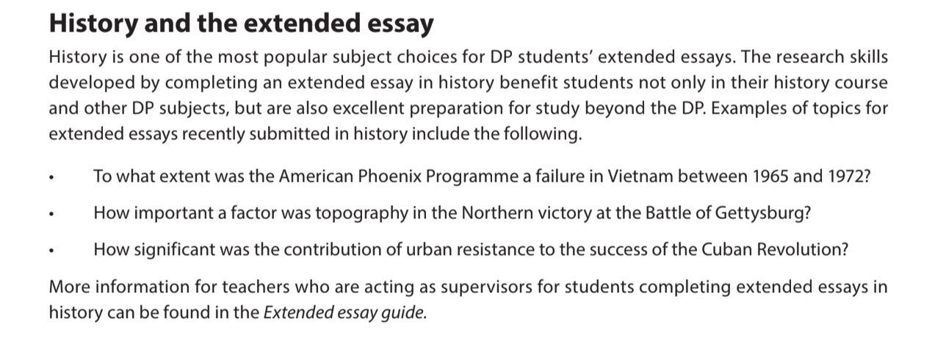
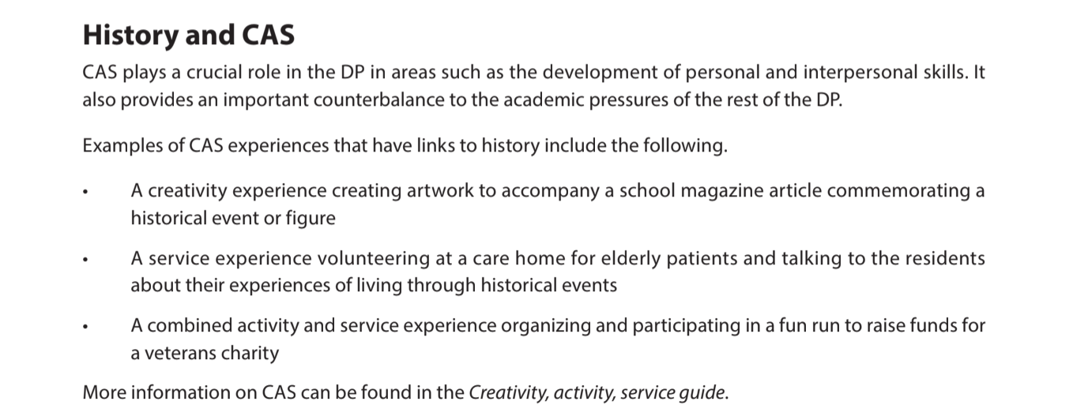
History and the Core

Slide 10
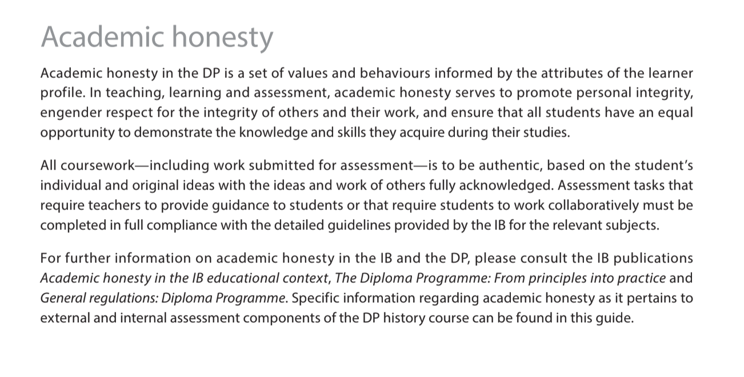
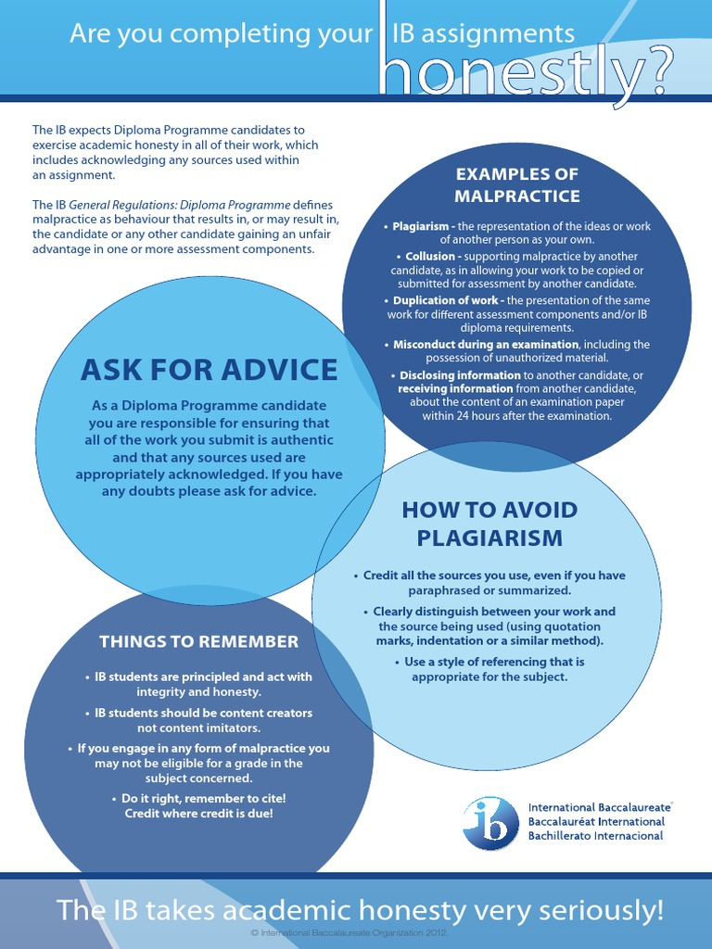
Read the IBO – Academic Honesty Policy here
https://www.ibo.org/contentassets/76d2b6d4731f44ff800d0d06d371a892/academic-integrity-policy-english.pdf

Slide 11
IB History Course
2021 - 23

Slide 12
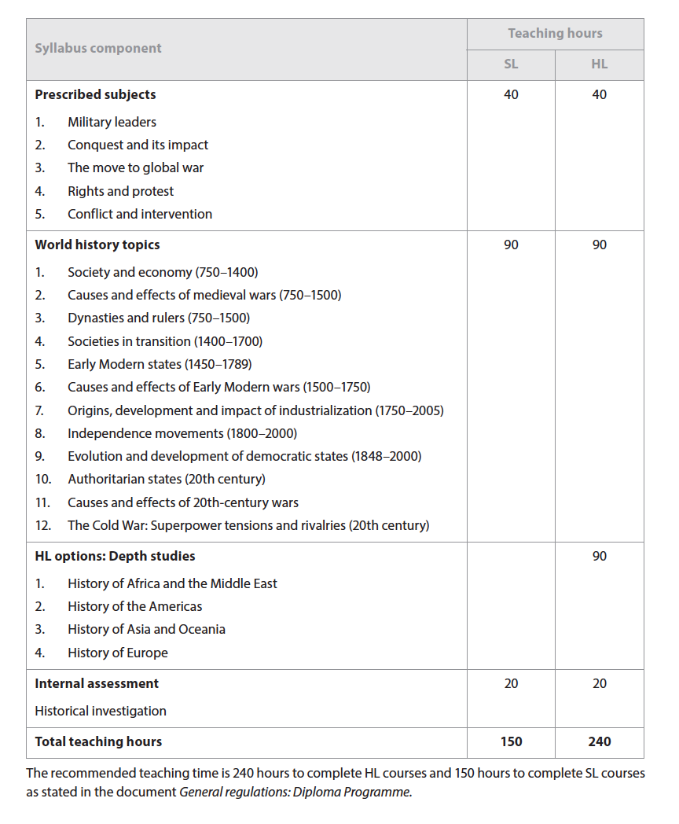

What will I study?

Slide 13
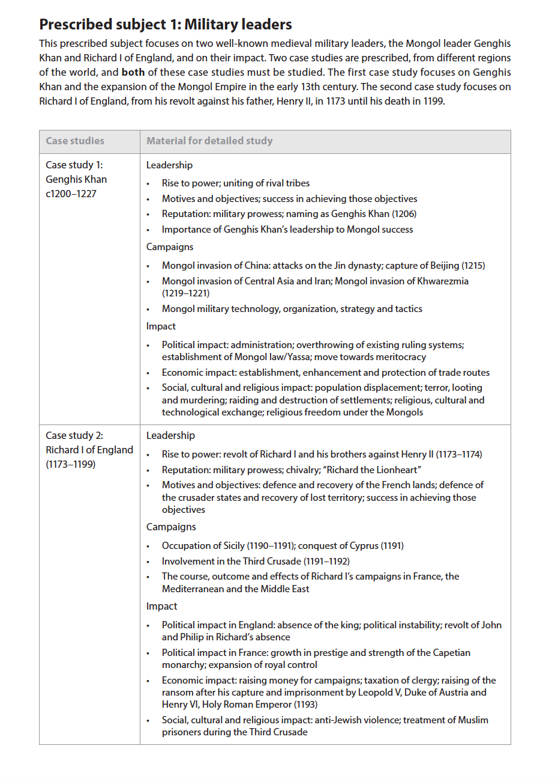
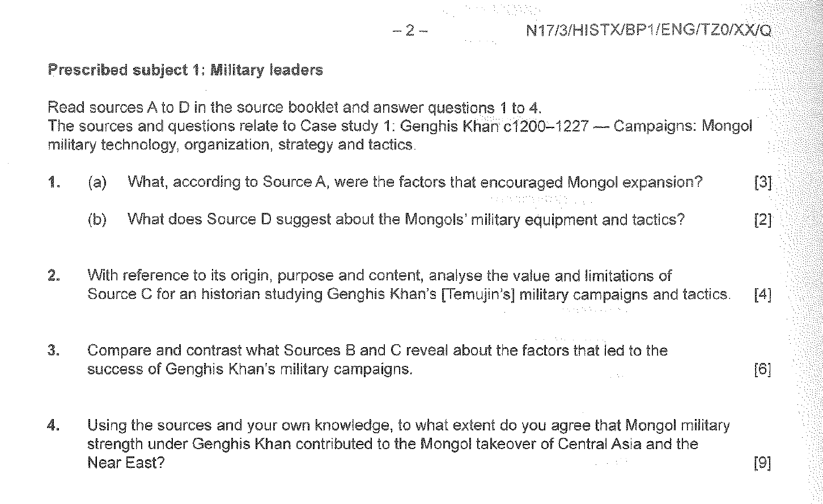
Paper 1 – Military Leaders

Slide 14
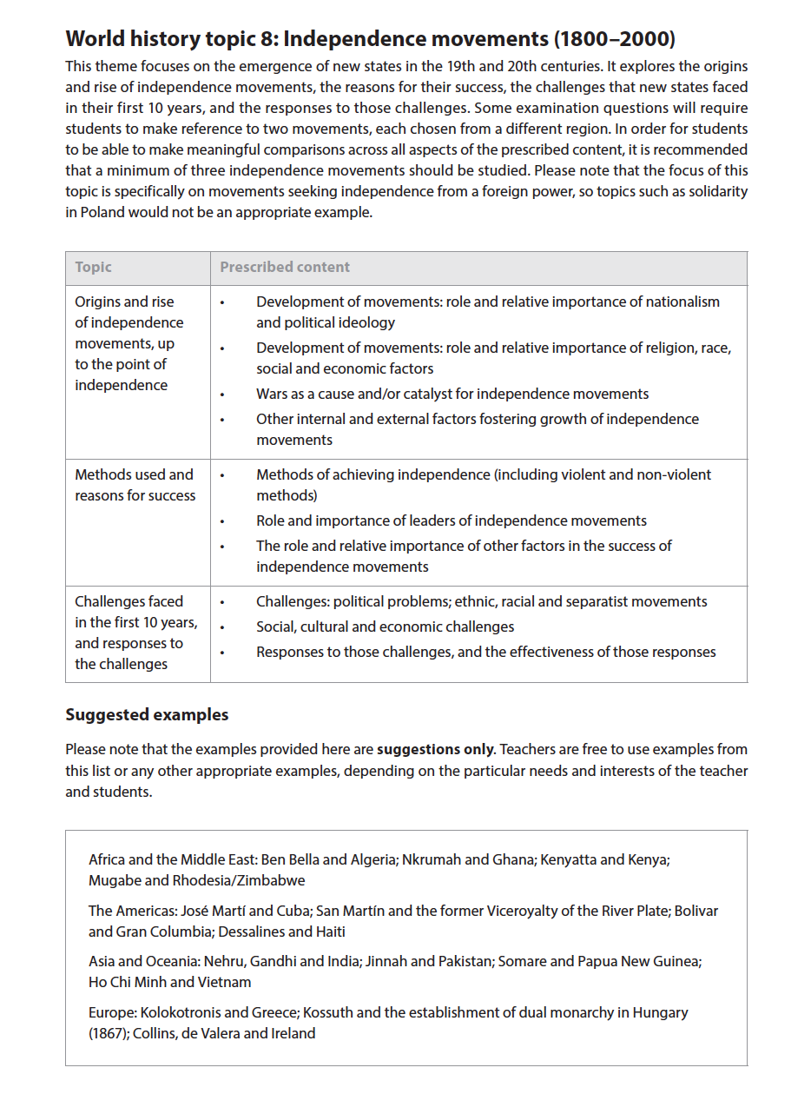
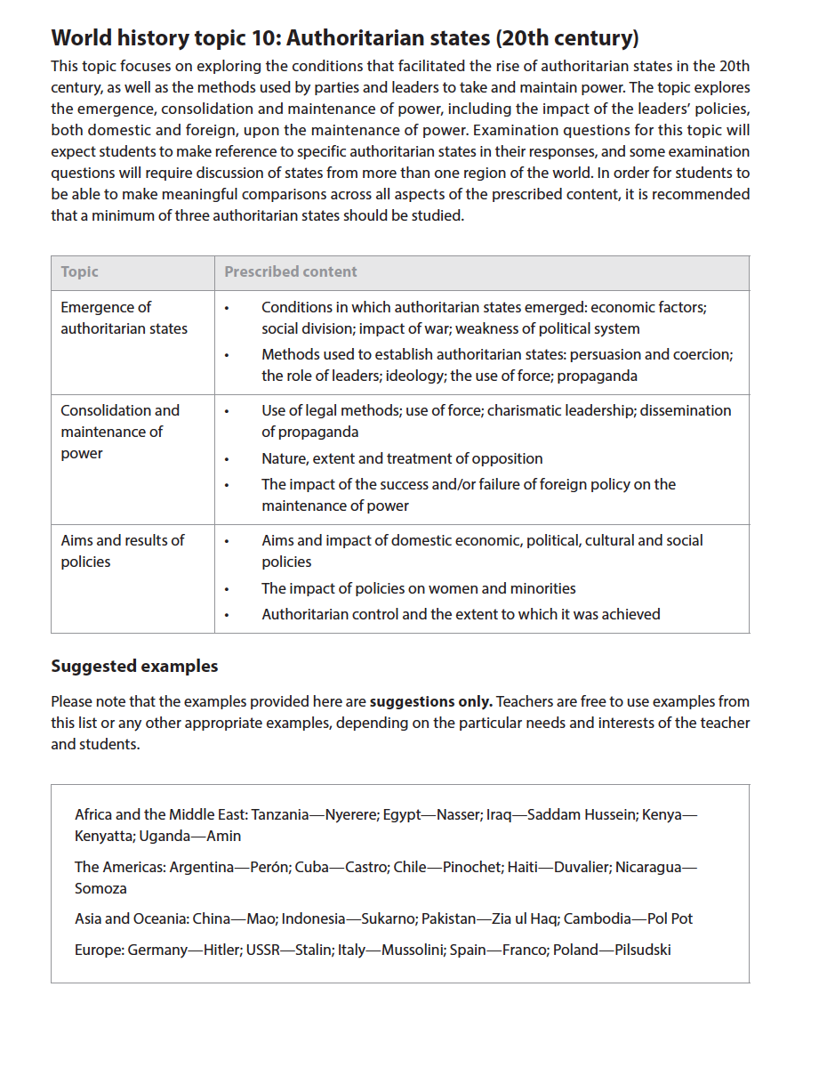
Paper 2
SL/HL

Slide 15
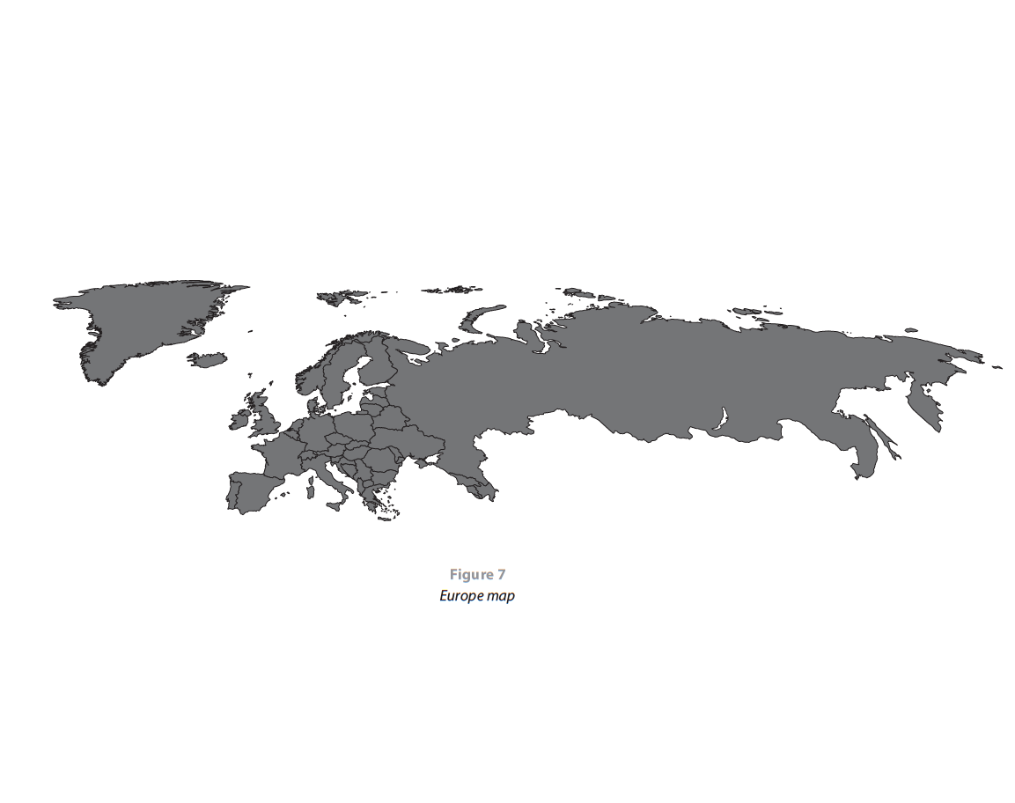
Paper 3 – The History of Europe – HL Only

Slide 16

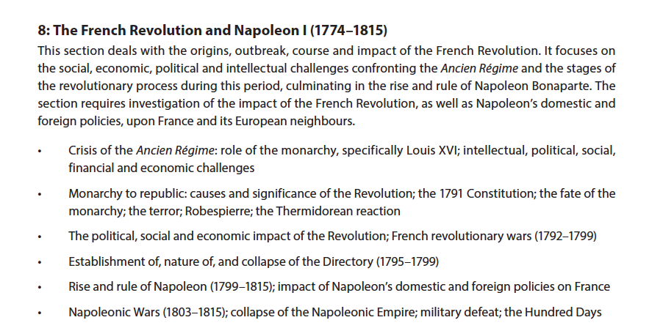
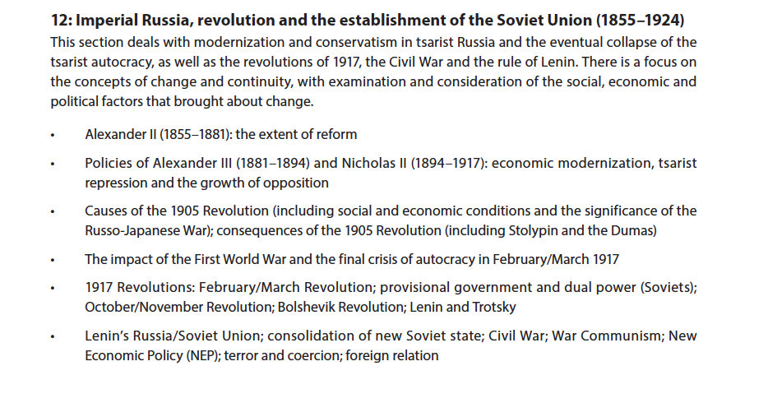

Topic 1 – The French Revolution
Topic 2 – Imperial Russia

Slide 17
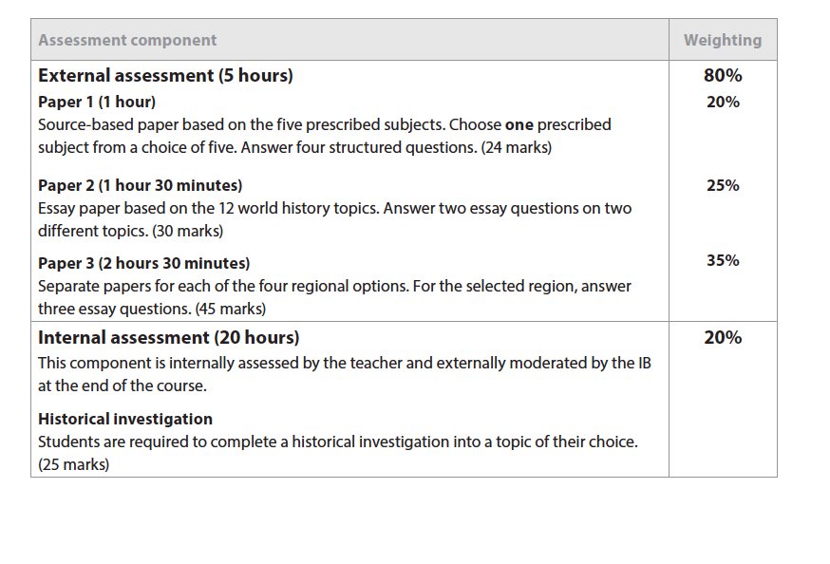
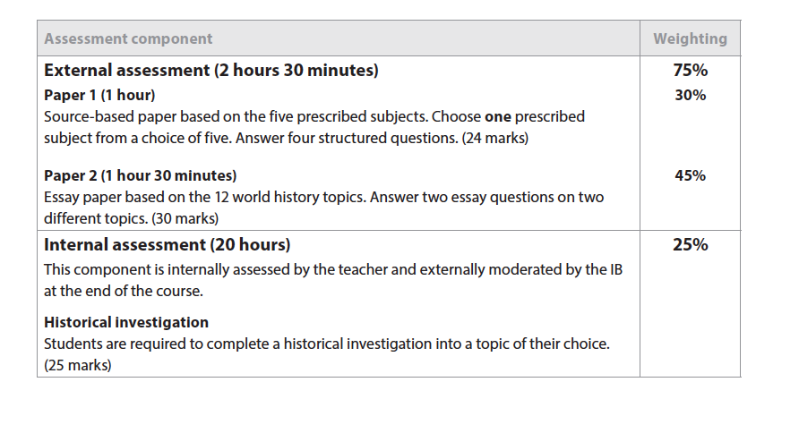
Standard Level Assessment
Higher Level Assessment

Slide 18

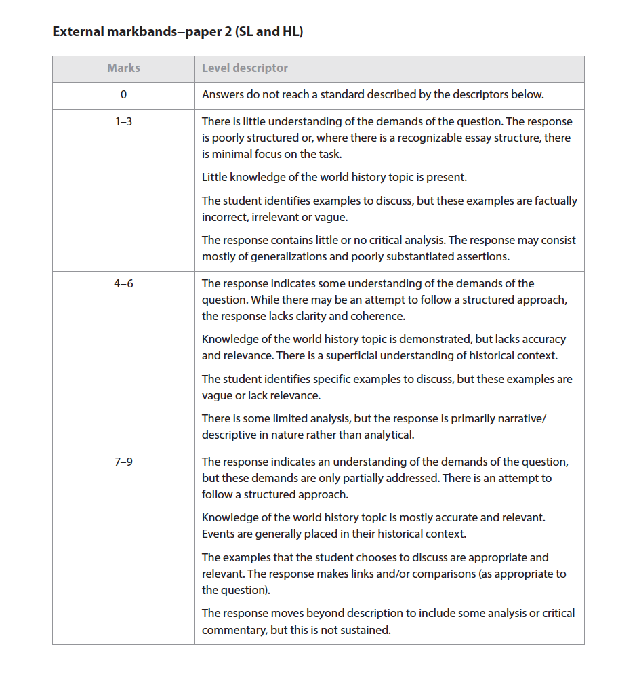
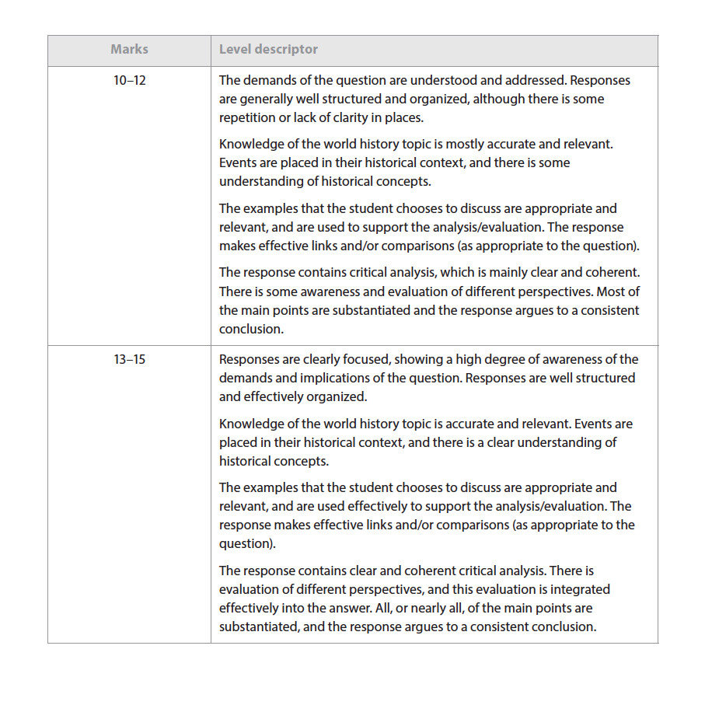
Paper 2 – Essay Mark Scheme

Slide 19
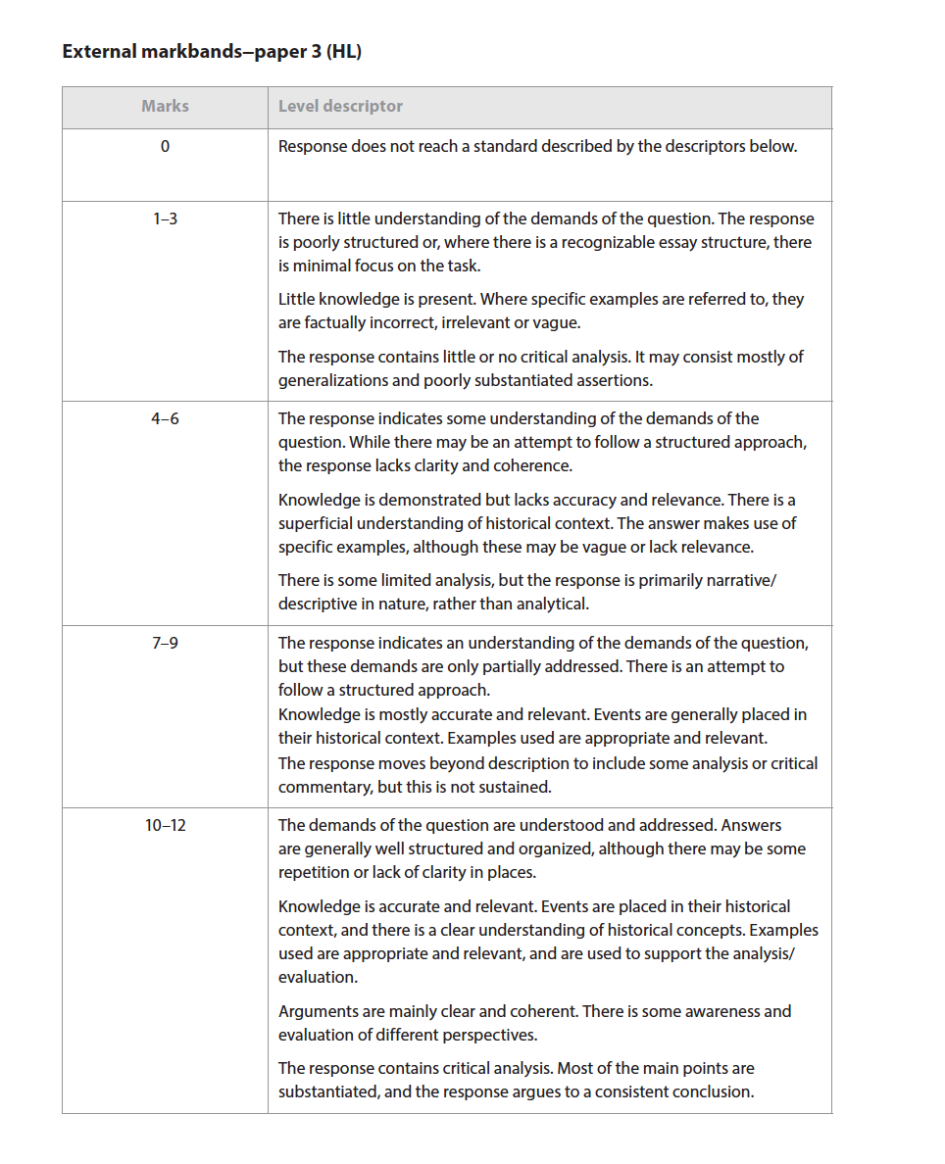
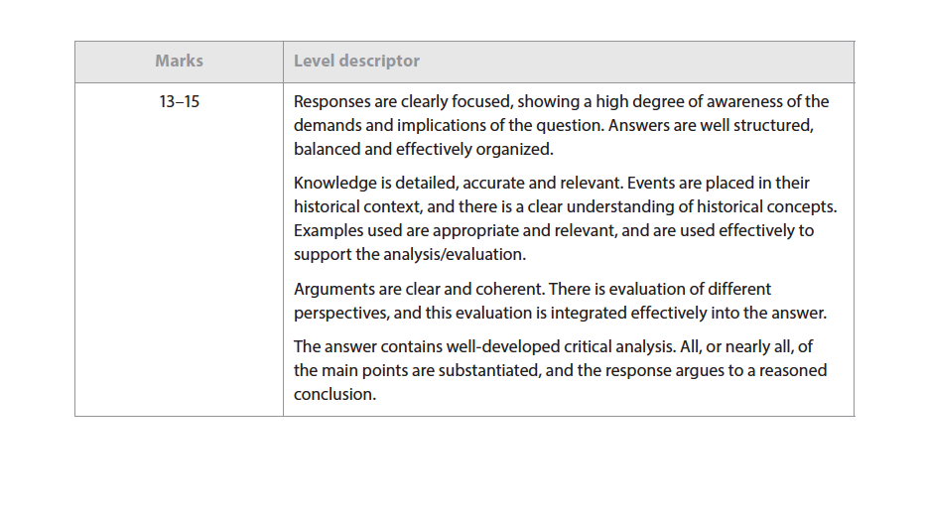

Paper 3 – Mark Scheme
You will answer any 3 questions from a choice of 4

Slide 20
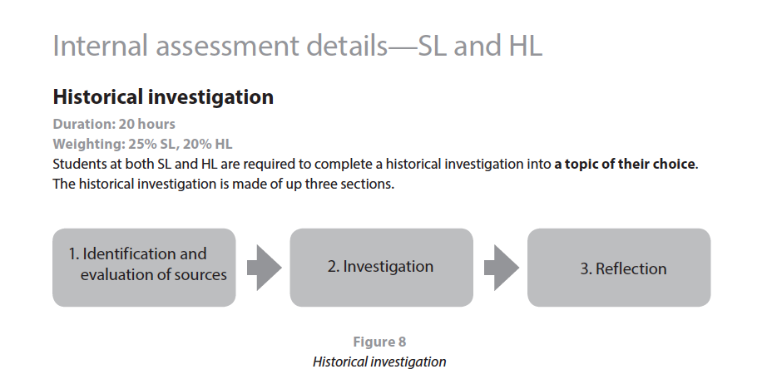

Slide 21
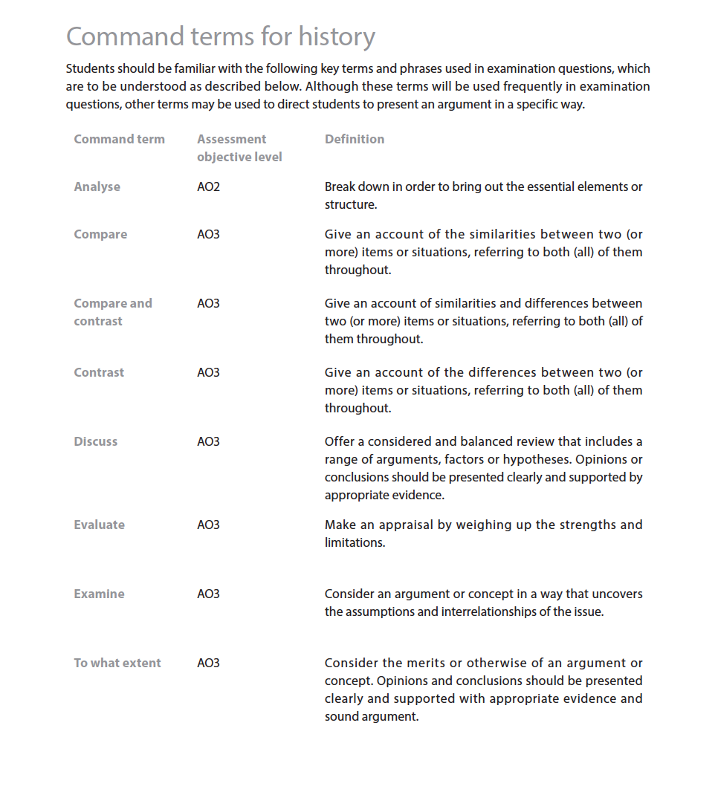
Useful explanations of Command Terms used in Essays

Slide 22
Useful Resources
Humanities Weebly
http://www.bishoustonhumanities.net/ibdp-history.html
Password: B!sh2018
Jstor – Online Library
https://www.jstor.org/
Username: Bishouston
Password:bulldogs1
In Thinking History
https://www.thinkib.net/history
Teacher sets up account

