Slide 1
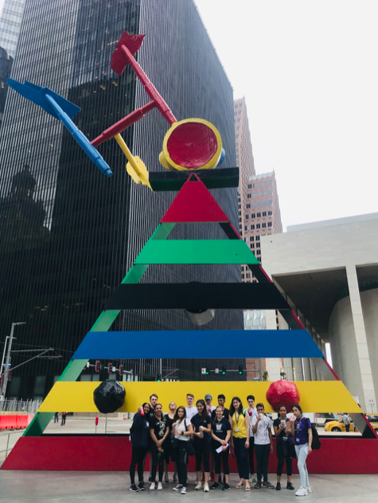
IA Section D – Analysis
D: Written analysis (0-8 marks) – 1,350 words

Slide 3
Checklist 1….

Slide 4
Checklist 2…..
Correction to the above checklist: Ensure that you accurately conduct a statistical test e.g. Spearman’s Rank. You need to explain the findings of your statistical test and relate them to your coursework question.

Slide 5
Think back to your questions you posed in section A
This is where you answer (or say if Houston did or did not meet the expected theory)
The building height will decline as you move away from the core
The quality of the environment will worsen as you move away from the Core
The number of pedestrians will decrease as you move away from the core
The quality of shops will decline as you move away from the core
There will be more high order services in the core than the frame

Slide 6
What are the characteristics of the CBD?
CHARACTERISTICS | DESCRIPTIONS
Intensive land use | Multi-storied buildings: highest retail productivity per unit area, characteristics by higher order functions.
Extended vertical scale | Growth mainly vertical.
Limited horizontal scale | Greatest horizontal dimension seldom exceed walking scale.
Limited horizontal change | Gradual horizontal change, with slums and undesirables limited to a few blocks.
Concentrated day time population | Location of highest concentration foot traffic; absence of permanent residential population.
Focus of mass transit | Major mass transit interchange location for entire city.
Centre of specialised functions | Extensive use of office space for executive and policy making functions: centre of specialised professional and business services.

Slide 7
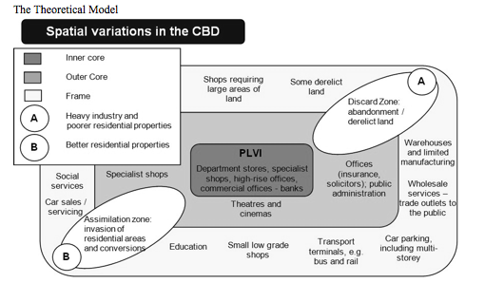
Make sure that you are referring to this theory and terminology throughout and also making link to the specific locational characteristics of Houston

Slide 8
Core frame model expectations

Slide 9
This is the section where you describe and explain your results. It maybe done as a separate section, or incorporated into your data presentation section. This section is extremely important because it is where you prove or disprove your hypotheses.
Things to Remember
When describing graphs and maps clearly refer to which graph/map you are talking about i.e. graph one / figure 3.2 shows that……….
When describing graphs or maps you must use figures and units and where appropriate dates i.e. Location 1 had the most pedestrians with 57.
When describing graphs, tables and maps make sure that you relate them back to your hypotheses (if you are using them). If you don’t prove or disprove your hypotheses then your questions are irrelevant.
Remember it does not matter whether your analysis proves or disproves your hypotheses. It also does not matter if your findings are inconclusive as long as you clearly state this in your analysis.
You must explain your results. If there are anomalies (things that don’t fit the trend) or results that don’t match your predictions try and explain why. Traffic might have been lower than expected because of a road closure or pedestrians might have been more than expected because of a market
Compare data between the weekday sample and weekend sample
Relate your analysis back to theory i.e. core frame model.
Manipulate your data using a statistical technique e.g. Spearman’s Rank correlation.

Slide 10
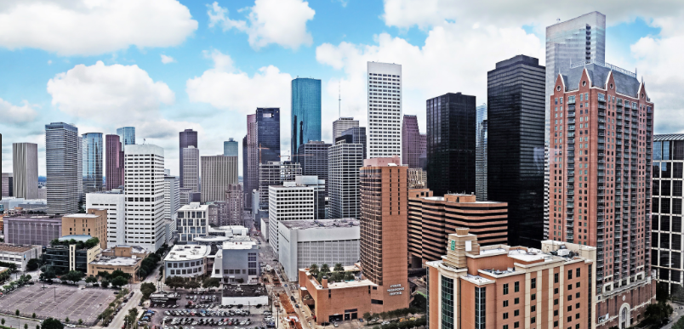
Locational characteristics of Downtown Houston
Tips:
You don’t have to mention every single location in analysis
Try to look for patterns- these may be clear in some of the mapping data presentation.
Be clear about location specific anomalies
Refer to field trip-follow up PPT

Slide 11
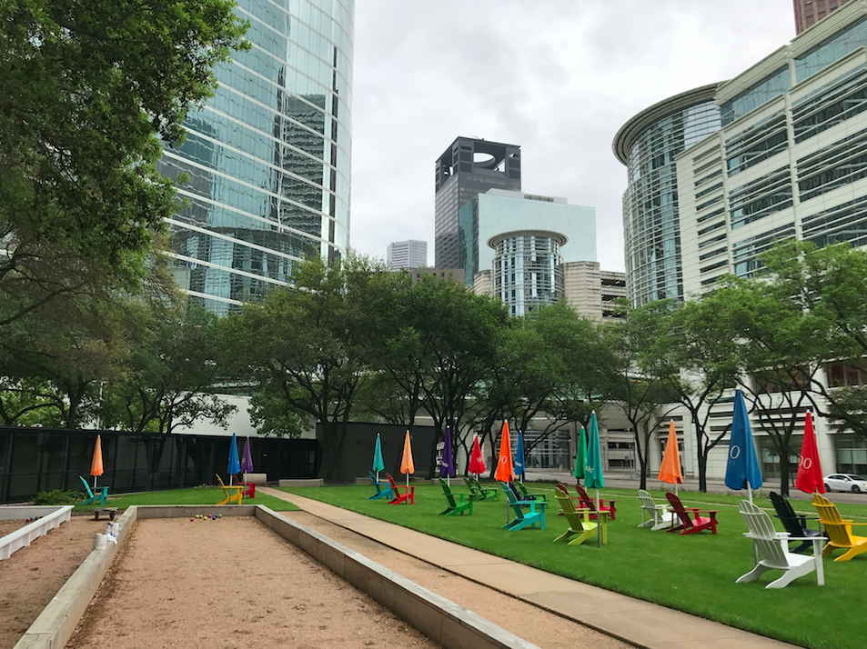
Site 1: Chevron buildings
Edge of CBD but does show some characteristics of the core (i.e. TNCs, tall buildings) but also car parks

Slide 12
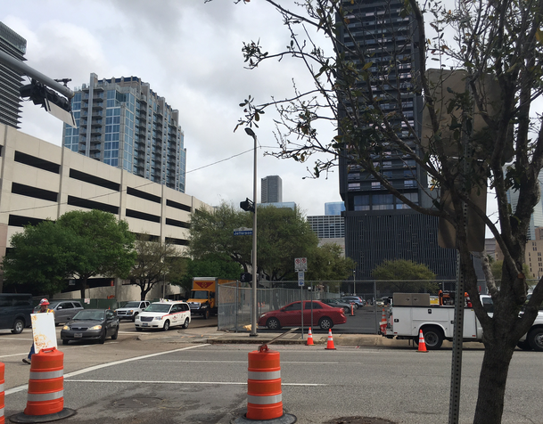
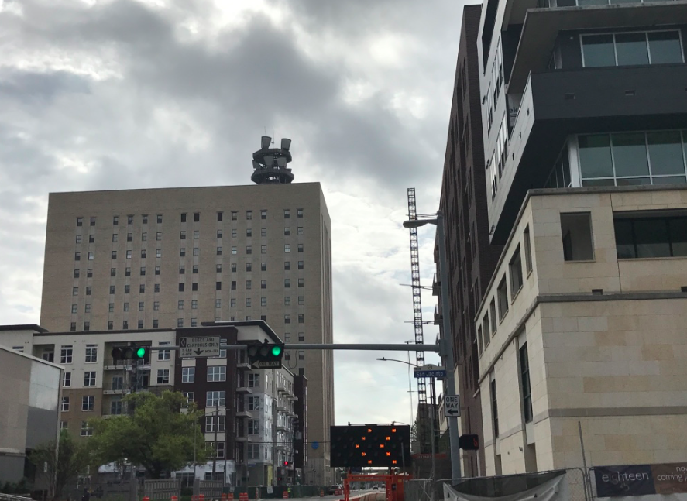
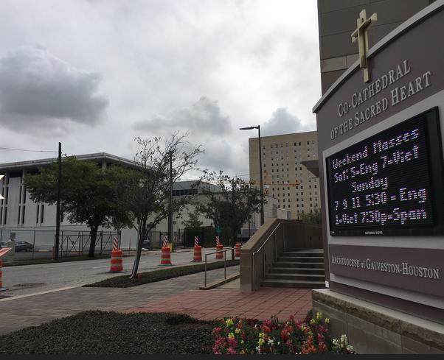
Site 2: Cathedral
Redevelopment- new apartments
Cathedral (modern) so on the edge.
Evidence of regeneration of brownfield sites around area- new hotels e.g. Holiday Inn and new apartments
St. Joseph's hospital nearby

Slide 13
Site 2: Cathedral
Is this where a cathedral may be found in European city?
Why may new developments be created here?
Other land use in area:
Hospital- why would this land use be unlike to be in the core?
Disused land- is this a sign of the frame?
Regeneration- why may this be happening here?

Slide 14
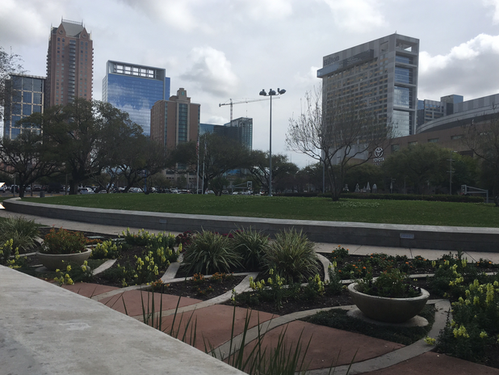
Site 3: Toyota Centre
Many car parks etc. to support major sports and concert venue
Landscaping/ park to make area attractive for visitors

Slide 15
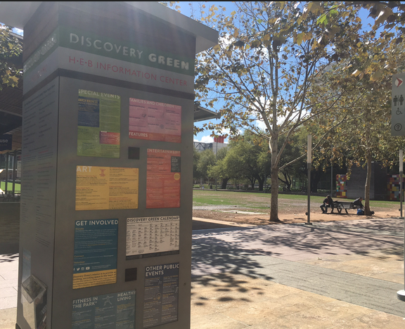
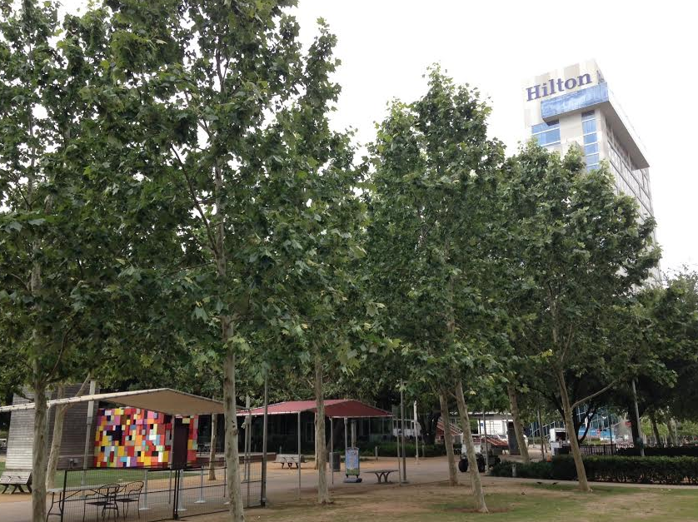
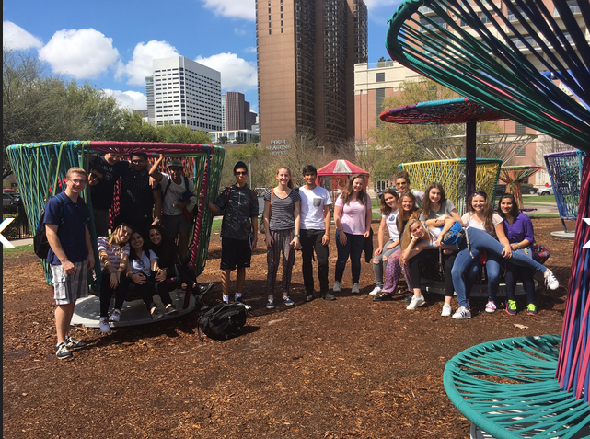
Site 4: Discovery Green (zone of assimilation?)
Green space- playgrounds/ lakes etc- why have they placed this in the CBD?
New hotels- why would this land use be here?
Restaurants-why would this land use be here?
Convention centre- why would this land use be here?
New development- building height?
Centre for events in Houston i.e. Superbowl celebrations and marathon etc.
.

Slide 16
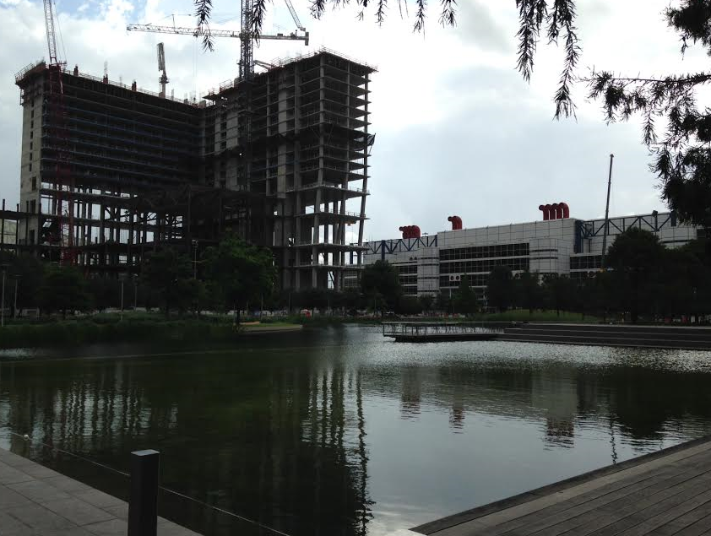
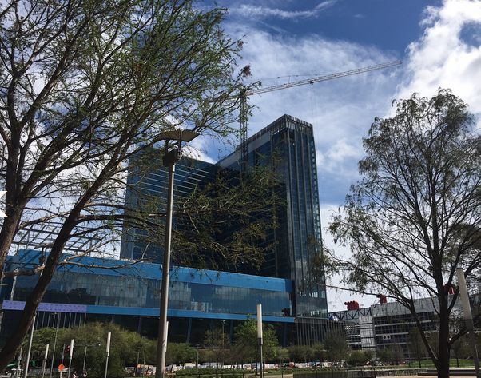
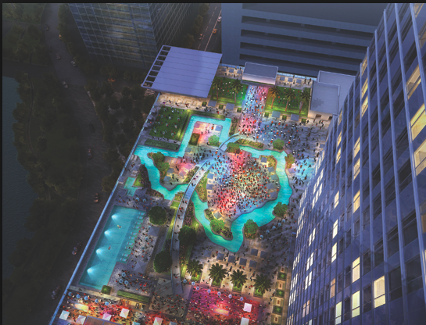
Redevelopment in area: Zone of assimilation
2017
2016
2015
http://www.cnn.com/2017/01/23/travel/marriott-marquis-houston-texas-shaped-lazy-river/
The $360 million Marriott Marquis, which opened in December, has 29 floors, 1,000 guest rooms and 52 event rooms with more than 100,000 square feet of space, including a 39,000 square-foot ballroom.

Slide 17
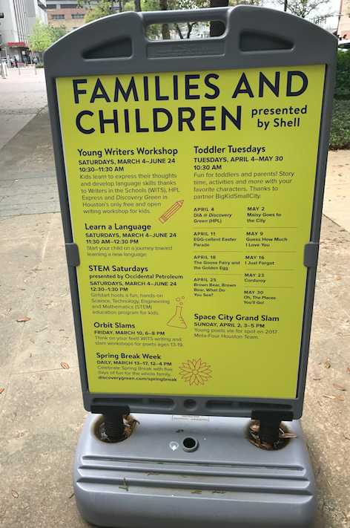
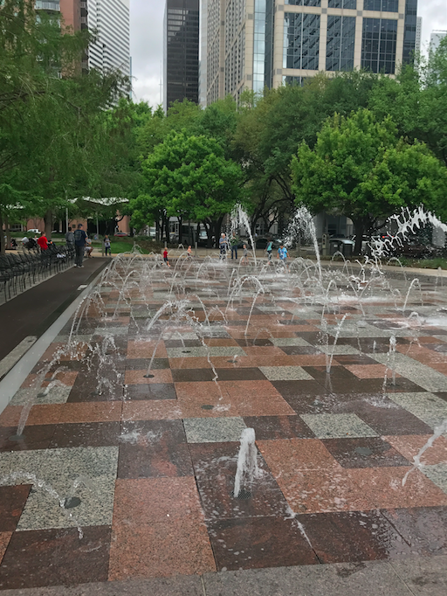
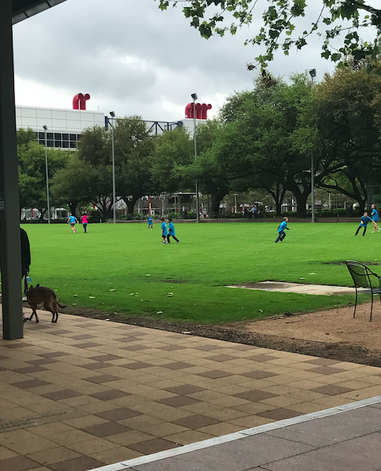
Discovery Green: Centre for activities

Slide 18
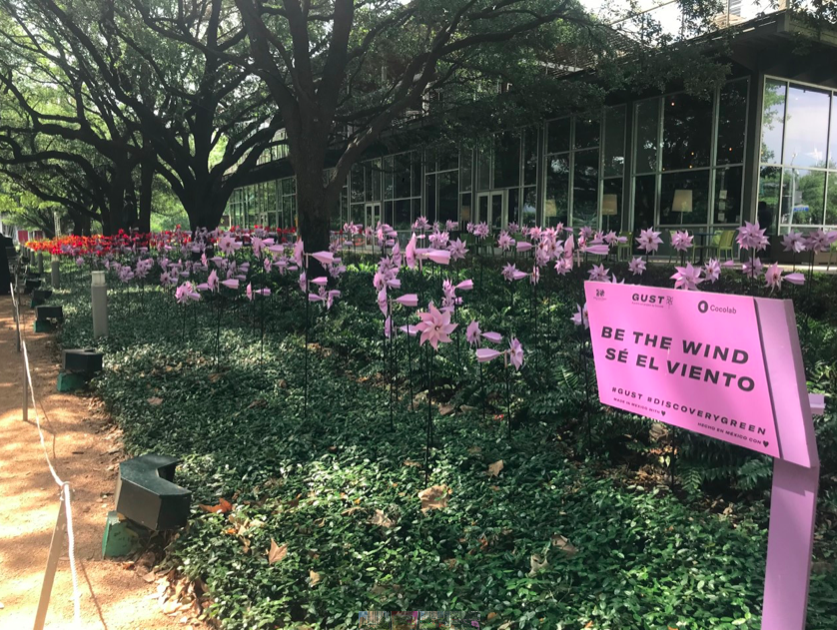
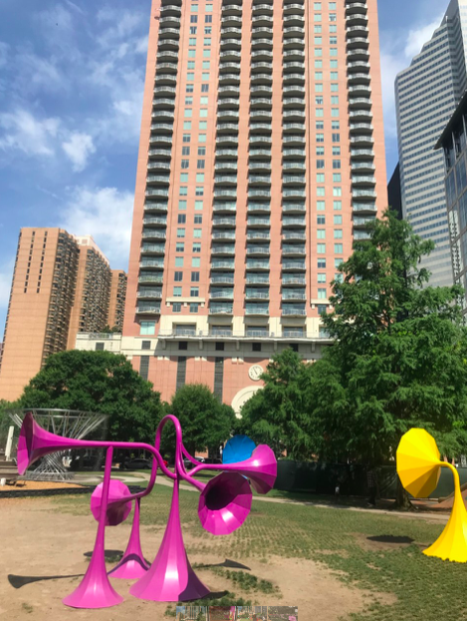
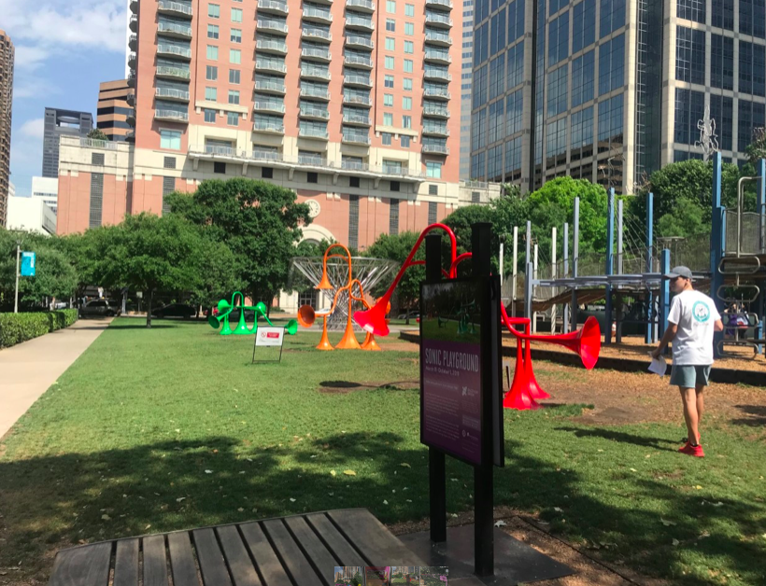
2019
Temporary art instillations to increase environmental quality and interest for visitors.

Slide 19
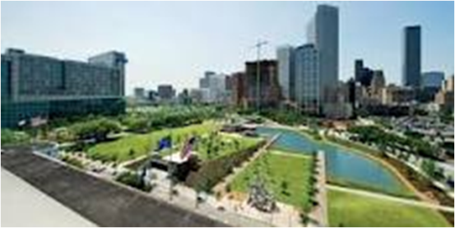
Possible theory
What is the importance of parks in urban areas?
Escape from urban stress
Moderate urban microclimates
Individual and community health benefits
Ecological understanding and sustainability
Preserve natural and cultural heritage- e.g. museums and woodlands
Prevent conflict in urban areas- skateboarders/ football/ cycling/ jogging etc…

Slide 20
Possible theory
http://greenfieldgeography.wikispaces.com/The+leisure+hierarchy+and+intra-urban+patterns
Source:

Slide 21
Possible theory
Zone of Assimilation – areas into which the CBD (and its characteristics) is expanding. The process by which areas of cities are improved through investment and development is known as… URBAN REGENERATION

Slide 22
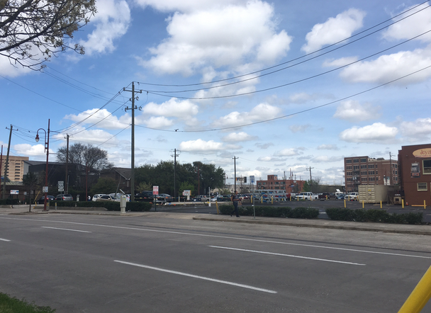
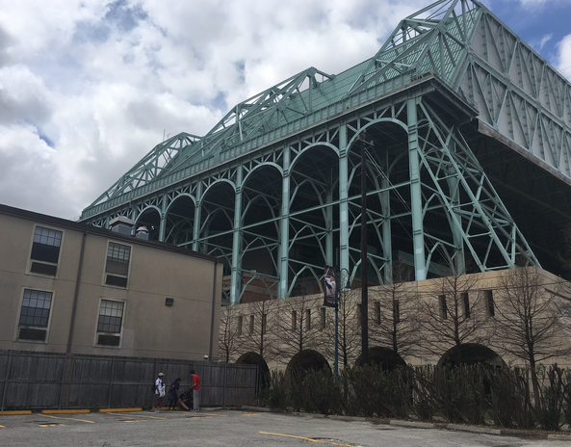
Site 5: Minute Maid Park
Baseball ground
Homeless shelters
Salvation army/ women's centre
Car parks
Bail bonds
Bars

Slide 23
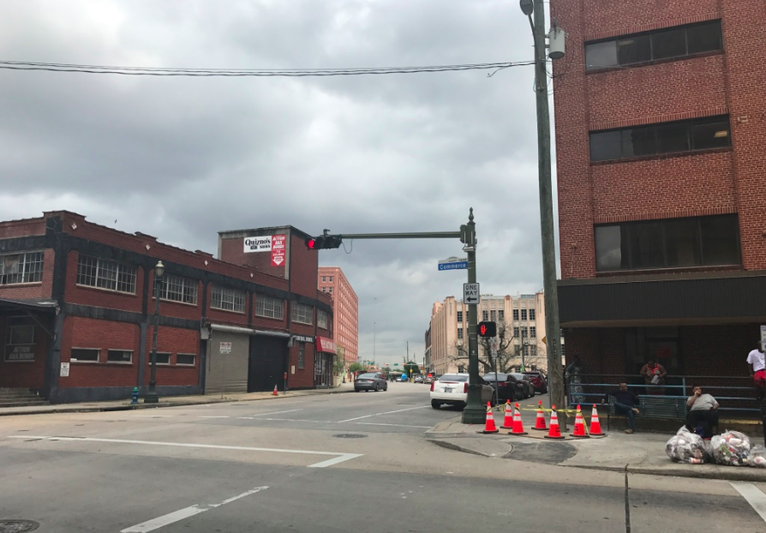
Site 6: Sheriffs office/ Jail District (zone of Discard?)
Sheriffs office
Jail
Bail bonds
Residential
Near University of Houston

Slide 24
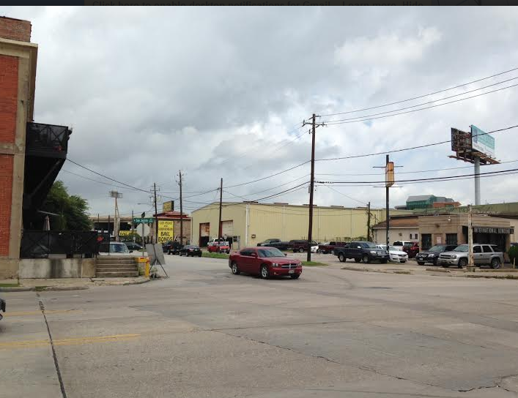
Site 5: Sheriff’s Office/ Jail District (zone of Discard?)
Sheriffs office
Jail
Bail bonds
Residential
Group with site 4

Slide 25
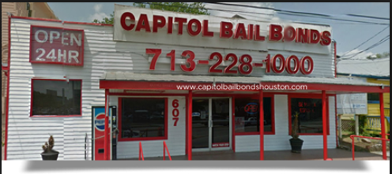
Theory: Zone of Discard
A haven for the homeless and social dropouts and as an area for adult entertainment. Common functions include pawnshops, cheap bars, low-grade cafes, cheap movie houses, repair shops, gun shops and low quality consumer mechanise.
Do sites 5 and 6 show these characteristics?

Slide 26
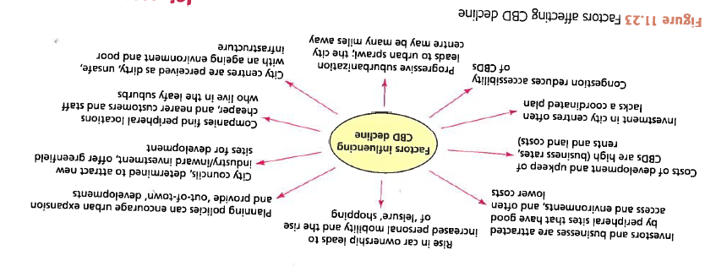
Decline in the CBD (source IB textbook)

Slide 27
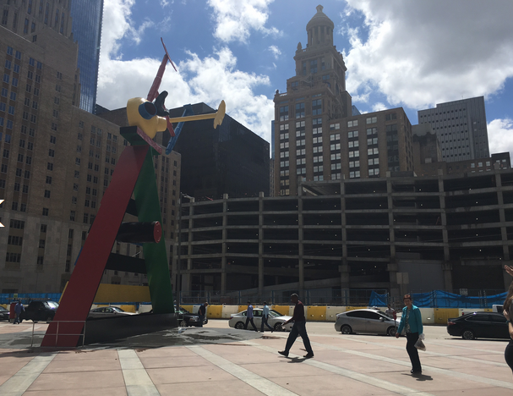
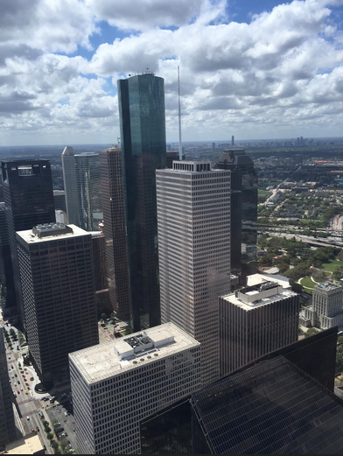
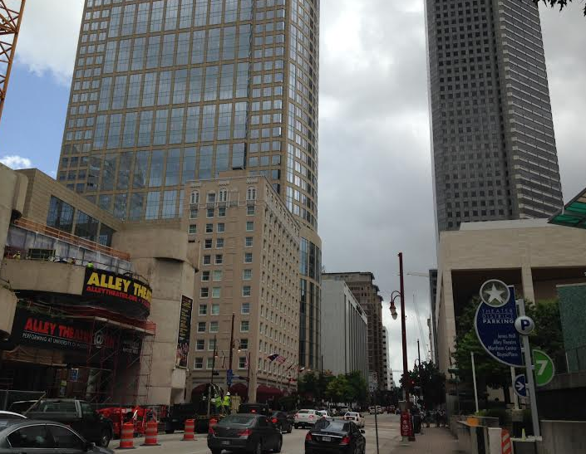
Site 7 : Theater District/ Chase Tower
Concentration of theatres- Alley/ Wortham Ballet )/ Jones Hall- symphony
Restaurants
Hotels
Concert venue
Chase- highest building- PVLI
Concentration of offices

Slide 28
Joan Miro sculpture Milam at Capitol Houston
http://joanmirohouston.blogspot.com/2013/06/joan-miro-sculpture-milam-at-capitol.html

Slide 29
Theory: THE ZONING OF URBAN AND SUBURBAN FUNCTIONS
A term used to describe the phenomenon when buildings of the same function cluster together in an area of a city or town.
Businesses of the same kind locate near to each other. For example, fashion shops are located in a particular street of a CBD, and jewelry shops are located together in a different street.
Agglomeration: Closely associated businesses locate close to one another, and the links between them are increased. This is a similar concept to that in urban agglomeration where cities grow into each other.

Slide 30
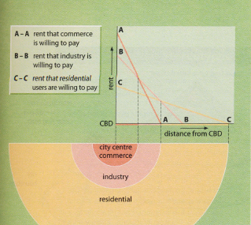
Bid-Rent Theory Concentrating on Commerce Rental Values (A)
Any key theory should be explained on context of study in the introduction

Slide 31
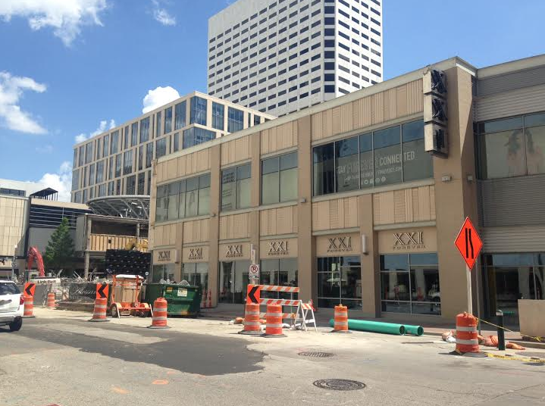
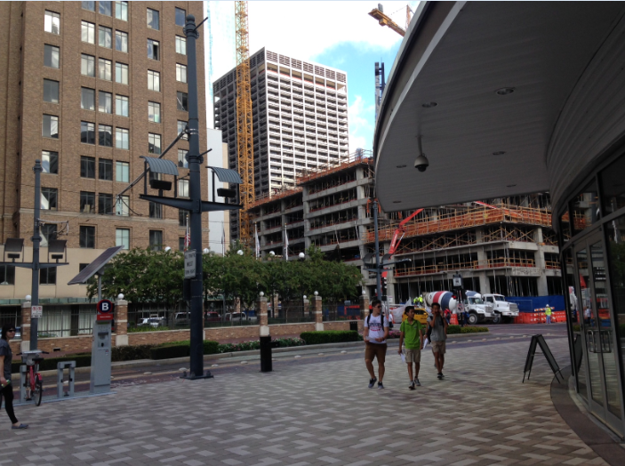
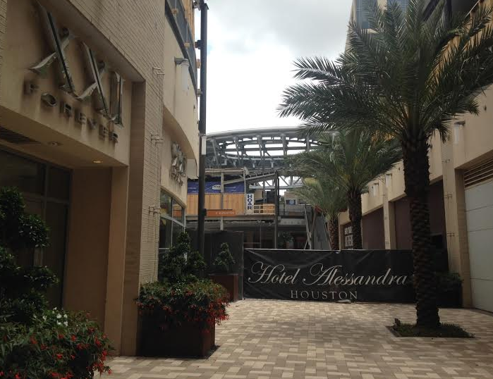
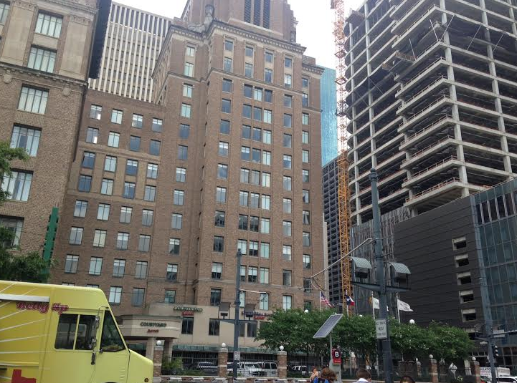
Site 8: Retail (under regeneration)- Main and Dallas
Shopping (but many abandoned- i.e. Macy’s)
Hotel
Cafes/ restaurants
Good access to sustainable transport

Slide 32
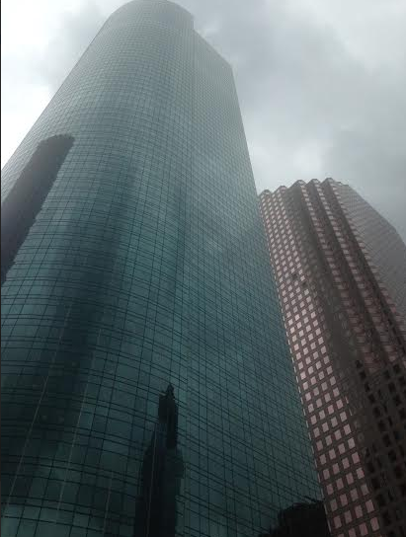
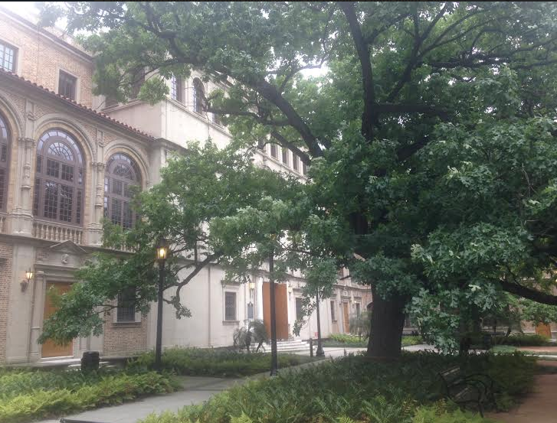
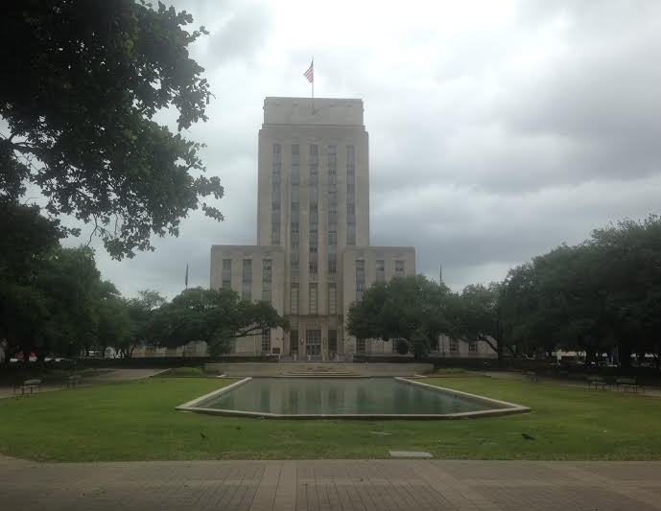
Site 9: Library/ Town Hall (core)
City hall- low density- parkland
Central Library
High rise office blocks

Slide 33
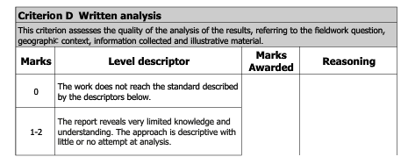
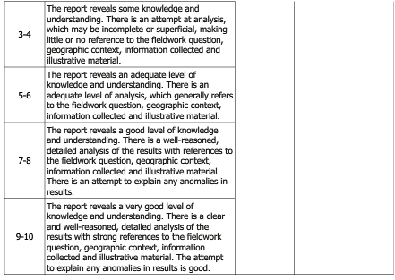
Peer assessment:
1: What level descriptor and why?
2: What was good about it?
3: What could be improved?
4: What have I learnt for my own IA?

Slide 34
Sample paragraph 1

Slide 35
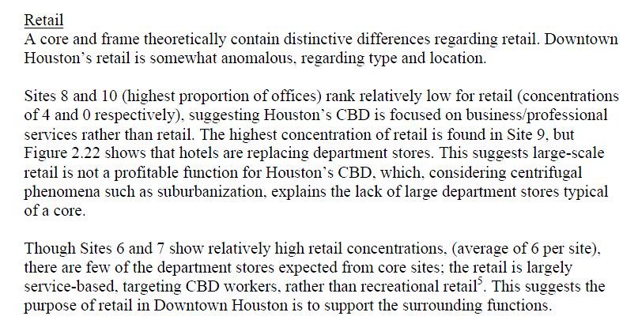
Sample paragraph 2

Slide 36
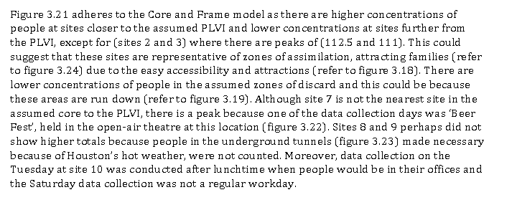
Sample paragraph 3

Slide 37
From example A on wiki
Use of data
Reference to figure number
Clear link to hypothesis
Good use of locational specific extra reading related to study
Link to theory

Slide 38
Sample paragraph 3
Link to theory (using correct language)
Link to figure number
Some evaluation (although this should come properly in last section)
Explanation of anomalies
Location specific factors considered

Slide 39
Section E: Conclusion
Can you sketch out a core/ frame of Downtown Houston using the data?
Is that a possible thing to do- evaluation

Slide 40
What to include in the conclusion
In this section you summarise your findings
A simple summary of what you have found
Have your hypotheses (if using) been proven or disproven
Include some basic figures to support your summary
Make sure you relate back to the research question and theory
Don’t introduce any new information in your conclusion

Slide 41
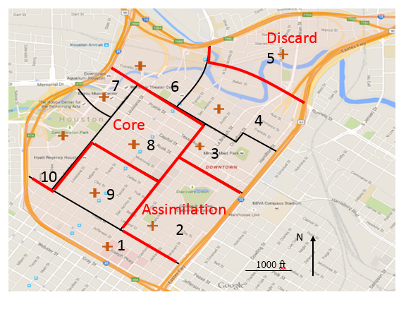
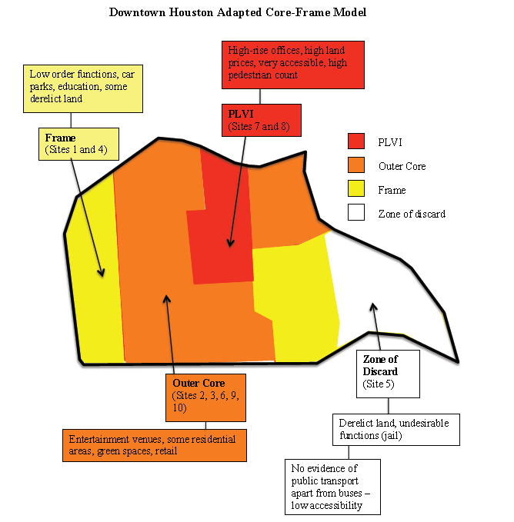
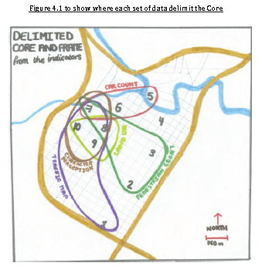
In this section you could draw your interpretation of how Houston links to the core/ frame model

Slide 42
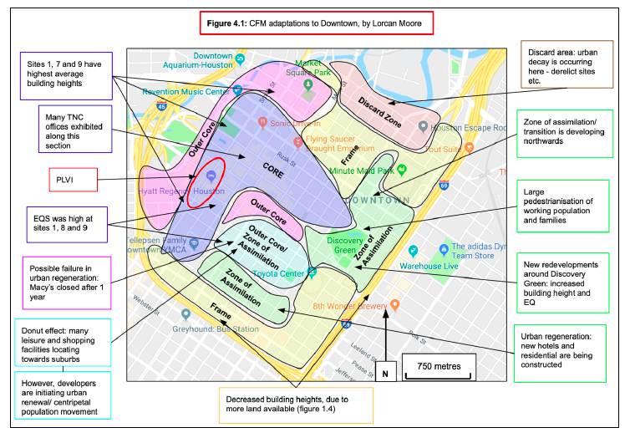

Slide 43
