Slide 1
What are the impacts of Hurricanes
What: The impacts of hurricanes.
Why:To be able to assess which areas of the US are most hazardous.
How: Investigating and analyzing eye witness experiences of various hurricanes.

Slide 2
Task 1 – Impacts of hurricanes
With your teacher go to word wall next to the Hive.
A) Recall your experience of a hurricane event. What did you see /experience ? How did you feel?
B) How can you categorize the impacts?

Slide 4
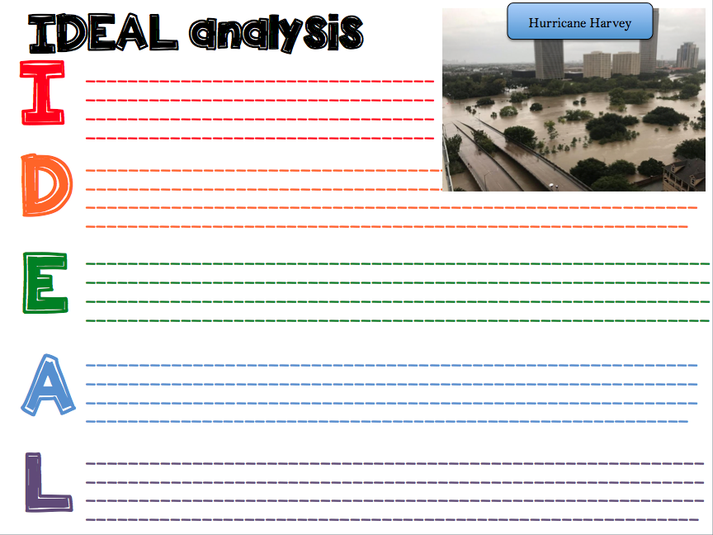

Slide 5
Source 1: Harvey: Into the Deluge
Watch the video and add to the effects of Harvey

Slide 6
Source 2: When the roads turned to rivers
Watch the video and add to the effects of Harvey

Slide 7
Task 2- Eye witness accounts
Use the QR code reader to complete the table.
Name | Hurricane | Summary of their experience | On a scale of 1-10 (10 being disastrous) rank their experience

Slide 8
Task 3
Draw out the following continuum and place the victims (and your experience of it). Justify your selection with a detailed paragraph.
1____________________________________________10
Minimum Disastrous
Impact experienced

Slide 9
The children of Orocovis

Slide 10
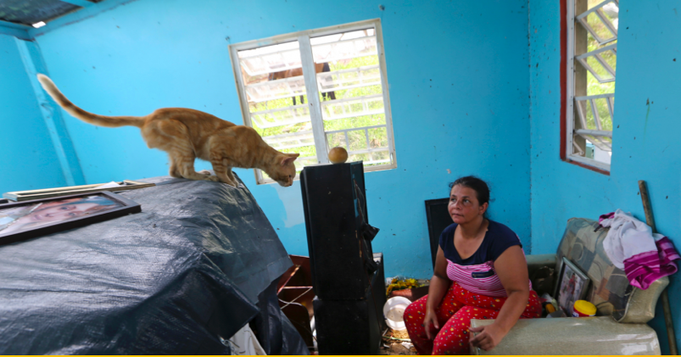
Maribel Valentin Espino

Slide 11
Gloria Castillo Luna

Slide 12
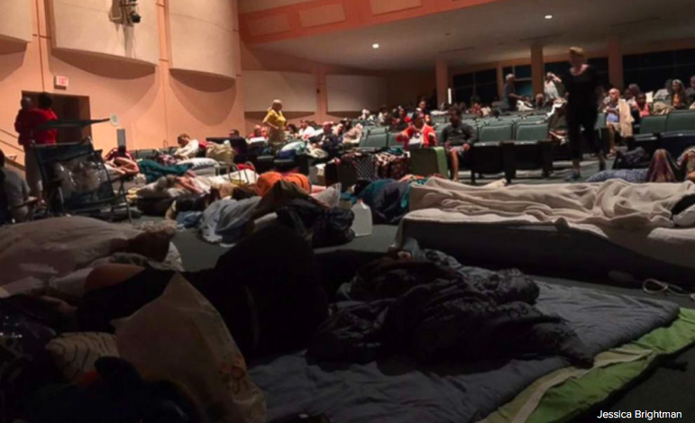
Jessica Brightman

Slide 13
Lesley Quinones

Slide 14
La Vita Bella residents

Slide 15
Task: Create an infographic
Dealing with heavy content- geographical skill: Creating visual representations to encourage understanding and highlight key information. Graphics are visual elements often used to point readers and viewers to particular information. They are also used in an effort to aid readers in their understanding of a particular concept or maker the concept more clear or interesting. Challenge: To include a range of specific case study detail figures/ place names) information about Hurricane Harvey relevant to the IGCSE geography course:
Causes of hurricanes- physical development
Wider causes- i.e. climate change and urbanisation in Houston
Impacts of a specific hurricane on a coastal area (Rockport)
Impacts of flooding (Houston)

