Slide 1
What are the impacts of Hurricanes
What: The impacts of hurricanes.
Why:To be able to assess which areas of the US are most hazardous.
How: Investigating and analyzing eye witness experiences of various hurricanes.

Slide 2
Task 1 – Impacts of hurricanes
With your teacher go to word wall next to the Hive.
A) Recall your experience of a hurricane event. What did you see /experience ? How did you feel?
B) How can you categorize the impacts?

Slide 4
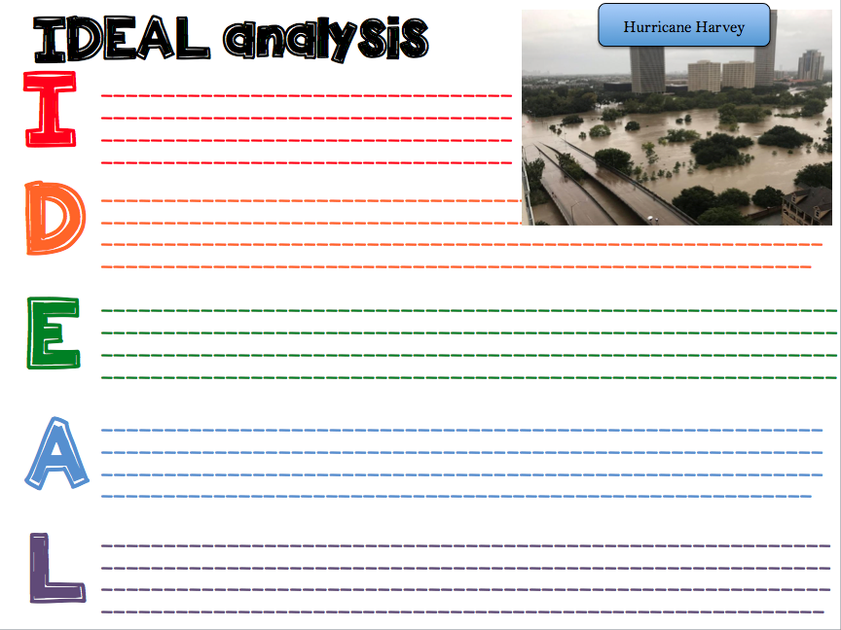

Slide 5
Source 1: Harvey: Into the Deluge
Watch the video and add to the effects of Harvey

Slide 6
Source 2: When the roads turned to rivers
Watch the video and add to the effects of Harvey

Slide 7
Task 2- Eye witness accounts
Use the QR code reader to complete the table.
Name | Hurricane | Summary of their experience | On a scale of 1-10 (10 being disastrous) rank their experience

Slide 8
Task 3
Draw out the following continuum and place the victims (and your experience of it). Justify your selection with a detailed paragraph.
1____________________________________________10
Minimum Disastrous
Impact experienced

Slide 9
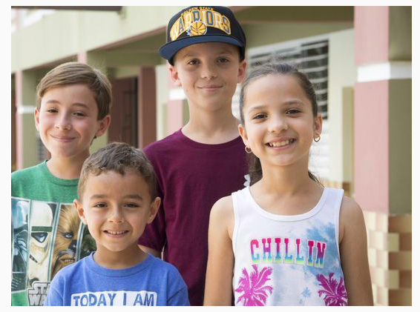
The children of Orocovis

Slide 10
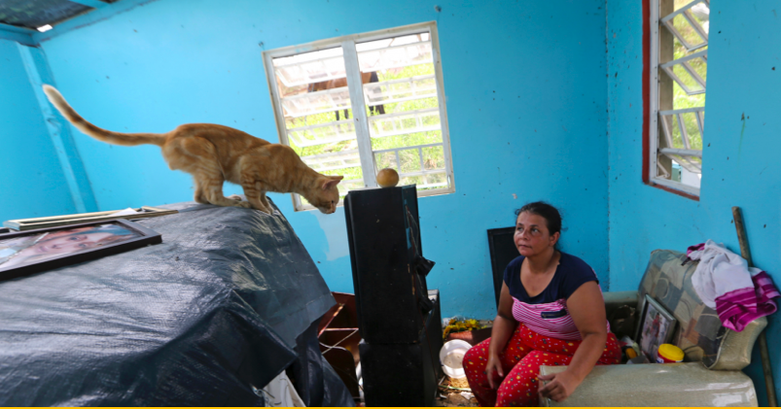
Maribel Valentin Espino

Slide 11
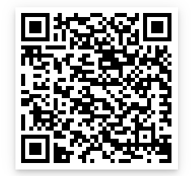
Gloria Castillo Luna

Slide 12
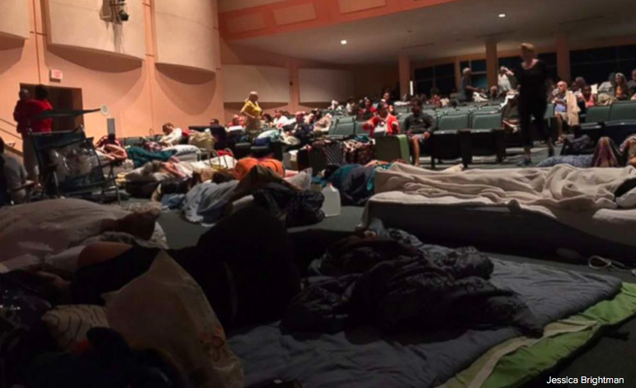
Jessica Brightman

Slide 13
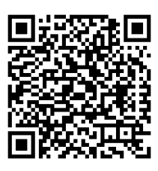
Lesley Quinones

Slide 14
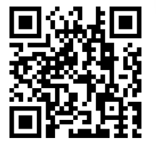
La Vita Bella residents

