Slide 1
What are the impacts of Hurricanes?
What: The impacts of hurricanes.
Why:To be able to assess which areas of the US are most hazardous.
How: Investigating and analyzing eye witness experiences of various hurricanes.

Slide 2
Coastal flooding and River flooding
Example exam questions: Coasts:
For a named area which you have studied, describe the impacts of a tropical storm. [7]
In many parts of the world the natural environment presents hazards to people. Choose an example of one of the following: a flood, a tropical storm, a drought. For a named area, describe the causes of the hazard which you have chosen. [7]
Rivers:
Explain how physical and human factors can increase the risk of river flooding (7 marks)
For a specific river flood explain the causes of the flood (7 marks)
Explain the impacts of a specific flood you have studied (7 marks)

Slide 4
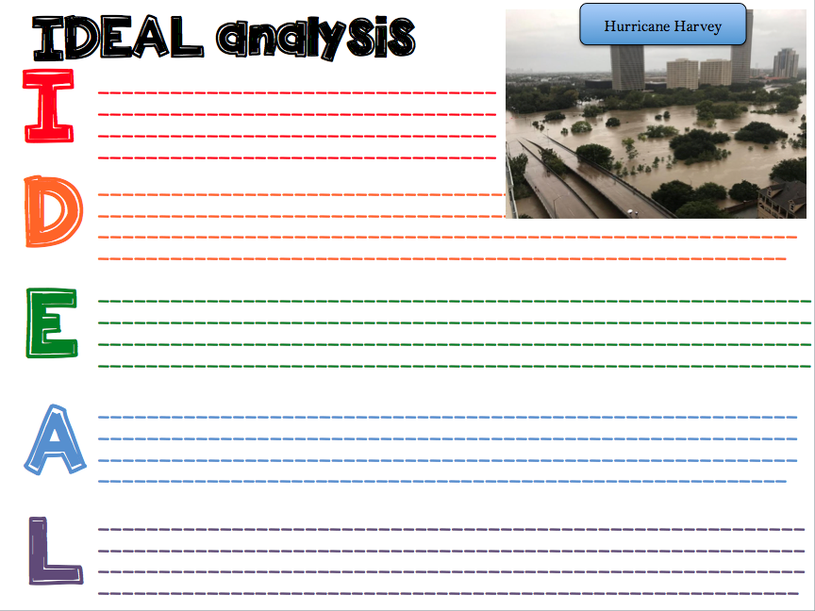

Slide 5
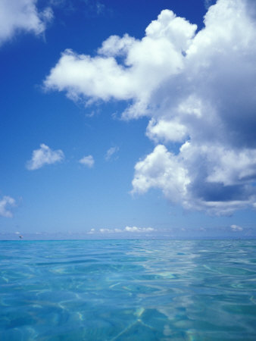
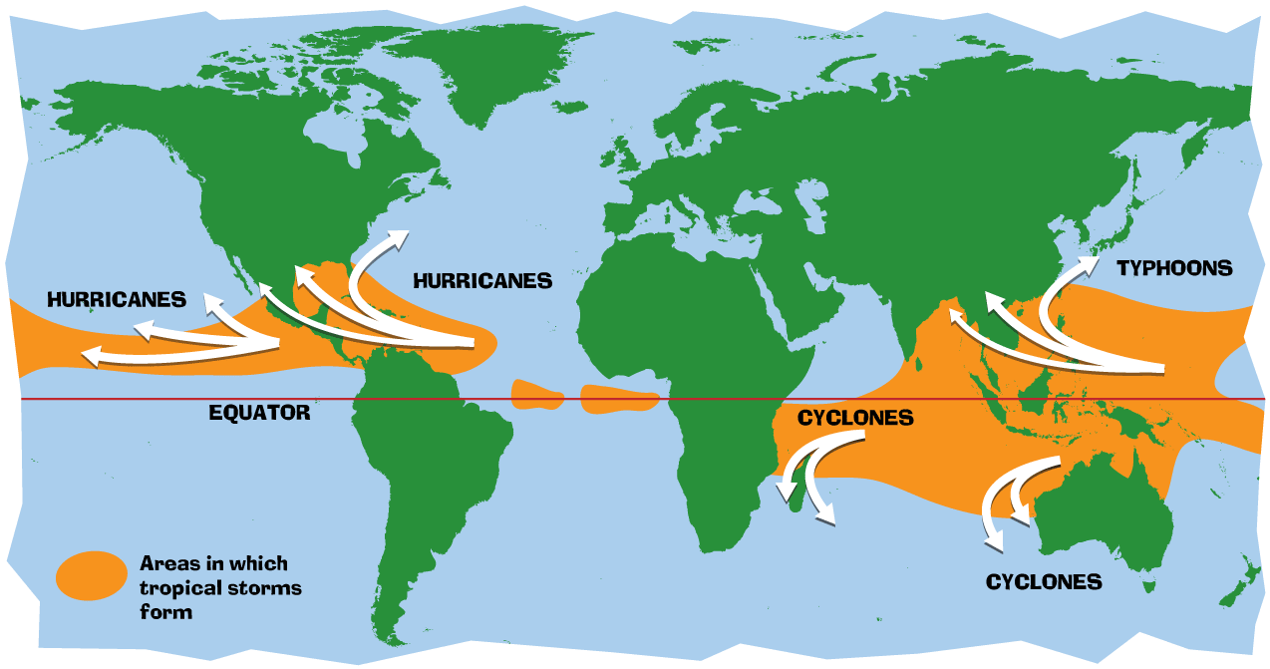
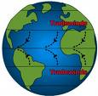
Exam questions
Describe the location of where tropical storms form (3 marks).
Explain why Tropical Storms occur in these parts of the world (3 marks).

Slide 6
Describe the location of where tropical storms form (3 marks).
Mark scheme
3 locational points needed. These could include:
They form between the equator and tropic of Cancer/Capricorn (1).
The firm to the north and south of the equator (1)
Could mention a specific ocean for (1)
Could say to the east of Asia/North of Australia for (1)

Slide 7
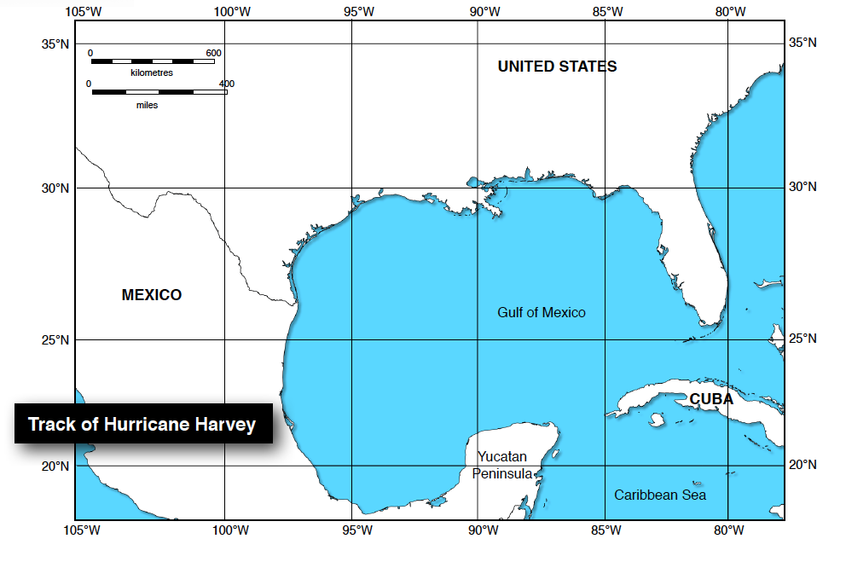
Geographical skills
The track and intensity of hurricane Harvey

Slide 8
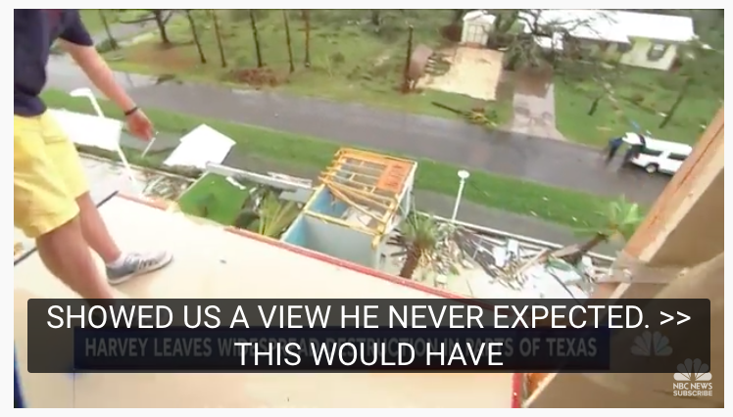
The impact of Harvey in Rockport

Slide 9
Harvey: Into the Deluge
Watch the video and add to the effects of Harvey

Slide 10
When the roads turned to rivers
Watch the video and add to the effects of Harvey

Slide 11
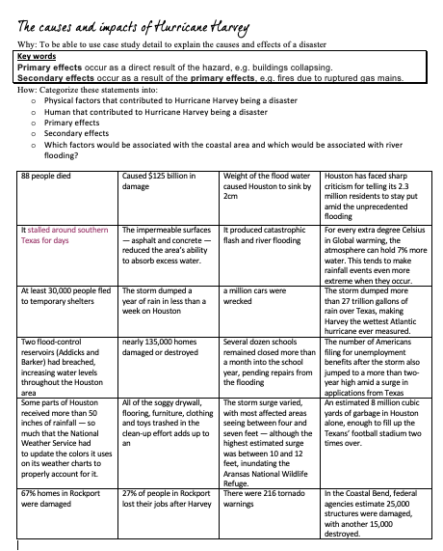
Sort the information about Harvey

Slide 12
Task: Create an infographic
Dealing with heavy content- geographical skill: Creating visual representations to encourage understanding and highlight key information. Graphics are visual elements often used to point readers and viewers to particular information. They are also used in an effort to aid readers in their understanding of a particular concept or maker the concept more clear or interesting. Challenge: To include a range of specific case study detail figures/ place names) information about Hurricane Harvey relevant to the IGCSE geography course:
Causes of hurricanes- physical development
Wider causes- i.e. climate change and urbanisation in Houston
Impacts of a specific hurricane on a coastal area (Rockport)
Impacts of flooding (Houston)

Slide 13
Coastal flooding and River flooding
Example exam questions: Coasts:
For a named area which you have studied, describe the impacts of a tropical storm. [7]
In many parts of the world the natural environment presents hazards to people. Choose an example of one of the following: a flood, a tropical storm, a drought. For a named area, describe the causes of the hazard which you have chosen. [7]
Rivers:
Explain how physical and human factors can increase the risk of river flooding (7 marks)
For a specific river flood explain the causes of the flood (7 marks)
Explain the impacts of a specific flood you have studied (7 marks)

